Slide 1
Jazz + Blues - Jazz Thrives in Chicago (46-51)
By: Matija Benko

Slide 2

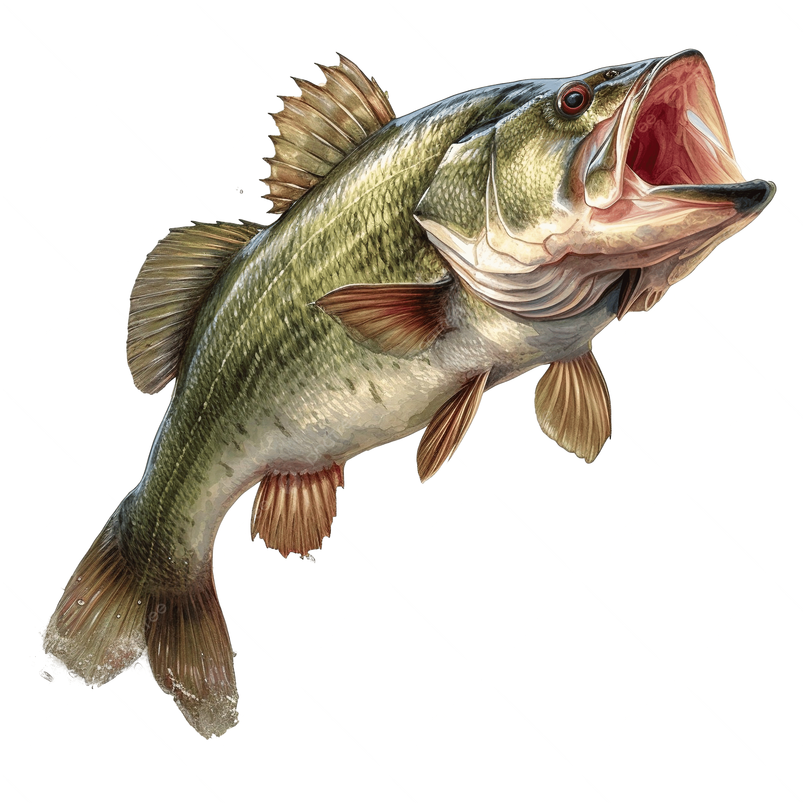
JAZZ + BLUES & The Cradle of Jazz
Jazz is broad & has lots of styles(most accessible being early styles)
  “New Orleans jazz,” “Dixieland,” & “Chicago jazz”
Sidney Story shoved prostitution to one part of NO in 1897(“Storyville”)
Music used as bait(competition with each other)
  Solo pianists
Cornet, trombone, clarinet
piano/banjo/guitar
/tuba & drums

Slide 3

A Recipe for Jazz & The End of Storyville
ragtime foundation, faster, swung rhythms, more improv, pianists & combos played dissonances, & call-and-response techniques/collective improvisation(terraced percussion from Latin America & Africa)[New Orleans]
White music nerds, less improv[Dixieland]
  Original Dixieland Jazz Band made first “jazz” recording(“Livery Stable Blues”) in 1917
1917, WWI Newton W.Baker wanted Storyville to close bc wants soldiers to be squeaky clean(shut down a lot of activity there and sucked for musicians’ businesses)

Slide 4
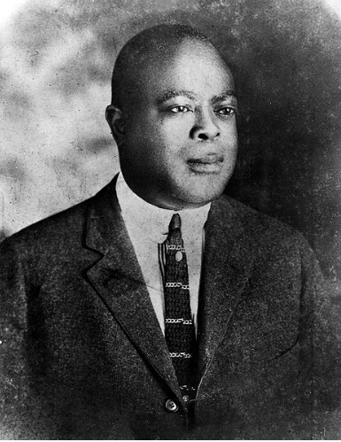
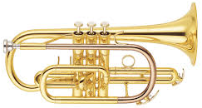
Heading North
Traveling north & lost NO features[Chicago Jazz]
  More iness
  longer solos(smaller collective improv)
Joe “King” Oliver(1881–1938), a cornet player, started in NO, & organized King Oliver’s Creole Jazz Band (featured other NO OGs)
Inconvenient studio far from Chicago(couldn’t stay)

Slide 5
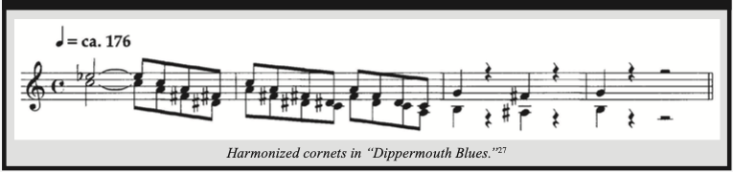
LISTENING COMPANION 2: “Dippermouth Blues” (1923) –Joe “King” Oliver
Oliver(6&7) & Louis Armstrong(5) - cornet, Honoré Dutry - trombone, Johnny Dodds - clarinet, Warren Dodds - drums, Bill Johnson - banjo, & Lillian Hardin - piano
NO(1, 2, 5, 8, & 9) & Chicago(Choruses 3, 4, 6, & 7)
homophony; stop-time; twelve-bar blues; collective-improv ending; swing rhythm; wah-wah mute
icon of early jazz & reference to later Jazz musicians

Slide 6
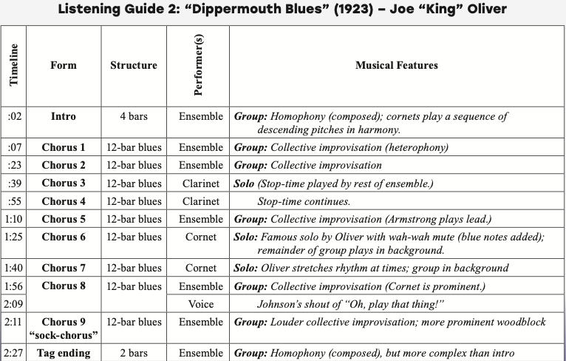
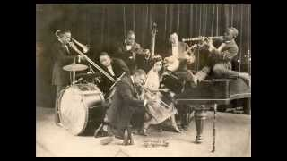

Slide 7
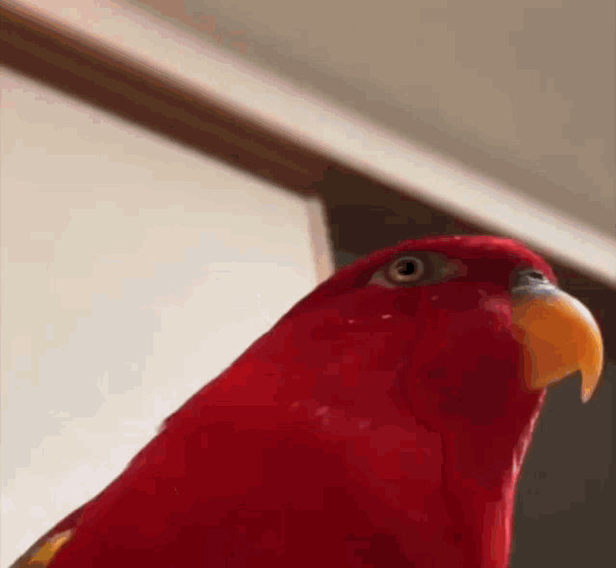
Thank You!

