Slide 1
LEDs and Solar Power - Relativity (110-112)
By: Matija Benko

Slide 2
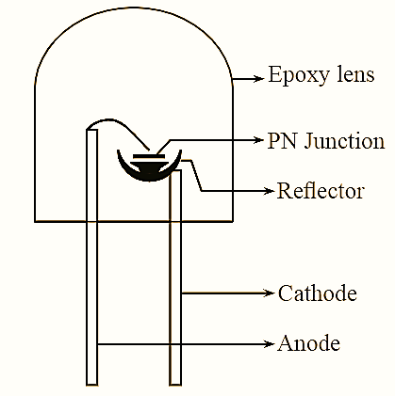
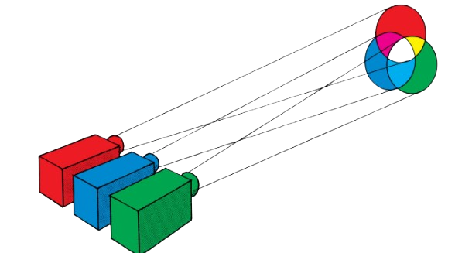
LEDs
Incandescent mostly emits heat
diode only lets current flow in 1 direction(AC→DC)
Light emitting diode(LED)
  Uses 2 semiconductors (bad conductors that get better together) & ext. voltage
  Electrons move to outer shell(just emits light)(depends on materials)
red→green → blue LEDs
Way more efficient than incandescent

Slide 3
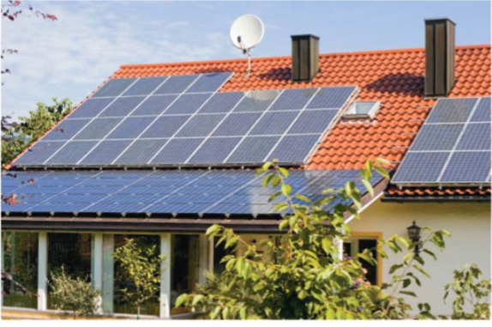
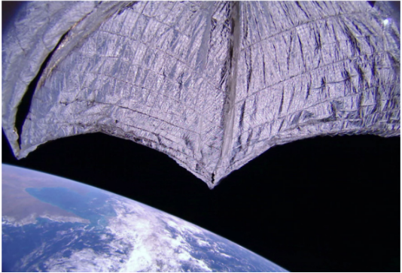
Solar Power
Semiconductors absorb light, electrons move to conducting shell, current flows
  Same things for IR in burglar alarms
More use of solar panels & cheaper(could take over energy in 20230s)
Most satellites are somewhat solar powered
For now we use chemical rockets to go way far from earth
  Maybe lightsail[catches sunlight to slowly move]

Slide 4

Thank You!

