Slide 1
Coulomb’s Law - Electric Fields (13-15)
By: Matija Benko

Slide 2
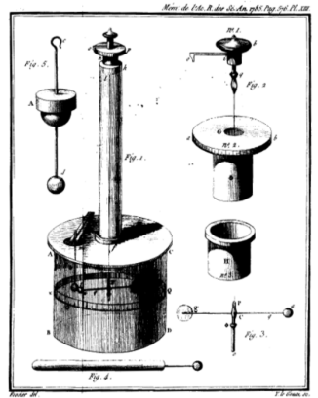
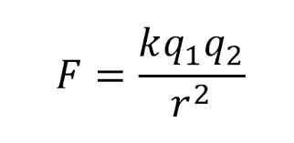
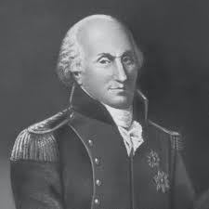
Coulomb’s Law
Charles Coulomb 1785
Torsion Balance(charged rod suspended by string & can be twisted by elec-forces from the charge)
Macro-scale is big for subatomics
Electric force proportional to charge (inverse square)

Slide 3
Coulomb’s Law(pt.2)
Electron is - 1.7*10⁻¹⁹ coulombs (quantized)
Static electricity -> micro/nanocoulombs
Coulomb’s constant is 8.99*10⁹ N m²/c²
Electric force is stronger than gravitational, but most atoms are neutral
e⁻
Coulomb’s constant
(8.99E9Nm²/c²)
Charge of both objects
Electric force
distance

Slide 4

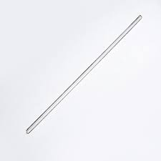
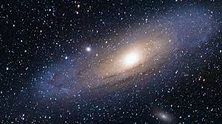
Example from packet
Rubbing glass rod with cloth takes the glass’ electrons and moves them to the cloth(protons stay where they are)
total charge for the glass & cloth system is 0 C
Total charge of universe is also 0 C

Slide 5

Thank You!

