Slide 1
Electricity is Life - Ohm’s Law (41-43)
By: Matija Benko

Slide 2
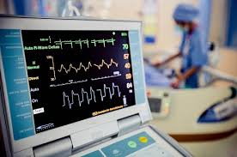
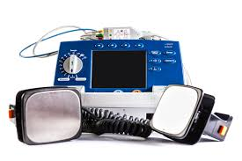
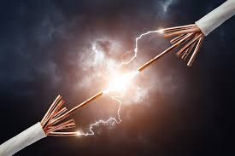
Electricity is Life
Ampere = Coulomb/second(electric current)
Electricity can kill you
  Direct lightning strike burns
  Nearby strikes deliver their energy
  appliances/fork in outlet
Keep studying how various parts communicate w/ electricity(Mary Shelley wrote Frankenstein)
EKG measures voltage across ur body to measure heart rate
Defibrillators make a crazy heart normal

Slide 3
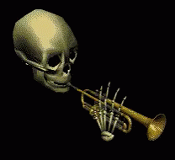
Thank You!

