Slide 1

Improving Raj Fashion: A Data-Driven Approach to Sustainable Growth
INDIAN INSTITUTE OF TECHNOLOGY MADRAS
CHENNAI – 600 036
Name: Banani Mallick
Email: 24ds2000087@ds.study.iitm.ac.in
Roll No.: 24DS2000087
Business Data Management Capstone Project
25-07-2025

Slide 2
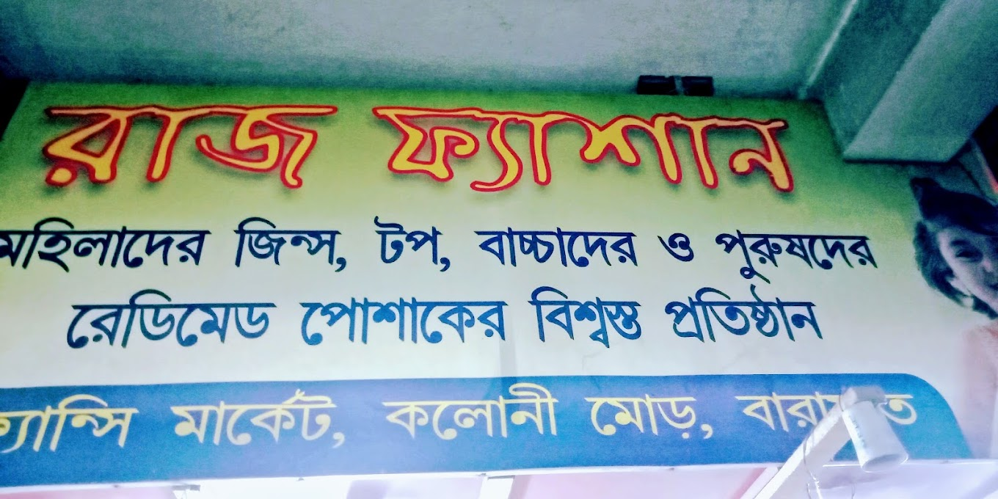

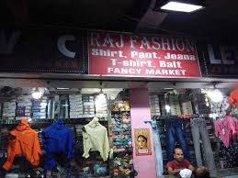
RAJ FASHION Store
Raj Fashion
Established 1995
Owner:
Mr. Tapan Adhya
Garments: Men's Wear
Focus: Affordability & Quality
ABOUT ORGANIZATION:
Location: Fancy Market, Barasat
Address: Barasat, Kolkata (700124)
Business Model: B2C
Efficiently managed by Mr. Tapan Adhya and supported by 10 staff members in his shop operations.
Monthly revenue approximately ₹700000.
Operational expenses around ₹250000.
1

Slide 3
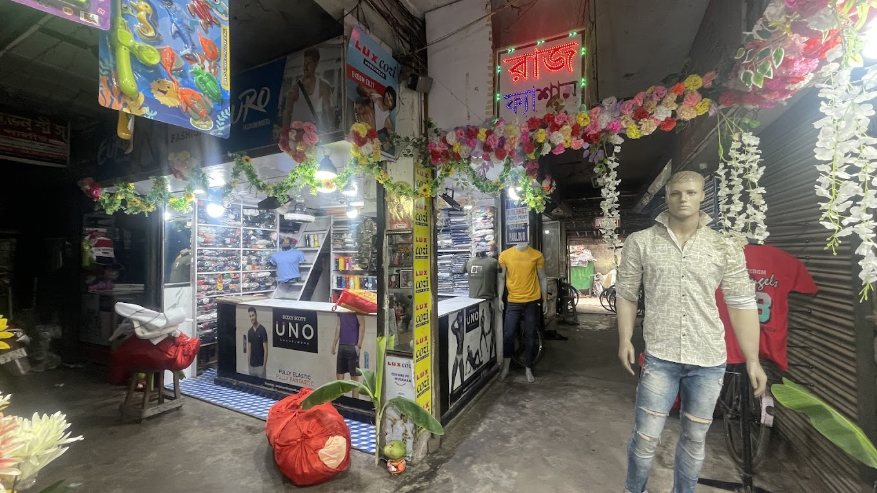
Project Summary
Key objectives:
Analyze Raj Fashion’s sales, inventory, and customer’s data to improve business performance using data-driven strategies.
Problem statements: 1. Stock Management Issues: Overstocking of low-demand items and stockouts of bestsellers due to poor forecasting.
2. Low Net Profit Margins: High-volume items like shirts have thin margins; formal wear and jeans tie up capital.
3. Customer Dependency: Major revenue comes from a few loyal buyers, making retention and tracking crucial..
Significance: Enables Raj Fashion to plan inventory smarter, price products more effectively, and retain top customers—building a strategy for long-term, sustainable growth.
2

Slide 4
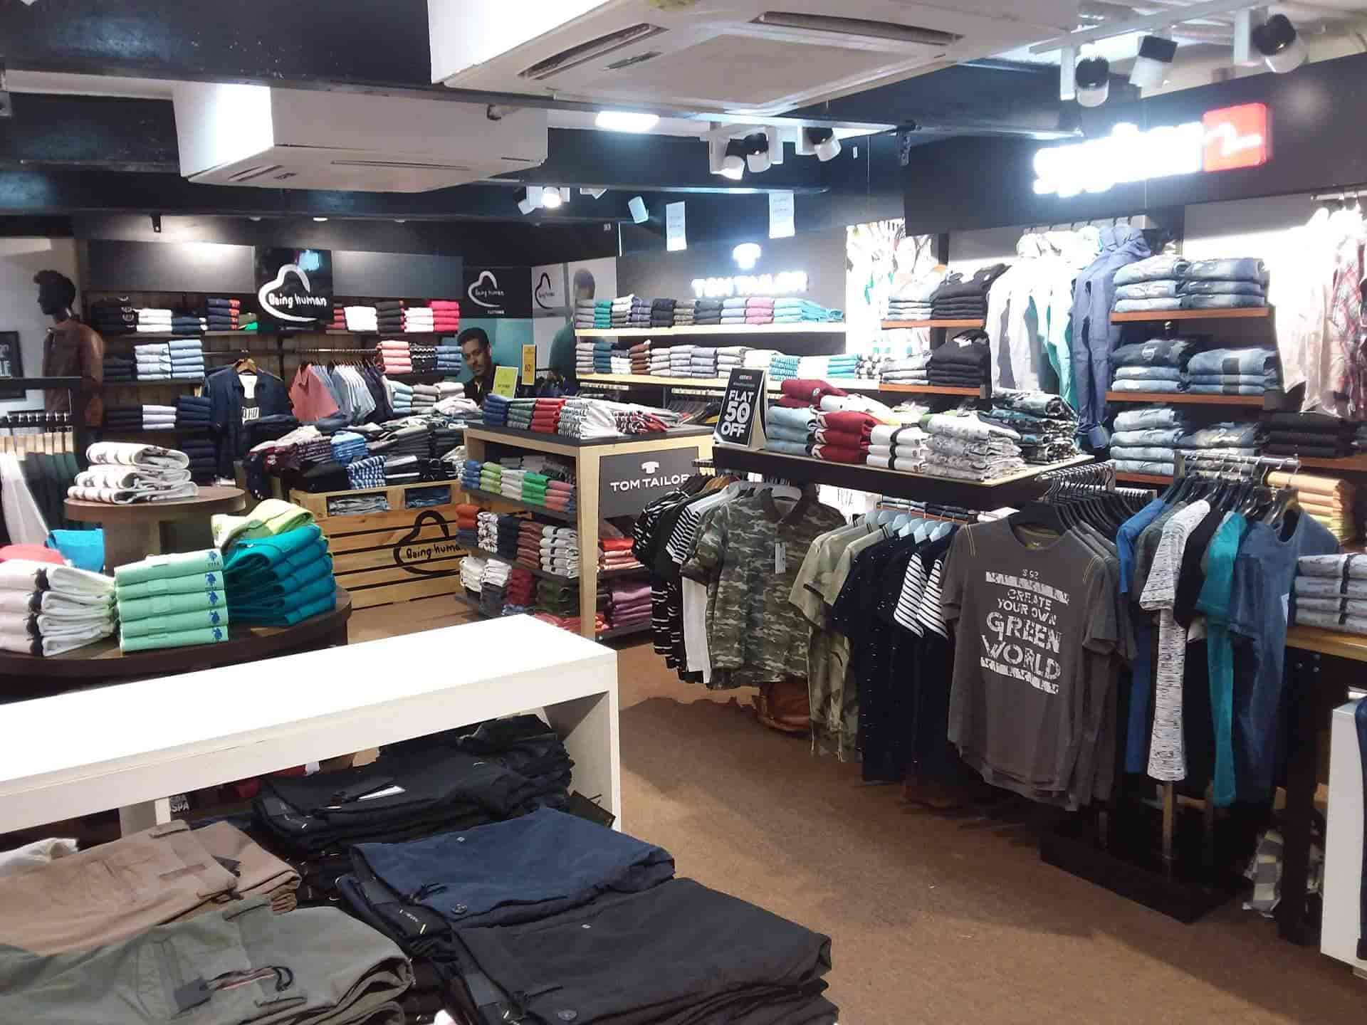
Data Collection and Methodology
• Data Collection: Primary data collected for 1st October 2024 to 31st December 2024 that is for 90 days.
• Data Sources:
Internal sales and stock records.
Supplier invoices and purchase records.
Customer transaction history.
• Data Cleaning: Missing values were handled, duplicates removed, and date formats standardized. Currency fields were converted to numeric format for accurate analysis.
• Methodologies used for Analysis:
Utilized line charts, bar graphs, Pareto charts, heatmaps, and pie plots to uncover sales patterns, profit trends, and seasonal demand.
ABC Analysis based on revenue
Sales Demand Forecasting
d) Profitability & Margin Analysis
e) Customer Segmentation
3

Slide 5
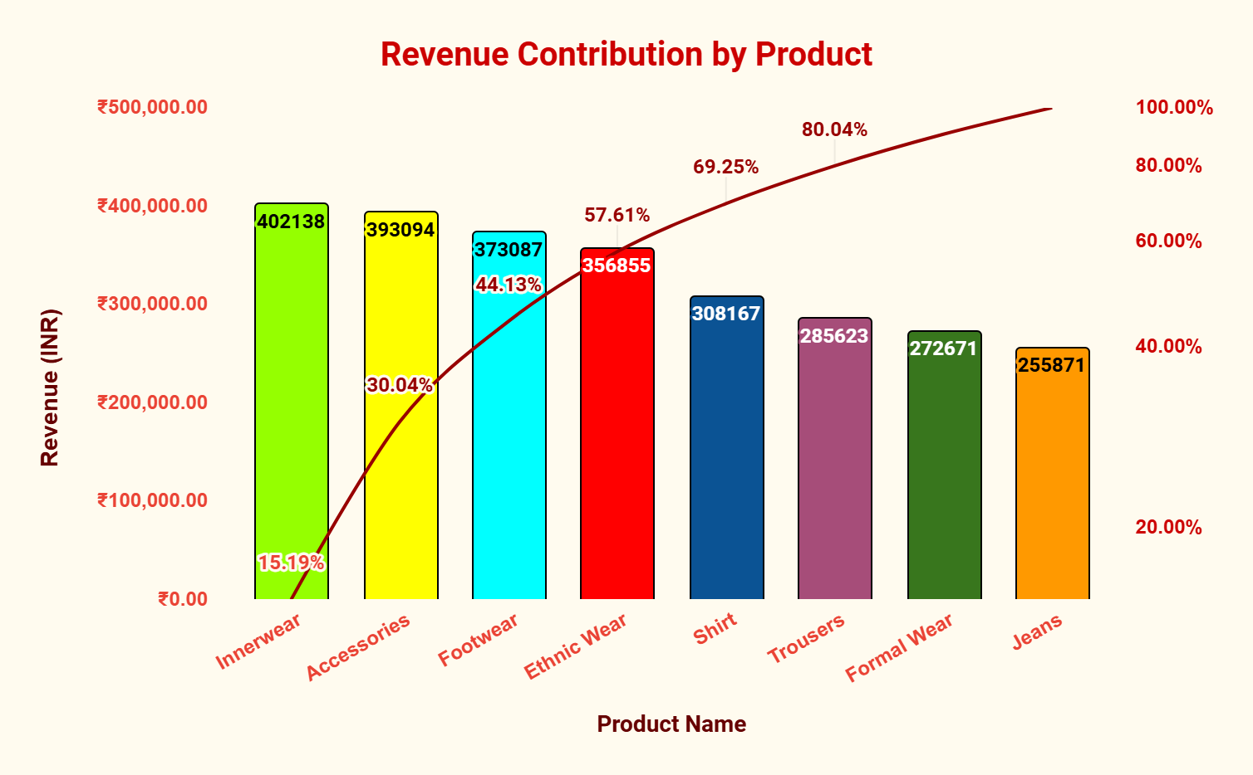
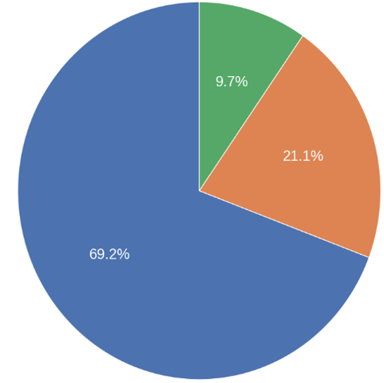
ABC Analysis based on Revenue
Product | Revenue | Cumulative Revenue | Cumulative %
Innerwear | 402138 | 402138 | 15.19%
Accessories | 393094 | 795232 | 30.04%
Footwear | 373087 | 1168319 | 44.13%
Ethnic Wear | 356855 | 1525174 | 57.61%
Shirt | 308167 | 1833341 | 69.25%
Trousers | 285623 | 2118964 | 80.04%
Formal Wear | 272671 | 2391635 | 90.34%
Jeans | 255871 | 2647506 | 100.00%
Table 1: Revenue amount of different Products
Figure 1: Pareto chart
Top Products: Innerwear (₹4.02L), Accessories (₹3.93L), Footwear (₹3.73L) – lead in revenue.
Cumulative Impact: Top 4 = 57.6%, Top 5 = 69% of total revenue.
Low Performers: Formal Wear, Jeans (₹2.5–2.7L) together < 20% of revenue.
4

Slide 6



Sales Demand Forecasting
1. Historical Sales Pattern (Oct–Dec 2024):
Daily sales fluctuate between 100–250 units, with noticeable spikes mid-October.
Sales stabilize around 120–180 units/day in November and December.
2. Forecasted Sales (Jan 2025):
Predicted values (in red) show a slightly increasing trend in January.
Sales expected to range between 130–170 units/day on average.
3. Confidence Interval:
Upper Bound: Could go up to ~230 units/day.
Lower Bound: Might drop to ~80 units/day, showing high variability.
Days
Figure 2: Forecasted Sales
Insight:
Business should prepare for a moderate sales rise in January 2025.Consider buffer inventory to handle demand fluctuations within confidence bounds.
5

Slide 7
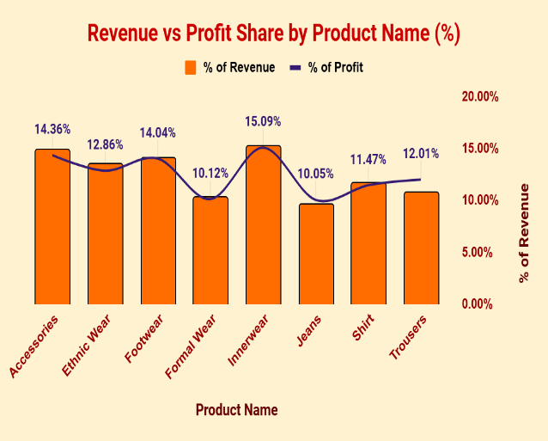
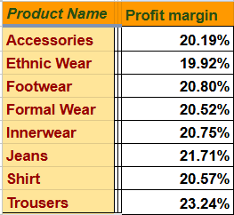
Relationship between Revenue and Profit
Product Name | SUM of Revenue | SUM of Profit | % of Revenue | % of Profit
Accessories | ₹393,094.00 | ₹79,360.00 | 14.85% | 14.36%
Ethnic Wear | ₹356,855.00 | ₹71,078.00 | 13.48% | 12.86%
Footwear | ₹373,087.00 | ₹77,593.00 | 14.09% | 14.04%
Formal Wear | ₹272,671.00 | ₹55,950.00 | 10.30% | 10.12%
Innerwear | ₹402,138.00 | ₹83,424.00 | 15.19% | 15.09%
Jeans | ₹255,871.00 | ₹55,555.00 | 9.66% | 10.05%
Shirt | ₹308,167.00 | ₹63,381.00 | 11.64% | 11.47%
Trousers | ₹285,623.00 | ₹66,369.00 | 10.79% | 12.01%
Grand Total | ₹2,647,506.00 | ₹552,710.00 | 100.00% | 100.00%
Figure 3: Profit v/s Revenue
Table 2: Profit, Revenue and Profit margin of Products
Innerwear leads in revenue but has relatively lower profit margins.
Accessories offer the highest profit share, making them the most profitable.
Formal Wear and Jeans show low profit despite decent revenue – need margin improvement.
6

Slide 8
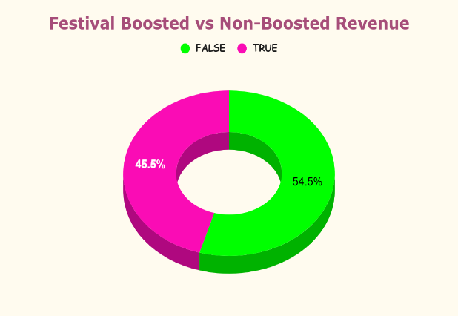
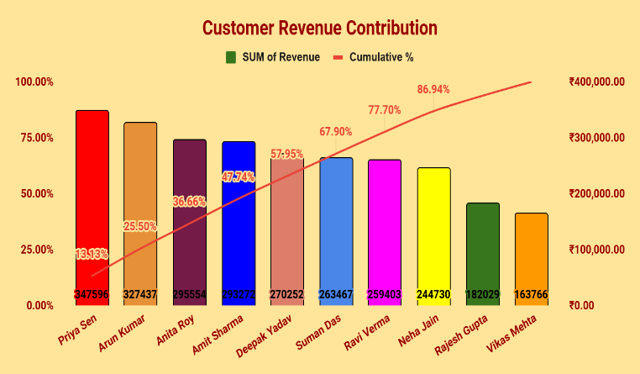
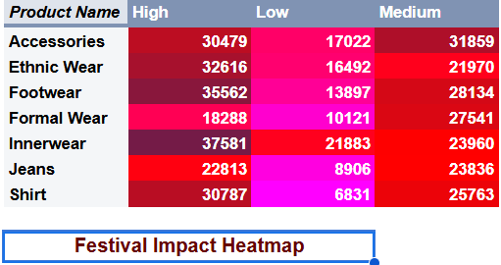
Customer Revenue Contribution and Festival Impact
Figure 4: Customer Revenue Contribution
Top 3 customers (Priya, Arun, Anita) contribute over 50% of total revenue.
Top 6 customers account for nearly 78% of the revenue.
Revenue is highly concentrated among a few key customers – ideal for focused retention.
7

Slide 9

Interpretation and Recommendations
1. Stock Planning & Optimization
Focus on fast-moving categories (Footwear, Accessories, Innerwear):
Enable automated reordering and real-time tracking to prevent frequent stockouts.
ABC Analysis Insight: Top 20% of products contribute ~80% of revenue – prioritize these for restocking and display.
Slow-moving items (e.g., Jeans, Formal Wear): Use bundling offers and clearance discounts to reduce unsold inventory and release tied-up capital.
2. Demand Forecasting
Apply Excel Forecast Sheet (ETS model): Sales data from Oct–Dec 2024 shows peaks during Durga Puja, Diwali, and weekends – forecast captures both seasonality and weekly cycles.
3. Sales & Pricing Strategy
Promote high-margin categories: Focus on Trousers (~25.12%) and Innerwear (~24.91%) for profit growth.
Dynamic pricing: Adjust pricing for items like Shirts and Formal Wear based on margin analysis and seasonal demand.
Bundle low-sellers: Pair underperformers (e.g., Jeans) with fast-sellers to boost turnover and reduce stagnation.
4. Customer Retention & Revenue Risk Control
Reward top 7 loyal customers (~87% revenue) with early access offers or loyalty rewards.
Set purchase-based tiers: Offer flexible terms to frequent buyers; limit borrowing or discounts for less active ones.
Use repeat purchase tracking: Design campaigns and repayment options based on customer history and contribution.
8

Slide 10
Thank you

