Slide 1
Secure Data Hiding in Image Using Steganography
CAPSTONE PROJECT
Presented By:BANARJI B
Student Name : BANARJI B
College Name & Department : PES UNIVERSITY,CSE

Slide 2
OUTLINE
Problem Statement
Technology used
Wow factor
End users
Result
Conclusion
Git-hub Link
Future scope

Slide 3
Problem Statement
In today’s digital era, sensitive information is frequently transmitted over the internet, making it vulnerable to interception and theft. While encryption protects data, it can be conspicuous and targeted by attackers. This project aims to implement a steganography system that conceals messages within images, ensuring that the very presence of sensitive data is undetectable. The system also incorporates passcode-based protection for additional security, providing a seamless and covert communication solution.

Slide 4
Technology used
Programming Language: Python
GUI Framework:
tkinter for developing an intuitive and easy-to-use interface.
Image Processing:
OpenCV for manipulating and processing images at the pixel level.
PIL (Python Imaging Library) for rendering images and creating previews in the application.
Security:
Hashlib for hashing passcodes using SHA-256 to ensure secure passcode storage.
Metadata Management:
datetime for generating timestamps for encrypted messages.
json for storing and validating metadata like message length, file name, and passcode hash.
Data Handling:
Bit-level embedding and extraction to ensure data integrity and efficient storage within the image.

Slide 5
Wow factors
Complete Encryption-Through-Steganography Solution:
Combines traditional encryption methods with steganography for a dual-layer security approach.
Dynamic Passcode Validation:
Ensures that only authorized users with the correct passcode can access hidden messages.
Message Capacity Estimation:
Calculates and displays the maximum message size that can be embedded based on the selected image.
Password Strength Meter:
Provides real-time feedback on password strength to encourage the use of strong, secure passcodes.
Cross-Platform Compatibility:
Designed to be operable across different OS platforms without requiring external dependencies.
Compression Customization:
Allows users to adjust image compression levels for optimal storage without compromising encryption quality.
Progress Indicators:
Real-time visual feedback on encryption and decryption progress ensures transparency in operations.
Error Handling:
The system includes robust error handling to address corrupted images or incorrect passcodes gracefully.

Slide 6
End users
General Users:
People looking for simple and secure ways to hide sensitive data in images.
Journalists and Activists:
Professionals who need a covert method of transmitting confidential information without raising suspicion.
Educational Institutions:
Students and researchers learning about steganography, encryption, and secure communication technologies.
Software Developers:
Developers working on projects involving cryptography, digital forensics, or secure communication.
Organizations:
Businesses that handle confidential client information and require additional layers of security
for sensitive data exchange.

Slide 7
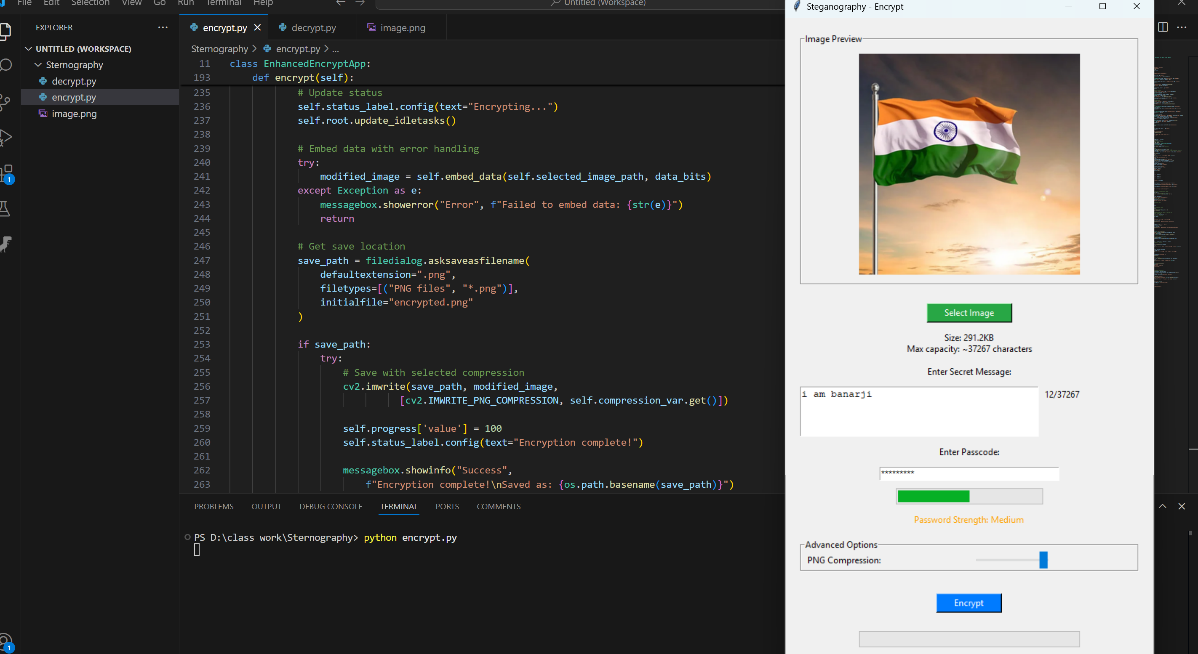
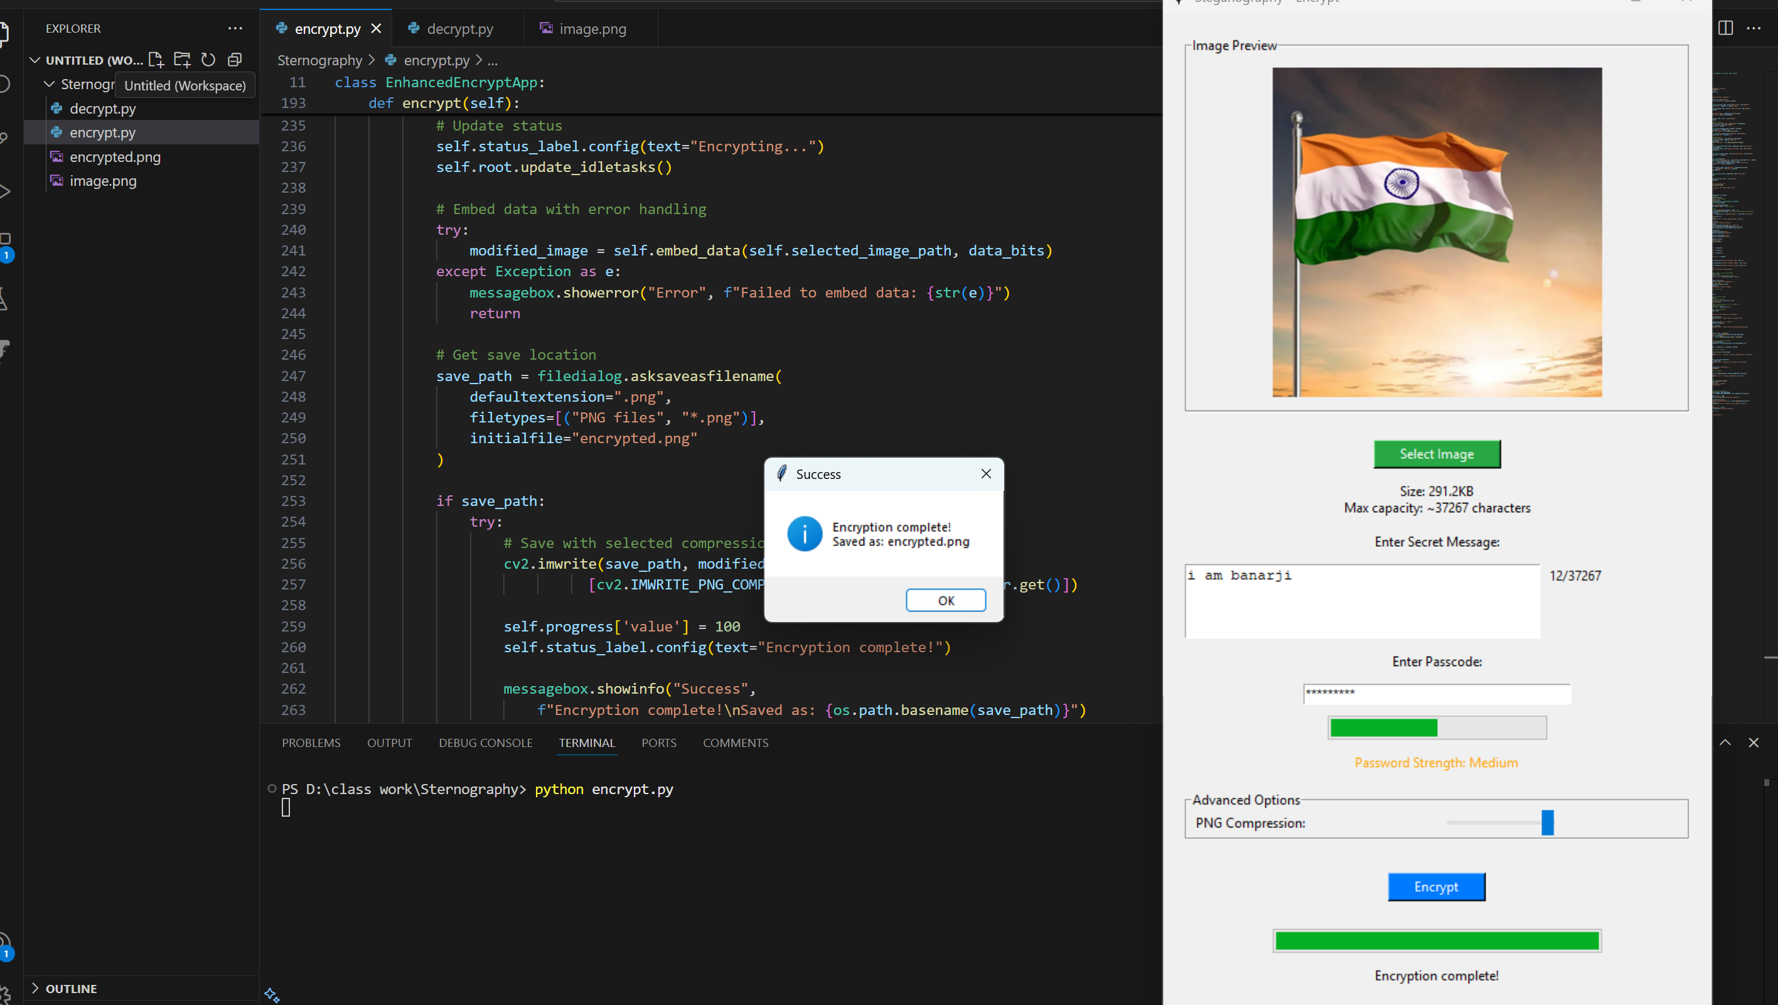
Results
For Encryption

Slide 8
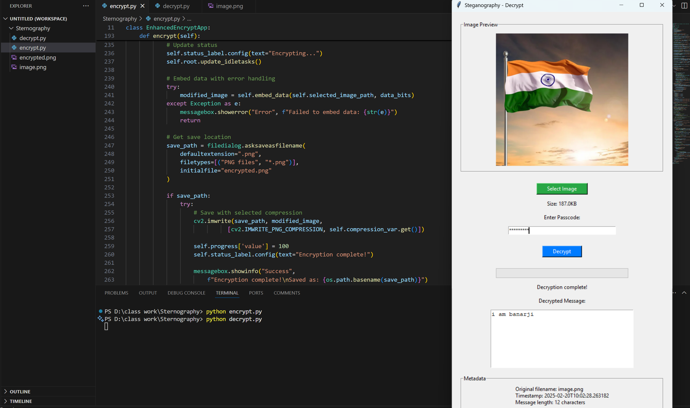
Results
For Decryption

Slide 9
Conclusion
The project demonstrates the successful integration of steganography and encryption to provide secure, covert communication channels. The system’s simplicity, security features, and flexibility make it suitable for a wide range of users. Its real-time feedback and user-friendly UI further enhance its appeal as a practical and effective solution for hiding sensitive information.

Slide 10
GitHub Link
https://github.com/Banarji03/Secure-Data-Hiding-in-Image-Using-Steganography.git

Slide 11
Future scope
Advanced Encryption Algorithms:
Integrate AES or RSA encryption alongside steganography for even stronger security.
Multi-Format Media Support:
Extend the project to support hiding messages in audio, video, or PDF files.
Cloud Integration:
Develop a cloud-based service that allows users to securely upload and download steganographic images.
Mobile App Development:
Create a mobile-friendly version of the system for increased accessibility.
Distributed System Support:
Enable collaborative encryption and decryption over networks for secure communication between multiple users.
Steganalysis Resistance:
Introduce mechanisms to counter steganalysis techniques that aim to detect hidden data in images.
Machine Learning Integration:
Explore AI-driven methods to dynamically optimize image storage and improve data concealment.
Blockchain Technology:
Incorporate blockchain for secure logging and tracking of encrypted image files.
User Authentication:
Add multi-factor authentication for enhanced protection during the decryption process.
Dark Mode UI:
Provide more theme options for a modern, customizable user experience.

Slide 12
THANK YOU

