Slide 1

Grupo 6 - IGNIS
Alyfer Pereira dos Santos – RA 01211001
Bianca Vediner – RA 01211011
Elizeu Luis Souza – RA 01211030
Gabriel da Silva Teodoro – RA 01211044
Vinicius Augusto Ferreira – RA 01211125
Wesley Paternezi – RA 01211132

Slide 2
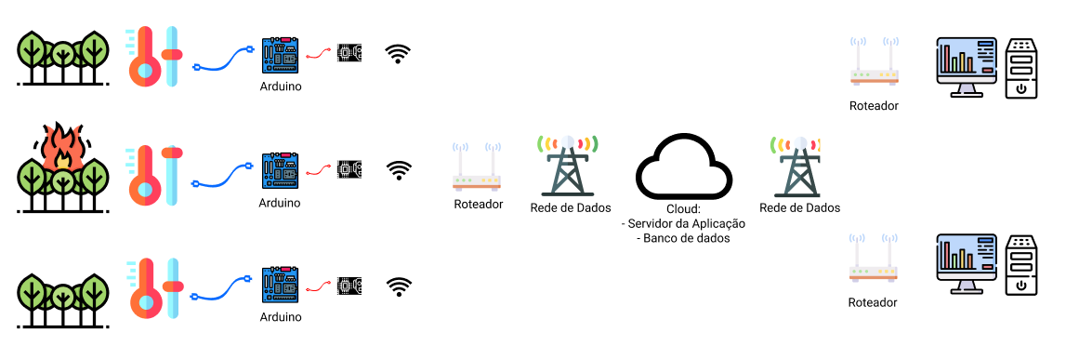
HLD – High Level Design

Slide 3
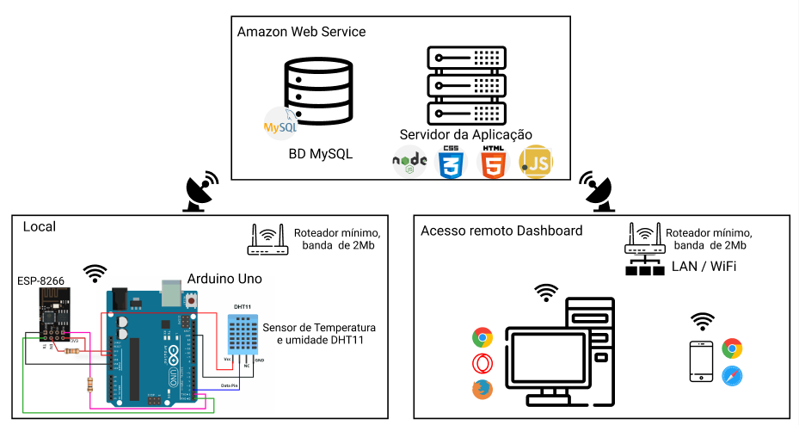
LLD – Low Level Design

Slide 4
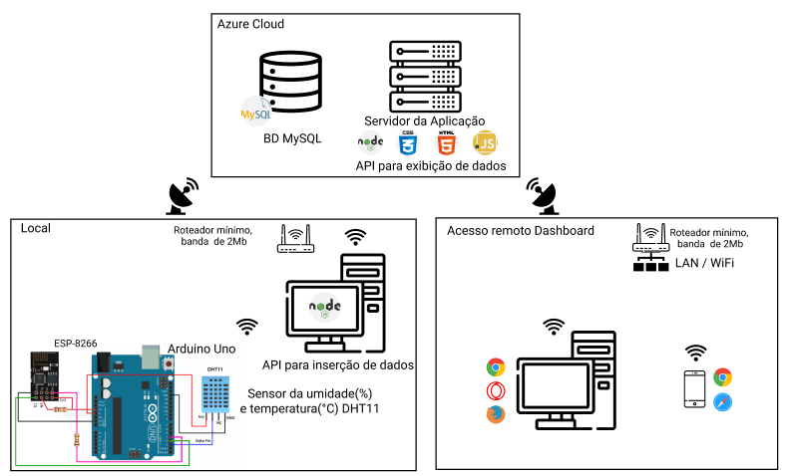
LLD – Low Level Design

