Slide 1
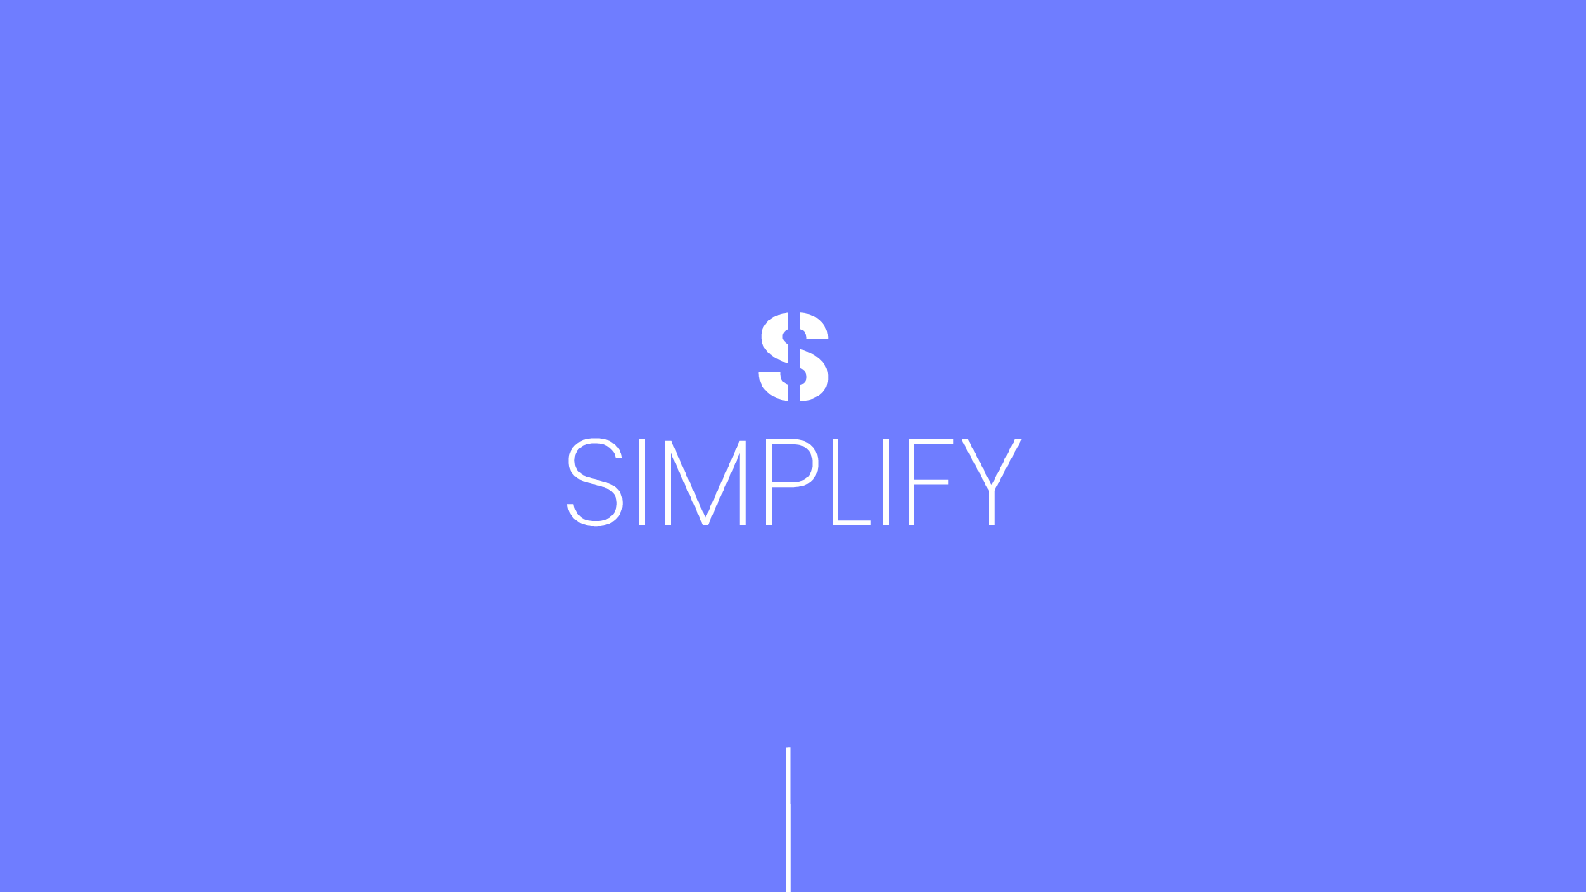

Slide 2
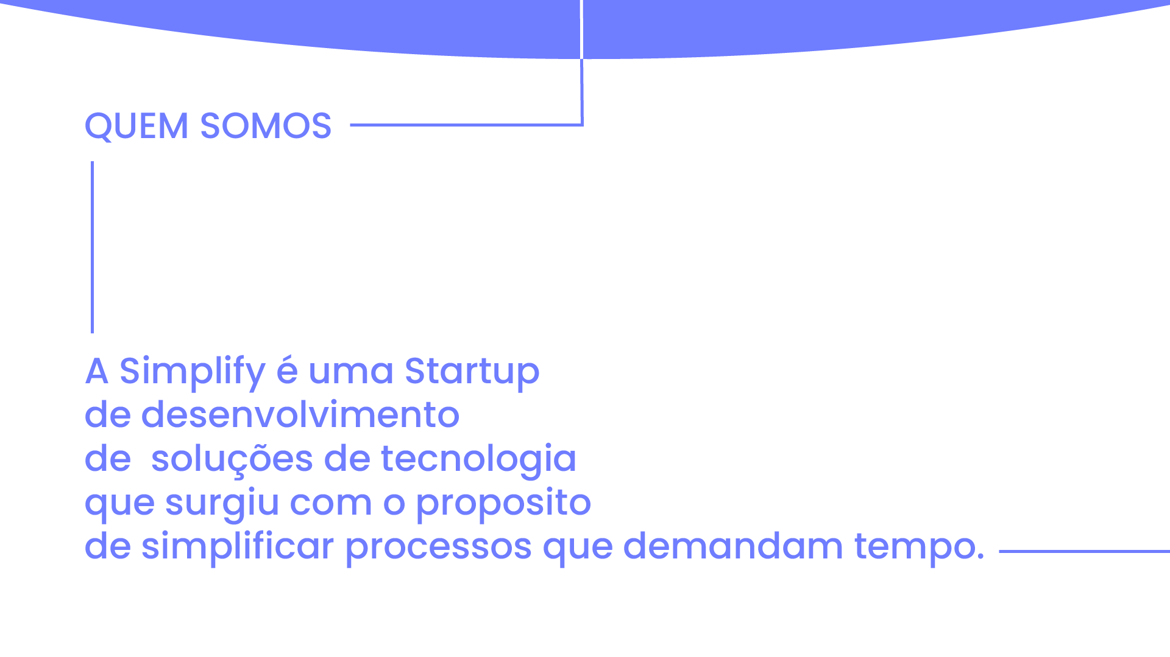

Slide 3
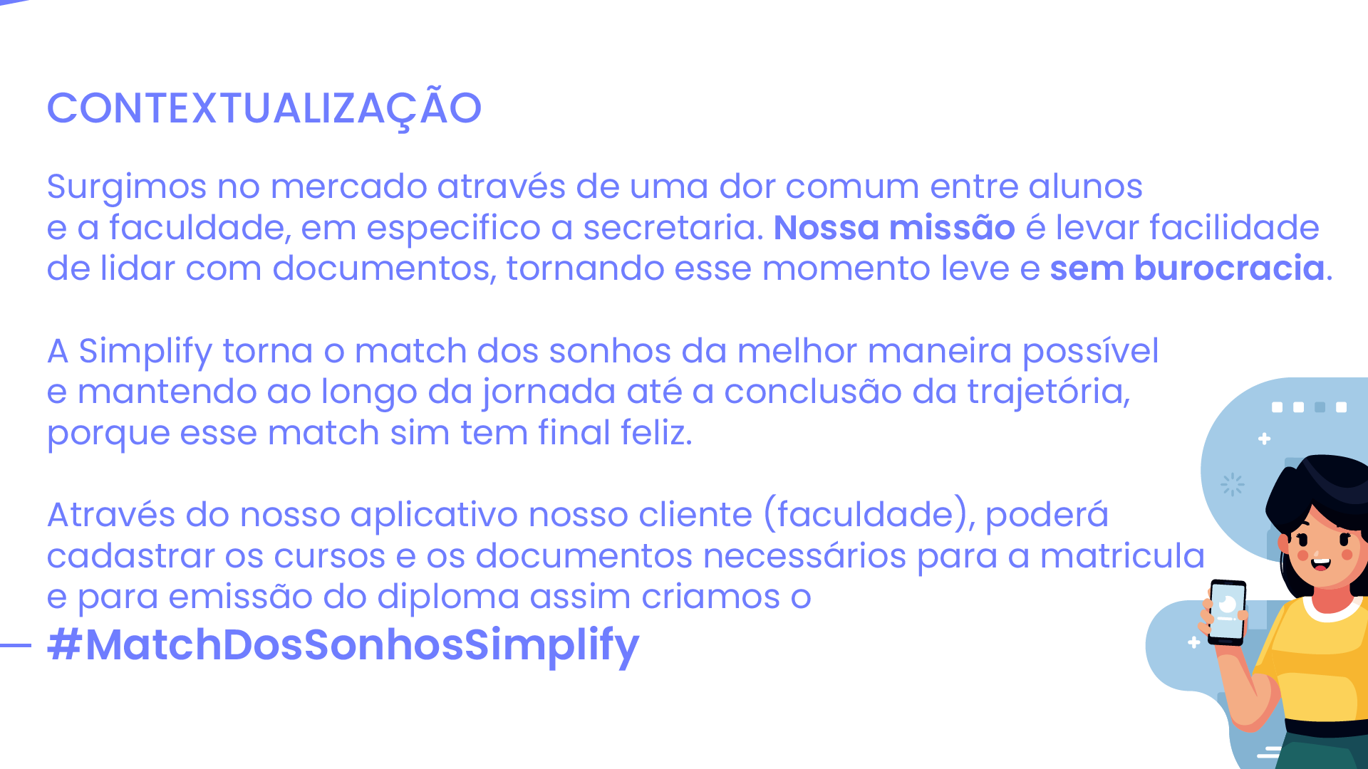

Slide 4
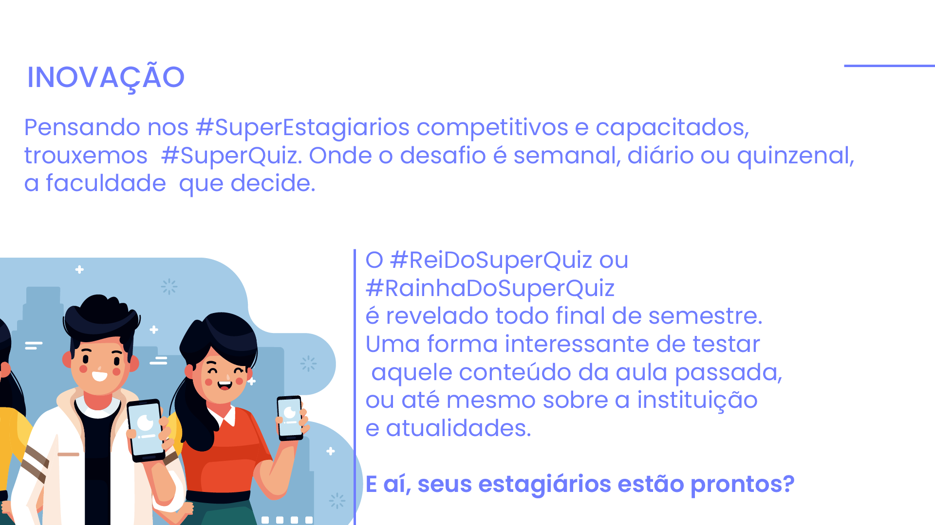

Slide 5
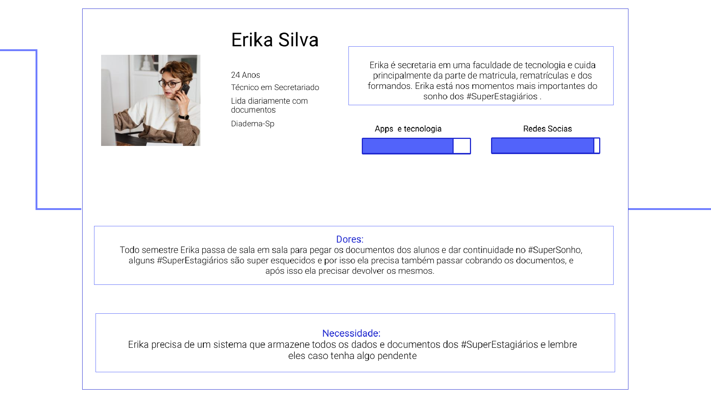

Slide 6
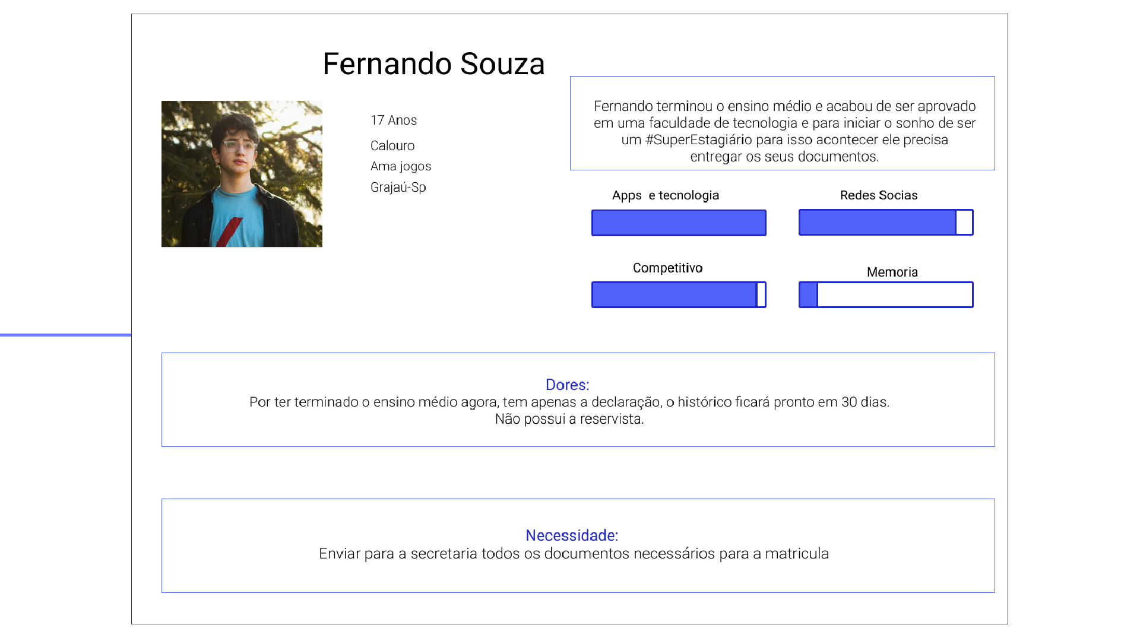

Slide 7


Slide 8


Slide 9


Slide 10
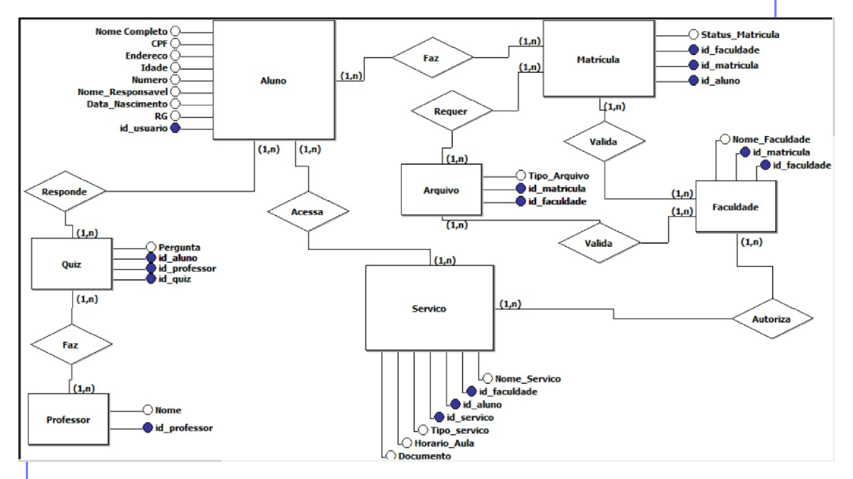

Slide 11

Scrum
Kanban
Status Report
Daily (15 minutos)

Slide 12
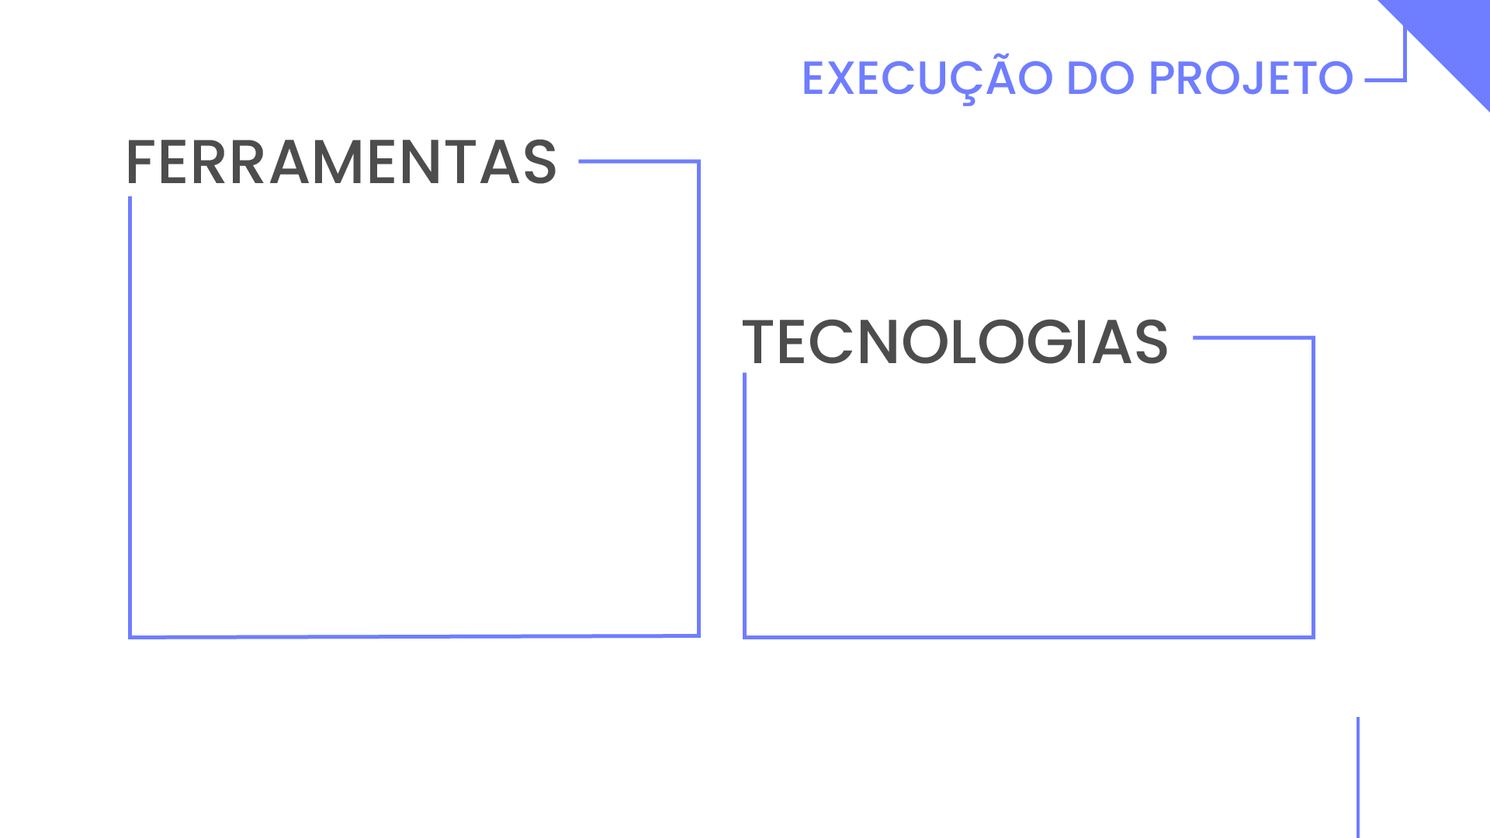
Git
Planner
Discord
Figma
Visual Studio Code
Android Studio
IntelliJ
Illustrator
Angular 9
Kotlin
Spring Boot
AWS Cloud

Slide 13

Kanban
Autonomia e
responsabilidade

Slide 14


Slide 15


