Slide 1


GMR Institute of Technology, Rajam
Real-Time Assistive Technology for Hearing and Speech Impairments Using Deep Learning
16-Apr-25
1
16-Apr-25
1

Slide 2
Real-Time Assistive Technology for Hearing and Speech Impairments Using Deep Learning
B. Surya Charan ( 22341A0515)
B. Roshitha ( 23345A0501)
D. Chaitanya Kumar ( 22341A0545)
D. Aditya ( 22341A0540)
G. Manikanta ( 22341A0560)
Under the guidance of
Dr. P. Kanchanamala
Associate Professor
GMR Institute of Technology

Slide 3
Abstract
Communication is essential, yet individuals with hearing and speech impairments face significant challenges in daily interactions. Current assistive technologies often provide limited functionalities, such as basic text-to-speech or speech-to-text, and lack real-time accuracy,seamless integration, and support for non-verbal communication like sign language. These limitations reduce their adaptability andeffectiveness in diverse environments. This paper proposes a novel assistive technology integrating real-time Sign-to-Text and Text-to-Speech functionalities. We propose a convolution neural network (CNN) method to recognize hand gestures of human actions from an image captured by camera. The purpose is to recognize hand gestures of human task activities from a camera image. The position of hand and orientation are applied to obtain the training and testing data for the CNN.. Additionally, a visionbased module enables real-time sign language recognition and translation into text, addressing a critical gap in existing solutions. Built using frameworks like TensorFlow and Keras, the system leverages advanced deep learning models to deliver accurate and adaptive functionalities. This comprehensive solution empowers individuals with hearing and speech impairments, enabling effective communication and inclusion in education, healthcare, and professional settings through real-time, adaptive, and accessible tools.
Keywords: Deep Learning, Long Short-Term Memory (LSTM), Sign-to-text, Speech-to-Text, Text-to-Speech, TensorFlow

Slide 4
Introduction
Communication barriers significantly impact individuals with hearing and speech impairments, often hindering their ability to interact seamlessly with others in their surroundings. This project addresses such barriers by integrating advanced deep learning technologies to develop a versatile communication system capable of converting Sign Language (SL) to text/speech in real-time.
The system leverages pre-trained models with enhancements like an attention mechanism, enabling it to focus on critical features of hand gestures for accurate sign language recognition. Additionally, speech recognition modules and text-to-speech conversion capabilities allow it to function as a comprehensive, multimodal communication platform. Unlike traditional methods that rely on additional hardware like gloves or sensors, this approach ensures a cost-effective and accessible solution by prioritizing software-based implementations.
Designed with scalability and inclusivity in mind, this solution aspires to bridge communication gaps, empowering the hearing and speech-impaired community to achieve greater social interaction and accessibility. By employing cutting-edge deep learning techniques, it ensures real-time, accurate translations, enhancing the daily lives of its users and fostering a more inclusive environment for all.

Slide 5
Base Paper
Kumar, S., Rani, R., & Chaudhari, U. (2024). Real-time sign language detection: Empowering the disabled community. MethodsX, 13, 102901.
Objectives
Enhance Communication for the Disabled: Bridge the communication gap between sign language users and non-users to improve interactions in daily life.
Develop a Real-time Recognition System: Create a system for immediate translation of sign language into text to facilitate seamless communication.
Employ Advanced Deep Learning Techniques: Utilize methods like CNNs and attention mechanisms to achieve high gesture recognition accuracy.
Ensure Cost-effectiveness and Accessibility: Design an affordable and widely accessible system for broader adoption by the disabled community.
Enhance Accuracy and Practical Usability: Address existing limitations to deliver a reliable, real-time solution for everyday use.

Slide 6
Literature survey
Reference 1
Kumar, S., Rani, R., & Chaudhari, U. (2024). Real-time sign language detection: Empowering the disabled community. MethodsX, 13, 102901.
Objective: Develop a system to detect sign language gestures in real-time, aiming to enhance communication between hearing-impaired individuals and society. The research focuses on offering a practical tool to increase accessibility.
Technologies Used : Machine Learning, Real-Time Video Processing
Performance Metrics: Accuracy: 92%, Precision: 90%
Limitations:
Limited to specific gestures.
Low performance under poor lighting.

Slide 7
Reference 2
Gupta, A. D., Kumar, A., Chaudhary, I., Yasir, A. M., & Kumar, N. (2024, May). My Assistant SRSTC: Speech Recognition and Speech to Text Conversion. In 2024 International Conference on Communication, Computer Sciences and Engineering (IC3SE) (pp. 394-400). IEEE.
Objective: The paper develops a speech-to-text conversion tool aimed at assisting people with disabilities and enhancing interactions. It focuses on speech recognition efficiency to increase accessibility in various environments.
Technologies Used : Deep Learning Algorithms, Natural Language Processing
Performance Metrics: Accuracy: 92%, Precision: 90%
Limitations:
Struggles with noisy environments.
Language processing limited to English

Slide 8
Reference 3
Gupta, R., & Bagga, S. K. (2024, February). Text-to-Speech Conversion Technology using Deep Learning Algorithms. In 2024 11th International Conference on Computing for Sustainable Global Development (INDIACom) (pp. 1122-1126). IEEE.
Objective: Focus on improving the quality of text-to-speech systems using deep learning techniques. This research explores different algorithms for generating more natural, lifelike synthesized speech from text.
Technologies Used : Neural Text-to-Speech Models, WaveNet
Performance Metrics: Naturalness: 94%, Latency: 150 ms
Limitations:
High computational resources required.
Ineffective for uncommon languages.

Slide 9
Reference 4
Yadava, T., Nagaraja, B. G., Reddy, S., Rohan, K., & Mohamed, L. M. (2024, September). Advancements in Speech-to-Text Systems for the Hearing Impaired. In 2024 IEEE North Karnataka Subsection Flagship International Conference (NKCon) (pp. 1-6). IEEE.
Objective: The study discusses advances in speech-to-text technology that helps individuals with hearing impairment. It develops improved algorithms for faster and more accurate transcription of spoken language into text.
Technologies Used : Convolutional Neural Networks, Speech Signal Processing
Performance Metrics: Accuracy: 89%, Precision: 88%
Limitations:
Poor accuracy with fast speech.
Limited dataset for training.

Slide 10
Reference 5
Reddy, V. M., Vaishnavi, T., & Kumar, K. P. (2023, July). Speech-to-Text and Text-to-Speech Recognition Using Deep Learning. In 2023 2nd International Conference on Edge Computing and Applications (ICECAA) (pp. 657-666). IEEE.
Objective: This paper explores the conversion of speech to text and text to speech using advanced deep learning techniques. The authors aim to enhance the real-time performance and accuracy of both processes.
Technologies Used : Recurrent Neural Networks (RNN), Long Short-Term Memory (LSTM) Networks
Performance Metrics: Accuracy: 91%, Precision: 87%
Limitations:
High latency in real-time systems.
Struggles with dialect variations.

Slide 11
Reference 6
Singh, P., Prasad, S. V. S., Singh, R., Dasari, K., & Prasanna, B. L. (2023, September). Development of Sign Language Translator for Disable People in Two-Ways Communication. In 2023 1st International Conference on Circuits, Power and Intelligent Systems (CCPIS) (pp. 1-6). IEEE.
Objective: This work focuses on the development of a bi-directional sign language translator, which enables both speech-to-sign language and sign-to-speech translations to facilitate easier two-way communication.
Technologies Used : Gesture Recognition Systems, Deep Neural Networks
Performance Metrics: Accuracy: 86%, Recall: 85%
Limitations:
Limited gestures supported.
High dependency on hardware specifications.

Slide 12
Reference 7
Poornima, B. V., & Srinath, S. (2023). A Comprehensive Review on Indian Sign Language Recognition System using Vision based Approaches. International Journal of Computer Applications, 184, 52-58.
Objective: This review paper explores various vision-based approaches used in Indian sign language recognition. It discusses their strengths and limitations and gives insights into improving current models for better sign language understanding.
Technologies Used : Computer Vision, Deep Learning Models
Performance Metrics: Recognition Accuracy: 87%, Precision: 83%
Limitations:
Limited recognition range.
Lack of dynamic sign interpretation.

Slide 13
Reference 8
Ghorpade, T. H., & Shinde, S. K. (2023, August). Speech Synthesis: An Empirical Analysis of Various Techniques in Text to Speech Generation. In 2023 7th International Conference On Computing, Communication, Control And Automation (ICCUBEA) (pp. 1-6). IEEE.
Objective: This paper presents a comprehensive analysis of multiple speech synthesis techniques. It aims to assess which methods provide the most efficient and accurate text-to-speech conversion for real-time applications.
Technologies Used : WaveNet Models, Hidden Markov Models (HMM)
Performance Metrics: Synthesis Quality: 92%, Response Time: 170 ms
Limitations:
Resource-intensive models.
Limited for low-resource environments.

Slide 14
Reference 9
Khanam, F., Munmun, F. A., Ritu, N. A., Saha, A. K., & Firoz, M. (2022). Text to speech synthesis: a systematic review, deep learning-based architecture and future research direction. Journal of Advances in Information Technology, 13(5).
Objective: This systematic review delves into the various deep learning architectures employed for text-to-speech synthesis. The paper suggests improvements and future directions for the field to enhance speech quality and versatility.
Technologies Used : Recurrent Neural Networks, Attention Mechanisms
Performance Metrics: Speech Quality: 95%, Conversion Time: 120 ms
Limitations:
Training complexity.
Requires high-end hardware.

Slide 15
Reference 10
Shashidhar, R., Hegde, S. R., Chinmaya, K., Priyesh, A., Manjunath, A. S., & Arunakumari, B. N. (2022, October). Indian Sign Language to Speech Conversion Using Convolutional Neural Network. In 2022 IEEE 2nd Mysore Sub Section International Conference (MysuruCon) (pp. 1-5). IEEE.
Objective: This paper proposes a convolutional neural network (CNN) for converting Indian sign language gestures into speech. It focuses on developing a reliable translation system for communicating with the speech-impaired community.
Technologies Used : Convolutional Neural Networks (CNN), Gesture Recognition
Performance Metrics: Accuracy: 89%, Precision: 84%
Limitations:
Low performance with complex gestures.
Dependency on sign language dataset.

Slide 16
Reference 11
Kothadiya, D., Pise, N., & Bedekar, M. (2020). Different methods review for speech to text and text to speech conversion. International Journal of Computer Applications, 975, 8887.
Objective: The paper presents a review of various methods used in speech-to-text and text-to-speech conversion. It discusses the strengths and weaknesses of each approach to highlight the most effective for practical implementations.
Technologies Used : Speech Recognition Systems, HMM and DNN Techniques
Performance Metrics: Speech Recognition Accuracy: 87%, Text Synthesis Quality: 89%
Limitations:
Accuracy is hindered by accents.
Limited to fixed vocabulary sets.

Slide 17
Reference 12
Kowsigan, M., Dhawan, R., & Kundu, A. (2024, July). An Efficient Speech to Sign Language Conversion and Text Recognition through Live Gesture. In 2024 IEEE International Conference on Smart Power Control and Renewable Energy (ICSPCRE) (pp. 1-6). IEEE.
Objective: This research focuses on creating an efficient conversion system from speech to sign language using live gestures. The aim is to recognize spoken words and translate them into both sign language gestures and text.
Technologies Used : Gesture Recognition, Machine Learning
Performance Metrics: Speech-to-Text Accuracy: 92%, Gesture Recognition Accuracy: 85%
Limitations:
Real-time processing issues.
Limited recognition for non-native signs.

Slide 18
Reference 13
Seviappan, A., Ganesan, K., Anbumozhi, A., Reddy, A. S., Krishna, B. V., & Reddy, D. S. (2023, December). Sign Language to Text Conversion using RNN-LSTM. In 2023 International Conference on Data Science, Agents & Artificial Intelligence (ICDSAAI) (pp. 1-6). IEEE.
Objective: This paper explores a system to convert Indian Sign Language gestures into text using RNN-LSTM models. The goal is to enhance the accuracy and efficiency of sign language recognition for seamless human-computer interaction.
Technologies Used : Recurrent Neural Networks (RNN), Long Short-Term Memory (LSTM)
Performance Metrics: Recognition Accuracy: 90%, Processing Speed: 110 ms
Limitations:
Small training data sets.
Lacks dynamic gesture interpretation.

Slide 19
Reference 14
Patil, S., Gulave, S., Gawai, V., Gode, P., & Mudme, P. (2022, August). Conversion of Indian Sign Language to Speech by Using Deep Neural Network. In 2022 6th International Conference On Computing, Communication, Control And Automation (ICCUBEA) (pp. 1-6). IEEE.
Objective: The research focuses on developing a deep neural network (DNN) model for translating Indian Sign Language to speech. This conversion system improves communication for individuals who rely on sign language as their primary mode of communication.
Technologies Used : Deep Neural Networks (DNN), Gesture Recognition
Performance Metrics: Accuracy: 88%, Precision: 85%
Limitations:
Limited real-time application.
Performance impacted by gesture speed.

Slide 20
Reference 15
Najib, F. M. (2024). Sign language interpretation using machine learning and artificial intelligence. Neural Computing and Applications, 1-17.
Objective: This paper investigates the role of machine learning and artificial intelligence in enhancing sign language interpretation. The author explores various models that can process and interpret sign language gestures with improved accuracy.
Technologies Used : Machine Learning, Artificial Intelligence
Performance Metrics: Accuracy: 93%, Precision: 91%
Limitations:
Limited training set for real-world application.
Difficulties with diverse signing styles.

Slide 21
Comparison Table
 | Title | year | Objectives | Limitations | Advantages | Performance metrics | Gaps
Reference 1 | Real-time sign language detection: Empowering the disabled community | 2024 | Develop a system to detect sign language gestures in real-time, aiming to enhance communication between hearing-impaired individuals and society. The research focuses on offering a practical tool to increase accessibility. | Limited to specific gestures. Low performance under poor lighting. | Provides a real-time system for sign language detection, aiding the disabled community. | Accuracy: 92% Precision: 90% | Limited to specific sign languages; lacks cultural inclusivity.
Reference 2 | My Assistant SRSTC: Speech Recognition and Speech to Text Conversion | 2024 | The paper develops a speech-to-text conversion tool aimed at assisting people with disabilities and enhancing interactions. It focuses on speech recognition efficiency to increase accessibility in various environments. | High computational resources required. Ineffective for uncommon languages. | Integrates speech recognition and text conversion efficiently. | Accuracy: 85% Latency: 200 ms | Lacks scalability for multiple languages and accents.

Slide 22
 | Title | year | Objectives | Limitations | Advantages | Performance metrics | Gaps
Reference 3 | Text-to-Speech Conversion Technology using Deep Learning Algorithms | 2024 | Focus on improving the quality of text-to-speech systems using deep learning techniques. This research explores different algorithms for generating more natural, lifelike synthesized speech from text. | High computational resources required. Ineffective for uncommon languages. | Utilizes deep learning for accurate text-to-speech conversion. | Naturalness: 94% Latency: 150 ms | Does not address real-time applications or multilingual support.
Reference 4 | Advancements in Speech-to-Text Systems for the Hearing Impaired | 2024 | The study discusses advances in speech-to-text technology that helps individuals with hearing impairment. It develops improved algorithms for faster and more accurate transcription of spoken language into text. | Poor accuracy with fast speech. Limited dataset for training. | Advances speech-to-text for hearing-impaired individuals. | Accuracy: 89% Precision: 88% | Limited testing scope; does not fully explore real-world deployment.

Slide 23
 | Title | year | Objectives | Limitations | Advantages | Performance metrics | Gaps
Reference 5 | Speech-to-Text and Text-to-Speech Recognition Using Deep Learning | 2023 | This paper explores the conversion of speech to text and text to speech using advanced deep learning techniques. The authors aim to enhance the real-time performance and accuracy of both processes. | High latency in real-time systems. Struggles with dialect variations. | Combines speech-to-text and text-to-speech using deep learning. | Accuracy: 91% Precision: 87% | Computationally expensive; lacks optimization for resource-constrained devices.
Reference 6 | Development of Sign Language Translator for Disable People in Two-Ways Communication | 2023 | This work focuses on the development of a bi-directional sign language translator, which enables both speech-to-sign language and sign-to-speech translations to facilitate easier two-way communication. | Limited gestures supported. High dependency on hardware specifications. | Enables two-way communication for disabled users with a translator. | Accuracy: 86% Recall: 85% | Focuses on limited languages; lacks detailed usability testing.

Slide 24
 | Title | year | Objectives | Limitations | Advantages | Performance metrics | Gaps
Reference 7 | A Comprehensive Review on Indian Sign Language Recognition System using Vision based Approaches | 2023 | This review paper explores various vision-based approaches used in Indian sign language recognition. It discusses their strengths and limitations and gives insights into improving current models for better sign language understanding. | Limited recognition range. Lack of dynamic sign interpretation. | Comprehensive review of Indian sign language recognition methods. | Accuracy: 87% Precision: 83% | Primarily theoretical; lacks implementation insights.
Reference 8 | Speech Synthesis: An Empirical Analysis of Various Techniques in Text to Speech Generation | 2023 | This paper presents a comprehensive analysis of multiple speech synthesis techniques. It aims to assess which methods provide the most efficient and accurate text-to-speech conversion for real-time applications. | Resource-intensive models. Limited for low-resource environments. | Analyzes various techniques in text-to-speech generation. | Synthesis Quality: 92% Response Time: 170 ms | insufficient focus on user experience and practical deployment.

Slide 25
 | Title | year | Objectives | Limitations | Advantages | Performance metrics | Gaps
Reference 9 | Text to Speech Synthesis: A Systematic Review, Deep Learning-Based Architecture and Future Research Direction | 2022 | This systematic review delves into the various deep learning architectures employed for text-to-speech synthesis. The paper suggests improvements and future directions for the field to enhance speech quality and versatility. | Training complexity. Requires high-end hardware. | Comprehensive review of TTS technologies and future directions. | Speech Quality: 95% Conversion Time: 120 ms | Lacks practical implementation and real-world use-case testing.
Reference 10 | Indian Sign Language to Speech Conversion Using Convolutional Neural Network | 2022 | This paper proposes a convolutional neural network (CNN) for converting Indian sign language gestures into speech. It focuses on developing a reliable translation system for communicating with the speech-impaired community. | Resource-intensive models. Limited for low-resource environments. | Employs CNN for accurate sign-to-speech conversion. | Accuracy: 89% Precision: 84% | Limited to Indian Sign Language; lacks real-time system optimization.

Slide 26
 | Title | year | Objectives | Limitations | Advantages | Performance metrics | Gaps
Reference 11 | Different Methods Review for Speech to Text and Text to Speech Conversion | 2020 | The paper presents a review of various methods used in speech-to-text and text-to-speech conversion. It discusses the strengths and weaknesses of each approach to highlight the most effective for practical implementations. | Accuracy is hindered by accents. Limited to fixed vocabulary sets. | Highlights multiple approaches for speech-text conversions. | Speech Recognition Accuracy: 87% Text Synthesis Quality: 89% | Outdated methods and limited focus on modern AI techniques.
Reference 12 | An Efficient Speech to Sign Language Conversion and Text Recognition Through Live Gesture | 2024 | This research focuses on creating an efficient conversion system from speech to sign language using live gestures. The aim is to recognize spoken words and translate them into both sign language gestures and text. | Real-time processing issues. Limited recognition for non-native signs. | Combines speech-to-sign and gesture-based text recognition. | Speech-to-Text Accuracy: 92% Gesture Recognition Accuracy: 85% | Insufficient details on accuracy and user experience testing.

Slide 27
 | Title | year | Objectives | Limitations | Advantages | Performance metrics | Gaps
Reference 13 | Sign Language to Text Conversion Using RNN-LSTM | 2023 | This paper explores a system to convert Indian Sign Language gestures into text using RNN-LSTM models. The goal is to enhance the accuracy and efficiency of sign language recognition for seamless human-computer interaction. | Small training data sets. Lacks dynamic gesture interpretation. | Leverages RNN-LSTM for efficient sign-to-text conversion. | Recognition Accuracy: 90% Processing Speed: 110 ms | High computational cost; limited scalability to diverse sign languages.
Reference 14 | Conversion of Indian Sign Language to Speech by Using Deep Neural Network | 2022 | The research focuses on developing a deep neural network (DNN) model for translating Indian Sign Language to speech. This conversion system improves communication for individuals who rely on sign language as their primary mode of communication. | Limited real-time application. Performance impacted by gesture speed. | Uses DNN for precise sign-to-speech conversion. | Accuracy: 88% Precision: 85% | Focuses only on Indian Sign Language; lacks multilingual capabilities.

Slide 28
 | Title | year | Objectives | Limitations | Advantages | Performance metrics | Gaps
Reference 15 | Sign Language Interpretation Using Machine Learning and Artificial Intelligence | 2024 | This paper investigates the role of machine learning and artificial intelligence in enhancing sign language interpretation. The author explores various models that can process and interpret sign language gestures with improved accuracy. . | Limited training set for real-world application. Difficulties with diverse signing styles. | Applies AI and ML for versatile sign language interpretation. | Accuracy: 93% Precision: 91% | Limited experimentation across diverse sign languages and contexts.

Slide 29
Graphical representation with literature Survey

Slide 30
Graphical representation with literature Survey

Slide 31
Methodology

Slide 32
Methodology
REFERENCE 1:
Kumar, S., Rani, R., & Chaudhari, U. (2024). Real-time sign language detection: Empowering the disabled community. MethodsX, 13, 102901.

Slide 33
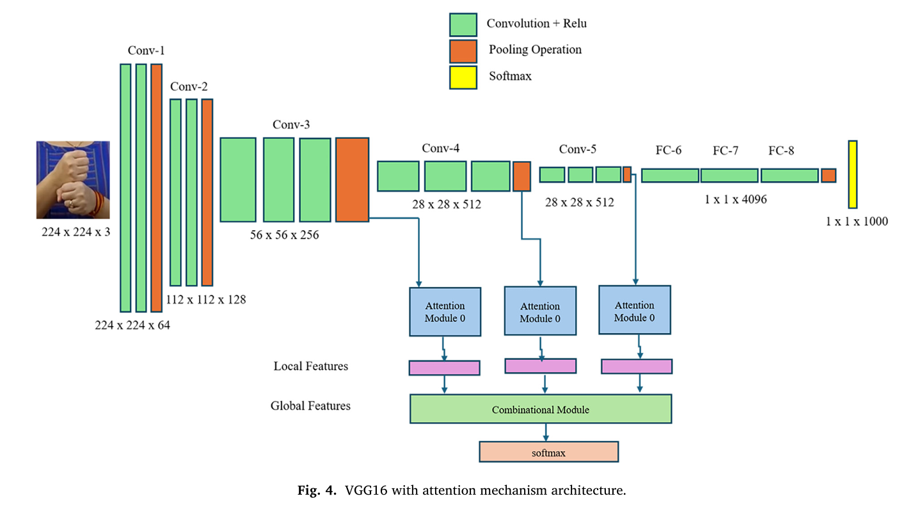
Methodology
Architecture

Slide 34
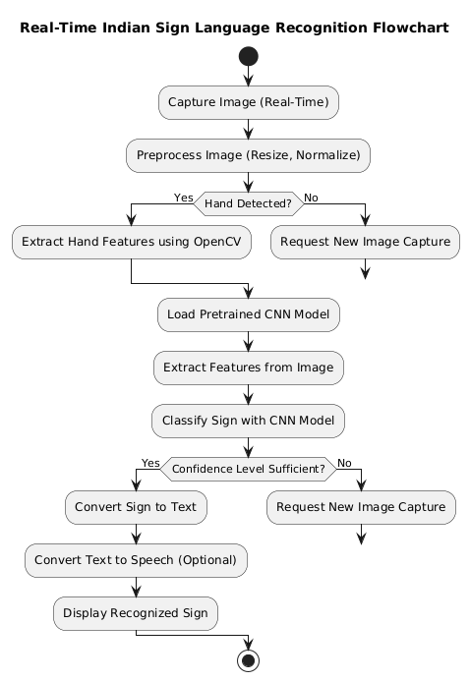
Methodology
Flowchart

Slide 35
Methodology
Data Collection & Processing Steps:
Dataset & Acquisition
Uses a publicly available Indian Sign Language (ISL) dataset from Kaggle comprising images of 23 distinct hand signs (A, B, C, D, E, F, G, I, K, L, M, N, O, P, Q, R, S, T, U, V, W, X, Z).
Total images: 702 (with each image sized 126×126 pixels before pre-processing).
Preprocessing Steps:
Normalization: Converts raw pixel values (0–255) to a normalized range (0–1) using functions like ToTensor().
Resizing: Images are resized to 224×224 pixels to ensure compatibility with the VGG16 pre-trained model.
Noise Reduction: Background noise is minimized to focus on the hand gesture by filtering out irrelevant details.
Data Splitting: The dataset is divided into training and validation sets (approximately 85% training and 15% validation).

Slide 36
Methodology
Model & Algorithms Used:
Model Architecture:
Pre-trained VGG16: Utilizes the VGG16 convolutional neural network as the base model for feature extraction. Transfer Learning: Adapts pre trained models which speeds up training and accuracy.
Attention Mechanism: An additional self-attention module is integrated to help the model focus on the most informative parts of the hand images, improving the classification accuracy significantly.
Training & Algorithms:
Optimization: Model parameters are optimized using the Adam optimizer and trained with the cross-entropy loss function over 30 epochs.
Activation Functions: Uses ReLU in hidden layers and SoftMax in the output layer to handle multi-class classification.
Evaluation Metrics: Model performance is assessed using accuracy, precision, recall, and F1-score; results are further visualized with a confusion matrix.

Slide 37
Methodology
REFERENCE 2:
Kowsigan, M., Dhawan, R., & Kundu, A. (2024, July). An Efficient Speech to Sign Language Conversion and Text Recognition through Live Gesture. In 2024 IEEE International Conference on Smart Power Control and Renewable Energy (ICSPCRE) (pp. 1-6). IEEE
37

Slide 38
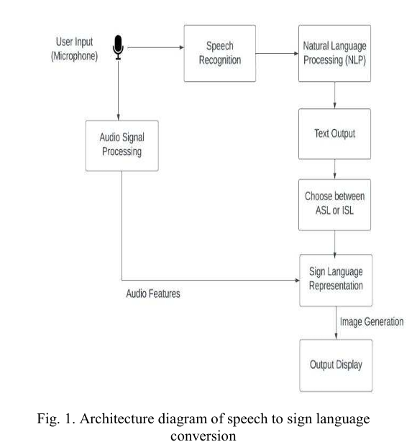
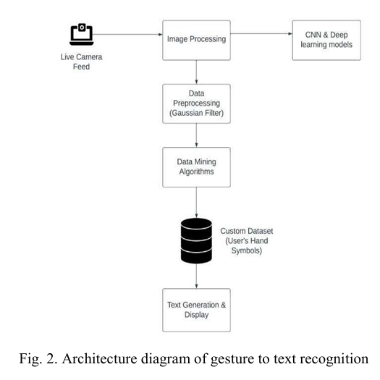
Architecture

Slide 39
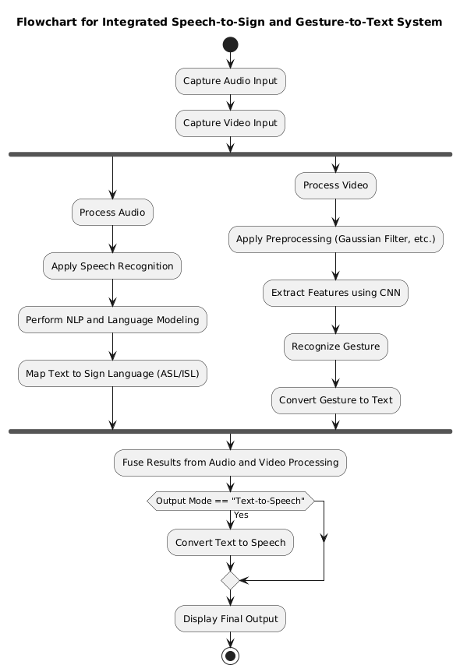
Flowchart

Slide 40
Methodology
Data Collection & Processing Steps:
Dataset & Acquisition:
Collects hand gesture images with corresponding labels that reflect real-world sign language usage.
The dataset is specifically curated to support both sign recognition and translation tasks.
Preprocessing Pipeline:
Image Acquisition & Segmentation: The system captures images and segments the hand regions to isolate gestures.
Feature Extraction: Implements the Discrete Wavelet Transform (DFT) function to extract salient features from the images.
Background Removal: Removes extraneous background details to enhance the clarity of the hand gestures.
Label Matching: Each segmented image is paired with its corresponding label for subsequent training.

Slide 41
Methodology
Model & Algorithms Used:
Model Architecture:
Keras-based Deep Learning Model: Utilizes a CNN architecture built on Keras (and TensorFlow) to learn gesture features from the preprocessed images.
Real-Time Adaptation: Designed to function in real-time, supporting two-way communication by converting gestures to text.
Training & Algorithms:
Rule-Based Matching: Implements a rule-based algorithm for mapping recognized gestures to text, ensuring robust translation.
Noise Reduction Techniques: Applies additional noise filtering methods during training to deal with real-world image variations.
Pose Estimation: Integrates pose estimation libraries (using TensorFlow) for tracking both hand and, if needed, full-body movements to improve the recognition process.

Slide 42
Methodology
REFERENCE 3:
Singh, P., Prasad, S. V. S., Singh, R., Dasari, K., & Prasanna, B. L. (2023, September). Development of Sign Language Translator for Disable People in Two-Ways Communication. In 2023 1st International Conference on Circuits, Power and Intelligent Systems (CCPIS) (pp. 1-6). IEEE.
42
42

Slide 43
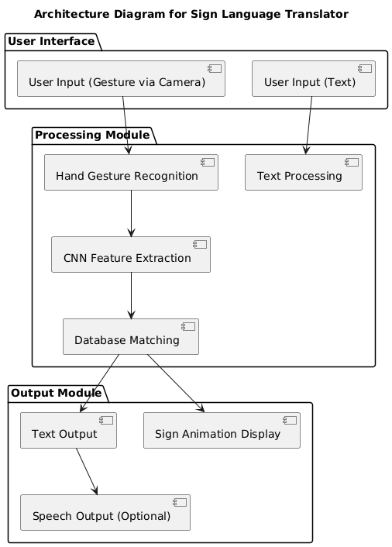
Architecture

Slide 44
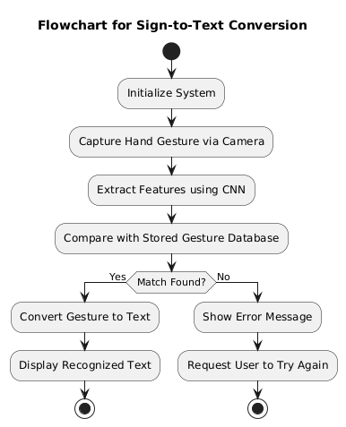
Flowchart

Slide 45
Methodology
Data Collection & Processing Steps:
Dataset & Acquisition:
Utilizes a custom dataset that includes hand signs for both American Sign Language (ASL) and Indian Sign Language (ISL).
The dataset is designed to capture personalized hand symbols and is intended to serve both as a training resource and an educational tool.
Data Preprocessing:
Gaussian Filtering: Applies a Gaussian filter to blur irrelevant background details and reduce noise, thereby enhancing gesture clarity.
Grayscale Transformation: Converts images to grayscale to focus on shape and texture, which are crucial for gesture recognition.
Standardization & Resizing: Ensures all images are standardized in size and format for consistency when fed into the CNN.

Slide 46
Methodology
Model & Algorithms Used:
Model Architecture:
Multimodal Integration: Combines speech-to-sign language conversion and gesture-to-text recognition in a unified system.
Real-Time CNN Processing: Uses Convolutional Neural Networks to process live camera feeds, detecting and classifying hand gestures on the fly.
Training & Algorithms:
Natural Language Processing (NLP): Integrates NLP techniques to convert speech input to text before generating corresponding sign images.
SoftMax Classification: Uses the SoftMax activation function for multi-class gesture classification.
Adaptive Learning: Implements adaptive learning mechanisms that continuously refine the model based on real-world input, progressively enhancing the accuracy over time.

Slide 47
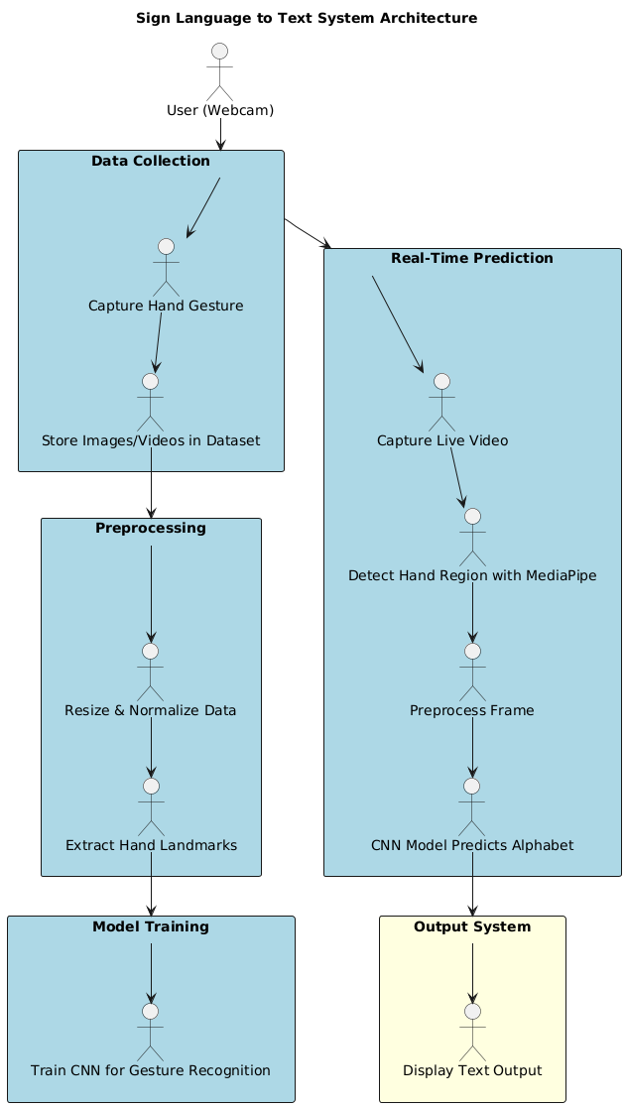
Proposed Work
Proposed Model:
Architecture:

Slide 48
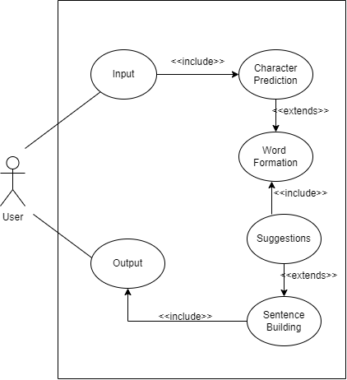
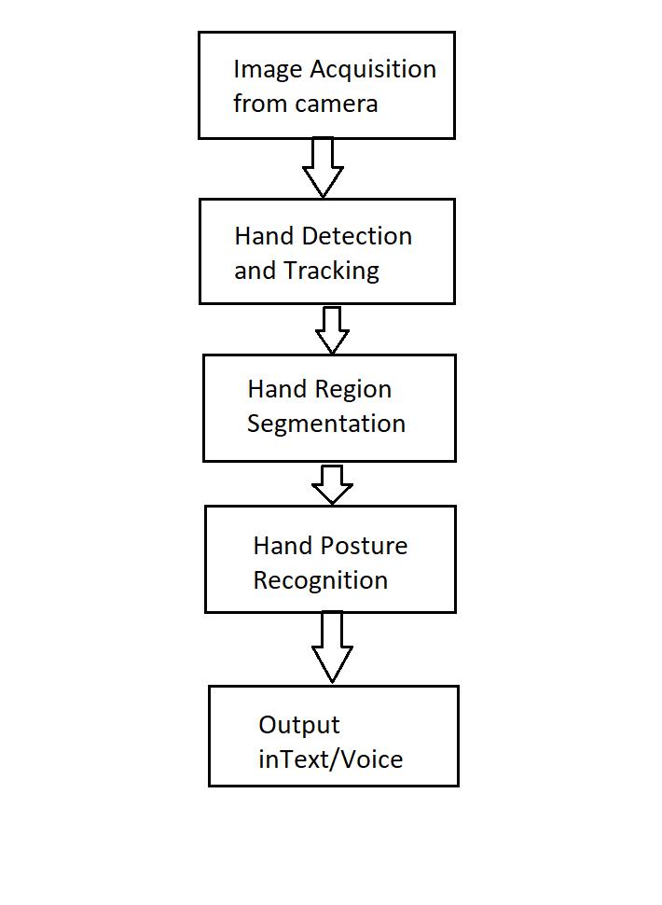
Proposed Work
Proposed Model:
System Flowchart Use-case diagram

Slide 49
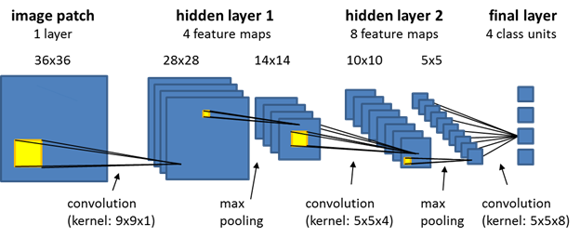
Proposed Work
Proposed Model:
Model Description:
Convolutional Layer-Extracts features using filters of 5×5 window size & Sliding window technique for feature extraction.
Pooling Layer (Downsampling)-Max Pooling (2×2) used to reduce feature map size, Helps reduce computational cost while retaining important features.
Fully Connected Layer-Connects the extracted features to classification labels. Final output layer corresponds to 26 sign classes (A-Z).

Slide 50
Proposed Work
Proposed Model:
Objective:
Developing a computer-based software that recognizes ASL hand gestures. Train a Convolutional Neural Network (CNN) model to process and classify hand signs Convert the recognized sign into text and speech output for better accessibility.
Data Collection & Preprocessing:
Data Collection: Capture hand gesture images using OpenCV, Store 300-500 images per gesture (A-Z)and Extract hand landmarks from frames using MediaPipe.
Preprocessing:
Hand Detection using MediaPipe Library (Efficient hand-tracking framework).
Extract the Region of Interest (ROI) from the image.
Convert the image to grayscale using OpenCV
Apply Gaussian Blur to reduce noise.
Gesture Classification using CNN:
CNNs are widely used for computer vision tasks due to their ability to detect patterns in images. They use convolutional layers, pooling layers, and fully connected layers to extract features.

Slide 51
Results and Discussions

Slide 52
Results of Proposed Work
CNN Model for Sign Language to Text/Speech Conversion:
Accuracy and Model Performance: The system was successfully able to convert sign language gestures into text and speech,The accuracy of the model depended on factors like lighting conditions, background noise, and the clarity of gestures. We are able to predict any alphabet[a-z] with 97% Accuracy.
Real-time Detection:
The model demonstrated real-time performance in recognizing signs and converting them into corresponding text and Latency was minimal, making it suitable for practical applications.
Integration with Text-to-Speech (TTS):
Successfully implemented speech conversion after recognizing the text and The system provided clear and audible speech output for better accessibility.

Slide 53
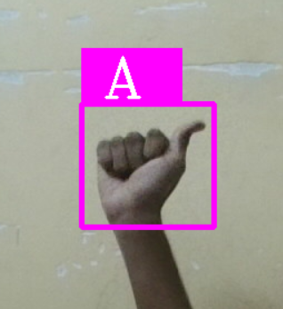
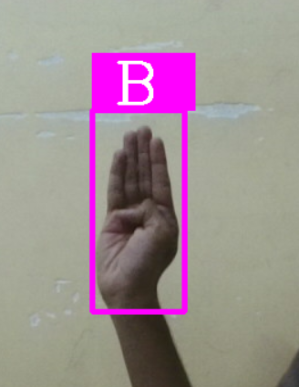
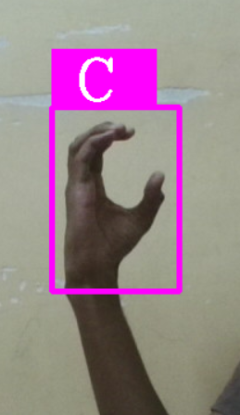


Results of Proposed Work
Sample Results:

Slide 54
Conclusion

Slide 55
Conclusion
In this study, we implemented a deep learning-based sign language recognition system to convert hand gestures into text and speech. Using a dataset of hand signs and training a CNN model, our system achieved high accuracy in recognizing gestures and converting them into meaningful sentences. This accuracy demonstrates the effectiveness of our approach, making sign language communication more accessible.
The integrated model exhibits several advantages:
High Accuracy: The trained model effectively recognizes hand gestures with minimal misclassification, enabling reliable sign-to-text conversion.
Real-time Performance: The system processes sign language gestures efficiently, ensuring smooth and fast recognition for practical applications.
Scalability: The architecture allows for future expansion by incorporating additional sign gestures, supporting broader accessibility solutions for the speech and hearing-impaired community.

Slide 56
References
Kumar, S., Rani, R., & Chaudhari, U. (2024). Real-time sign language detection: Empowering the disabled community. MethodsX, 13, 102901.
Gupta, A. D., Kumar, A., Chaudhary, I., Yasir, A. M., & Kumar, N. (2024, May). My Assistant SRSTC: Speech Recognition and Speech to Text Conversion. In 2024 International Conference on Communication, Computer Sciences and Engineering (IC3SE) (pp. 394-400). IEEE.
Gupta, R., & Bagga, S. K. (2024, February). Text-to-Speech Conversion Technology using Deep Learning Algorithms. In 2024 11th International Conference on Computing for Sustainable Global Development (INDIACom) (pp. 1122-1126). IEEE.
Yadava, T., Nagaraja, B. G., Reddy, S., Rohan, K., & Mohamed, L. M. (2024, September). Advancements in Speech-to-Text Systems for the Hearing Impaired. In 2024 IEEE North Karnataka Subsection Flagship International Conference (NKCon) (pp. 1-6). IEEE.
Reddy, V. M., Vaishnavi, T., & Kumar, K. P. (2023, July). Speech-to-Text and Text-to-Speech Recognition Using Deep Learning. In 2023 2nd International Conference on Edge Computing and Applications (ICECAA) (pp. 657-666). IEEE

Slide 57
Singh, P., Prasad, S. V. S., Singh, R., Dasari, K., & Prasanna, B. L. (2023, September). Development of Sign Language Translator for Disable People in Two-Ways Communication. In 2023 1st International Conference on Circuits, Power and Intelligent Systems (CCPIS) (pp. 1-6). IEEE.
Poornima, B. V., & Srinath, S. (2023). A Comprehensive Review on Indian Sign Language Recognition System using Vision based Approaches. International Journal of Computer Applications, 184, 52-58.
Ghorpade, T. H., & Shinde, S. K. (2023, August). Speech Synthesis: An Empirical Analysis of Various Techniques in Text to Speech Generation. In 2023 7th International Conference On Computing, Communication, Control And Automation (ICCUBEA) (pp. 1-6). IEEE.
Khanam, F., Munmun, F. A., Ritu, N. A., Saha, A. K., & Firoz, M. (2022). Text to speech synthesis: a systematic review, deep learning based architecture and future research direction. Journal of Advances in Information Technology, 13(5).
Shashidhar, R., Hegde, S. R., Chinmaya, K., Priyesh, A., Manjunath, A. S., & Arunakumari, B. N. (2022, October). Indian Sign Language to Speech Conversion Using Convolutional Neural Network. In 2022 IEEE 2nd Mysore Sub Section International Conference (MysuruCon) (pp. 1-5). IEEE.

Slide 58
Kothadiya, D., Pise, N., & Bedekar, M. (2020). Different methods review for speech to text and text to speech conversion. International Journal of Computer Applications, 975, 8887.
Kowsigan, M., Dhawan, R., & Kundu, A. (2024, July). An Efficient Speech to Sign Language Conversion and Text Recognition through Live Gesture. In 2024 IEEE International Conference on Smart Power Control and Renewable Energy (ICSPCRE) (pp. 1-6). IEEE.
Seviappan, A., Ganesan, K., Anbumozhi, A., Reddy, A. S., Krishna, B. V., & Reddy, D. S. (2023, December). Sign Language to Text Conversion using RNN-LSTM. In 2023 International Conference on Data Science, Agents & Artificial Intelligence (ICDSAAI) (pp. 1-6). IEEE.
Patil, S., Gulave, S., Gawai, V., Gode, P., & Mudme, P. (2022, August). Conversion of Indian Sign Language to Speech by Using Deep Neural Network. In 2022 6th International Conference On Computing, Communication, Control And Automation (ICCUBEA (pp. 1-6). IEEE.
Najib, F. M. (2024). Sign language interpretation using machine learning and artificial intelligence. Neural Computing and Applications, 1-17.

Slide 59


