Slide 1
HCI & UI/UX FINAL PROJECT — TUGAS AKHIR
Redesigning K24Klik
A Design Thinking Approach to a Cleaner, Faster Pharmacy App
Bandar Qaid Ahmed Abdulrab
NIM 244110601013 | Kelas 4 Informatika A
Program Studi Informatika
Fakultas Sains dan Teknologi
UIN Prof. K.H. Saifuddin Zuhri Purwokerto — T.A. 2026
5
32
78.33
Design Thinking
stages applied
real survey
respondents
SUS usability
score (Acceptable)
Notes:
Welcome / opening slide. Introduce the project: redesigning K24Klik, the medicine delivery app, using the Design Thinking methodology. Mention this deck is the central walkthrough for the final exam — every section of the written report maps to one of these slides.

Slide 2






PRESENTATION ROADMAP
What I'll Walk Through Today
01
02
03
Background & App Audit
Research & Empathy
System Design
Why K24Klik, app identity, and current UI/UX problems
Heuristic evaluation, survey, interview, personas
Hierarchical Task Analysis & privacy (UU PDP) compliance
04
05
06
Prototyping
Implementation
Evaluation & Results
Lo-Fi wireframes → Hi-Fi Figma, theory-backed decisions
Flutter + Firebase MVP, dark mode, responsive layout
SUS score, AI code review, conclusion & future work
K24Klik Redesign — Final Project Walkthrough
02
Notes:
This is the roadmap slide — refer back to it if asked 'what's next' or to navigate during Q&A. Six parts: background, research, system design, prototyping, implementation, evaluation.

Slide 3
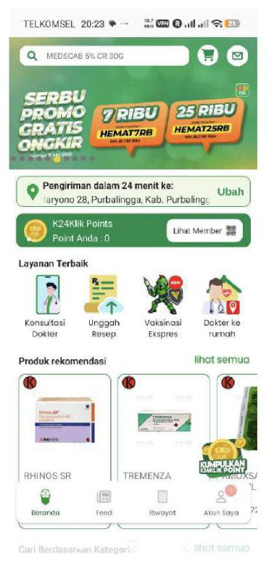
CHAPTER 1.1 — BACKGROUND
Why K24Klik?
Health & pharmacy apps are essential — but UX often lags behind.
K24Klik is a national 24-minute medicine delivery platform. I focused on its use at the local K-24 branches in Purbalingga & Banyumas (AW Sumarmo & Dukuhwaluh).
Even with a strong national brand, the current UI suffers from severe visual clutter, invasive pop-ups, and cognitive overload — which hurts local users trying to order medicine quickly during emergencies.
4.2 / 5.0
Play Store rating
44K+
total reviews
1M+
downloads
CHALLENGE STATEMENT (1.3)
“Redesign K24Klik so local users in Purbalingga/Banyumas can search, view details, and order medicine independently 50% faster — through a clean, minimalist design free from disruptive pop-ups.”
24 min
delivery promise
Source: Report Ch.1.1–1.2, Fig. 3.1
Current K24Klik Home Screen — v5.215.14
03
Notes:
Explain why this app: a real, popular pharmacy app (1M+ downloads, 4.2 rating, 44K reviews) but with real local users who need it during emergencies. The challenge statement is the north star for the whole project — 50% faster, minimalist, pop-up free. Point at the screenshot to literally show the clutter.

Slide 4





CHAPTER 1.2 — APP INFO & IDENTITY
K24Klik at a Glance
Core Services / Features
App Identity & Metadata
Medicine E-Commerce
App Name
K24KLIK: Beli Obat Cepat 24mnt
OTC & prescription drugs
Developer
PT. K24 Klik Indonesia
Flexible Delivery
Category
Medical / Health & Fitness
24-min Prioritas, 1-hr Instan, Regular, or Ambil di Apotek
Version
v5.215.14
Dokter Siaga Online
Last Updated
April 15, 2026
Telemedicine consultation — Rp 15.000
“Pesan obat dari rumah lebih cepat loh, 24 menit sudah sampai!”
Unggah Resep
Digital & physical prescription upload
Target users: general public, urgent-medicine patients, mothers buying baby supplies, and elderly patients / caretakers needing routine prescriptions.
K24Klik Points
Loyalty program & vouchers
Brand Colors
K-24 Green
Yellow/Orange Accent
White / Off-white
Source: Report Ch.1.2.1–1.2.2
04
Notes:
Quick orientation to the app being redesigned. Mention the brand identity (K-24 green, yellow/orange accents) is preserved in the redesign — we're fixing UX, not throwing away the brand. The 5 services map directly to the bottom nav and home screen feature buttons in the original app.

Slide 5



CHAPTER 1.2.2 — HCI & ERGONOMIC EVALUATION
What's Actually Wrong With the Current App?
Before redesigning anything, I evaluated the live app against core HCI theory — Gestalt principles, mental workload (ergonomics), and the mobile Thumb Zone.
Gestalt: Proximity & Figure-Ground
Ergonomics: Mental Workload
Thumb Zone: One-Handed Use
The home screen crams banners, feature icons (Konsultasi, Unggah Resep, Vaksinasi), points, and category grids together — the eye doesn't know where to focus.
Buying a simple medicine carries high cognitive load. Users hit a wall of pop-ups (“Enable Location”, “Dapatkan Cashback”, purchase terms) before they can even act.
Bottom nav is fine, but key filters and pop-up ‘X’ close buttons sit at the very top of the screen — hard to reach with one hand.
THE CURRENT ARCHITECTURE (1.2.3)
Onboarding (5 swipeable screens) → Login/Register → Home (location selector, 4 feature buttons, promo banners, category grid, best-seller carousels) → Search & Filter → Product Detail (long scrolling text blocks: Komposisi, Indikasi, Dosis, Efek Samping + Tanya Jawab Apoteker) → Cart & Checkout (min-purchase pop-up, delivery & payment selection).
This 6-step, multi-screen flow was the basis for simplifying the MVP down to 4 core screens.
Source: Report Ch.1.2.2–1.2.3
05
Notes:
This sets up the 'problem' before we get to data. Three core HCI complaints: Gestalt clutter, ergonomic mental overload from pop-ups, and Thumb Zone violations. The bottom strip shows just how long the current user journey is — that's the baseline I simplified.

Slide 6
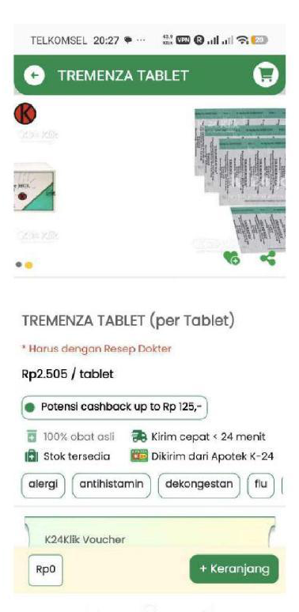
CHAPTER 3.1 — DATA GATHERING
Heuristic Evaluation of the Original App
Using Jakob Nielsen's 10 Usability Heuristics, I scored the live app (v5.215.14) on a 0–4 severity scale.
Nielsen's Heuristic | Observation / Pain Point | Severity
8. Aesthetic & Minimalist Design | Visual clutter — banners, promos & menus crammed together causing high cognitive load. | 4
3. User Control & Freedom | Aggressive pop-ups — location permission & promo dialogs block users before they can search. | 4
7. Flexibility & Efficiency | Information overload — medicine details are long, stacked text blocks requiring endless scrolling. | 3
1. Visibility of System Status | Confusing checkout — minimum-purchase warnings appear only as errors at the final payment step. | 3
Fig. 3.1 — Original PDP: dense info blocks
Severity scale: 0 = no problem — 4 = catastrophe | Source: Report Table 3.1, Fig. 3.1
06
Notes:
Walk through the table row by row. Two severity-4 issues (aesthetic clutter, pop-ups) and two severity-3 issues (info overload, checkout status). These four pain points become the four redesign priorities later. The screenshot on the right is the actual Product Detail Page showing the dense, stacked layout.

Slide 7


CHAPTER 1.2.4 — APP STORE REVIEW ANALYSIS
Real User Reviews Justify the Redesign
What Works
UX Pain Points → What I Fixed
Budi S.
Ahmad T.
“Terlalu banyak popup! Baru buka aplikasi langsung disuruh nyalakan lokasi, lalu ada popup banner promo...”
Violates User Control & Freedom
Fix: removed invasive pop-ups entirely
“Sangat membantu saat malam hari butuh obat demam untuk anak. Pengiriman benar-benar cepat 24 menit dari apotek K-24 Dukuhwaluh.”
Insight: local branch fulfillment + speed are the core values.
Siti A.
“Halaman deskripsi obat kepanjangan. Tulisannya kecil-kecil dan numpuk jadi satu...”
Violates Aesthetic & Minimalist Design
Fix: collapsible Accordion tabs for descriptions
Rina M.
“Obatnya komplit dan pasti asli. Lumayan sering dapat promo gratis ongkir.”
Dimas P.
“Checkoutnya ribet. Pas mau bayar disuruh milih cabang sendiri, peringatan minimal belanja munculnya pas mau klik bayar...”
Violates Visibility of System Status / Error Prevention
Fix: one clean checkout page, warnings shown early
Insight: trust in stock authenticity & free-shipping promos.
Source: Report Ch.1.2.4 (App Store Review Analysis)
07
Notes:
This is the qualitative evidence base. Two things work (speed and trust). Three specific complaints map 1:1 to the heuristic violations from the previous slide, and each gets a concrete fix that we'll see implemented later in the prototype.

Slide 8
CHAPTER 3.2 — QUANTITATIVE USER SURVEY
32 Real Respondents, 18–25 Years Old
A Google Form survey was distributed to local young-adult users — the app's primary demographic for urgent medicine purchases.
UI Preference
38%
Text Readability
Complained the medicine description text was too long and dizzying to read → inspired the Accordion-based Description/Dosage/Side-Effects layout.
97%
66%
Language Preference
Wanted a bilingual app (Indonesian + English toggle) → implemented as a dynamic EN/ID locale switch in Profile.
31 of 32 respondents preferred a minimalist, clean, simple UI over a dense, promo-heavy one.
Source: Report Ch.3.2 (Form: forms.cloud.microsoft/r/nX6umJxAYV)
08
Notes:
Three key numbers: 97% want minimalism (the biggest justification for the whole redesign), 38% struggled with text readability (drove the Accordion design), and 66% wanted bilingual support (drove the EN/ID locale toggle). These three numbers map directly to three concrete features you'll see in the prototype.

Slide 9


CHAPTER 3.3 & 3.4 — QUALITATIVE RESEARCH
Pharmacy Worker Interview & User Personas
On-Site Interview — K-24 Pharmacy Staff
The Urgent Buyer
University Student, 22
Q1 — Do customers prefer simple, to-the-point apps?
“Orang beli obat itu biasanya lagi sakit, panik, atau buru-buru... mendingan aplikasinya langsung to-the-point ke kolom pencarian obat.”
Q2 — Do promo pop-ups help or hurt sales?
“Kalau buat yang lagi butuh obat darurat, pop-up itu malah bikin emosi... mendingan promonya ditaruh di menu khusus (banner kecil), jangan sampai nutupin layar depan.”
Q3 — Would a faster checkout help pharmacy staff too?
“Kalau checkout-nya dibikin simpel dan satu halaman aja, pesanan yang masuk ke sistem kita juga lebih jelas dan kita nyiapin obatnya bisa lebih cepet.”
Goal: Find & order flu medicine as fast as possible while sick at home.
Frustration: Hates disruptive promo pop-ups and dense, cluttered layouts.
Tech comfort: High — prefers minimalist apps like Apple Health or Gojek.
The First-Timer
Young Professional, 20
Goal: Check prices and read side effects clearly.
Frustration: Overwhelmed by long, unstructured medical text (poor visual hierarchy).
Key takeaway: time-sensitive psychology of medicine buyers makes blocking pop-ups ineffective, and a simplified checkout reduces both user errors AND pharmacist fulfillment errors.
Source: Report Ch.3.3–3.4, Fig. 3.3
09
Notes:
This slide carries the qualitative weight. Mention Figure 3.3 in the report has photos proving the interview happened on-site at K-24. Both personas were derived from the 32-person survey and feed directly into the HTA and prototype design decisions next.

Slide 10

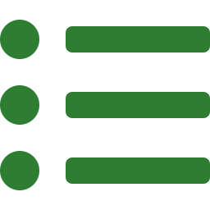
CHAPTER 1.4 & 2 — METHODOLOGY & LITERATURE
Design Thinking + 5 HCI Theory Lenses
1
→
2
→
3
→
4
→
5
Empathize
Define
Ideate
Prototype
Test
Chosen over traditional UCD because the problem needed deep Empathy-driven exploration of latent needs, with rapid Stanford d.school-style prototyping to find the most ergonomic interface.
Nielsen's 10 Heuristics
Shneiderman's 8 Golden Rules
CRAP Principles
Gestalt Principles
Physical & Cognitive Ergonomics
Standard UI evaluation — error prevention, user control & freedom.
Interactive design principles: consistency, informative feedback.
Contrast, Repetition, Alignment, Proximity (Robin Williams).
Visual perception psychology — Similarity, Figure-Ground.
Thumb Zone + min. touch target 44×44pt (Apple HIG).
MVP development used Flutter (Google's cross-platform UI toolkit, single codebase → Android + Web).
10
Notes:
This is the theory backbone slide. Explain Design Thinking's 5 stages briefly, why it was chosen over UCD, then the 5 HCI frameworks that justify every later design decision — Nielsen for the heuristic table we just saw, Shneiderman for the dialog/feedback decisions, CRAP and Gestalt for visual layout, and ergonomics for the Thumb Zone + 44x44pt touch targets.

Slide 11

CHAPTER 4 — SYSTEM DESIGN & ARCHITECTURE
Task Flow Design & Privacy Compliance
4.1 Hierarchical Task Analysis — “Ordering Medicine”
0. Memesan Obat di Aplikasi K24Klik
1. Autentikasi
2. Cari & Pilih Obat
3. Tinjau Detail Obat
4. Checkout & Bayar
1.1 Input Email & Sandi
2.1 Gunakan Search Bar / Kategori
3.1 Buka tab Dosis/Deskripsi
4.1 Buka Tab Keranjang
1.2 Klik 'Masuk'
2.2 Klik Kartu Produk
3.2 Klik '+ Keranjang'
4.2 Klik Lanjut Pembayaran
4.3 Pilih Delivery & Payment
4.4 Klik 'Konfirmasi'
4.2 Privacy Compliance — UU PDP No. 27 of 2022 (Indonesia's Personal Data Protection Law)
Data Collection: Only essential transactional data (Name, Email, Phone, Address). Encryption: User data & credentials secured via Google Firebase. Ethical UX: Checkout explicitly warns users not to enter real card data during simulation.
Source: Report Ch.4.1–4.2, Fig. 4.1
11
Notes:
The HTA breaks 'ordering medicine' into 4 streamlined branches with only 1-4 sub-steps each — directly reducing the original 6-step, multi-screen flow. Each branch maps to one of the 4 MVP screens. Privacy: UU PDP 2022 compliance via Firebase encryption, minimal data collection, and an ethical checkout warning.

Slide 12
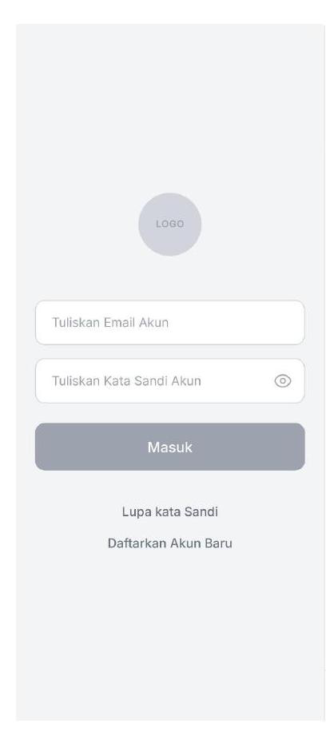
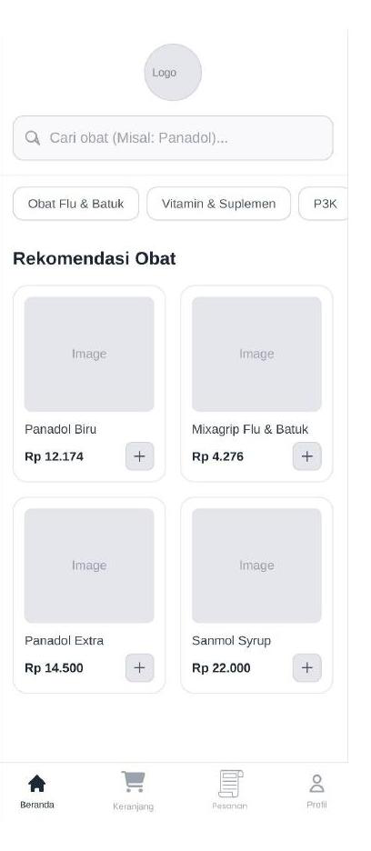
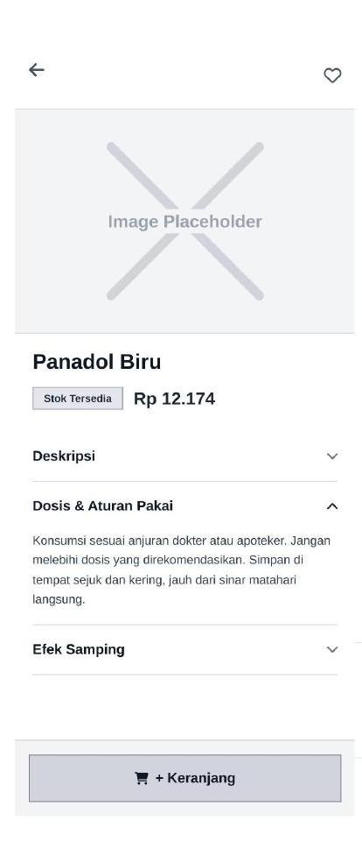
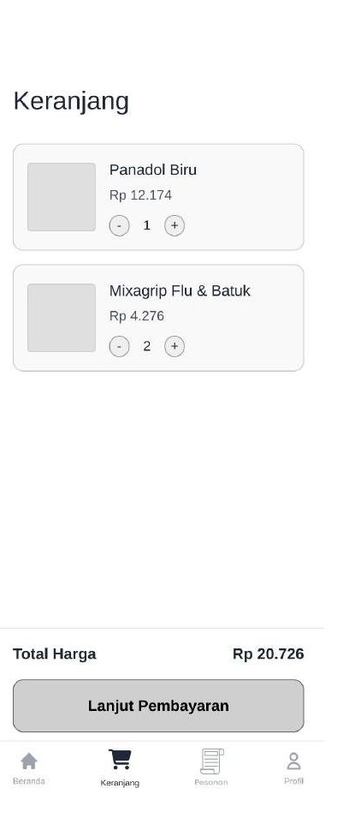
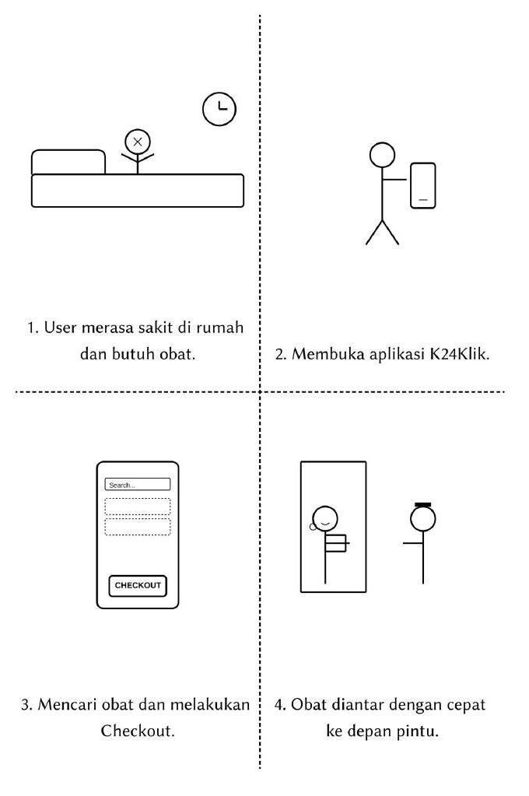
CHAPTER 5.1 — IDEATE PHASE
Lo-Fi Wireframes & Storyboard
Rapid paper sketching (Crazy 8s) produced 8 lo-fi screens, plus a storyboard mapping the “Context of Use” for a sick user.
Storyboard: Context of Use
Login
Home
Product Detail
Cart
Login → Home → Product Detail → Cart → Checkout → Orders → Profile → Favorites — all 8 screens were sketched before moving to Hi-Fi.
Lo-Fi Wireframe & Storyboard files: linked in report Ch.5.1 (Google Drive)
Source: Report Fig. 5.1a–5.1e
12
Notes:
Show the 4 lo-fi screens and storyboard side by side. Emphasize this is the 'Ideate' phase — rapid sketching to lock in the simplified 4-screen MVP flow from the HTA before any visual design happened. Storyboard tells the 'sick user gets medicine fast' story end to end.

Slide 13
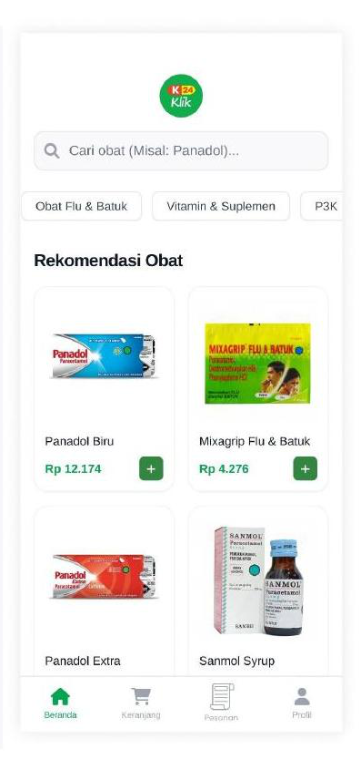
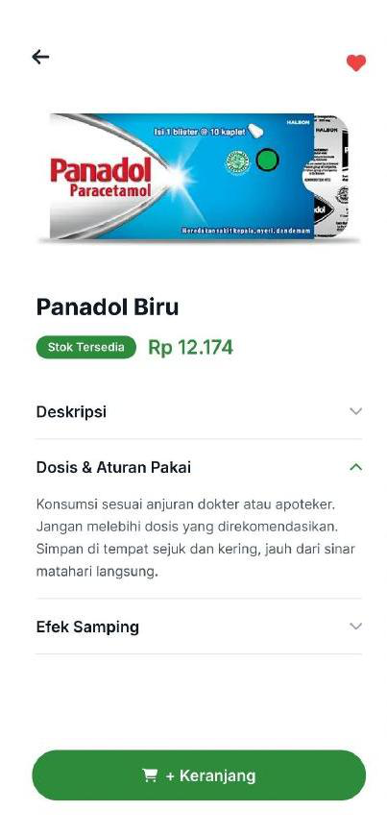


CHAPTER 5.2 — HI-FI PROTOTYPING (FIGMA)
Every Pixel Has a Reason
Visual Ergonomics → Dark Mode
“Mata lelah melihat kontras tinggi terlalu lama” — Dark Mode reduces visual fatigue for late-night medicine searches. (Slide 56)
Physical Ergonomics → Thumb Zone
Core nav & 'Add to Cart' sit in the Thumb Zone; tap targets meet Apple HIG 44×44pt minimum. (Slides 174–175)
Cognitive Ergonomics → Accordions
“Kurangi beban memori & sederhanakan proses” — heavy medical text (Deskripsi, Dosis) hidden in collapsible tabs. (Slide 176)
Nielsen H8 / H3 / H6 / H9
Stripped pop-ups (H8); free browsing without forced login (H3); category chips for recall (H6); polite 'Not Found' empty states & avatar fallback (H9).
Shneiderman — Universal Usability & Closure
EN/ID language toggle for diverse users; “Pesanan Berhasil!” confirmation gives psychological closure after checkout.
Hi-Fi screens replicate K-24 brand colors & typography — strictly checked against Figma in implementation.
Gestalt & CRAP
Identical product card dimensions + Card-style order history (Similarity / Figure-Ground); K-24 Green #2E7D32 on white passes WCAG AA 4.5:1 (Contrast); price details grouped via Proximity in checkout.
Source: Report Ch.5.2, Fig. 5.3a–5.3b
13
Notes:
This is the most theory-dense slide — connect each design choice back to the literature review framework from slide 10. Dark mode = visual ergonomics, thumb zone placement = physical ergonomics, accordions = cognitive ergonomics, then Nielsen / Shneiderman / Gestalt+CRAP cover the remaining decisions. Every item here has a corresponding slide reference in the actual course material (slides 56, 118-120, 174-177).

Slide 14


CHAPTER 5.3 — FEATURE-BY-FEATURE UX REASONING
Walking Through the Final Flow
Each screen in the prototype was designed to streamline one part of the user journey from the HTA.
Authentication Flow
Bottom Navigation Bar
Home (Search & Grid)
Prioritizes Error Prevention — Forgot Password sends a real reset link; Register forces Confirm Password validation.
Anchors the app in the Thumb Zone so users can switch pages safely with one hand.
Category chips give Recognition over Recall; adaptive grid (maxCrossAxisExtent) prevents stretched images on wider screens.
Product Detail Screen
Cart & Checkout
Profile & Settings Hub
Accordions reduce cognitive load for heavy medical text; 'Add to Cart' triggers an instant SnackBar (System Status Visibility).
One scrollable page for Flexibility & Efficiency; ethical warning against entering real card data during simulation.
Adaptive layout — edge-to-edge on mobile, centered on web; fallback avatar logic if a profile image URL breaks.
Source: Report Ch.5.3
14
Notes:
Six features, six UX justifications. This bridges design (previous slide) to implementation (next slide) — these are the screens that became actual Flutter screens in the screens/ folder.

Slide 15



CHAPTER 6.1 — IMPLEMENTATION & DEVELOPMENT
From Figma to a Working Flutter MVP
The Hi-Fi Figma design was translated into a functional, cross-platform MVP using Flutter — chosen so one codebase ships to both Android (APK) and Web.
Flutter
Riverpod
GoRouter
Firebase Auth + Firestore
Flutter Localizations
Frontend Framework
State Management
Declarative Routing
Cloud Backend
Multi-language Engine
Visually identical app for Android & Web from a single codebase — cross-platform consistency.
Safely manages Cart, Dark Mode & Language state — instant UI reaction (e.g. flip dark mode → instant repaint).
Proper URL support for Web (localhost/#/home) and a working hardware Back button on Android.
Real profiles, products & orders prove the ERD schema works — a 'smart application', not a dumb prototype.
Native EN/ID translation with no slow third-party API — supports Universal Usability for all users.
Project structure follows a Feature/Layer-First Architecture: lib/models (ERD: user, product, order), lib/providers (Riverpod logic), lib/screens (UI), lib/l10n (EN/ID translation dictionaries).
Source: Report Ch.6.1, Appendix A (GitHub)
15
Notes:
Five technologies, each with an academic/UX justification — not just 'because it's popular'. Flutter for cross-platform consistency, Riverpod for instant reactive UI (relevant to dark mode demo next), GoRouter for proper web URLs and back-button, Firebase to make the MVP 'real' with a working ERD, and Localizations for the bilingual feature from the survey.

Slide 16
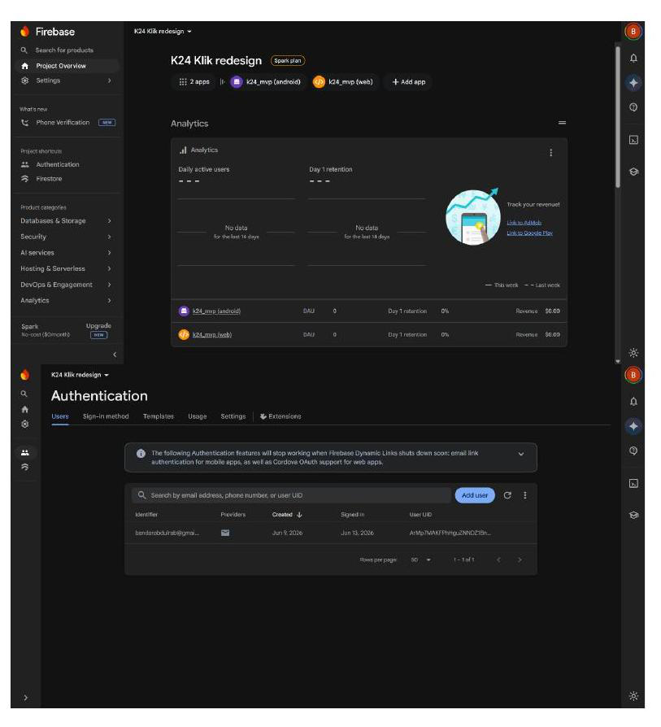
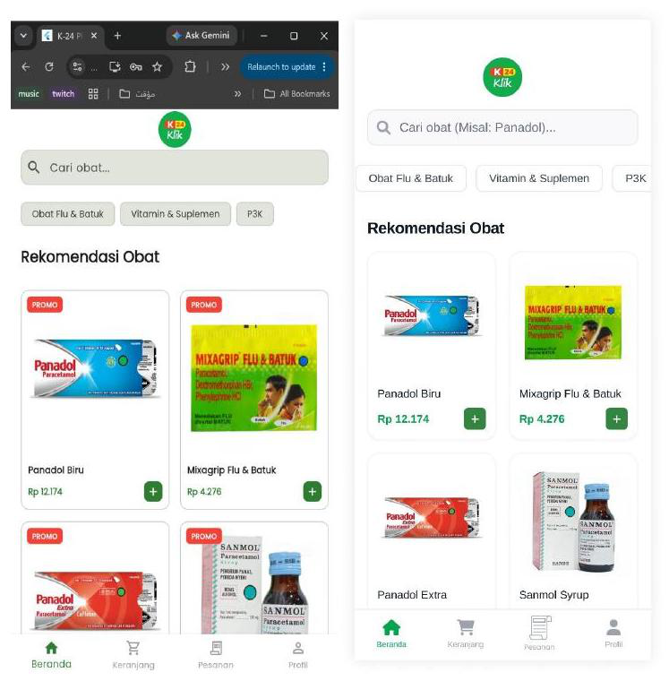
CHAPTER 6.1–6.2 — BACKEND & CONSISTENCY CHECK
A Real Cloud Backend, Verified Against Figma
Firebase Console — Authentication & Firestore Orders collection (live data)
6.2 Consistency Check — Figma prototype (right) vs. Flutter Web implementation (left)
Authentication, Firestore product/order/user collections, and the side-by-side check confirm the Flutter UI replicates the Figma layout, typography, and exact color hex codes.
Source: Report Fig. 6.1a–6.2
16
Notes:
Two proofs of a real, working app: (1) the Firebase console showing actual user authentication and a real order document in Firestore — not mocked data; (2) the side-by-side consistency check proving the Flutter implementation matches the Figma Hi-Fi design pixel-for-pixel in color and layout.

Slide 17
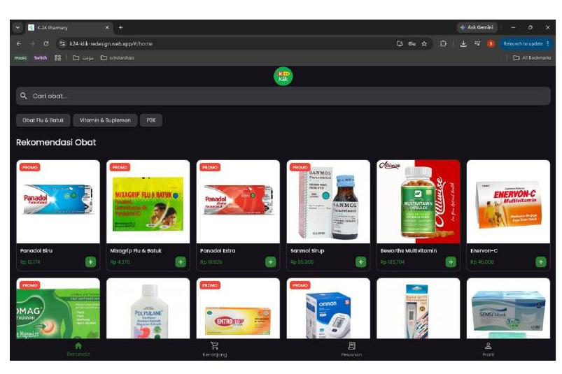
CHAPTER 6.3–6.4 — ADVANCED FEATURES & DATA FLOW
Responsive, Dark-Mode, Cloud-Connected
6.4 The Data Flow
1
Init
App boots → Firebase.initializeApp()
2
Auth
User logs in → auth_provider saves ID into memory
3
Fetch
product_provider queries Firestore → paints Home grid
4
Interact
'Add to Cart' → saved in cart_provider (RAM, instant)
5
Checkout
Confirm → cart + User ID + Total POSTs to Firestore 'orders'
Live Web App — responsive desktop layout, full product grid, Dark Mode
Adaptive Responsive Design: ProfileScreen uses MediaQuery to detect screen width — edge-to-edge on mobile, centered on desktop/web.
Dark Mode: Dynamic toggle reduces eye strain for nighttime medicine searches — directly addresses physiological ergonomic needs.
6
Reset
cart_provider clears; orders_screen live-updates via Firestore listener
Source: Report Ch.6.3–6.4, Fig. 6.3
17
Notes:
Two advanced implementation features tying back to ergonomics theory: responsive adaptive layout (works on web AND mobile) and dark mode (visual ergonomics from slide 13). Then the 6-step data lifecycle shows this is a real, live-updating cloud app — not static mockups.

Slide 18

CHAPTER 7 — EVALUATION & TESTING
78.33 SUS Score — “Acceptable” Usability
Table 7.1 — SUS Score per Respondent (12 real users, Figma prototype)
7.1 Multi-AI Code & Accessibility Testing
The Flutter codebase was fed to Claude 3.5 Sonnet and ChatGPT to check logic flaws, edge cases, and UI accessibility — preventing developer bias.
Result: Contrast ratios stayed above WCAG AA in both Light & Dark modes; Firestore async calls verified to use try-catch for graceful network error handling.
AVERAGE SUS SCORE (12 USERS)
78.33
> 70 = “Acceptable (Good)” — Formula: ((Odd Sum − 5) + (25 − Even Sum)) × 2.5
* R4 & R7 showed “straight-lining” (didn't read reverse-coded items) — retained for data authenticity. Even with these low outliers, the average stays solidly “Acceptable”.
Source: Report Ch.7.1–7.3, Table 7.1
18
Notes:
Two evaluation methods: AI-based code review (multi-model to avoid bias) and SUS survey with 12 real users on the Figma prototype. 78.33 average clears the >70 'Acceptable' threshold from the SUS interpretation scale. Note the two low outliers (R4, R7) are flagged as straight-lining but kept for honesty — and the average still holds up.

Slide 19


CHAPTER 8 — CONCLUSION & FUTURE WORK
From Cluttered to Confident
8.1 Summary
8.2 Future Work
Applying Design Thinking end-to-end — grounded in real data from 32 survey respondents and on-site stakeholder interviews — the three core UX flaws of K24Klik were identified and resolved:
Real-time Maps API for accurate delivery tracking
Visual clutter → minimalist home screen, no aggressive pop-ups
Cognitive overload → collapsible Accordion tabs for medical text
Complex checkout navigation → single-page, early-warning checkout flow
Encrypted Telemedicine consultation feature
Result: a clean, ergonomic, bilingual, cloud-connected Flutter MVP with a highly acceptable SUS score of 78.33.
Deeper A/B testing on the Cart UI to optimize conversion
19
Notes:
Closing slide. Reiterate the three flaws and their fixes, the SUS result, and three concrete future directions. This is a strong slide to end the main narrative on before opening to questions / appendix links.

Slide 20


APPENDIX A — LIVE PROJECT LINKS
Everything Is Live & Verifiable
Every artifact referenced in this presentation — wireframes, prototype, code, and the live app — is publicly accessible.
GitHub Repository (Source Code)
Live Web App (Firebase Hosting)
github.com/BandarAbdulrab/Final-Project-UAS-of-Human-Computer-Interaction-UI-UX-Course
k24-klik-redesign.web.app
Figma Hi-Fi Prototype
Android APK Download
Linked in report Appendix A — “View Hi-Fi Prototype”
Linked via Google Drive — report Appendix A
Code Explanations (docs/)
Surveys & Raw Data
github.com/.../tree/main/docs/Code %26 Software Explanations
Quantitative UX survey + SUS evaluation — forms & Excel data, Ch.3.2 & 7.2
Thank you — questions welcome.
20
Notes:
Final slide — use this to navigate live during Q&A: open the GitHub repo, the live web app, or the Figma prototype as needed if the examiner wants to see the real thing. Every link here is also documented in the report's Appendix A.

