Slide 1



Name of Project
Energy Consumption Trend Analysis

Slide 2

Learning Objectives
Understand the distribution of buildings and energy consumption across urban areas.
Analyze energy cost contribution by type (Gas, Electricity, Water).
Leverage interactive dashboards to derive actionable business insights.
Encourage data-driven decisions for energy efficiency improvements.
GOAL
Source :
www.freepik.com/

Slide 3
Tools and Technology used
Power BI: Data modeling and visualization.
Microsoft Excel: Data preparation and storage.
DAX (Data Analysis Expressions): Creating custom measures and KPIs.
Power Query: Data transformation and cleaning.
Visualization Techniques: Bar chart, pie chart, KPIs, and filters.

Slide 4
Methodology
Imported raw data from Excel into Power BI.
Cleaned and transformed data using Power Query (e.g., handling nulls, standardizing formats).
Created calculated measures (e.g., average Consumptions).
Designed visuals:
Bar charts for city-wise analysis.
KPIs for high-level summaries.
Pie charts for cost distribution by energy type.
Finalized dashboard layout for storytelling and insight presentation.

Slide 5
Problem Statement:
Energy management faces challenges due to:
Dispersed and unorganized consumption data.
Lack of insights on which cities or energy types consume or cost the most.
Difficulty in prioritizing sustainability or cost-cutting efforts without analytics.

Slide 6
Solution:
Centralized visualization platform created in Power BI.
Provided clear KPIs for quick decision-making.
Detailed breakdown by city and energy type.
Visual storytelling to help policy makers and building managers understand trends and outliers.

Slide 7
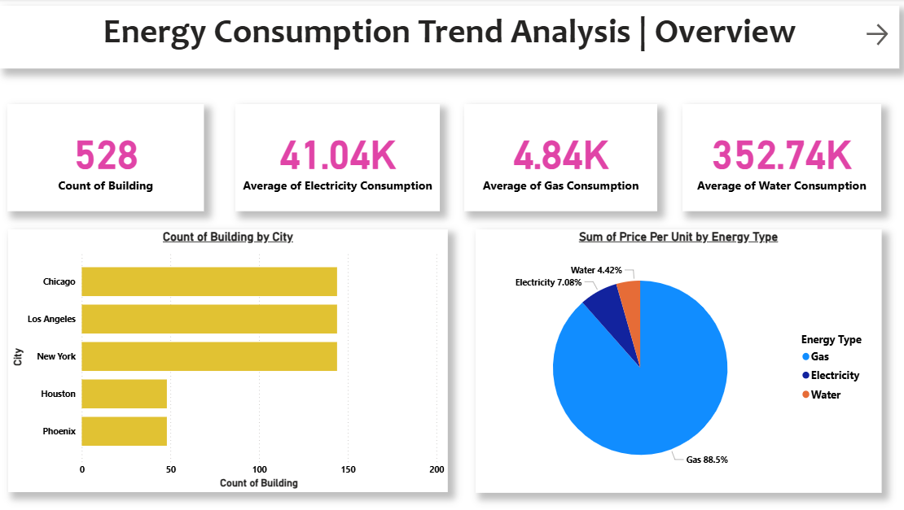
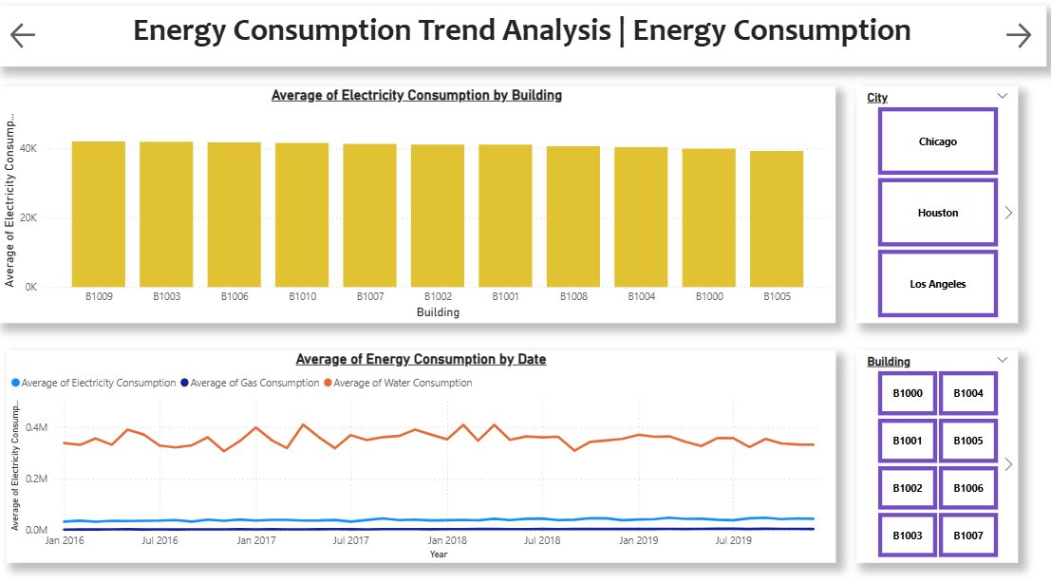
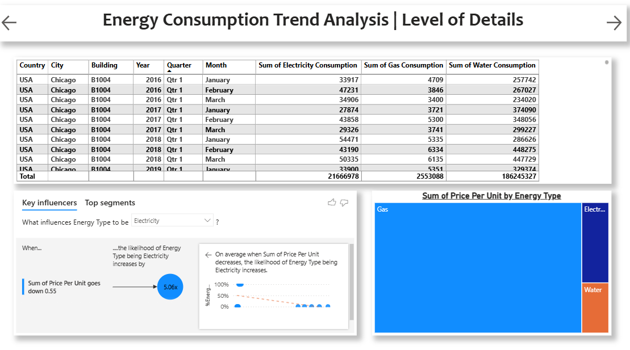
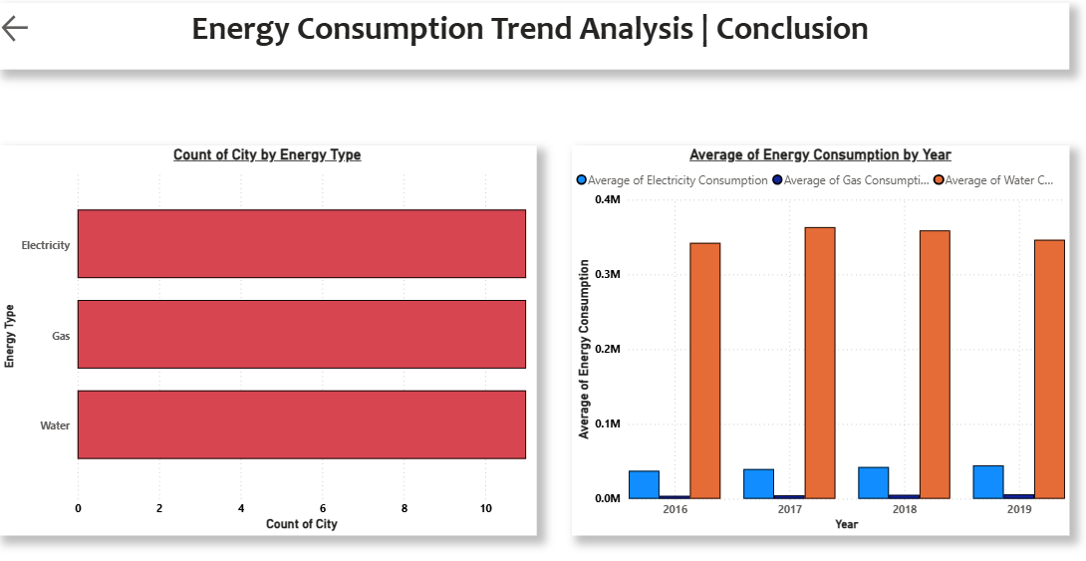
Screenshot of Output:

Slide 8
Conclusion:
Cities like New York, Chicago, and Los Angeles have the highest building counts.
Electricity has the highest average consumption, followed by Water and Gas.
In terms of cost, Gas dominates with 88.5% share—indicating an area of focus for cost control.
The dashboard facilitates efficient monitoring, resource planning, and sustainable energy strategies.

