Slide 1

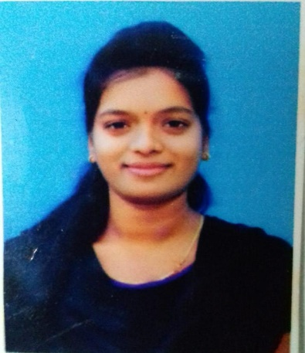



LAVANYA BANDARU
Education and certificates
Bachelor of Technology in Computer Science.
Year of Passing: 2018-2021
Analyst/Software Engineer
Base Location: BANGALORE
Email ID:
bandaru.lavanya@capgemini.com
Skills
SQL
Basic of python
Operating System
_{Mobile No: 9676686614}
Grade:
A4
Database
SQL database – MySQL
Strengths
I can implement my Theoretical, Logical, Technical skills in the practical real-life environment with committed & dedicated people, which will help me to explore myself fully and realize my potential.
Willing to work as a key player in challenging & creative environment. Also, to secure a responsible career opportunity to fully utilize my training and skills, while making a significant contribution to the success of the company.
Ready to learn new technologies and implement them to further improve my knowledge.
Eager to work in a team of dedicated people and serve a key role in the enhancement and development of the project.
Achievements
Web Technologies
HTML, CSS
Achieved certificate of excellence in oracle from course era.
Achieved certificate of excellence for JDA software in my training period.
Additional Details
Quick Learner
Time management
Disciplined and Responsible
Add-ons
GitHub
Completed training in COTS Package Training, Bangalore.
POS
JDA Software
Certifications
Certified AWS CCP Level-1
.
Additional Details
Excellent Communication Skills
Team Player
Areas of Interest
Interested in Coding technologies.
Career development in Cloud.
Presentation Title | Author | Date © Capgemini 2017. All rights reserved | 1
https://github.com/Bandaru11/resume

