Slide 1

Fake News Detection in Social Media
R.V.R & J.C COLLEGE OF ENGINEERING
Presented by:-
B.Likhith Sai(Y23CD014)
B.Harsha Vardan(Y23CD019)
D.Venkata Sai(Y23CD048)
Guide Name:
Mr Rallabandi Ch S N P Sairam
Assistant professor

Slide 2
Problem Statement
The project aims to develop a machine learning system to detect fake news by identifying unreliable news sources.
The model evaluates multiple articles from the same source to determine whether the source produces fake news.
Once a source is classified as a fake news producer, future articles from that source can be predicted as fake with high confidence.
A source-based approach improves tolerance to individual article misclassification by leveraging multiple data points per source.
The model is intended for use in social media platforms to assign visibility weights to news content.
News stories identified as highly likely to be fake can be made less visible, helping reduce the spread of misinformation.

Slide 3
Existing System
Fake news detection research already existed.
Traditional methods mainly relied on manual fact-checking or rule-based systems.
Some machine learning approaches were available but were not easily accessible to users.
Most existing systems were offline, not designed for real-time usage.
Users had no simple interface to verify news instantly.

Slide 4
Proposed System
Fake news detection existed earlier in research form, but we developed a real-time, ML-based fake news detection system with a user-friendly web interface using the Passive Aggressive Classifier.

Slide 5
Project scope
The system is intended for social-media–like news flow, but our detection is focused on news articles and textual posts, not raw social media streams
Real-time social media data is very large and dynamic. In our mini project, We trained the model on a standard fake news dataset, and the trained model can be used as a filtering tools for social media platforms

Slide 6
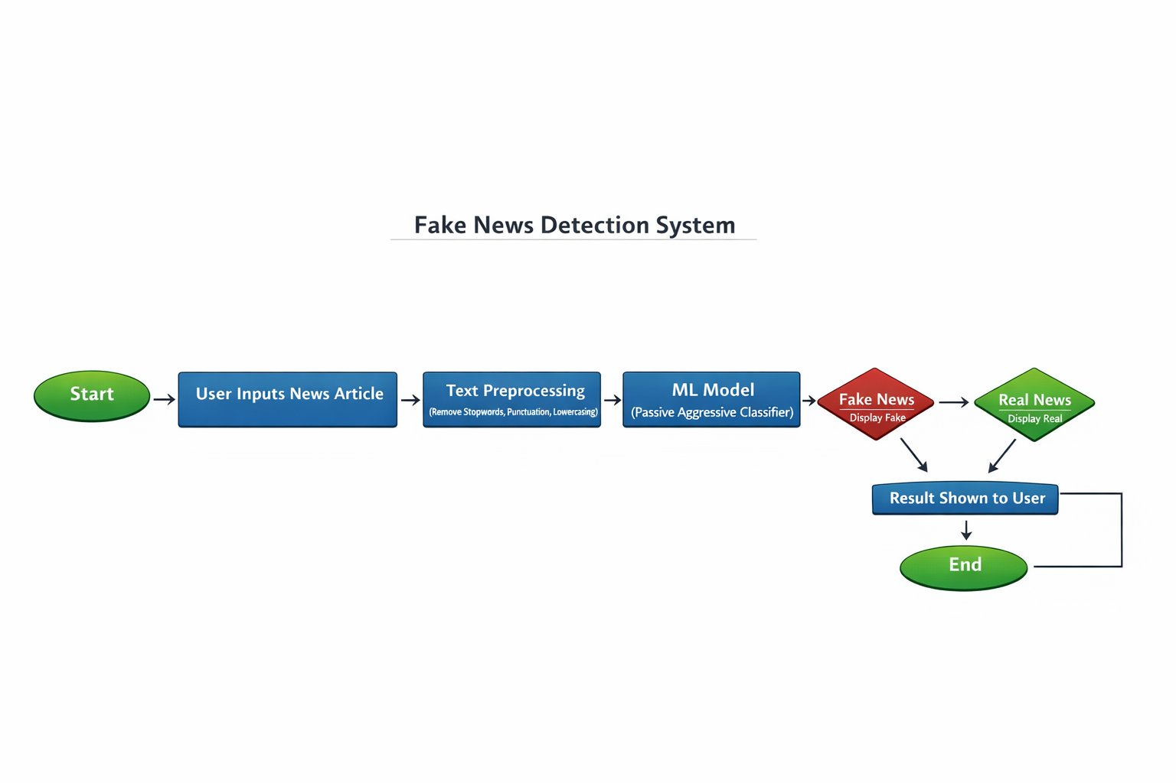
Model diagram

Slide 7
Technologies
Frontend (User Interface)
HTML, CSS
Programming Language
Python
Data Handling & Analysis
Pandas
NumPy
Development Tools
Git & GitHub

Slide 8
Thank You

