Slide 1
Hands‑Free Mouse Control System
Empowering People Without Hands
Ram Chandhar Muddam, Srivigna Bandela, Naga Ashrith Vollala,
Sukrutha Budda, Yashas Chandra Pendem
Data Science Project – April 2026

Slide 2
Problem Statement & Motivation
Core Problem: People with upper limb disabilities cannot use a mouse/keyboard.
Background: Millions face digital exclusion; existing solutions cost $500–$5000.
Why it matters: A low-cost webcam alternative can restore independence, communication, and the ability to call for help.

Slide 3
Project Objectives
Primary: Build real-time hands-free mouse control using only a webcam.
Secondary:
Quick action buttons (hungry, thirsty, help) with voice feedback
Emergency email alert with attached usage log
Log every user action (timestamp, action, details) to Excel

Slide 4
Agenda
1. The Challenge & Our Solution
2. System Architecture & Gestures
3. Gesture Detection Methods (Feature Engineering)
4. User Interface & Quick Actions
5. Logging & Emergency Alert
6. Results & Performance
7. Impact for Disabled Users
8. Future Work & Conclusion

Slide 5
System Architecture
Webcam → MediaPipe (Face & Hand Landmarks) → Gesture Recognition → Actions
• Two-file design: controller.py (background thread) + Eyetrack.py (GUI)
• States: IDLE → STARTING (countdown) → ACTIVE
• Outputs: PyAutoGUI mouse, pyttsx3 voice, Excel logging, email alerts

Slide 6
Gesture Vocabulary
Mouse movement: Nose tip (laser pointer)
Click: Close both eyes ≥2 seconds (progress bar)
Start: Nod 3 times OR open hand
Stop: Head left→right→left OR fist
On-screen keyboard: Both hands fully open
Quick actions: Hover + blink → speak phrase 3 times

Slide 7
Gesture Detection Methods
Eye Aspect Ratio (EAR) for blink detection
→ EAR = (vertical distances) / (2×horizontal distance)
→ Threshold = 0.20; ignore very short/long blinks
Nod detection: vertical nose movement >15 px (state machine)
Left-right-left: horizontal nose movement >20 px
Finger counting: thumb vs. pip, other fingertips vs. pips

Slide 8
User Interface & Quick Actions
Full-screen GUI (1280×800) with live video (50% width)
Buttons: Start, Stop, Keyboard, Emergency (red), Exit
Sliders: Mouse smoothing, click duration
Quick actions: Hungry, Thirsty, Help, Emergency, Take me out, Water, Bathroom, Pain, I need attention
Status bar + voice feedback for every action

Slide 9
Logging & Emergency Alert
Every action logged to trackingdetails.xlsx:
→ Timestamp, Action, Details (e.g., 'Clicked: hungry via quick action')
Emergency button:
→ Sends email to caregiver with subject '🚨 EMERGENCY ALERT'
→ Attaches the Excel log file automatically
→ Voice says 'Emergency email sent' + popup confirmation

Slide 10
Results & Performance
Test environment: Windows 11, Intel i5, 8GB RAM, webcam (30 fps)
Accuracy (50 trials per gesture):
• Nose mouse tracking: 100% responsiveness
• Nod detection: 94% success
• Eye closure click: 92% (false positives reduced)
• Hand gestures: 88% (lighting dependent)
• Quick action triggers: 96%
Latency: <100 ms from gesture to action

Slide 11
Impact for Disabled Users
For users:
→ Complete hands-free computer access for under $50
→ Independence: write emails, browse, call for help
→ Quick action buttons reduce frustration for basic needs
For caregivers/institutions:
→ Logging provides actionable data (e.g., emergency trends)
→ Low maintenance, no calibration needed per user

Slide 12
Limitations & Future Work
Current limitations:
→ Requires decent lighting for hand detection
→ Eye closure may be difficult for some users
→ Gesture sensitivity needs manual tuning
Future enhancements:
→ Voice commands (speech recognition)
→ Eye gaze tracking for users who cannot move head
→ Calibration wizard to auto-learn user's range
→ Mobile app version (Android/iOS)
→ Caregiver dashboard (web) for real-time logs

Slide 13
Conclusion
We built a low-cost, real-time, hands‑free mouse control system using only a standard webcam.
Key achievements:
→ 8 gesture types, 9 quick actions, emergency email with log
→ Voice feedback and popups for every action
→ Modular, maintainable code (controller, GUI, logger, email modules)
Next step: Deploy in a real rehabilitation center for field testing.
Thank you! Questions?

Slide 14
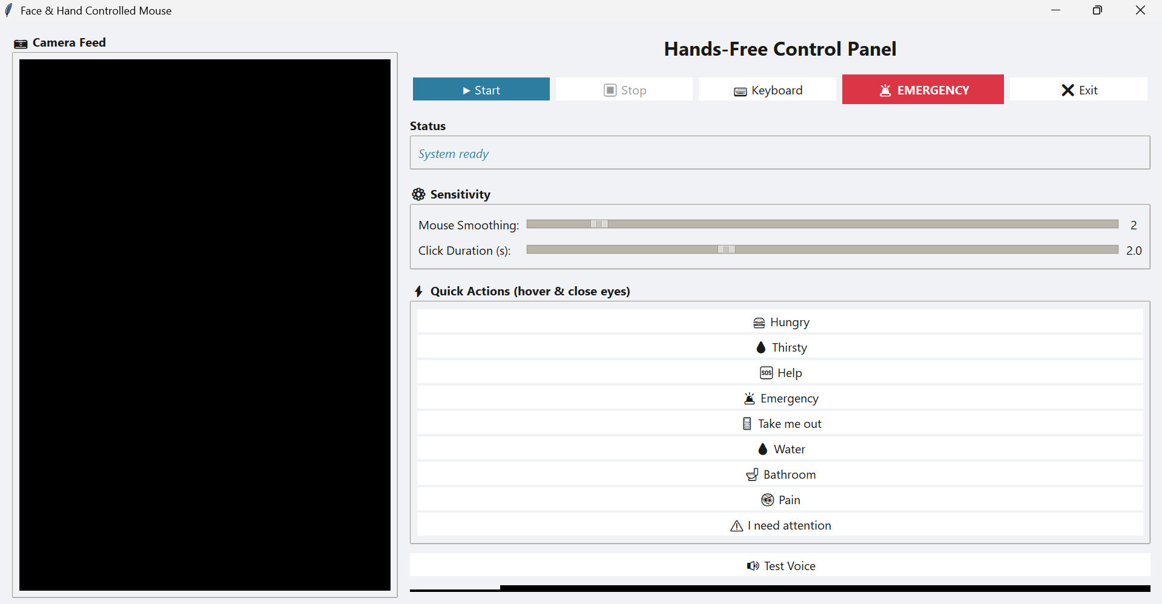
Output Screenshots

