Slide 1
Project 1: Covid and the Stock Market
Alejandro Velez
Andrew Martinez
Frank Yu
Scott Cerny

Slide 2
Summary
Our project is to see how the stock market was affected by the global pandemic. Here are the questions we will be attempting to answer:
For the 11 stock market sectors (Energy, Materials, Industrials, Utilities, Healthcare, Financials, Consumer Discretionary, Consumer Staples, Information Technology, Communication Services, Real Estate), which ones benefitted from the pandemic?
Can we predict the market for the next three weeks using logistical regression?
How did the stock market perform in correlation to covid deaths?
Using a word cloud, can we correlate positive news articles to stock market gains?
Sources: Yahoo NinjaTrader New York Times API Johns Hopkins CSSEGISandData

Slide 3
Question 1: Which of the 11 stock market sectors benefitted from the pandemic?
Place Text Here

Slide 4
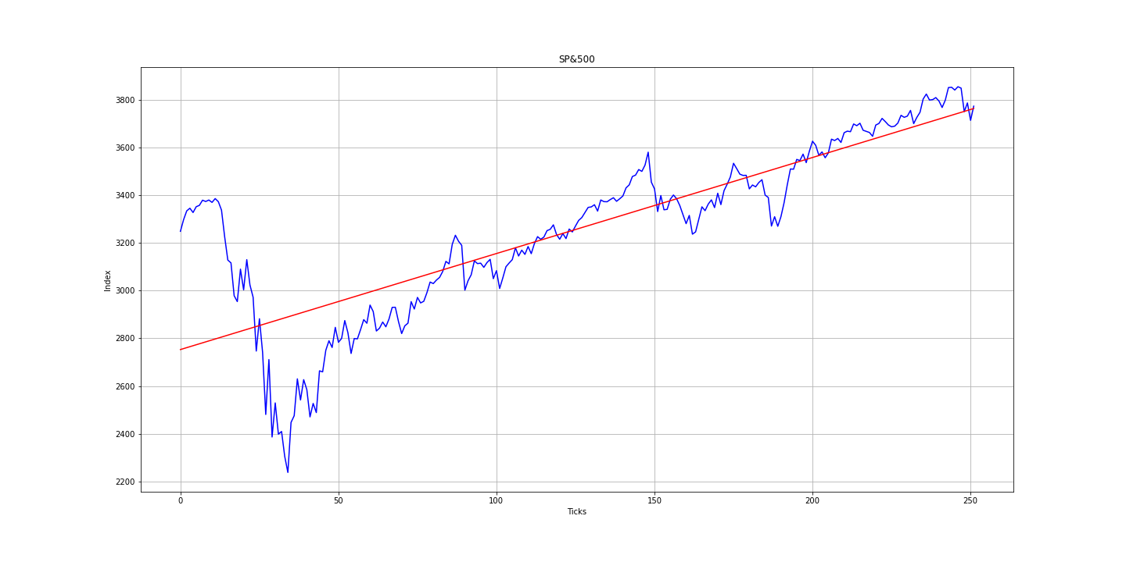
Question 2: Can we predict the market for the next three weeks using Linear Regression or Polynomial Regression?
Although we have a prediction value as shown, what would another large drop have done to our trendline?
The accuracy for this type of model is 63%.
If we started making our prediction after the dip/March-2020 then our prediction would be more accurate.

Slide 5
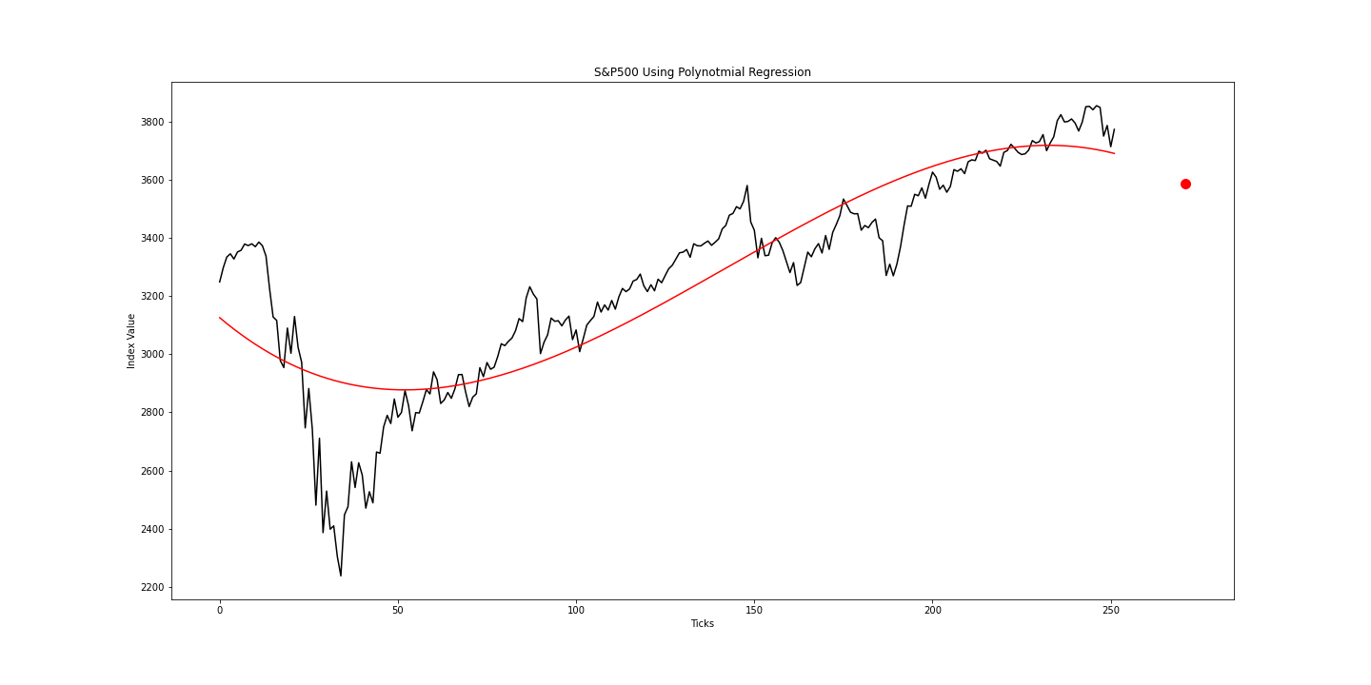

Polynomial regression
What is Polynomial Regression?
Degrees set to 3 in this model.
The accuracy using Polynomial Regression is 78% compared to the 63% from linear regression

Slide 6
Conclusion: polynomial Regression provides a more accurate prediction than linear regression but there are better machine learning models for predicting time-series data such as LSTM(Long Short Term Memory)

Slide 7
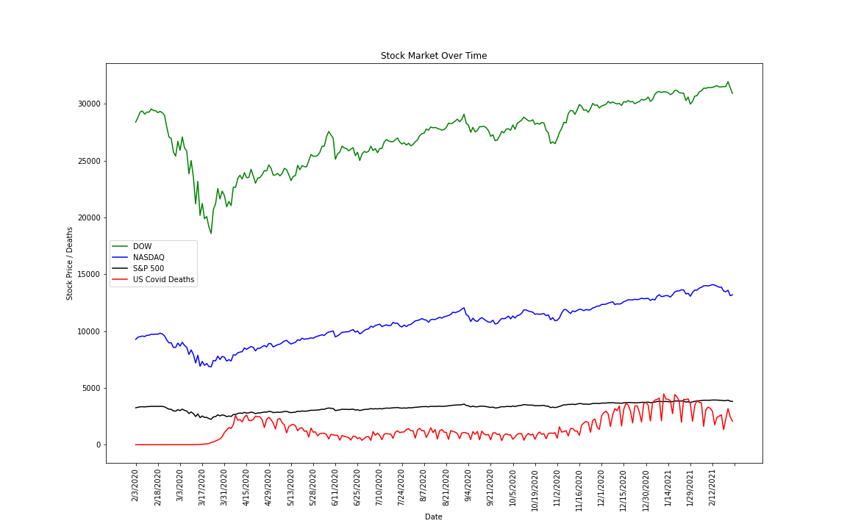
Question 3: How did the stock market perform in correlation to covid deaths?
For US Covid Death Data:
The correlation between NASDAQ and US Covid Deaths is 0.59
The correlation between the S&P 500 and US Covid Deaths is 0.52
The correlation between the DOW and US Covid Deaths is 0.45

Slide 8
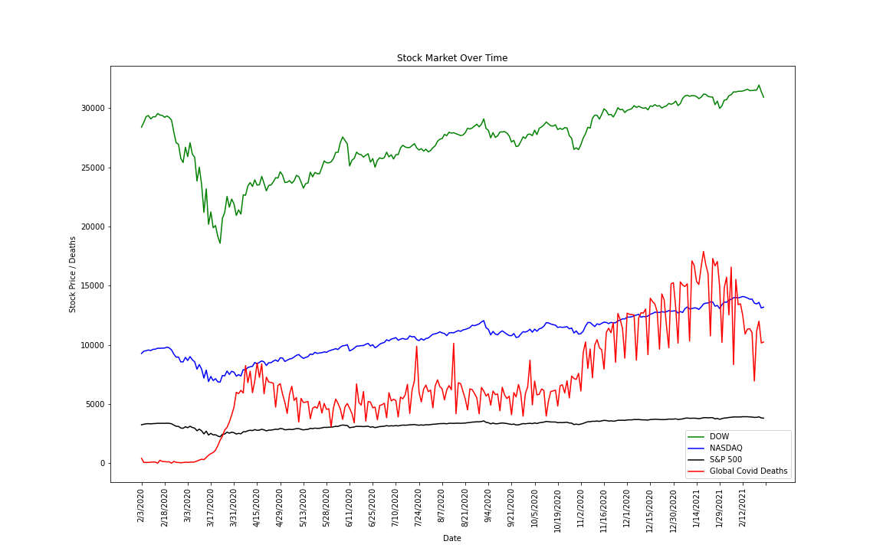
Question 3: How did the stock market perform in correlation to covid deaths?
For Global Covid Death Data:
The correlation between NASDAQ and Global Covid Deaths is 0.77
The correlation between the S&P 500 and Global Covid Deaths is 0.69
The correlation between the DOW and US Global Deaths is 0.61

Slide 9
Question 3: How did the stock market perform in correlation to covid deaths?
Conclusion:
Initially, I was expecting a greater correlation between the number of covid deaths and the stock market. I was expecting that the greater the number of deaths, the lower the stock market would be.
Using US only covid data at first, I noticed that at the very beginning of the pandemic, the stock market did start to drop right away, however it dropped the most before US deaths really started. This drop in the stock market in the first month not as closely tied to actual death numbers as I assumed it would be.
Since the US was not the first country to have covid exposure, I decided to go back and run the numbers again using global covid death data. This did show a closer correlation for about the first month than using just US data did.
However, in late March 2020 as the deaths continued to climb, the stock market started to go back up. The stock market continued to basically go up from that time forward regardless of the covid death counts. During the big global covid death spike that started around November 2020 and continued into January 2021, the stock market actually went up consistently (which is the opposite of what happened at the beginning of the pandemic).
My final conclusion is that other than the initial onset of the global pandemic, the number of covid deaths did not affect the stock market in a major way.

Slide 10
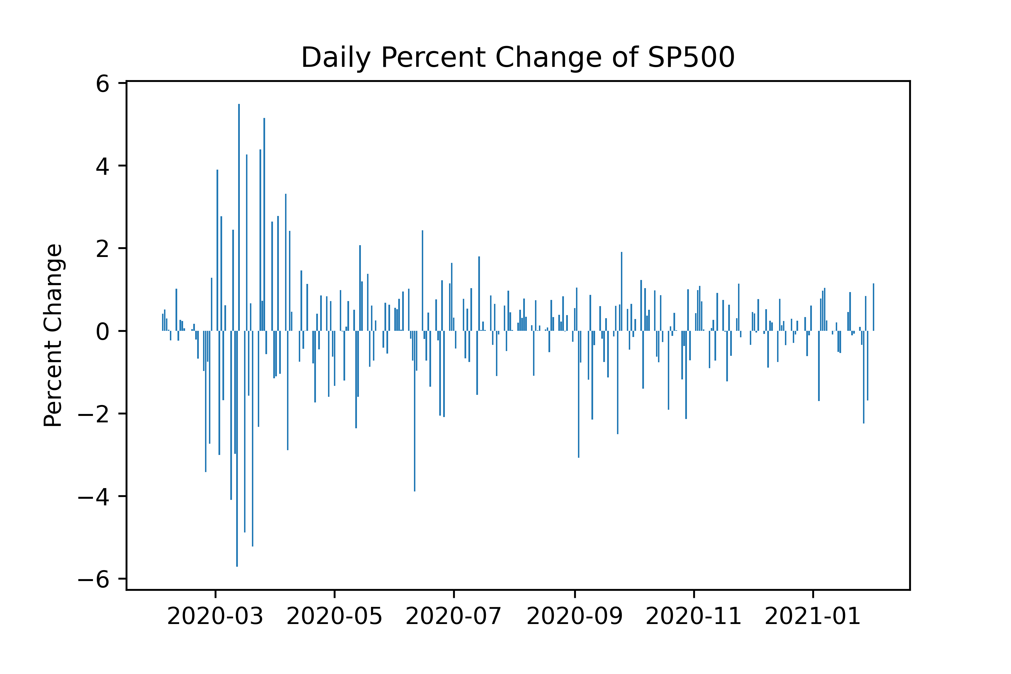
Question 4: wordcloud from articles during significant market drops
Brief look at the Daily Percent Change of S&P500
Significant Volatility during the initial COVID Period

Slide 11
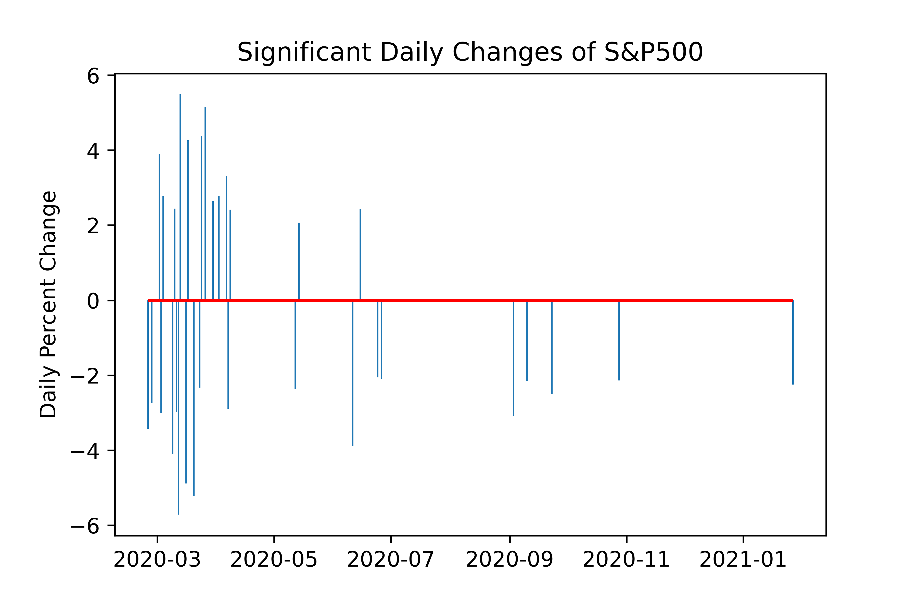
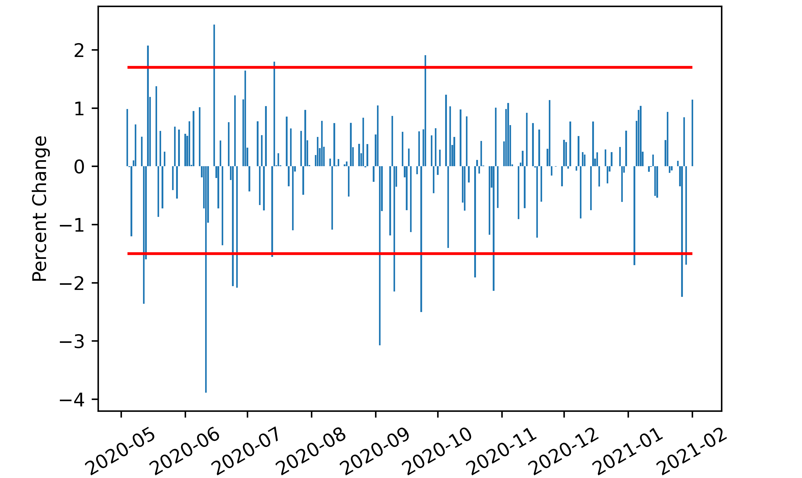
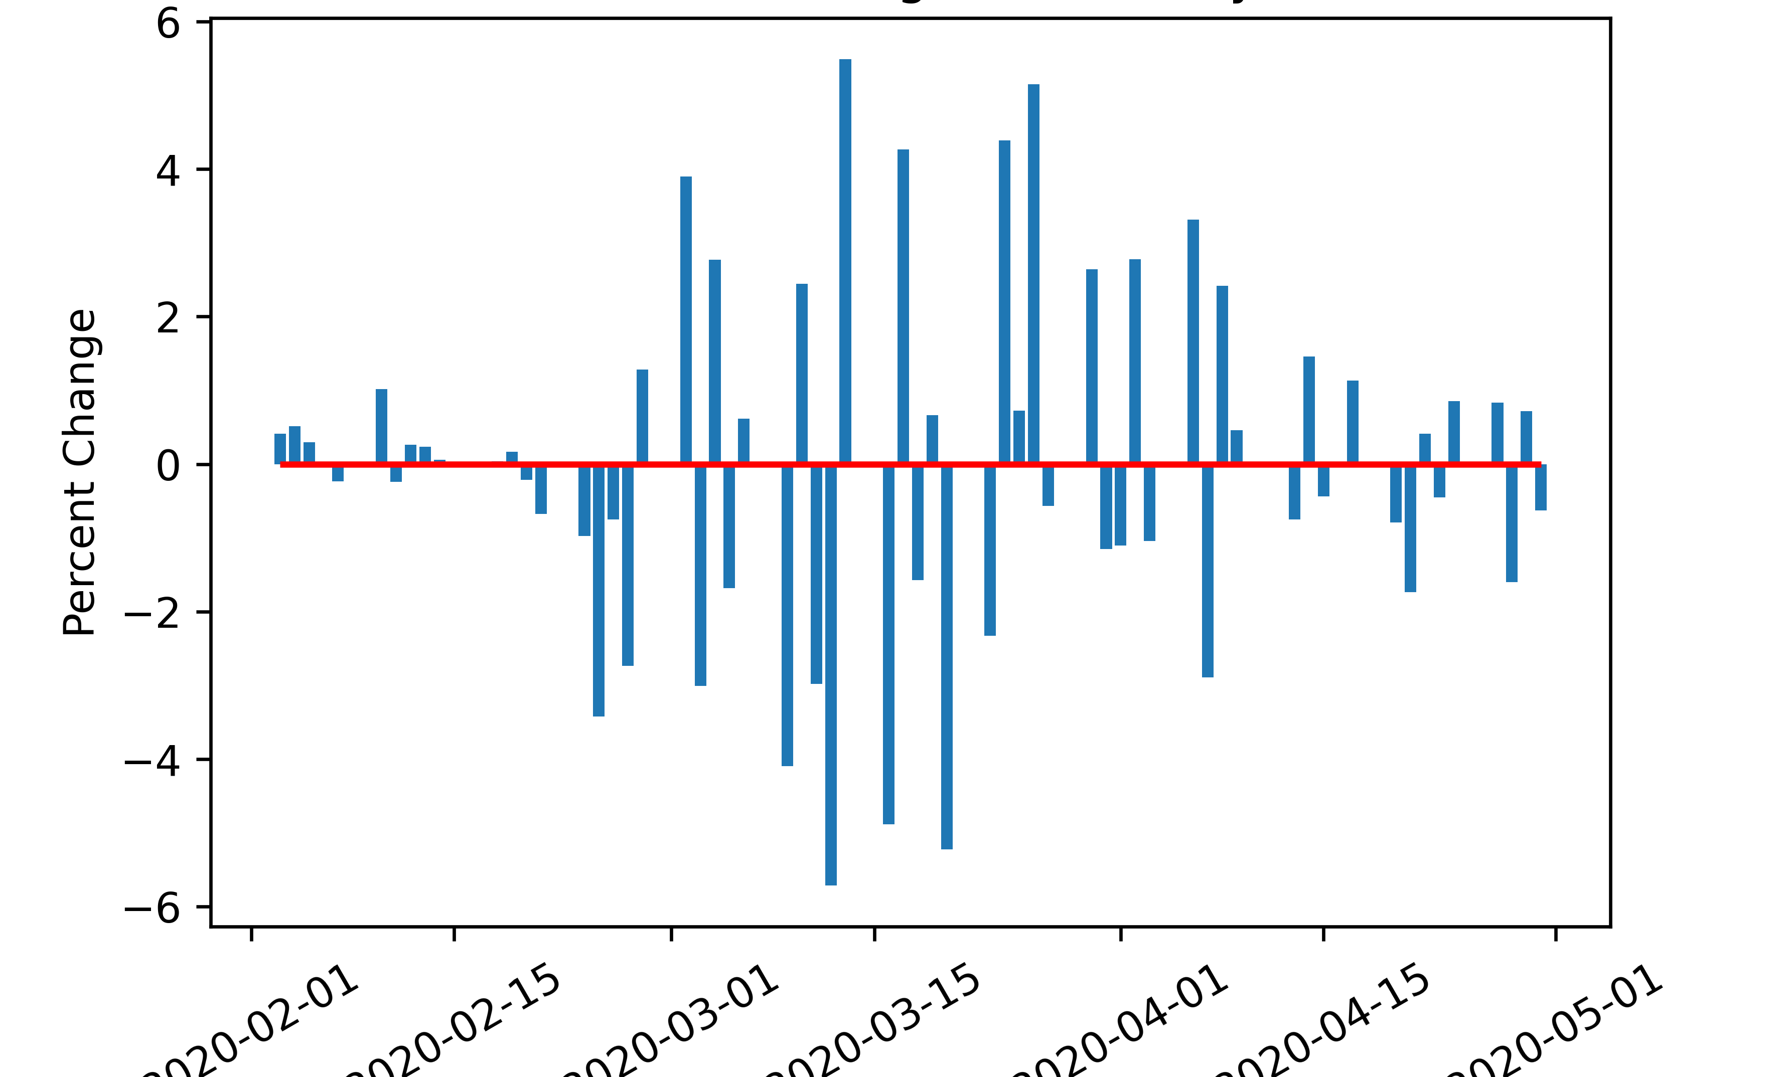
Daily Percent Change After May
Daily Percent Change Before May
The market has much greater volatility before May
The outlier Upper Bound is 1.70, and Lower Bound is -1.50 after May.
The outlier Upper Bound is 2.79, and Lower Bound is -3.03 before May

Slide 12

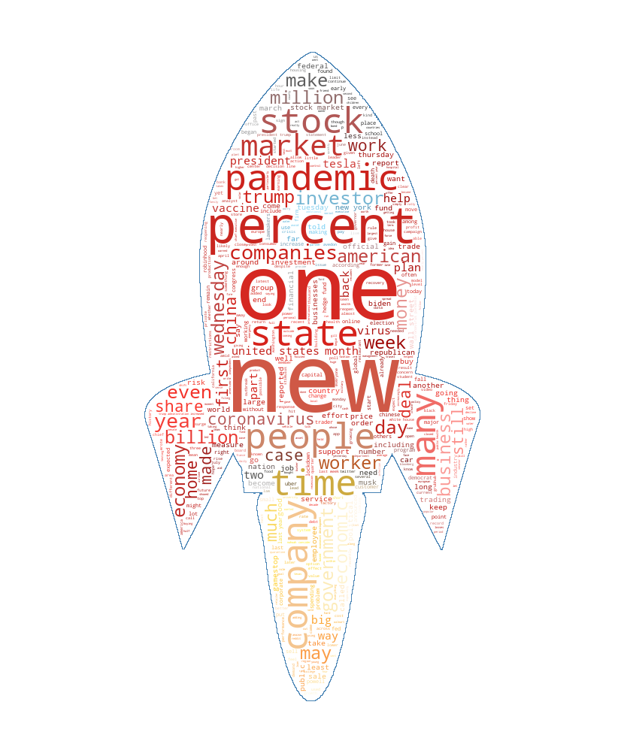
SO WHAT WAS THE SENTIMENT DURING SIGNIFICNAT DROP BEFORE AND AFTER MAY?
Before MAY
After MAY

Slide 13
Questions?

Slide 14
Template
Place Text Here

