Slide 1
Project 1: Covid and the Stock Market
Alejandro Velez
Andrew Martinez
Frank Yu
Scott Cerny

Slide 2
Summary
Our project is to see how the stock market was affected by the global pandemic. Here are the questions we will be attempting to answer:
For the 11 stock market sectors (Energy, Materials, Industrials, Utilities, Healthcare, Financials, Consumer Discretionary, Consumer Staples, Information Technology, Communication Services, Real Estate), which ones benefitted from the pandemic?
Can we predict the market for the next three weeks using logistical regression?
How did the stock market perform in correlation to covid deaths?
Using a word cloud, can we correlate positive news articles to stock market gains?
Sources: Yahoo NinjaTrader New York Times API Johns Hopkins CSSEGISandData

Slide 3
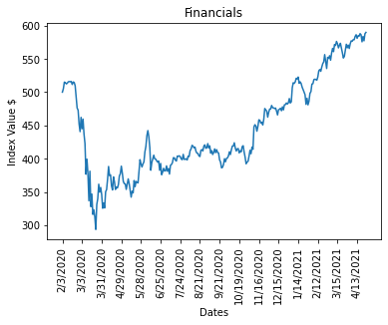
Question 1: Which of the 11 stock market sectors benefitted from the pandemic?
With the large finical crisis that occurred during the pandemic, we we’re wondering
Did the pandemic effect each stock market sector equally?
Did any sectors benefit from the pandemic?

Slide 4
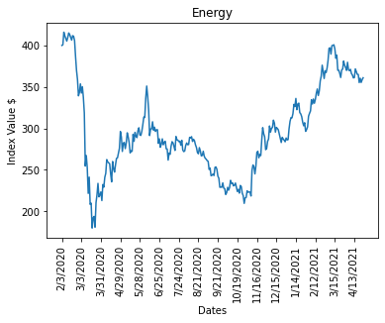
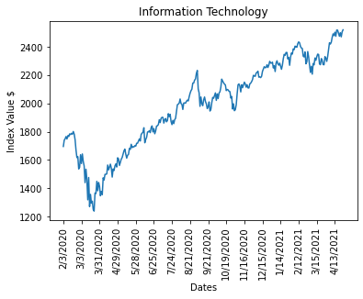
After constructing the graphs and analyzing the data. None of the sectors had seemed to have benefited from the pandemic.
It’s interesting to note, that almost every single sector not only recovered from the plunge, but actually gained in value as the pandemic has dragged except for the Energy and Utilities sectors.
Some sectors doubled in Value over the course of the pandemic such as IT, Materials, and Communication services..

Slide 5
Conclusion
No sector directly benefited from pandemic. How due to new economic demands made by the pandemic, certain sectors experienced massive growth as the year passed.

Slide 6
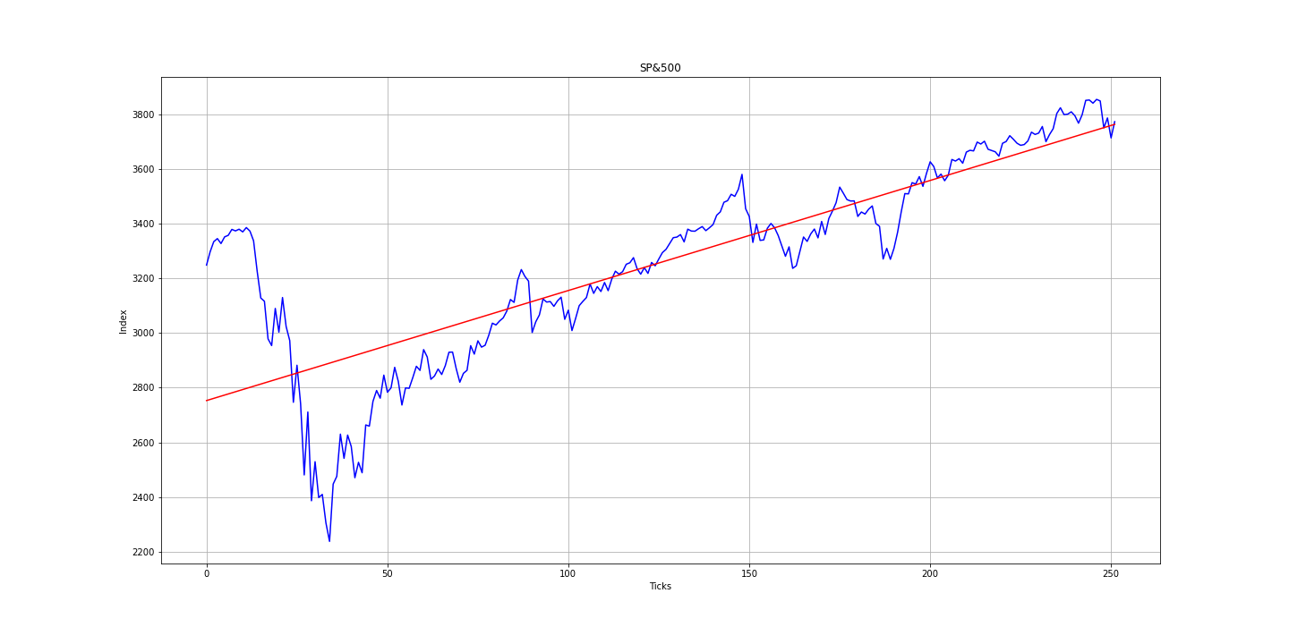
Question 2: Can we predict the market for the next three weeks using Linear Regression or Polynomial Regression?
Although we have a prediction value as shown, what would another large drop have done to our trendline?
The accuracy for this type of model is 63%.
If we started making our prediction after the dip/March-2020 then our prediction would be more accurate.

Slide 7
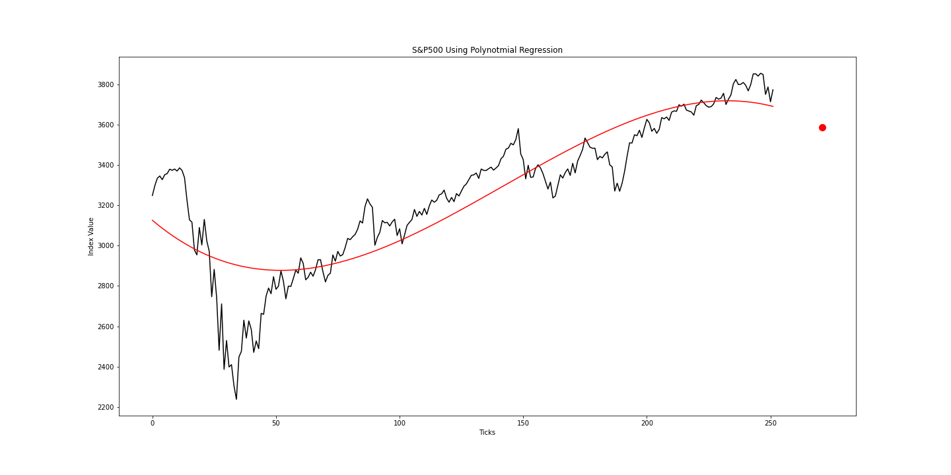

Polynomial regression
What is Polynomial Regression?
Degrees set to 3 in this model.
The accuracy using Polynomial Regression is 78% compared to the 63% from linear regression

Slide 8
Conclusion: polynomial Regression provides a more accurate prediction than linear regression but there are better machine learning models for predicting time-series data such as LSTM(Long Short Term Memory)

Slide 9
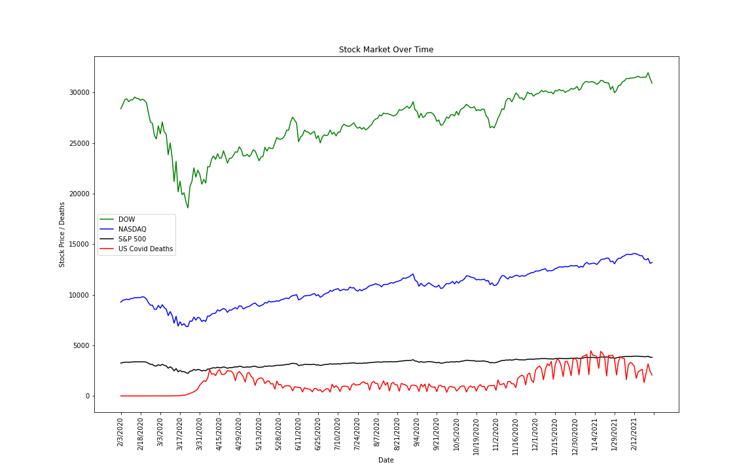
Question 3: How did the stock market perform in correlation to covid deaths?
For US Covid Death Data:
The correlation between daily NASDAQ change and US Covid Deaths is -0.01.
The correlation between daily S&P 500 change and US Covid Deaths is -0.04.
The correlation between daily DOW change and US Covid Deaths is -0.04.

Slide 10
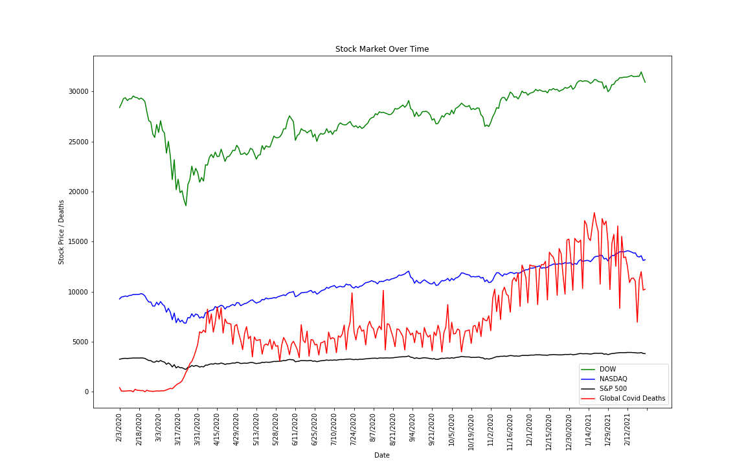
Question 3: How did the stock market perform in correlation to covid deaths?
For Global Covid Death Data:
The correlation between daily NASDAQ change and Global Covid Deaths is 0.01.
The correlation between daily S&P 500 change and Global Covid Deaths is -0.05.
The correlation between daily DOW change and US Global Deaths is -0.05

Slide 11
Question 3: How did the stock market perform in correlation to covid deaths?
Question:
Did the daily number of covid deaths correlate with the daily performance of the stock market?
Analysis:
Initially the assumption was that there would be some correlation between a greater number of covid deaths and a lower stock market performance.
Comparing the US covid death data and the stock market showed that there was almost no correlation. The stock marked start to drop in the beginning, but almost all of this drop was before the US deaths started.
Since the US was not the first country to have covid exposure, the next step was to compare global covid deaths with stock market performance. The global data did show more of a correlation for about the first month of the pandemic. However, from that point forward the stock market generally went up regardless of higher or lower global covid deaths. There was a spike in global deaths from November 2020 through January 2021, but the stock market continued to go up during that period (which is the opposite of what was seen in the first month of the pandemic).
Conclusion:
Over the first year of the pandemic, it does not appear that there was a direct correlation, with the possible exception of the first month in which there was a slight negative correlation (NASDAQ -0.13, S&P 500 -0.17, DOW -0.17).

Slide 12
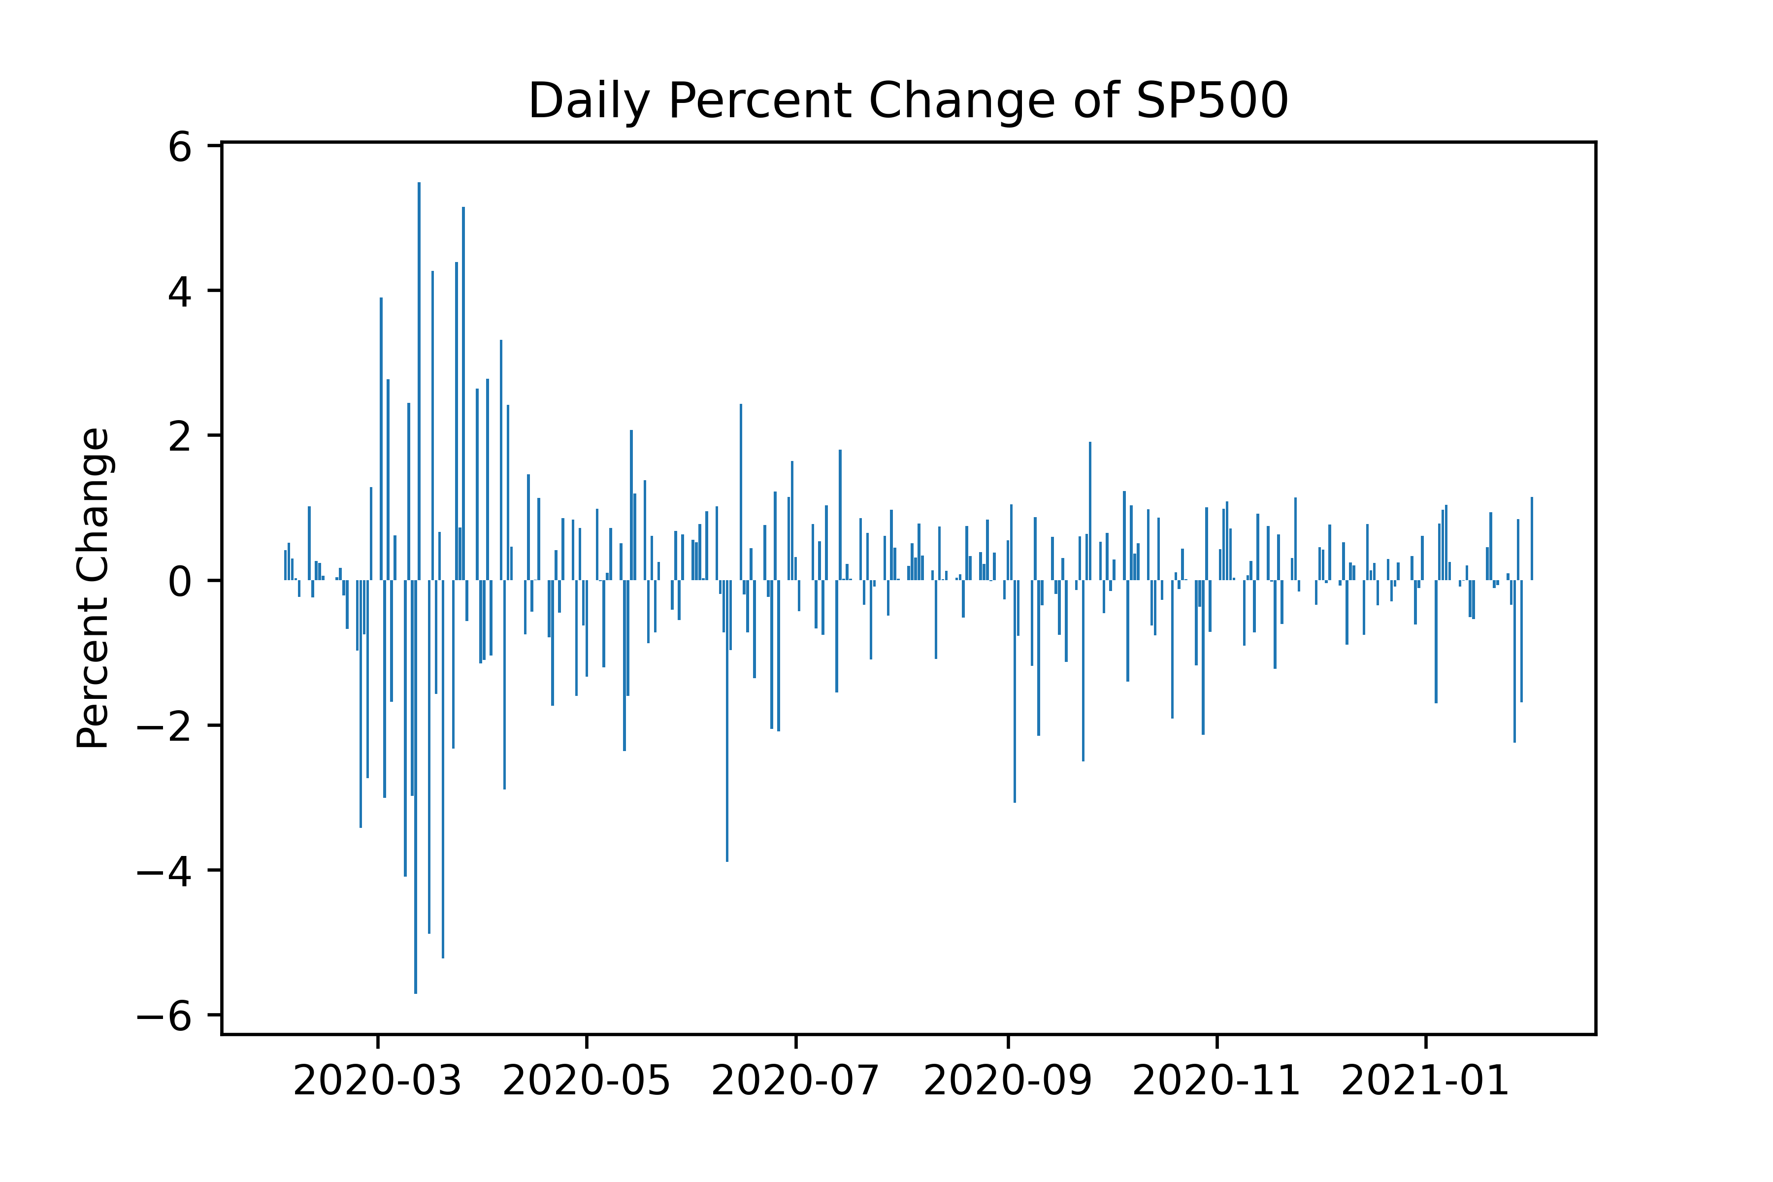
Question 4: wordcloud from articles during significant market drops
Brief look at the Daily Percent Change of S&P500
Significant Volatility during the initial COVID Period

Slide 13
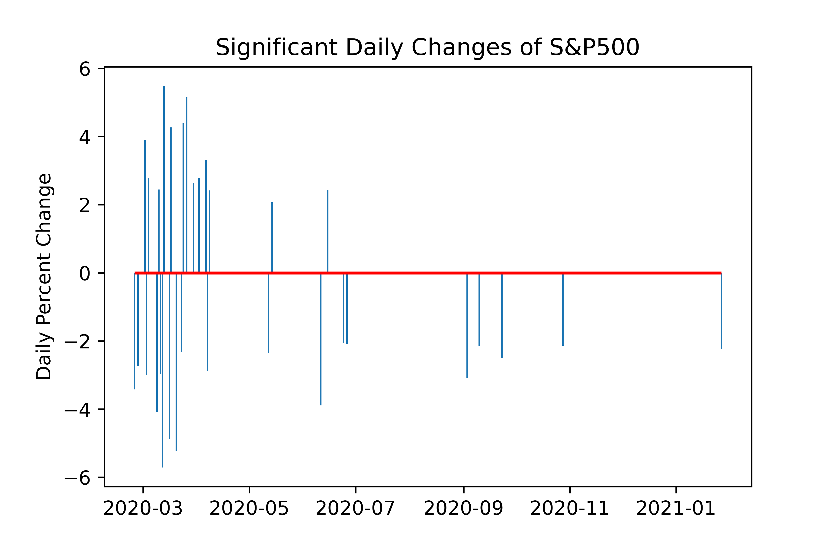
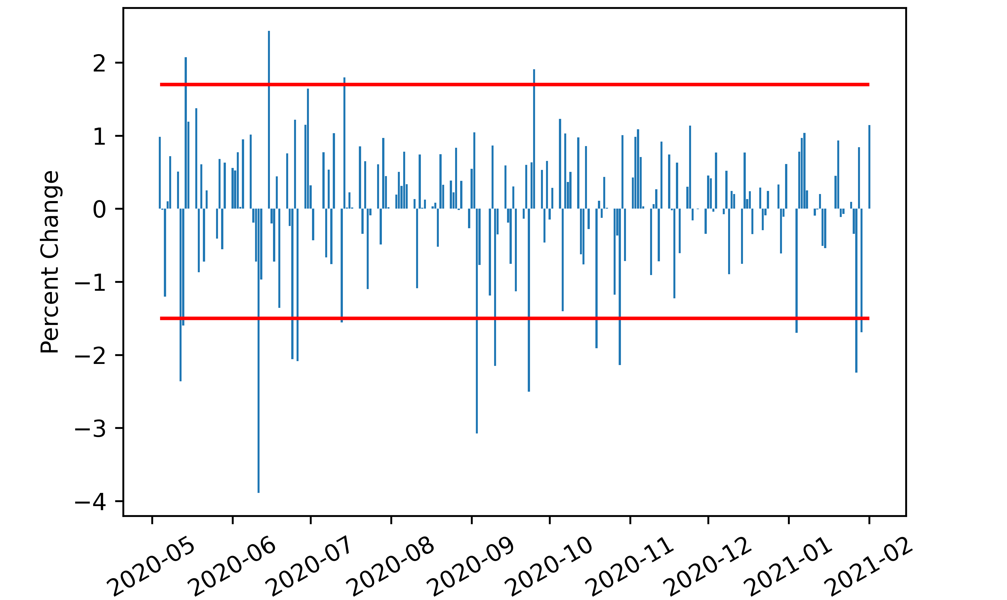
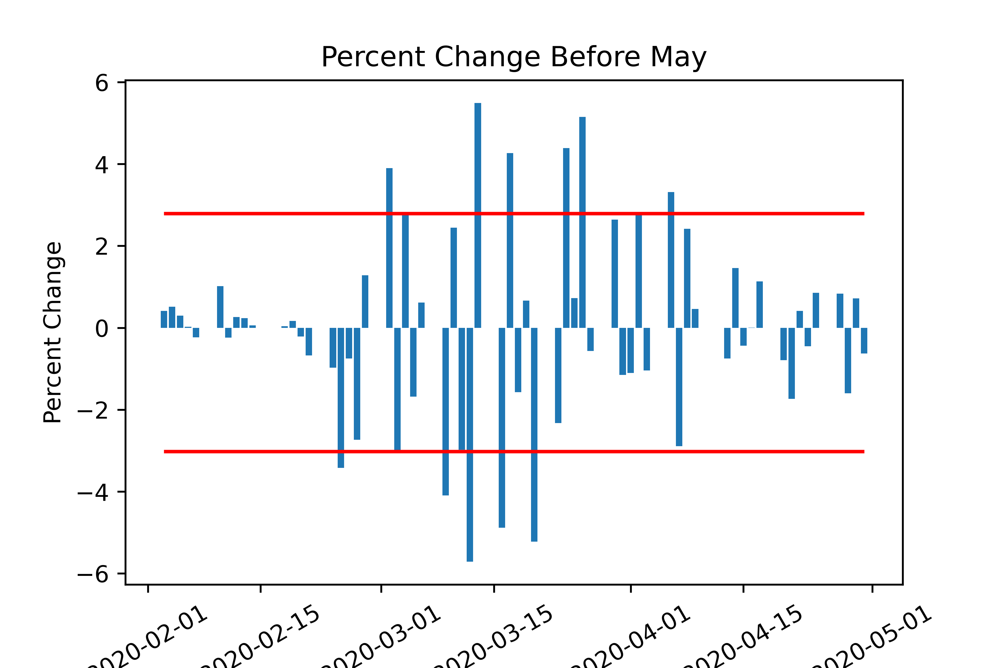
Daily Percent Change After May
The market has much greater volatility before May
The outlier Upper Bound is 1.70, and Lower Bound is -1.50 after May.
The outlier Upper Bound is 2.79, and Lower Bound is -3.03 before May

Slide 14

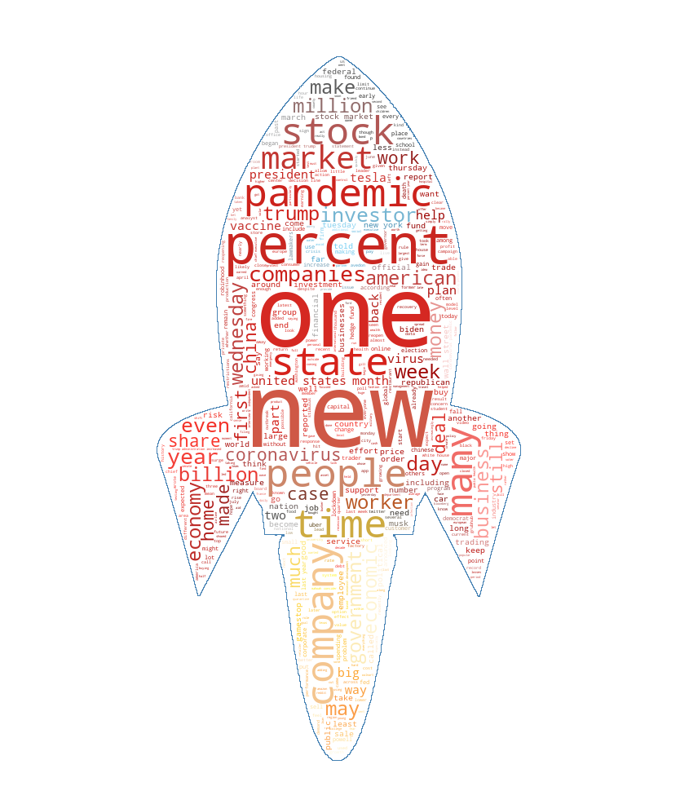
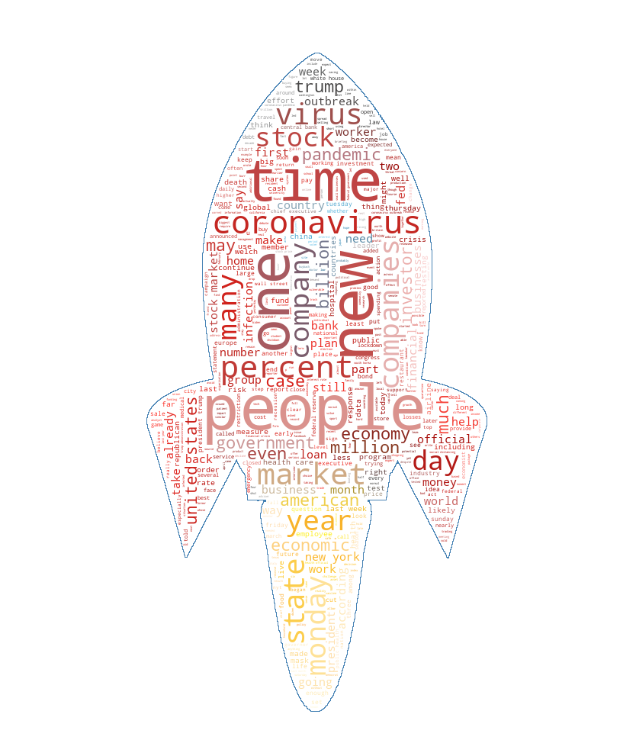
SO WHAT WAS THE SENTIMENT DURING SIGNIFICNAT DROP BEFORE AND AFTER MAY?
Drop Before MAY
Drops After MAY
Gains (Combined)

Slide 15
Sentiment scores from NLTK Vader
red days after may is {'neg': 0.079, 'neu': 0.819, 'pos': 0.102, 'compound': 1.0}
Combined green days sentiment score:
{'neg': 0.09, 'neu': 0.812, 'pos': 0.099, 'compound': 1.0}
Red days from Februrary to May:
{'neg': 0.104, 'neu': 0.799, 'pos': 0.097, 'compound': -1.0}
Red days AFTER may:
{'neg': 0.079, 'neu': 0.819, 'pos': 0.102, 'compound': 1.0}

Slide 16
Questions?

