Slide 1
Clean School Zones
Low-cost sensors for school transport idling + AC efficiency monitoring
2 sensors per vehicle: outside exhaust exposure + inside cabin air
Goal: identify repeat offenders and trigger maintenance / anti-idling action.
1 / 4

Slide 2
Prioritization Matrix
High
URGENT
STRATEGIC
Easy to implement
High payoff
Hard to implement
High payoff
Start pilot: CO spikes + idling alerts
Fleet policy, operator scoring, city reporting
Payoff →
OPTIONAL
AVOID
Easy to implement
Low payoff
Hard to implement
Low payoff
Dashboard polish, badges, manual notes
Over-complex prediction before data quality
Low
Easy
Hard
Implementation →
2 / 4

Slide 3
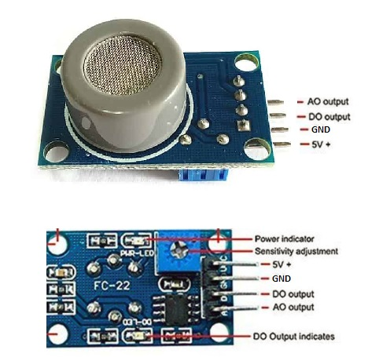
Cheap Sensor Candidate
MQ-7B Carbon Monoxide Sensor
Main feature
Detects CO spikes from idling exhaust
Useful range: 10–500 ppm CO • 5V operation • simple analog circuit
Outside
vehicle
Use it as the outside sensor; pair readings with GPS/time to flag idling hot-spots near school gates.
25%
CO alert
Source: Winsen MQ-7B specifications; not a certified emissions tester — calibration is required.
3 / 4

Slide 4
Three Risk Assumptions
1
Sensor signal is meaningful
Low-cost CO/air sensors must correlate with real exposure, not just noise.
2
Placement stays reliable
Heat, vibration, rain, dust, and airflow must not distort readings too much.
3
Schools will act
Alerts only matter if operators enforce anti-idling and fix inefficient AC units.
4 / 4

