Slide 1
SMART HEALTH CONSULTATION
GUIDED BY,
DONE BY,
Ms. Nikhitha
Assistant professor
Dept. of CSE
Banee Ishaque K
Sai Krishna K
Safa

Slide 2
CONTENTS
Objective
Introduction
Literature survey
Proposed system
Architecture
Modules
Implementation
Comparison
Conclusion
Future work
Reference

Slide 3
OBJECTIVE
To predict disease based on user symptoms and issue appointments of desired Doctors at desired time using ML Algorithms.

Slide 4
INTRODUCTION
The proposed system consists of following Actors,
General user area
Help system:
Video tutorials and offline documentation.
Testimonials.
Doctor’s area
Daily schedule:
Details of appointment per day.
Leave management.

Slide 5
INTRODUCTION(Contd.....)
Patient’s area
Medical data management.
Registration for treatment.
Billing.

Slide 6
Admin
Doctors manipulation.
Suspension & Authorization.
Freezing of accounts.
Affiliation manipulation.
Complaints management.

Slide 7
LITERATURE SURVEY
Topic | Authors | Features | Pros | Con
[1].A health check and prediction system for lifestyle -Related disease prevention. | Xia Yu;Shuoyu Wang;2006 | Fuzzy set theory was employed to deal with the fuzziness of degree of subject symptoms. | Updating of the medical knowledge database become easy and quick. | More complex fuzzy set is used.
[2].A semantic feature space for disease prediction | Mariam Daoud;Jimmy Xiangji Huang;William Melek;C.Joseph Kurian;2013 | SNOMED-CT concepts, Biomedical text mining tool is used. | Disease prediction is based on patient reported symptoms and medical sign . | No algorithms used(based on biomedical text mining tool).

Slide 8
LITERATURE SURVEY
Topic | Authors | Features | Pros | Cons
[3].Disease prediction using hybrid K-means and support vector machine. | Sandeep Kaur;Sheetal Kalra;2016 | Uses hybrid K-means and SVM is used for disease prediction. | Uses SVM. | Customized data set is used.
[4].A novel feature selection based classification algorithm for real-time medical disease prediction. | Satuluri Naganjaneyulu;BuragaSrinivasa Rao;2018 | Novel feature selection based classification model is used. | Improved disease classification rate. | Usage of customized data set.

Slide 9
PROPOSED SYSTEM
User need to register as a member.
Medical history should be updated.
System predicts a list of doctors as per requirements (e.g.: Orthopedic, General Physician etc.)
Online appointments.
Authorized Doctors.

Slide 10
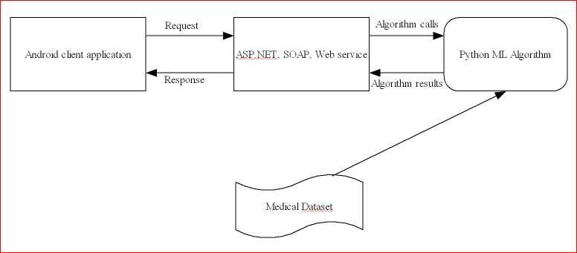
ARCHITECTURE (Old)

Slide 11
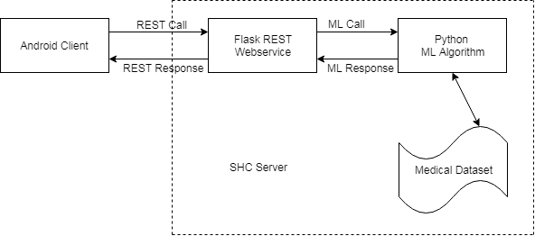
ARCHITECTURE (New)

Slide 12
MODULES
Patient
Registration and login
Medical history manipulation
Billing
Arrange Appointments
Doctor
Day by day appointments
Duty leaves

Slide 13
Admin
Login
Doctor Authorization
User voice
Account manipulation

Slide 14
IMPLEMENTATION
Hardware Requirements:
Client Side
Android Smart Phone
Server Side
4 GB RAM
160 GB HDD
Windows 7
Keyboard & Mouse

Slide 15
Software Requirements:
Client Side
At least API 19 (Kit Kat)
Server Side
Python with ML Libraries (Naive - Bias)
MySQL
Google Datasets

Slide 16
Algorithms
Naive Bias Algorithm
SVM

Slide 17
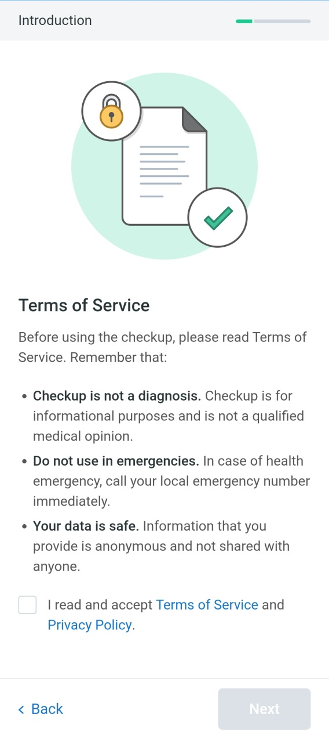

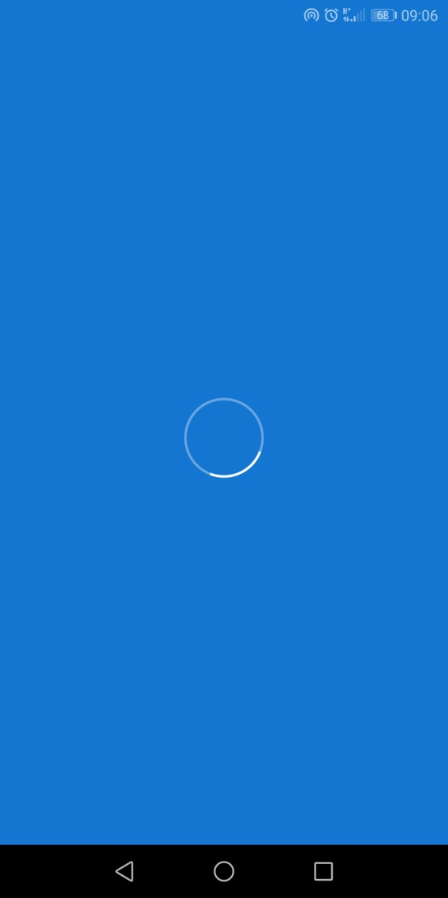
Design Sketches

Slide 18
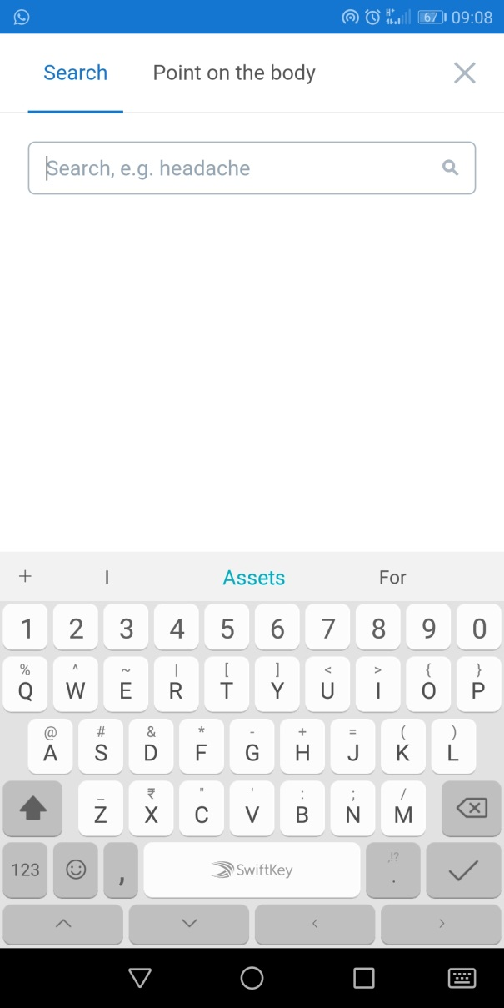
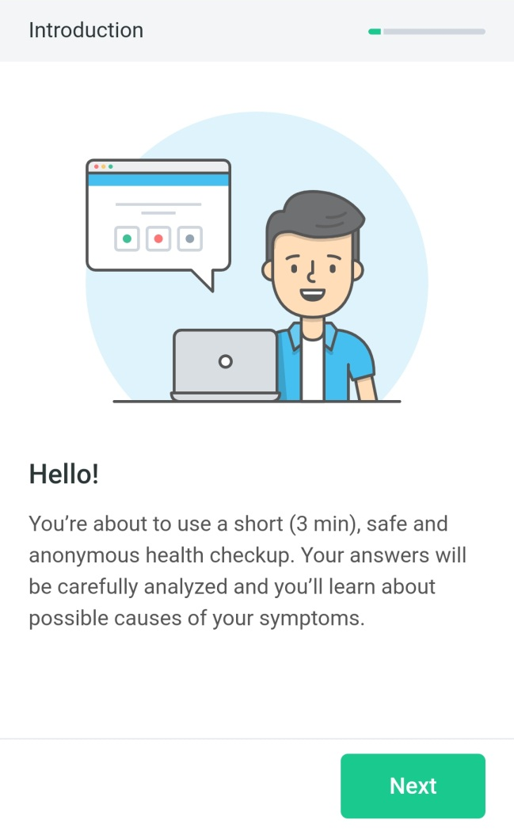
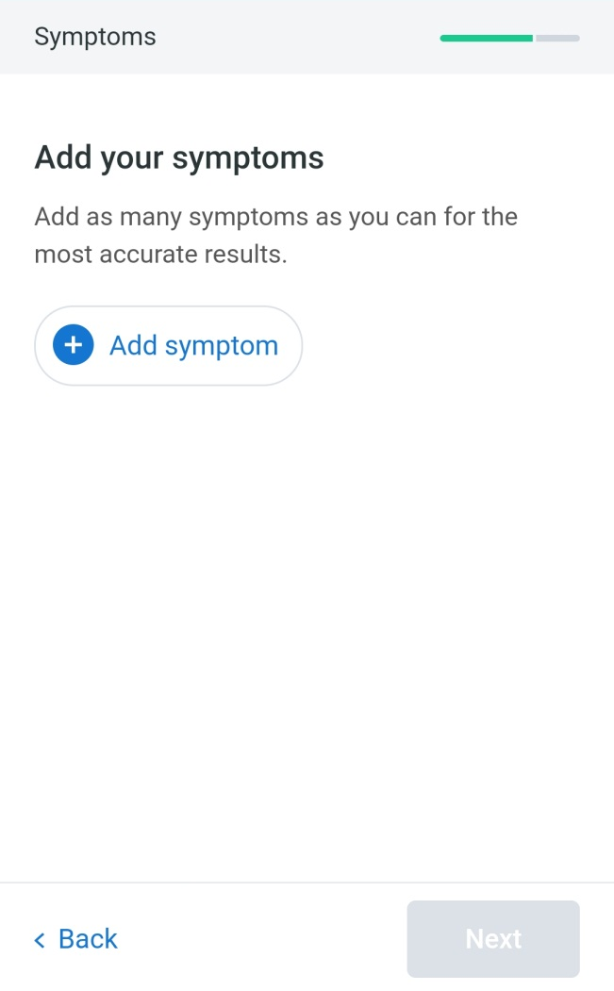
Design Sketches (Cont.)

Slide 19
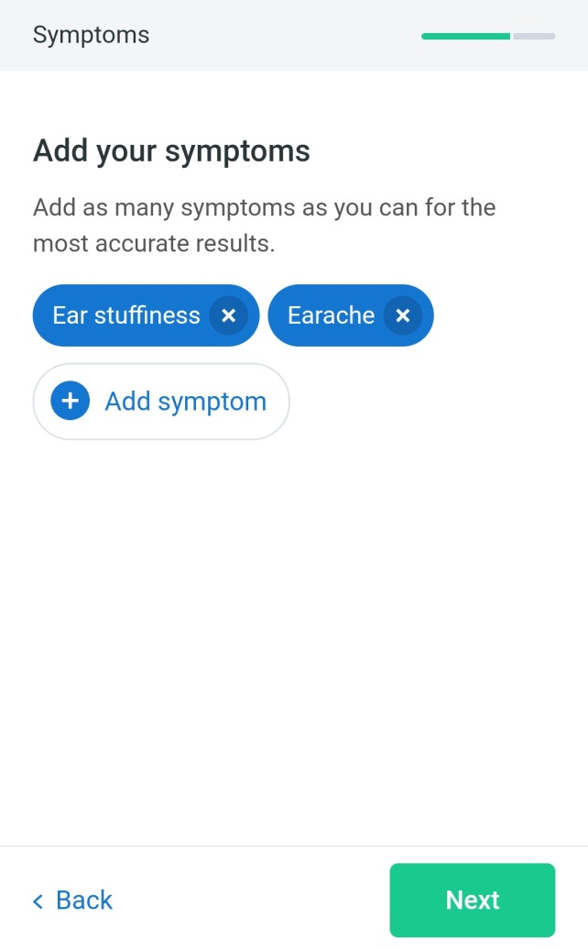
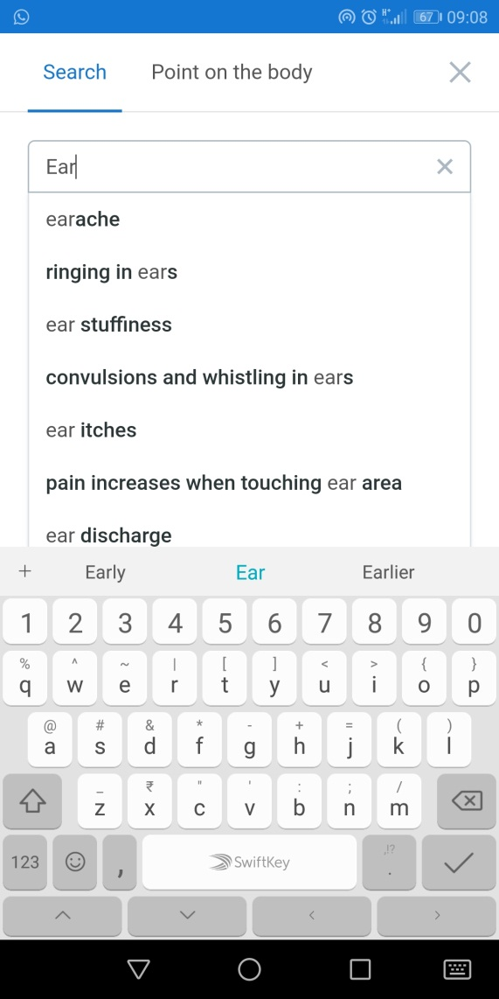
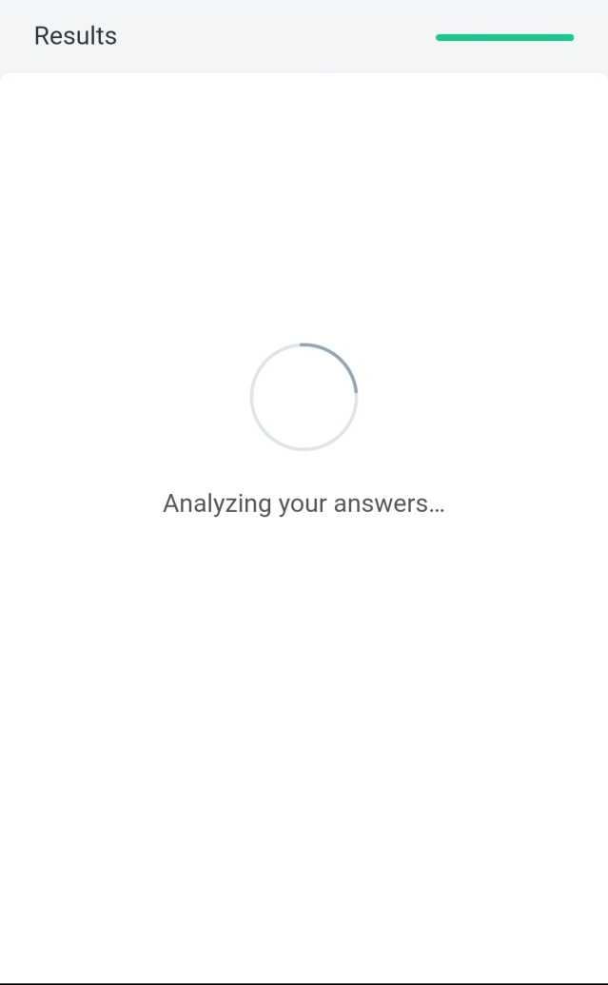
Design Sketches (Cont.)

Slide 20
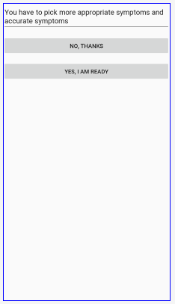
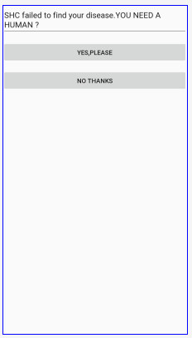
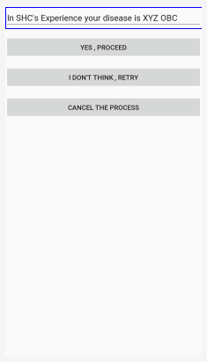
Design Sketches (Cont.)

Slide 21
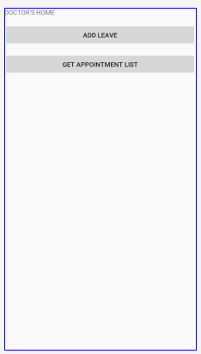
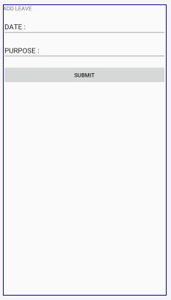
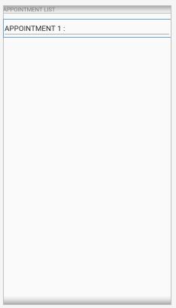
Design Sketches (Cont.)

Slide 22
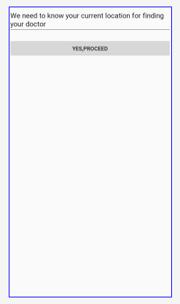
Design Sketches (Cont.)
To Done,
Doctor List Based on Disease
Appointment List Based on Doctor
Payment Page

Slide 23
Database Schemas
Disease
Id | Int | - | Primary, AI
Name | Varchar | 150 | -
Description | Varchar | 500 | -
Doctor
Id | Int | - | Primary, AI
Name | Varchar | 50 | -
Address | Varchar | 250 | -
Contact_number | Varchar | 15 | Unique
Email_id | Varchar | 50 | Unique
Fee | Real | - | -

Slide 24
Database Schemas (Cont.)
Doctor_Diseases
Id | Int | - | Primary, AI
Doctor_id | Int | - | Foreign
Disease_id | Int | - | Foreign
Patient
Id | Int | - | Primary, AI
Name | Varchar | 50 | -
Address | Varchar | 250 | -
Contact_number | Varchar | 15 | Unique
Email_id | Varchar | 50 | Unique

Slide 25
Database Schemas (Cont.)
Slots
Id | Int | - | Primary, AI
Slot_start | Time | - | -
Slot_end | Time | - | -
Appointments
Id | Int | - | Primary, AI
Appointment_date | Date | - | -
Doctor_id | Int | - | Foreign
Patient_id | Int | - | Foreign
Slot_id | Int | - | Foreign

Slide 26
Database Schemas (Cont.)
Doctor_Slots
Id | Int | - | Primary, AI
Doctor_id | Int | - | Foreign
Slot_id | Int | - | Foreign
To Done,
License_details
Payments
Card_details
UPI_settings

Slide 27
COMPARISON
EXISTING SYSTEM | PROPOSED SYSTEM
Uses standalone single systems. | In cooperate various clients such as mobile clients, web clients etc.
Nested long if-else-ladder/complex fuzzy set. | ML technologies are used(Naïve Bias and SVM).
Uses custom made data sets. | Uses public dataset which include data for common diseases.

Slide 28
CONCLUSION
SHC is a 24x7 online Patient-Doctor interactive system.
Uses ML algorithms.
Location based service.

Slide 29
FUTURE WORK
Enlargement of service area from small to large areas.
Use of more accurate ML algorithms.
Develop a specialized disease prediction ML algorithm.

Slide 30
REFERENCES
[1].Xia Yu,Shuoyu Wang,”A health check and prediction system for lifestyle -Related disease prevention”,2oo6.
[2].Mariam Daoud;Jimmy Xiangji;Huang;William Melek;C.Joseph Kurian;”A semantic feature space for disease prediction”,2013.
[3].Sandeep Kaur;Sheetal Kalra;”Disease prediction using hybrid K-means and support vector machine”,2016.
[4].Satuluri Naganjaneyulu;BuragaSrinivasa Rao;”A Novel feature selection based classification on algorithm for real time medical disease prediction”,2018.
30

Slide 31
THANK YOU

