Slide 1
RED · YELLOW · GREEN
LOOP
CHECK THE
Your Digital Watchman
DOOR, NOT THE HOUSE
A proactive shield against scams, deepfakes & fraud — built for Android users who don't already suspect they're being targeted.
NYLP AI HACKATHON 2026
TEAM CLOSEDLOOP
Notes:
Loop — your digital watchman. Open with the framing: a proactive shield, not another scanner.

Slide 2
01 · CORE IDEA
A Proactive Shield, Not a Reactive Scanner
Most safety apps wait for a user to get suspicious and go open them. Loop flips that: it sits on the phone at all times and puts itself between the user and the danger — before a scam link ever loads or a scam message ever gets acted on.
Floating Shield Bubble
A system-overlay bubble lives on top of every app. Tap it for a quick menu — "Check a message/link" or "I'm on a call."
“We check the door you’re about to walk through — we don’t read your house.”
Real Link Interception
Loop is the phone's default browser handler. Any tapped link — SMS, WhatsApp, notes — routes through Loop's check screen first, before the real site opens.
Loop never asks for READ_SMS, notification access, accessibility service, or live call-audio capture — permissions every scam app abuses. It only intercepts the moment a user is about to act.
LOOP · NYLP AI HACKATHON 2026
2
Notes:
Loop sits between the user and the danger. It never asks for the permissions scam apps abuse.

Slide 3
01 · CORE IDEA
Under the Hood: One Check Engine, Three Signals
Every check — a pasted message, an intercepted link, or a suspicious photo — resolves to the same simple output: a color, a reason, and an action.
RED
YELLOW
GREEN
Stop — this is a scam.
Be careful — verify first.
Looks safe to proceed.
+ a one-sentence, plain-language reason, spoken aloud and shown in English or Urdu
Text & Link Check
Image Check
Screenshot Rule
Groq LLM classifies messages; regex heuristics flag raw IPs, no-https, and trust-bait domains first.
Gemini vision reads photos & videos for manipulation tells — always paired with "verify independently."
Fixed reply: "Screenshots prove nothing — check your own app." No analysis attempted, by design.
LOOP · NYLP AI HACKATHON 2026
3
Notes:
One engine, three signals. Every check resolves to a color, a reason, and an action.

Slide 4
02 · TARGET AUDIENCE
Built for the User Who Wouldn't Think to Check
Low-literacy, non-technical Android users in Pakistan — people who don't already suspect they're being scammed, may not read fluently, and think in a local language, not English.
01
02
03
Not already suspicious
Local-language first
The Android-native threat
Scam-checking apps only help people who remember to open them. Loop's proactive layer serves everyone else.
Urdu-speaking, non-technical users are consistently underserved by English-only, jargon-heavy security tools.
The SMS-stealing malware this problem targets is itself Android-native — this is where the risk actually lives.
LOOP · NYLP AI HACKATHON 2026
4
Notes:
The user who wouldn't think to check: low-literacy, non-technical Android users in Pakistan.

Slide 5
03 · WHY IT WORKS
Designed Around the Accessibility Barrier, Not Around It
EN / اردو
Voice + color + minimal text
Proactive, not opt-in
Bilingual throughout
The check happens to the user automatically, at the moment of risk — nothing to remember, nothing to already suspect.
Every screen and every spoken verdict is available in English or Urdu, including the toggle itself.
Spoken verdicts and a red/yellow/green system remove the literacy barrier — no dense paragraphs to parse under stress.
The proactive layer specifically serves the user who wouldn't think to open a checking app in the first place.
LOOP · NYLP AI HACKATHON 2026
5
Notes:
Designed around the accessibility barrier: voice, color, proactivity, bilingual throughout.

Slide 6
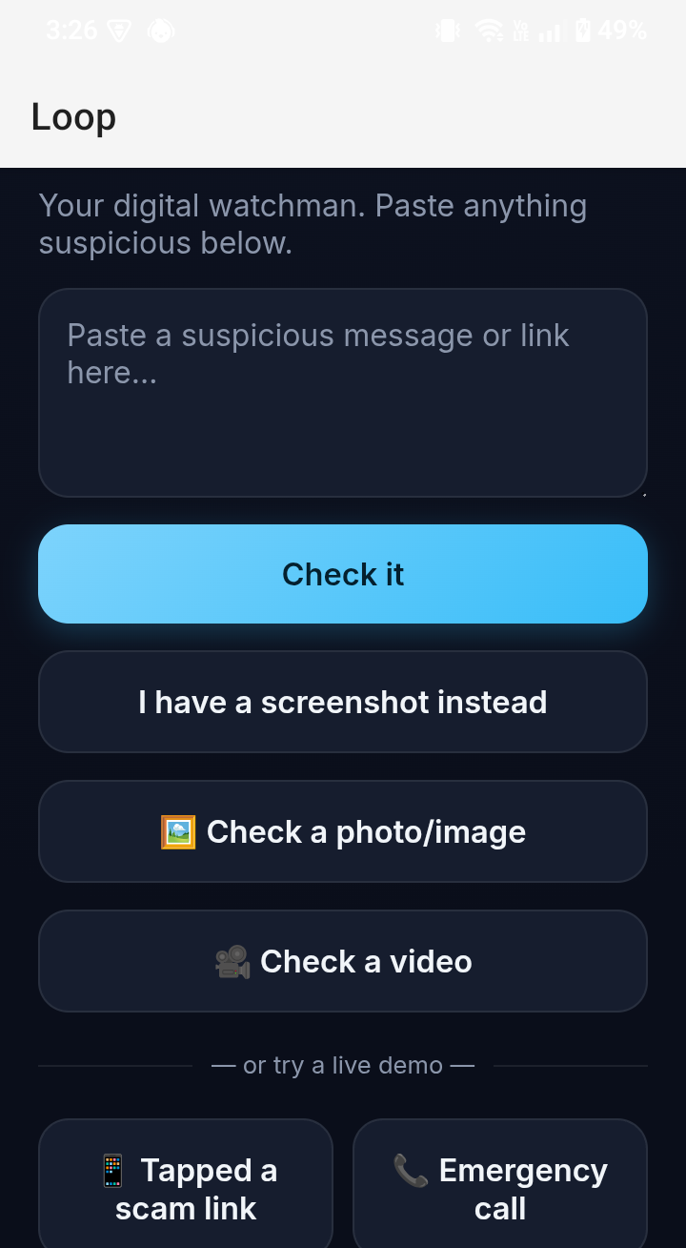
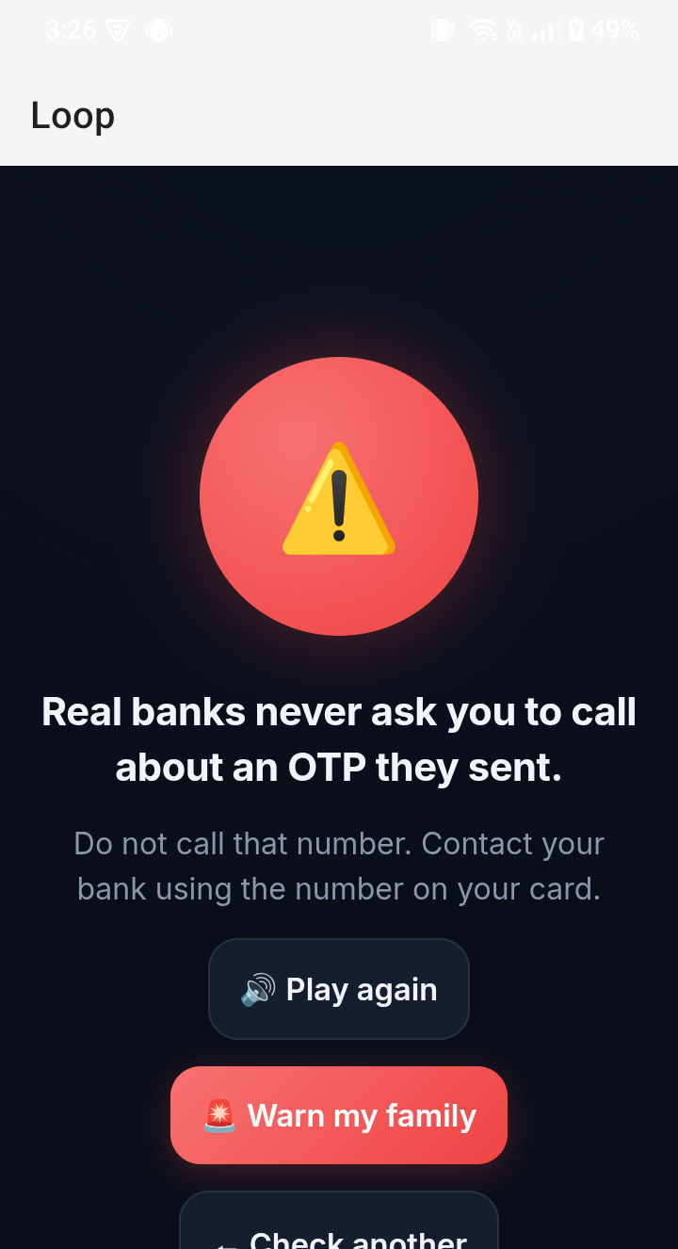
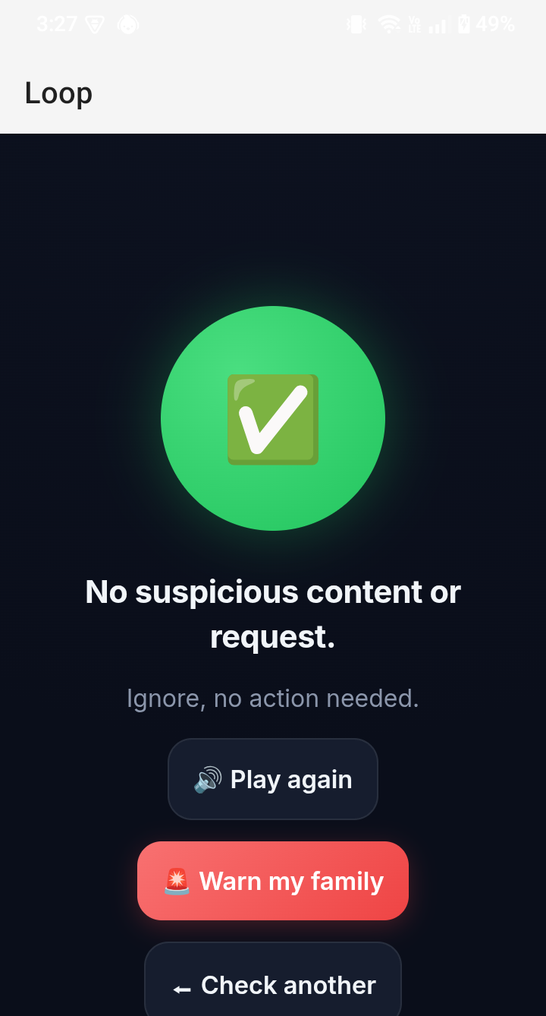
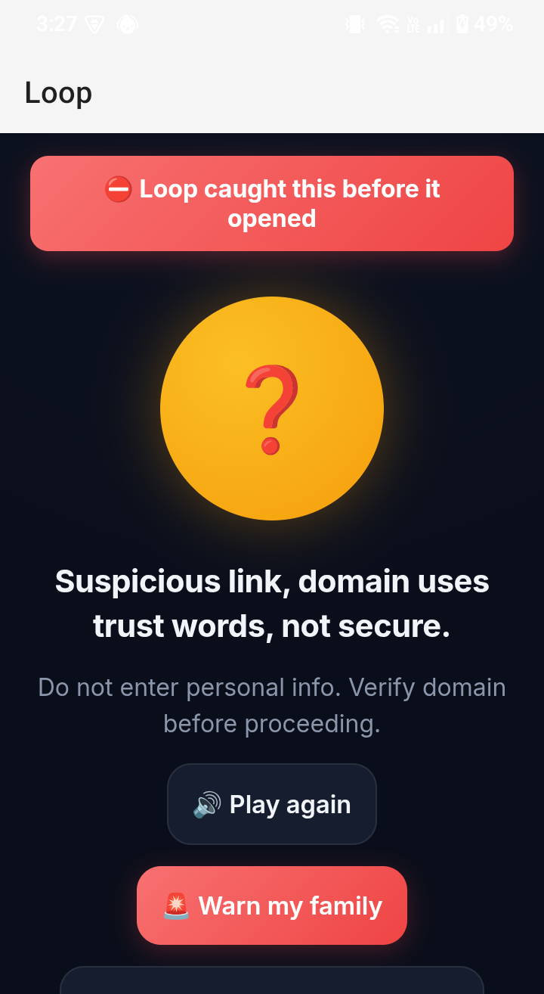
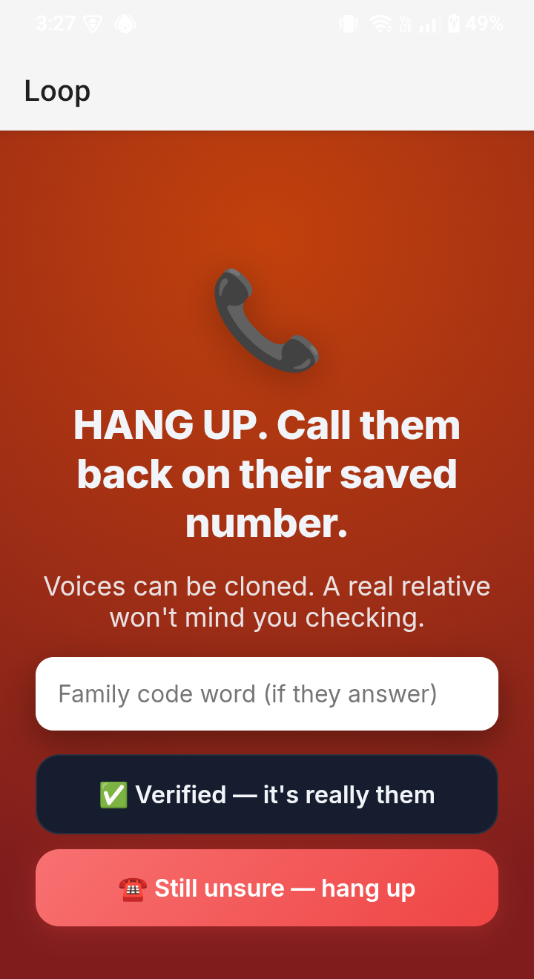
05 · PROOF
Real Screenshots, Real Device — Not Mockups
SHIPPED
Home
Scam caught
Safe message
Link intercepted
VERIFY flow
LOOP · NYLP AI HACKATHON 2026
8
Notes:
Real screenshots from a real device — walk through home, a caught scam, a safe message, an intercepted link, and the VERIFY flow.

Slide 7
04 · IMPLEMENTATION STRATEGY
Why Android, and How It's Built
Link-handler, share-target, and system-overlay access are OS-level capabilities that don't exist the same way on iOS. That's the real technical differentiator — not a platform of convenience.
LAYER 01
LAYER 02
LAYER 03
Android (Kotlin)
Backend (Node.js)
Frontend
WindowManager overlay bubble · VIEW intent-filter for link interception · WebView check UI with JS↔native bridge.
Zero npm dependencies, built-in http · Groq API for text classification · Gemini API for image/video analysis.
Single-page vanilla HTML/JS, mobile-first, bilingual · Web Speech API powers spoken verdicts.
NEXT →
FLAG is live: one-tap community reports turn a scam red for everyone. Next, Urdu voice-first verdicts (spoken input, Urdu audio out, no reading required) on the same check engine.
LOOP · NYLP AI HACKATHON 2026
7
Notes:
Android is the technical differentiator, not a convenience choice.

Slide 8
A shield that checks the door, not the house.
Proactive. Bilingual. Honest about what it can't do yet.
LOOP — YOUR DIGITAL WATCHMAN.
Notes:
Close on the door metaphor and the honesty pitch.

