Slide 1
Analyzing X ray Data from X ray binaries

Slide 2
What are XRBs?

Slide 3
What Software have I used?
Heasoft
SAODS9
SXT Pipeline tools

Slide 4
Why Heasoft?
Xselect
Xspec
And a myriad of plotting tools

Slide 5
How did I use Xselect?
To obtain GTI filtered .pha .im, .ext and .lc files.4
But wait, whats GTI and what are those files? And how would we use them, and their significance.... etc.

Slide 6
What do we need to use Xspec.
The event spectral file (.pha)
The background file (.pha)
The response file (.rmf)
The auxillary response file (.arf)

Slide 7
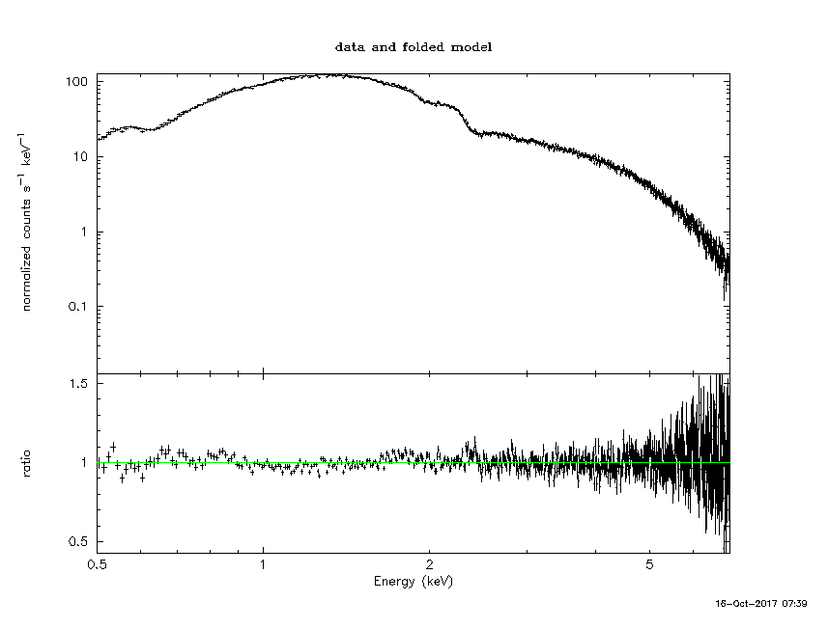
What did Xspec give me?
This:

Slide 8
And some numbers
FW mode
~norm= 9.7
reduced chi squared ~= 1.30
PC mode
~norm= 10.1
reduced chi squared ~= 1.10

Slide 9
Whats next?
The actual fun part. Analyzing the data from 1A 2466 588
Learning LAXPC analysis
Analyzing timing data from the same source from different instruments for different energy range.

Slide 10
Thank you

