Slide 1
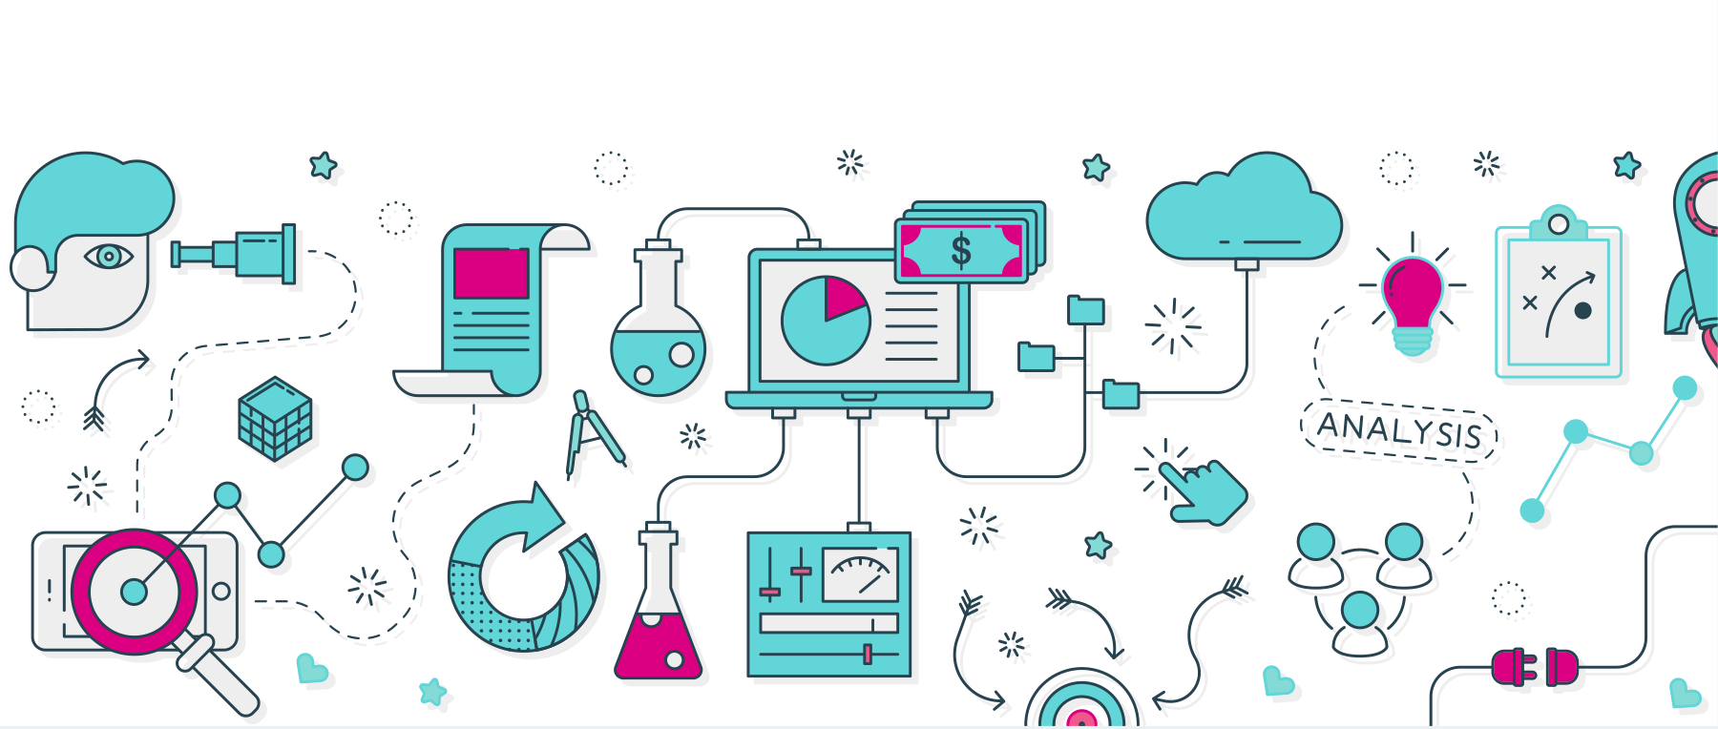
CS-782(SEMINAR 1) JIS COLLEGE OF ENGINEERING
.

Slide 2
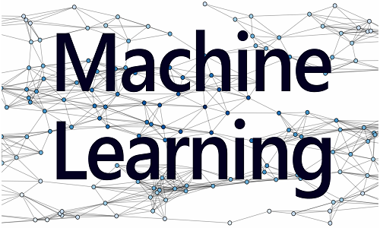
.

Slide 3
CS-782 seminar group
AMITAVA BOSE
SOHAM BANERJEE
SAUNAK SARKAR
SHOURJADEEP SARKAR

Slide 4
CONTENT
What Is Machine Learning?
Machine Learning Process?
Why Machine Learning?
What Required To create good Machine Learning System?
Who Using It?
How Machine Learning learns a Target Function?
What is a Deep Learning?
Optimization Technique
Type Of Learning?
Future of Machine Learning?

Slide 5
What is a Machine Learning?
Automating automation
Getting computers to program themselves
Writing software is the bottleneck
Let the data do the work instead!
Machine learning is an application of artificial intelligence (AI) that provides systems the ability to automatically learn and improve from experience without being explicitly programmed. Machine learning focuses on the development of computer programs that can access data and use it learn for themselves.
The process of learning begins with observations or data, such as examples, direct experience, or instruction, in order to look for patterns in data and make better decisions in the future based on the examples that we provide. The primary aim is to allow the computers learn automatically without human intervention or assistance and adjust actions accordingly.

Slide 6
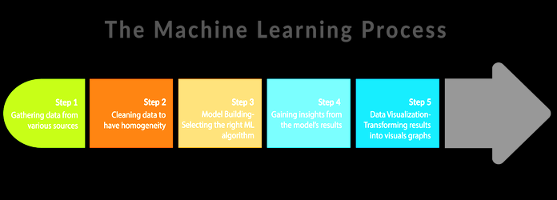
Machine Learning Process

Slide 7
Traditional Programming
Machine Learning
Data
Computer
Output
Program
Data
Computer
Program
Output

Slide 8

ml
NO MORE LIKE GARDENING
Seeds- Algorithm.
Nutrients- Data.
Gardener- You.
Plants- program.
Every machine learning algorithm has three components:
Representation
Evaluation
Optimization

Slide 9
Why Machine Learning?
Interest in machine learning is due to the same factors that have made data mining and Bayesian analysis more popular than ever. Things like growing volumes and varieties of available data, computational processing that is cheaper and more powerful, and affordable data storage.
All of these things mean it's possible to quickly and automatically produce models that can analize bigger, more complex data and deliver faster, more accurate results – even on a very large scale. And by building precise models, an organization has a better chance of identifying profitable opportunities – or avoiding unknown risks.

Slide 10
What's required to create good machine learning systems? `
Data preparation capabilities.
Algorithms – basic and advanced.
Automation and iterative processes.
Scalability.
Ensemble modelling.

Slide 11


Who's using it?
Financial services- Banks and other businesses in the financial industry use machine learning technology for two key purposes: to identify important insights in data, and prevent fraud. The insights can identify investment opportunities, or help investors know when to trade. Data mining can also identify clients with high-risk profiles, or use cyber surveillance to pinpoint warning signs of fraud.
Government- Government agencies such as public safety and utilities have a particular need for machine learning since they have multiple sources of data that can be mined for insights. Analyse sensor data, for example, identifies ways to increase efficiency and save money. Machine learning can also help detect fraud and minimize identity theft.
Health care-Machine learning is a fast-growing trend in the health care industry, thanks to the advent of wearable devices and sensors that can use data to assess a patient's health in real time. The technology can also help medical experts analyse data to identify trends or red flags that may lead to improved diagnoses and treatment.
Marketing and sales- Websites recommending items you might like based on previous purchases are using machine learning to analyse your buying history – and promote other items you'd be interested in. This ability to capture data, analyse it and use it to personalize a shopping experience (or implement a marketing campaign) is the future of retail.
Transportation -Analyse data to identify patterns and trends is key to the transportation industry, which relies on making routes more efficient and predicting potential problems to increase profitability. The data analysis and modelling aspects of machine learning are important tools to delivery companies, public transportation and other transportation organizations.
Oil and gas- Finding new energy sources. Analyse minerals in the ground. Predicting refinery sensor failure. Streamlining oil distribution to make it more efficient and cost-effective. The number of machine learning use cases for this industry is vast – and still expanding.

Slide 12
How Machine Learning Learns a Target Function
Hence, a machine learning performs a learning task where it is used to make predictions in the future (Y) when it is given new examples of input samples (x).
Y = f(x)
As you can see, we do not know any properties of the target function f. What is its form? Linear, non-linear? So we use machine learning to approximate this function by learning from examples (x). If we knew the properties of f, then there would be no need for learning from data and use machine learning. Instead, we could have used the target function directly by solving the equation. But in the product review example, the behaviour of the target function cannot be described using an equation and therefore machine learning is used to derive an approximation of this target function. The target function tries to capture the representation of product reviews by mapping each kind of product review input to the output.
For doing this, the machine learning algorithm considers certain assumptions about the target function and starts the estimation of the target function with a hypothesis. The hypothesis might vary from time to time since the target function is unknown. Therefore, to arrive at a better function that approximates well the target function, some iterations of the hypothesis are done to estimate the best output. Hence, the hypothesis helps the machine learning algorithm to arrive at a better approximation of the target function in a shorter period, rather than letting the machine learning algorithm itself to figure out the whole thing by trying endless computations. This would take very long to arrive at a prediction.

Slide 13
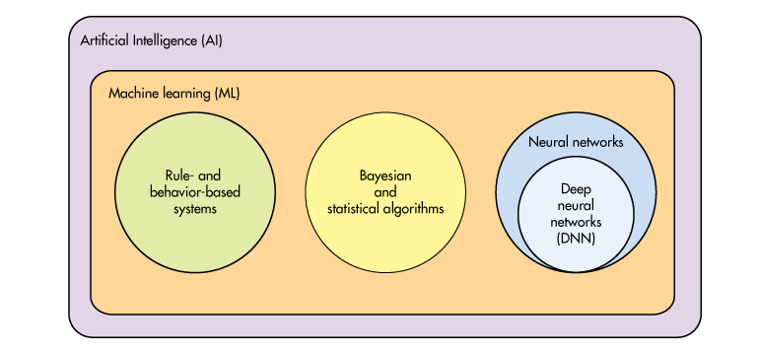
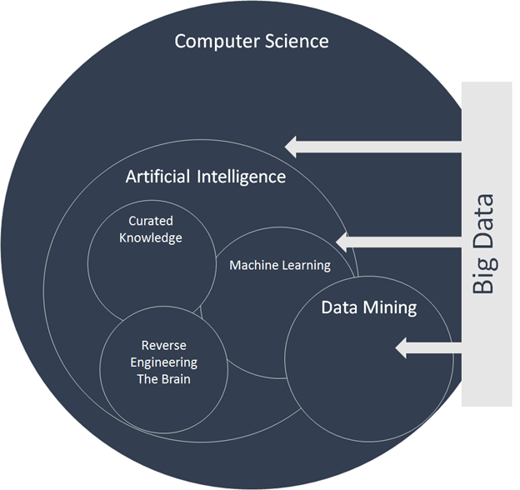
.
..

Slide 14
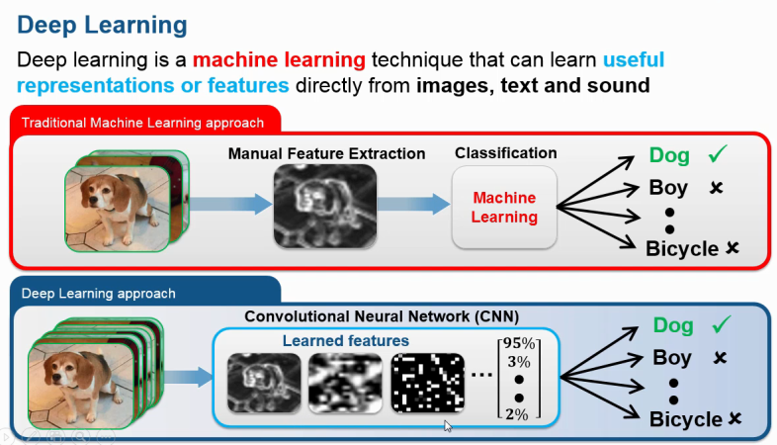
What Is a Deep Learning

Slide 15

applications
Web search
Computational biology
Finance
E-commerce
Space exploration
Robotics
Information extraction
Social networks
Debugging

Slide 16
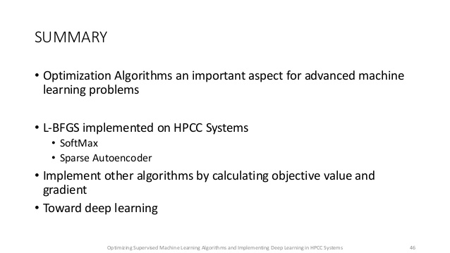
Optimization
Combinatorial optimization
E.g.: Greedy search
Convex optimization
E.g.: Gradient descent
Constrained optimization
E.g.: Linear programming

Slide 17
Type Of Learning
Supervised (inductive) learning
Training data includes desired outputs
Unsupervised learning
Training data does not include desired outputs
Semi-supervised learning
Training data includes a few desired outputs
Reinforcement learning
Rewards from sequence of actions

Slide 18
Credit
Jis College Library’s E facility
Soft Computing-pearson

Slide 19

Future Of Machine Learning
I am only some days old in ML so, am not in right place to say what is the future, but I can mention some supercool upcoming trends in Ml
1. AI based Virtual Machines that can right and execute
programs: like Google+
2. Better Unsupervised algorithms : like http://arxiv.org/abs/1306.1091
3. Specialized Machine Learning hardware : like http://www.computerworld.com/art...
4. Quantum Computing algorithms : like http://arxiv.org/abs/1307.0411
5 . Better Boltzmann Machines: like http://arxiv.org/abs/1411.3784 6. Alignment learning connecting various types of high-dimensional
data http://cs.stanford.edu/people/ka...
7. Tensor Factorization for recos : like http://www.cip.ifi.lmu.de/~nicke...

Slide 20


.

