Slide 1
Explainable ML and DL Models on Breast Cancer Data
Apurba paul (supervisor)
Abhilash Banerjee(123190803001)
Abhishek chakarborty(123190803002)
Amit Kumar Dubey(123190803010)
Anitabha Das(123190803015)
Arya Raj(123190803028)

Slide 2
Content
Breast Cancer
Machine Learning
Deep Learning
Machine Learning Vs Deep Learning
Steps To Make Machine Learning And Deep Learning Model
Explainable AI(XAI)

Slide 3

Breast Cancer
Breast Cancer Is The Second Leading Cause Of Cancer Death In Women, Second Only To Lung Cancer. The Leading Risk Factor For Breast Cancer Is Simply Being A Woman. Though Breast Cancer Does Occur In Men, The Disease Is 100 Times More Common In Women. A Woman Has About A One In Eight Chance Of Being Diagnosed With Breast Cancer In Her Lifetime, According To The National Cancer Institute.
Most Women (About Eight Out Of 10) Who Get Breast Cancer Do Not Have A Family History Of The Disease. But Women Who Have Close Blood Relatives With Breast Cancer Have A Higher Risk. Having A First-degree Relative (Mother, Sister Or Daughter) With Breast Cancer Almost Doubles A Woman's Risk.

Slide 4
Machine Learning
Machine Learning (ML) Is A Field Of Artificial Intelligence That Uses Statistical Techniques To Give Computer Systems The Ability To "Earn From Data, Without Being Explicitly Programmed
Breast Cancer
Biopsy
Data
Machine Learning
&
Deep Learning
Diagnosis

Slide 5
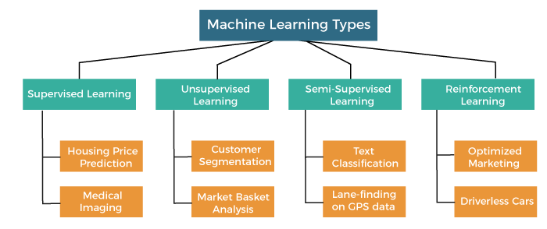
Types of Machine Learning

Slide 6
Algorithms
There Are Many Types Of Algorithm In Machine Learning But We Have Used Five Of Them In Our Project .
Logistic Regression
Decision Tree
Random Forest
Gaussian Naive Bayes
Support vector machine (SVM)

Slide 7
Deep Learning
It Is A Subset Of Machine Learning That Uses Artificial Neural Network To Mimic The Learning Process Of Human Brain.
Artificial Neural Networks (ANNs) are a type of machine learning model that are inspired by the structure and function of the human brain. They consist of layers of interconnected “neurons” that process and transmit information.

Slide 8
Types of Artificial neural network
There are many types of Artificial neural network but we have used three of them in our project .
Feedforward Neural Network
Convolutional Neural Network
Recurrent Neural Network

Slide 9
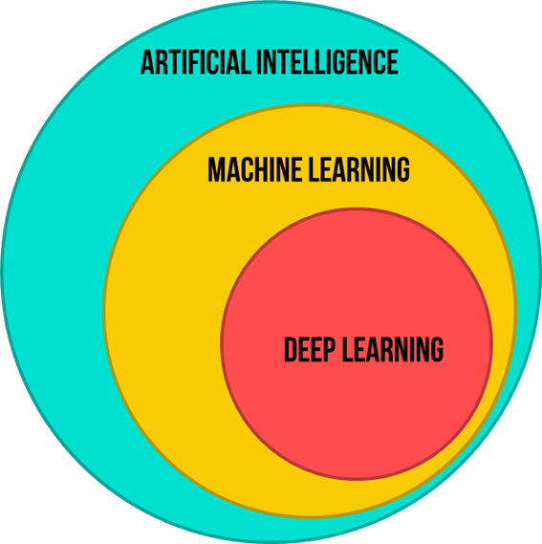
Machine learning Vs Deep Learning
Machine Learning | Deep Learning
It Is A Subset Of Ai Which Gives Computer The Ability To Learn Without Being Explicitly Programmed. | It is a subset of Ml that uses ANN to mimic the learning process of human brain.
It Needs Less Hardware .Training Can Be Performed Using CPU. | It Need High End Machines To Work. It Need Dedicated GPU.
It Mostly Requires Structured Data. | It Can Work With Both Structured & Non- Structured.
Less Accurate. | More Accurate.
Requires Human Intervention To Learn And Correct. | Learns On Its Own From Its Past Mistake.
Algorithms-Decision tree, SVM, Random forest etc. | Algorithms-FFNN,CNN,RNN etc.

Slide 10
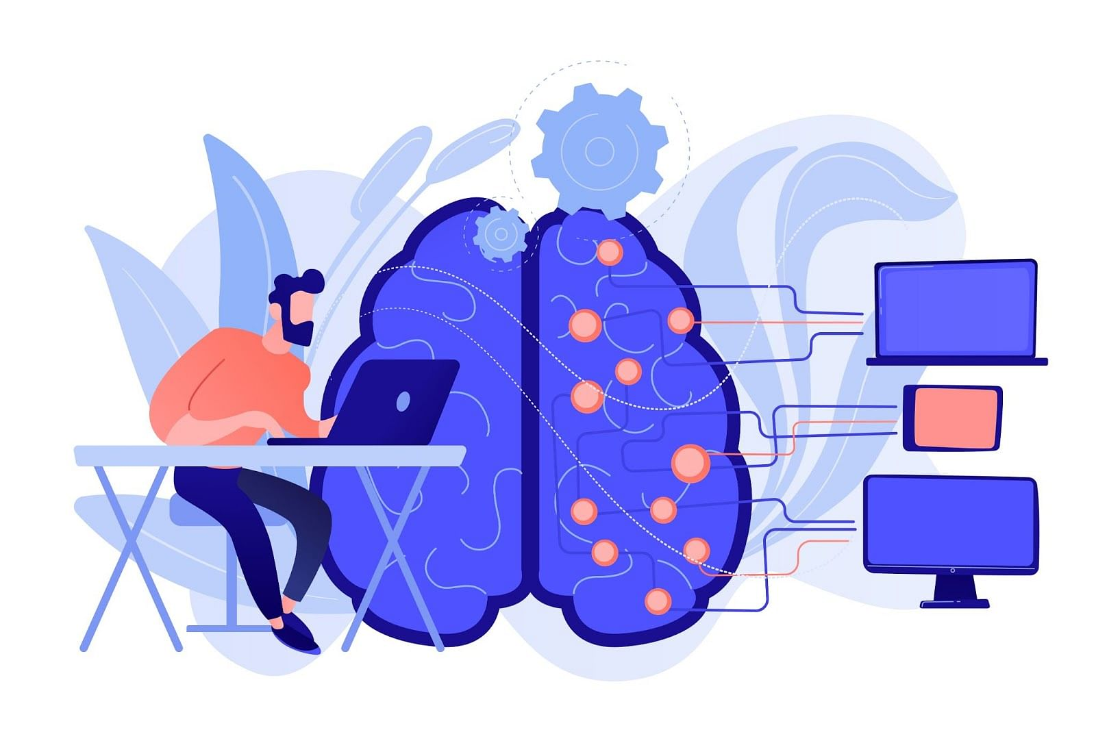
Steps to make mL and dL model
Collecting Data
Preparing The Data
Choosing A Model
Training A Model
Evaluating A Model
Improving The Model

Slide 11
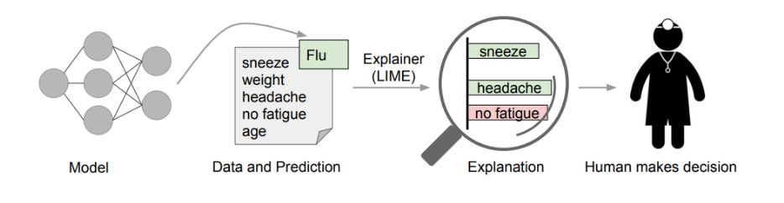
Explainable AI(XAI)
It Is A Set Of Tools That Helps Us To Understand The Predictions Made By Our Machine Learning & Deep Learning Model. AI Algorithms Are Often Known As “Black Box” Means We Don’t Know What Happening Inside We Just Give Input Get Output, So Explainable AI Helps Us To Understand How It Is Generating The Output
There Are Many Library/Techniques Inside It.
Shap
LIME Etc.

Slide 12






