Slide 1

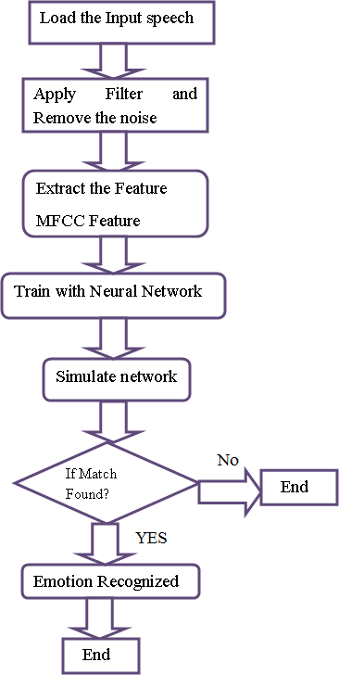
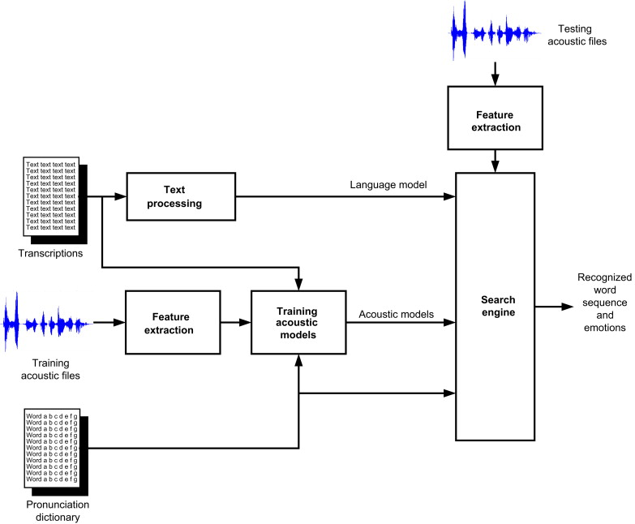
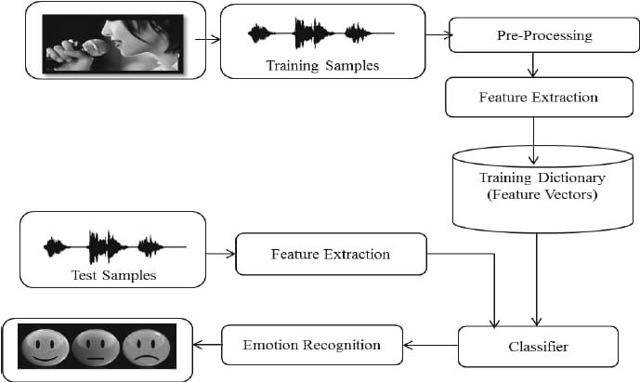
HUMAN VOICE EMOTION RECOGNITION USING MULTILAYER PERCEPTRON
Department of Computer Science & Engineering
School of Computing
1156CS701 – MAJOR PROJECT
WINTER SEMESTER 21-22
ABSTRACT
INTRODUCTION
RESULTS
STANDARDS AND POLICIES
Emotion recognition is a quickly developing examination in recent years. In contrast to people, machines come up short on the capacities to see and show feelings. In any case, human-computer collaboration can be improved via automated emotions recognition, along these lines decreasing the need of human intervention . four fundamental feelings (Anger, Happy, Fear and Neutral) are analyzed from emotional speech signals. Signal processing techniques are used for getting the production features from these signals. Emotional displays pass on extensive data about the psychological condition of a person. This has opened up another exploration field called automatic emotion recognition, having fundamental objectives to understand and retrieve desired emotions.
Emotions play a significant part in human existence. It very well may be recognized from the speech uttered by the person, it is a medium of expression of one’s point of view or sentiments to other people.This cycle could be accumulated alongside video that is, the face recognition by utilizing its own API’s converged with voice and can be created as a software application in future specialized industry, thus that it will portray the state of the individual with whom we are collaborating with.It will be more and more useful for person abroad with their relatives and parents in their hometown.Speech emotion processing and recognition system was generally composed of three parts, which were speech signal acquisition, feature extraction, and emotion recognition.
In this study, owing to the intricacy of emotion analysis and modelling, the survey on speech emotion recognition is still emerging. Different academicians are making progress, using various methods to find a complete speech emotion recognition process . We suggested a speech emotion recognition methodology for getting emotions using machine learning algorithms of MLP as classifiers and we have enhanced 85.12% of accuracy as a standard .looking at our past studies using MLP precision of accustomed computation.
• IEEE 829 - Software Test Documentation
• IEEE 830 -Software Requirements Specifications
• IEEE1012- Software verification and validation
• IEEE 1016 - Software design description
.
METHODOLOGIES
Figure -2: Data flow diagram
Figure 3:Sequence diagram.
Multi-layer Perceptron: A novel multi-layer perceptron (MLP)-based speech recognition method is proposed in this study. The MLP consists of three or more layers (an input and an output layer with one or more hidden layers) of nonlinearly-activating nodes.Multilayer perceptron are often applied to supervised learning problems. They train on a set of input-output pairs and learn to model the correlation (or dependencies) between those inputs and outputs. The Network being real values. If you have categorical data, such as attribute with the values “male” and “female”, emotion attributes 2 such as “happy”, “sad”, “angry” etc. you can convert it to a realvalued representation which is called a one hot encoding.
CONCLUSIONS
The studies over this idea fetches us the knowledge, that this techniques is yet play the vital position in scientific and technical field. A dumb video can come across only 70% of the mood or situation of the individual enacting similarly from the voice of a person. 75 percent of the mood or condition may be detected. When both audio and video is mixed ninety five percent of the mood of the character may be detected.
TEAM MEMBER DETAILS
VTU12241/M SAHITH REDDY
VTU14141/CH BHARGAVI
VTU14145/G SWETHA REDDY
Phone No:9849721451
Phone No:6380259946
Phone No:6309243350
Mail ID:Vtu12241@veltech.edu.in
Mail ID:Vtu14141@veltech.edu.in
Mail ID:Vtu14145@veltech.edu.in
ACKNOWLEDGEMENT
Mrs.Femi.D,Asst Professor,CSE
Contact No:+91 89395 20500
femid@veltech.edu.in
Figure-1 : Architecture Diagram

