Slide 1
Python
TA
Python

Slide 2

關於 Python
適合初學者學習，較為直觀
如何使用？ Google colab
(註)確保筆電可連網路，使用chrome作為瀏覽器佳
TA
Python

Slide 3
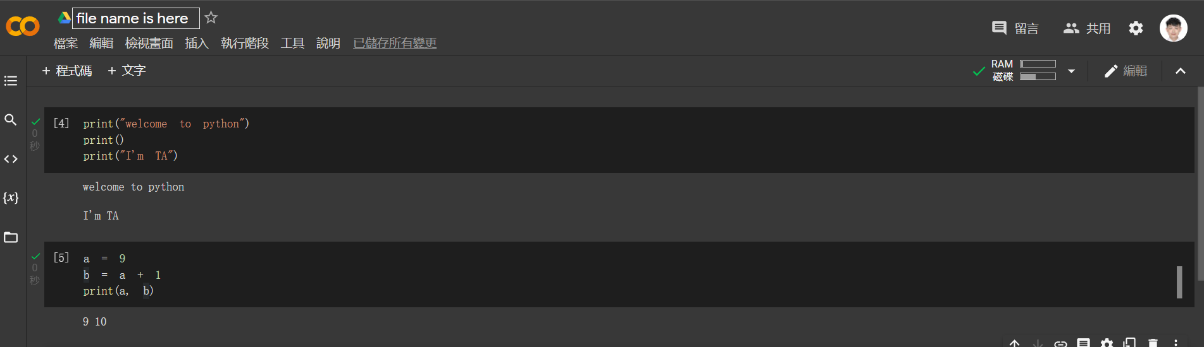

關於 Python
Run cell 快捷鍵：shift + enter
TA
Python

Slide 4
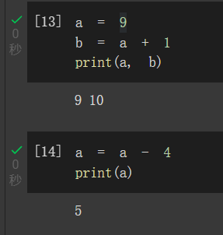

基本介紹
print
宣告變數
variable = 某個值
運算符號
num1 = 13
num2 = 4
print(num1 + num2) #加法
print(num1 - num2) #減法
print(num1 * num2) #乘法
print(num1 // num2) #除法的商
print(num1 / num2) #除法
print(num1 % num2) #除法的餘數
print(num1 ** num2) #次方
註記
"""
This is a long comment
Need more than two lines
"""
print("Hello World!") # first function
(註) 框框內的程式碼可以先複製至記事本，再複製剛貼到記事本的程式碼，即可複製至colab
TA
Python

Slide 5


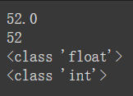
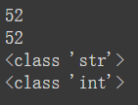
資料型態 data type
三個重要類型：int(整數)、float(小數)、string(字串)
查看資料型態
重新賦予新值
型態轉換
a = 689
b = 8.7
c = "Hi everyone, "
print(type(a))
print(type(b))
print(type(c))
a = 689
print(type(a))
a = 8.7
print(type(a))
f = 52.0
i = int(f)
print(f)
print(i)
print(type(f))
print(type(i))
s = "52"
i = int(s)
print(s)
print(i)
print(type(s))
print(type(i))
TA
Python

Slide 6
條件判斷 conditional
if condition:
statements
if condition:
statements 1
else:
statements 2
if condition:
statements 1
elif:
statements 2
else:
statements 3
print("Please enter your income:")
income = float(input()) #輸入值
if income <= 10000:
tax = 0.02 * income
if income > 10000:
tax = 0.08 * (income - 10000) + 200
print("Tax amount: $" + str(tax))
print("Please enter your income:")
income = float(input())
if income <= 10000:
tax = 0.02 * income
elif 10000 < income <= 12000:
tax = 0.08 * (income - 10000) + 200
else:
tax = 0.1 * (income - 10000) + 400
print("Tax amount: $" + str(tax))
if income <= 10000:
tax = 0.02 * income
else:
tax = 0.08 * (income - 10000) + 200
TA
Python

Slide 7

比較符號 comparison operator
比較符號
比較(==) v.s. 指派(=)
大於：>
小於：<
大於等於：>=
小於等於：<=
等於：==
不等於：!=
a = 10
if a == 10
print(“true”)
else:
print(“false”)
布林值
print(10>2)
Print(10<2)
TA
Python

Slide 8
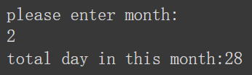
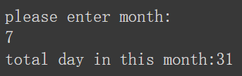
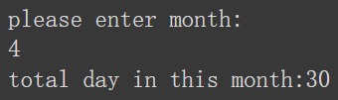
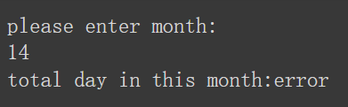
Exercise 1 - 每月天數
幾月的天數有多少天？ (印出結果)
TA
Python

Slide 9
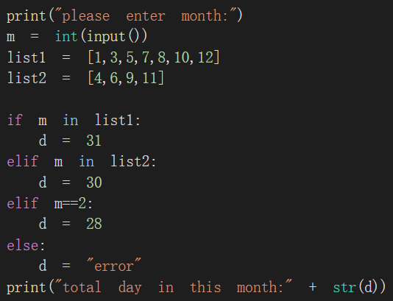
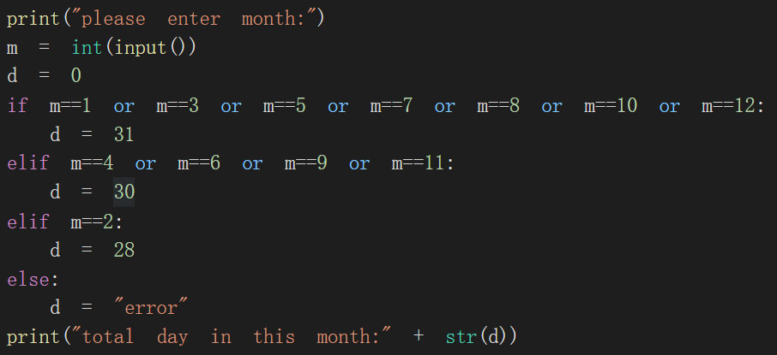
Exercise 1
TA
Python

Slide 10

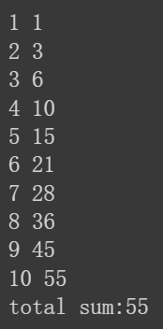
迴圈(for 、 while)
for variable in list:
statements
while condition:
statements
for i in range(1,11):
print(i)
i = 1
while i <= 10 :
print(i)
i+=1
sum = 0
for i in range(1, 11):
sum = sum + i
print(i, sum)
print("total sum:“ + str(sum))
i = 1
sum = 0
while i <= 10 :
sum += i
print(i,sum)
i+=1
print("total sum:“ + str(sum))
TA
Python

Slide 11
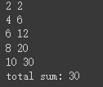


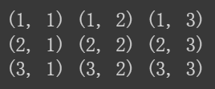
for 迴圈
for variable in list:
statements
sum = 0
for i in range(1,11):
if i % 2 == 0:
sum = sum + i
print(i,sum)
print("total sum:",sum)
a = 1
b = 2
c = 3
for i in a, c, b:
print(i)
for x in range(3): #0, 1, 2
x += 1
for y in range(3): #0, 1, 2
y += 1
print("(" + str(x) + ", " + str(y) + ")", end = " ")
print()
for i in 1, 2, 3:
if i % 2 != 0:
print(i)
TA
Python

Slide 12
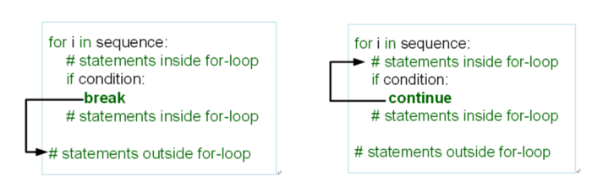


while迴圈
while condition:
statements
break
continue
#反轉數字 ex :輸入123
#輸出 : 321
a = int(input())
reverse = 0
while a != 0:
temp = a % 10
reverse = reverse*10 + temp
a = a // 10
print(reverse)
i = 0
while True : #while 判別為真，一直持續下去
i = i+1
print(i ,emd="")
if i == 10:
break
i = 0
while i < 10:
i = i+1
if i == 4:
continue
print(i ,end = "")
TA
Python

Slide 13
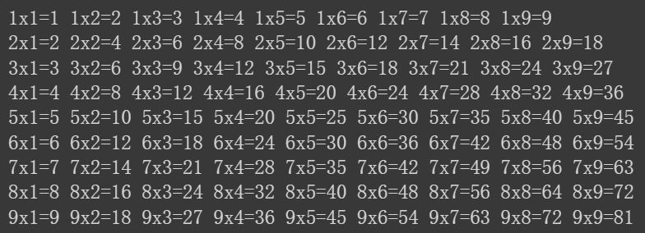

Exercise 2 – 九九乘法表
九九乘法表 (印出結果)
同一個迴圈在同一排
TA
Python

Slide 14
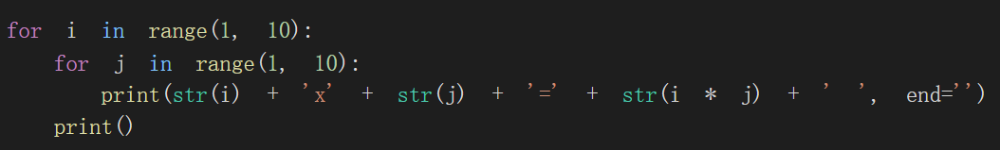
Exercise 2 – 九九乘法表
TA
Python

Slide 15
串列 list
儲存一連串有順序性的元素
0
1
2
3
…
n-1
索引(index)
元素值(element)
89
55
73
66
…
100
TA
Python

Slide 16
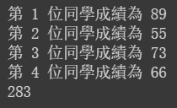
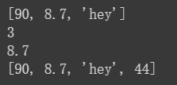
串列 list
串列 list
一維串列
儲存一連串有順序性的元素
成績計算
score = [89, 55, 73, 66]
sum = 0
for i in range(4): #0, 1, 2, 3
sum = sum + score[i]
print("第", i+1, "位同學成績為",score[i])
print(sum)
alist = [90, 8.7, "hey"]
print(alist)
print(len(alist))
print(alist[1]) #index
alist.append(44)
print(alist)
TA
Python

Slide 17

串列 list
一維串列
二維串列
費式數列
score = []
for i in range(2):
score.append([0]*3)
print(score)
score[0][0]=79
score[0][1]=89
score[0][2]=99
score[1][0]=57
score[1][1]=54
score[1][2]=60
print(score)
fib = [0]*10
fib[0] = 1
fib[1] = 1
for i in range(2,10): #2,3,…,9
fib[i] = fib[i-1] + fib[i-2]
for i in range(10):
print(i+1, fib[i])
score = [[79,89,99],[57,54,60]]
TA
Python

Slide 18


字典 dictionary
‘My dictionary’
‘Allen3’
…
鍵值(Key)
字典值(Value)
‘Allen1’
180
‘Allen2’
180
70
…
TA
Python

Slide 19
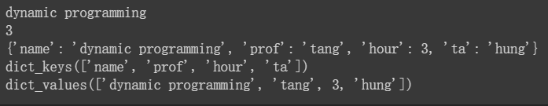
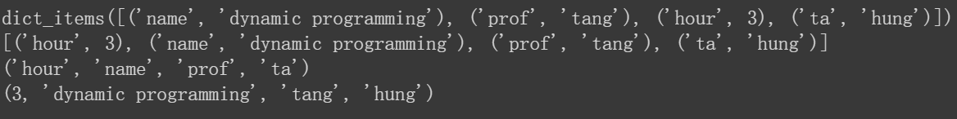

字典 dictionary
每個元素由key和value組成
a_class = {"name":"dynamic programming", "prof":"tang", "hour":3}
print(a_class["name"])
print(a_class["hour"])
a_class[“ta”] = “hung” #新增
print(a_class)
print(a_class.keys())
print(a_class.values())
temp = a_class.items()
print(temp)
s_class = sorted(temp)
print(s_class)
x, y = zip(*s_class)
print(x)
print(y)
d_try = {}
for i in range(1, 4):
j = "a" * i
d_try[i] = j
print(d_try)
作圖會用到
TA
Python

Slide 20

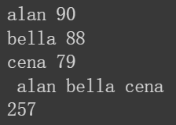
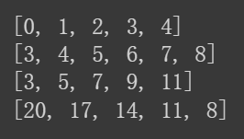
for迴圈 - list、 dictionary
adict = {1:11, 2:12, 3:13, 4:14}
x = 0
y = 0 for i in adict: #把KEY VALUE各自PRINT
print(i, adict[i])
x = x + i #做加總
y = y + adict[i]
print(x)
print(y)
alist = []
for i in range(5):
alist.append(i)
print(alist)
blist = []
for j in range(3,9):
blist.append(j)
print(blist)
clist = []
for k in range(3,13,2):
clist.append(k)
print(clist)
dlist = []
for l in range(20,6,-3):
dlist.append(l)
print(dlist)
bdict = {"alan":90, "bella":88, "cena":79}
a = ““ #空字串
b = 0
for i in bdict:
print(i, bdict[i])
a = a + “ ” + i #做加總
b = b + bdict[i]
print(a)
print(b)
TA
Python

Slide 21
Exercise 3 – 儲存值
陣列
字典
TA
Python

Slide 22
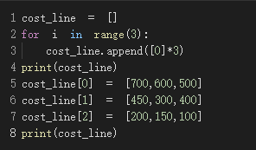
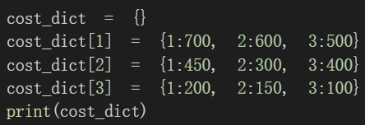
Exercise 3 – 儲存值
陣列
字典
TA
Python

Slide 23


最大值最小值
x = max(30,40,50,60)
y = min(30,40,50,60)
print("x:", x, "y:",y)
cost_dict = {}
cost_dict[1] = {1:700, 2:600, 3:500}
cost_dict[2] = {1:450, 2:300, 3:400}
cost_dict[3] = {1:200, 2:150, 3:100}
all_min = {} #放各期最佳決策的字典
for i in cost_dict: #期數
min_value = 10000000 #懲罰值
min_key = 0
for j in cost_dict[i]: #決策
if min_value > cost_dict[i][j]:
min_value = cost_dict[i][j]
min_key = (i,j)
all_min[min_key] = min_value
print(all_min)
情境
決策者需決定三期決策問題，已知各期各決策的成本值，試問各期最佳決策與成本為？
TA
Python

Slide 24

函式(function)
def 函式語法(參數名稱):
函式內部程式碼
return 資料
#建立一個函式讓其可以加總到 輸入的數值
def sum1(n):
sum = 0
for i in range(n+1):
sum += i
return sum
sum1(10)
def sayhi(): #定義一個無參數的函式 叫sayhi
print("Hi")
def message(msg):
print(msg)
def add(n1,n2): #有參數
return n1+n2 #回傳兩數加總
#呼叫函數
sayhi()
message("hello")
add(10,2)
def check_even(number):
if number % 2 == 0:
return True
else :
return False
check_even(8)
TA
Python

Slide 25

遞迴(Recursion)
# 階乘
def factorial(n):
if n==0 or n==1 :
return 1
else :
return n*factorial(n-1)
factorial(4)
# 費式數列 講解
f(0) = 0, f(1) = 1
f(n) = f(n-1) + f(n-2), n>=2
f(2)
f(3)
f(4) f(1)
f(2) f(1)
f(0)
1
f(1)
1
0
f(0)
2
1
# 費式數列
def fibonacci(n):
if n ==0:
return 0
elif n == 1:
return 1
else :
return fibonacci(n-1) + fibonacci(n-2)
fibonacci(7)
1
1
0
TA
Python

Slide 26

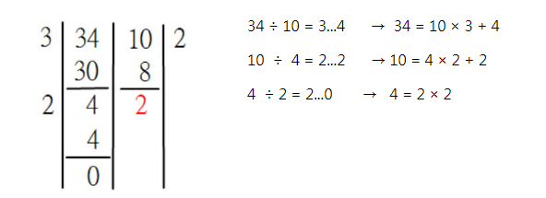

Exercise 4 – 求取最大公因數
利用遞迴來做最大公因數
結果
利用輾轉相除法
TA
Python

Slide 27

Exercise 4 – 求取最大公因數
#找最大公因數
def gcd(m, n):
if n == 0:
return m
else:
return gcd(n, m % n)
m = int(input("輸入 m："))
n = int(input("輸入 n："))
print("Gcd: ", gcd(m, n))
結果
TA
Python

Slide 28
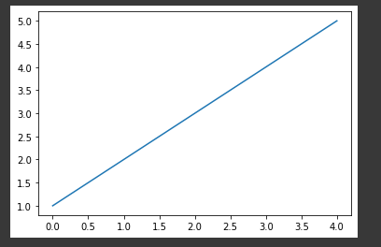
matplotlib作圖
圖表是由 figure 和 axes 兩個元素所構成
import matplotlib.pyplot as plt
x = [1,2,3,4,5]
plt.plot(x)
plt.show()
import matplotlib.pyplot as plt
x = [1,2,3,4,5]
f = plt.figure()
plt.subplot()
plt.plot(x)
plt.show()
Figure 表示matplotlib 繪製圖表的空間，在繪製圖表時，要先創建一個畫布，才能在加入各種元素，儲存或輸出圖片時，也都是以 figure 為單位進行儲存或輸出
axes 表示「座標系統」，如果是二維圖表，axes 會包含兩個座標軸 ( axis )、如果是二維圖表，axes 會包含三個座標軸 ( axis )，依此類推，在一個 figure 之中，可以設定多個 axes
TA
Python

Slide 29
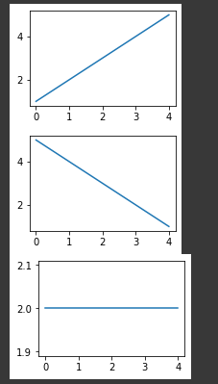
matplotlib作圖
import matplotlib.pyplot as plt
x = [1,2,3,4,5]
y = [5,4,3,2,1]
z = [2,2,2,2,2]
fig1 = plt.figure() #每次新增一個figure 就會新增一個畫布
plt.subplot(2,2,1)
plt.plot(x)
fig2 = plt.figure()
plt.subplot(2,2,1)
plt.plot(y)
fig3 = plt.figure()
plt.subplot(2,2,1)
plt.plot(z)
plt.show()
TA
Python

Slide 30
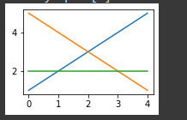
matplotlib作圖
import matplotlib.pyplot as plt
x = [1,2,3,4,5] #資料
y = [5,4,3,2,1]
z = [2,2,2,2,2]
fig1 = plt.figure(num=1) #加入num1 可把圖表都固定在同一張畫布上
plt.subplot(2,2,1)
plt.plot(x)
fig2 = plt.figure(num=1)
plt.subplot(2,2,1)
plt.plot(y)
fig3 = plt.figure(num=1)
plt.subplot(2,2,1)
plt.plot(z)
plt.show()
TA
Python

Slide 31
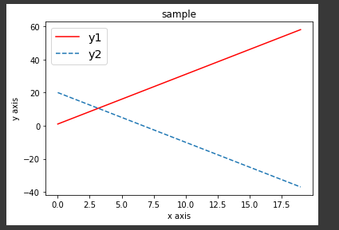
matplotlib作圖
import numpy as np # 引入NumPy
import matplotlib.pyplot as plt # 引入matplotlib的函數
x = np.arange(20) # x軸的值
y1 = 3 * x + 1 # y軸的值
y2 = -3 * x + 20 # y軸的值
plt.title("add legend") # 圖的標題
plt.xlabel("x axis") # x軸的名稱
plt.ylabel("y axis") # y軸的名稱
plt.plot(x,y1, color = "red", label = "y1") # 繪製x,y1的圖
plt.plot(x,y2, ls = "--", label = "y2") # 繪製x,y2的圖
plt.legend(loc = 0, prop={'size': "x-large"})
plt.show() # 顯現圖形
TA
Python

Slide 32
Exerciser5 – 最佳定價
需求量(q) = 基準需求量(a) – 價格敏感度(b) x 價格(p)
利潤(profit) =需求量(q) x (價格(p) – 成本(c))
假設a = 20, b = 1, c = 5
求價格從$5至$20各自的利潤值，存成字典型式，並作圖
TA
Python

Slide 33
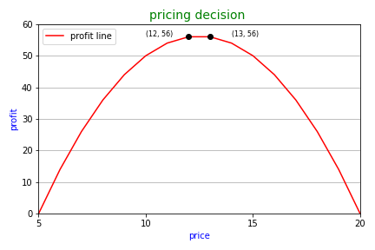
Exerciser5 – 最佳定價
TA
Python

Slide 34
Exerciser5 – 最佳定價
d = {}
for p in range(5, 21):
profit = (20 - p) * (p - 5)
d[p] = profit
print(d)
import matplotlib.pyplot as plt
from google.colab import files
l1 = d.items()
l2 = sorted(l1)
x, y = zip(*l2)
plt.xlim(5, 20) #範圍
plt.ylim(0,60)
plt.xticks([5, 10, 15, 20], color = ‘black‘) #刻度
plt.yticks([0, 10, 20, 30, 40, 50, 60] ,color = 'black')
plt.plot(x, y, color = “r”, label = “profit line”) #線條
plt.legend(loc = 'upper left')
plt.title("pricing decision ", color = 'green', fontsize = 14)
plt.xlabel('price', color = "b")
plt.ylabel('profit', color = "b")
ax = plt.gca()
ax.yaxis.grid(True)
ax.plot([12], [56], 'o', color = "black")
plt.text(10, 56, "(12, 56)", fontsize = 8, color = "black")
ax.plot([13], [56], 'o', color = "black")
plt.text(14, 56, "(13, 56)", fontsize = 8, color = "black")
plt.tight_layout()
plt.savefig("price.png")
files.download("price.png")
plt.show()
TA
Python

Slide 35
import matplotlib.pyplot as plt
from google.colab import files
l1 = d.items()
l2 = sorted(l1)
x, y = zip(*l2)
plt.xlim(5, 20)
plt.ylim(0,60)
plt.xticks([5, 10, 15, 20], color = 'black')
plt.yticks([0, 10, 20, 30, 40, 50, 60] ,color = 'black')
plt.plot(x, y, color = "r", label = "profit line")
plt.legend(loc = 'upper left')
plt.title(“pricing decision ”, color = ‘green’, fontsize = 14) 名稱
plt.xlabel('price', color = "b")
plt.ylabel('profit', color = "b")
ax = plt.gca()
ax.yaxis.grid(True)
ax.plot([12], [56], ‘o’, color = “black”) #黑點
plt.text(10, 56, “(12, 56)”, fontsize = 8, color = “black”) #備註
ax.plot([13], [56], 'o', color = "black")
plt.text(14, 56, "(13, 56)", fontsize = 8, color = "black")
plt.tight_layout()
plt.savefig("price.png")
files.download(“price.png”) #下載檔案
plt.show()
Exerciser5 – 最佳定價
TA
Python

