Slide 1

BE EXTRAORDINARY

Slide 2
Introduction to the Linux Shell
Ade Fewings, Aaron Owen, Oliver Barbaresi
Bangor University
Updated: 22/10/2022

Slide 3



eResearch
Supercomputing Wales
Available to researchers at Bangor
Research Software Engineers
Collate expert knowledge into an open and shared centralised repository
Yammer
GitHub Workshops
Projects
Acknowledgements

Slide 4






Training workshops
Introduction to the Linux Shell
Version Control using Git
Programming Principles and Practice using Python
Advanced Python
Parallel Processing in Python
Machine learning with Python
Introduction to MATLAB
R workshops
See and discuss on the Yammer group and suggestions for new training courses welcome

Slide 5

Linux
An open source Unix-like operating system (OS)
Open source - anyone can access and update
Unix-like - multi-user operating system
OS - computer software which manages the computer hardware/resources and provides services
First released in 1991, and is implemented EVERYWHERE:
Runs most of the internet
Common house-hold appliances
Self-driving cars

Slide 6
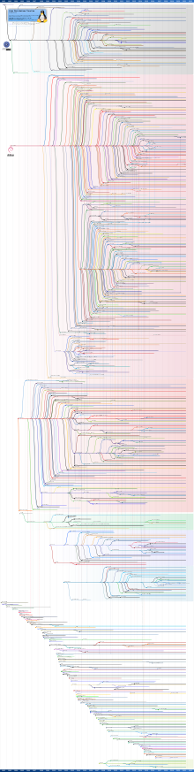
Linux Distributions
A Linux distribution is a packaging of the Linux kernel along with other software to form an Operating System
Also known as distros
Open source – anyone can use and change
Hundreds of different distributions have been developed
Approximately 300 which are actively maintained ^{[1]}
New distros are typically developed from an existing one
A Root distro is the parent branch which the others originate from
Seen clearly on the flowchart as the tightly bunched branches originating from a common ancestry
Any issues with so many different branches?
Can confuse between distros and may be some minor and hard-to-notice subtle differences
[1] – suse.com

Slide 7
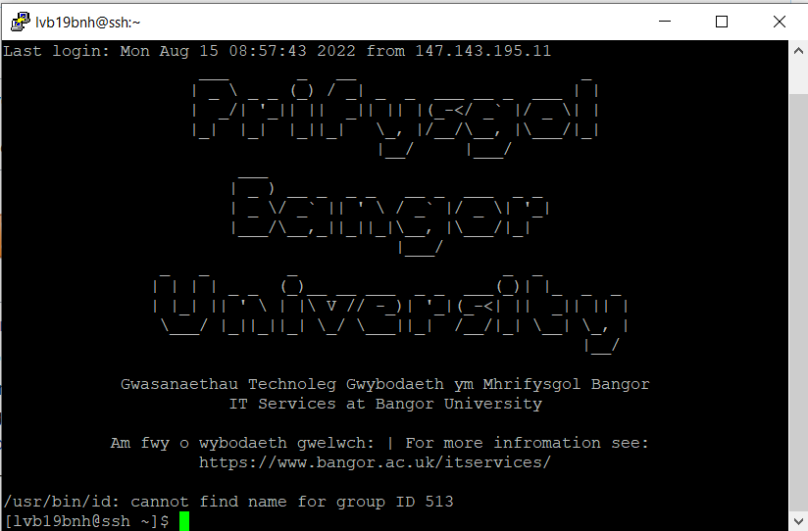
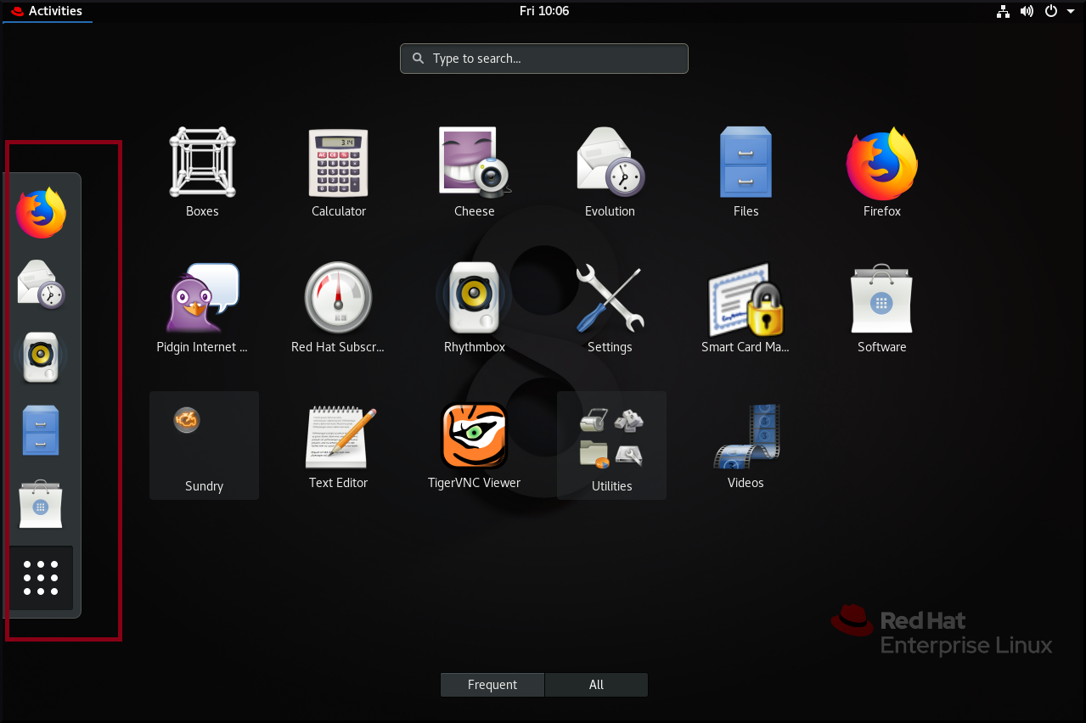
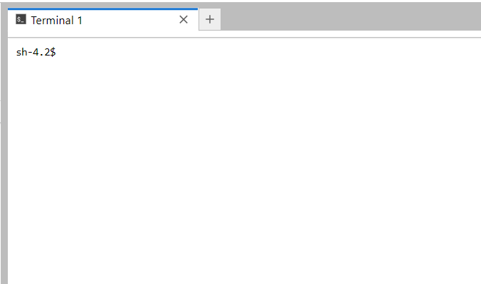
How to use Linux
Graphical or textual interface
we will be using the textual interface in this course
Also known as the Command Line or Shell
[1] - geeksforgeeks.org

Slide 8
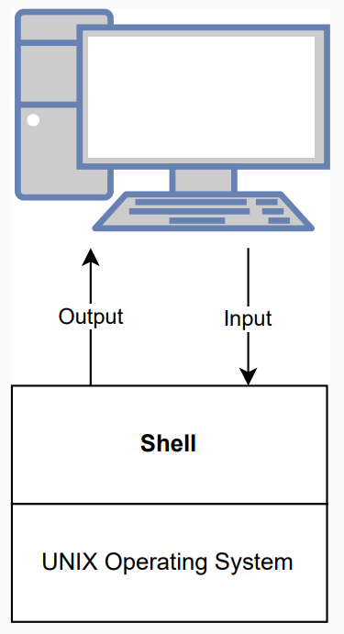
What is a shell?
A program that provides a user interface for Unix-like operating systems (Kernel)
Its job us to translate the user’s commands into the operating system (OS) instructions
The OS starts a shell for each user when they log in or open a terminal window
Examples of Shells:
Bourne Family: sh, ash, ksh, bash
C Family: csh, tcsh
Perl Family: Perlsh, zoidberg
Microsoft Family: cmd.exe, Windows PowerShell
What we’ll be using!

Slide 9
Why Bash?
Installed as the default interactive shell for users on most Linux systems (default for putty)
The use of Graphical User Interfaces (GUI) does not scale well when delivering instructions to a computer
Due to it using a lot of memory and being user optimized
Repetitive tasks can be done automatically and quickly
Sequences of commands can be written into a script, improving the reproducibility of workflows
Two ways to use Bash: as a user interface and as a programming environment
Bash will take some time to get familiar with, however, a small number of commands will get you a long way
Basic Bash knowledge is required to use the Supercomputing Wales service

Slide 10
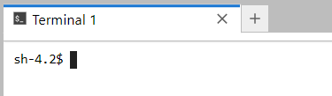
Option 1: Access a Linux machine
Visit https://jupyter.bangor.ac.uk/jupyter
Login using you Bangor University credentials
Select the Terminal application
Type ssh compute and hit enter
Can you see the last login credentials?
Last login: Mon Aug 15 10:10:43 2022 from …………
$ Presented with a prompt, indicating that the shell is ready to accept input:

Slide 11
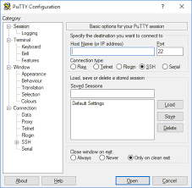
Option 2: Access a Linux machine
Open an application called ‘Putty’
Host name: ssh.bangor.ac.uk
Click ‘Open’
Enter your university username and password when prompted and hit enter
Type ssh compute and hit enter
Can you see the last login credentials?
Last login………
$ presented with a prompt, indication that the shell is ready to accept input
If this doesn’t work, see next slide
SSH = Secure SHell

Slide 12

Option 2: Access a Linux machine
If this doesn’t work you can try setting up dual factor authentication using the Microsoft Authentication app
Download “Microsoft Authenticator” from the app store
Select “University or School account”
Enter your Bangor login details
After entering your user and password into the Linux machine this time, you should get a notification on the app to allow the log in to continue
If this still doesn’t work, contact servicedesk@bangor.ac.uk

Slide 13
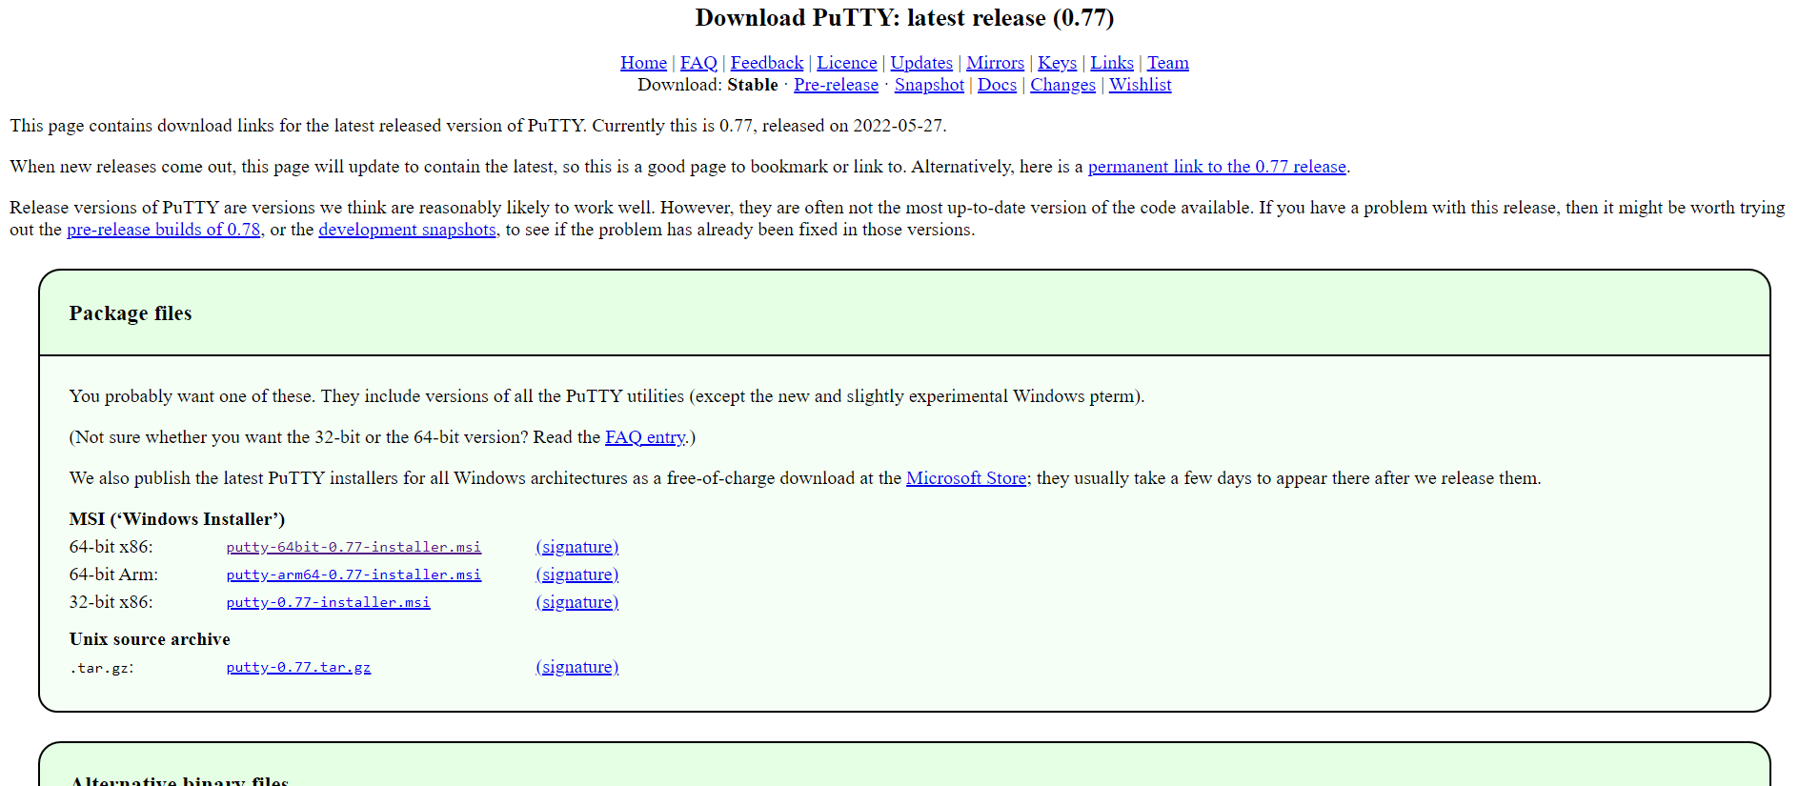
Option 2: Access a Linux machine
If Putty is not installed, you can go to the Bangor University software portal and install
If you do not have a Bangor University machine go to follow this link and select the 64-bit 86 option

Slide 14
Machine Communication- SSH
The essence of secure shell or SSH is to enable access or communication to other machines in a secure way
SSH was developed from a previous communication network called Telnet which was developed in the 1960’s but was not very secure and could be intercepted relatively easily as well as not being encrypted
Encryption essentially means that the information is converted into a cyphertext which isn’t understandable by a person or machine until a specific key is used to convert it back to understandable information
Passwords and/or public/private keys are used to ensure secure communication

Slide 15




Machine Communication: SSH
The way this works can be described with the following analogy, say we would like to get information from one machine to another (or server)
Firstly, the data is encrypted on the local (senders) machine

Slide 16
Machine Communication: SSH
The data is then sent to the receiving machine/server using the corresponding IP address’s
The receiver does not have the key to have access to the data, but encrypts it with its own key

Slide 17

Machine Communication: SSH
The information is then sent back to the original sender which can unlock the original lock with its own key
And then sends the information back to the receiver now with only its own lock

Slide 18
Machine Communication: SSH
The receiver has its own key to its own lock
Which means the information can then be accessed by the receiver

Slide 19
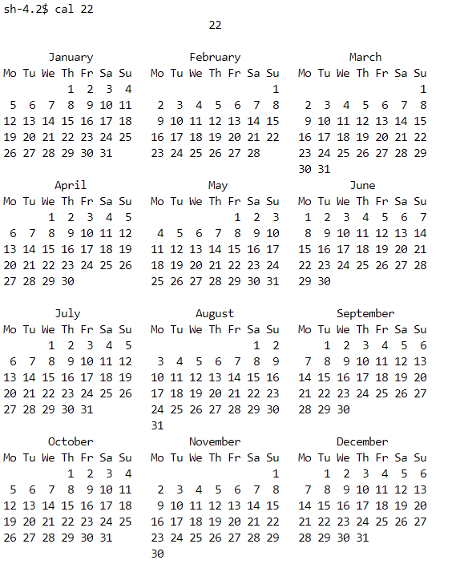
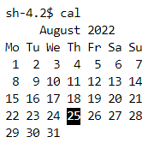

Explore
When you see an Exercise section, feel free to run the commands in the shell
Exercise:
cal - Display a calendar for the current month
cal 22 - 2022 Display a calendar for the year
date - Print the system date and time

Slide 20


Explore
Exercise:
w - See the Information about current users
whoami - Print your user id
users - Who is logged in?
echo - ‘Welcome to Bash’ Print a message
clear or Ctrl+L - clear terminal
ks - Command not found? Usually means a user has mistyped the command
In the shell environment, you cannot use the mouse, the arrow keys only!
Using the up and down arrows can be used to navigate through command history

Slide 21
Getting help
help - Provides information on commands in Bash
man - System manual
Press q to exit, Spacebar to go to the next screen, b Go to the previous screen
Exercise: execute these commands in bash and see what happens
help
man cal
man w
man whoami
man bash
man echo

Slide 22
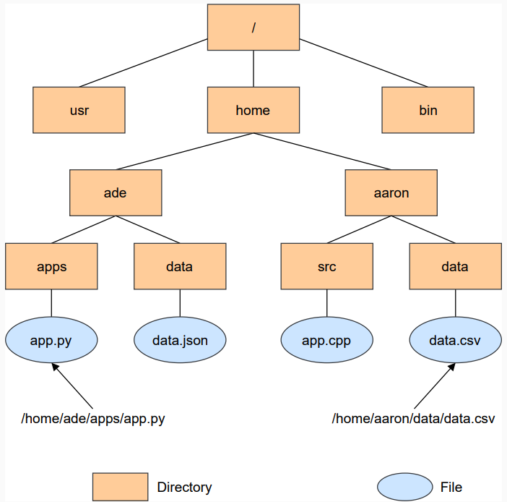
The Working Directory
The directory that the shell is currently looking at
Data in Unix is organised into files
Files are organised into directories
Everything is organised in a tree-like structure called the filesystem structure
The filesystem is responsible for managing and directories
Absolute vs Relative paths

Slide 23
The Working Directory
pwd - Print the working directory
sh-4.2$ pwd
/home/people/<username>/linuxTraining
tree - Recursively list of display the content of a directory in a tree-like format

Slide 24
Files and Directories
ls
ls - List the contents of a directory
man ls - What options are available? Press q to quit
ls /tmp/bash - List the contents of /tmp/bash
ls -a /tmp/bash - List contents of /tmp/bash, including hidden files
ls -l /tmp/bash - Use long listing format when printing
ls ~ - List contents of your home directory (~ denotes home directory)
Wildcard
Metacharacters such as * and ? have a special meaning in Unix
ls *.py - Matches zero or more characters in a filename
ls ?c - Matches any single character

Slide 25
Syntax of a Shell command
Example:
ls -l /tmp/bash
ls - command
-l option
/tmp/bash – argument
Help
man ls
ls --help
ls --help | less
ls –x - Error
Man command have a --help option to display more information to use the command or program

Slide 26

Files and Directories
Some common command to reorder contents:
ls /tmp/bash - Lists contents by alphabetical order
ls -t /tmp/bash - Lists contents by last modified time
ls -r /tmp/bash - Reverse order when sorting
ls -tr /tmp/bash or ls -t -r /tmp/bash
ls -ltr /tmp/bash - Use long listing format to verify
Challenge
List files in /tmp/bash by reverse alphabetical order
Solution
ls -lr /tmp/bash

Slide 27
Files and Directories: Permissions
There is a lot of useful informnation and permissions associated with the ls -l shell command:
drwxr-xr-x. 2 issa16 is 4096 Nov 16 21:04 data
-rw-r -r -. 1 issa16 is 270 Nov 16 14:28 logins.txt
-rw-r -r -. 1 issa16 is 78 Nov 16 14:02 names.txt
Each column left to right shows:
File type and permission given on the file (-,b,c,d,l,p,s)
Number of memory blocks taken by the file or directory
Owner of the file (creator)
Group owner. Each user will have a group.
File size in bytes.
Date and time the file was created or modified. ]
File or directory name.

Slide 28

Navigating Directories
cd
man cd - What options are available? Press q to exit.
cd - Change the working directory to your home directory
cd /tmp/bash - Change the working directory to /tmp/bash
cd .. - Move up one directory
pwd - Shows the current directory path
cd /tmp/bash - Change the working directory to /tmp/bash
cd ../.. - Move up two directories

Slide 29
Navigating Directories: Examples
Example navigating directories:
cd ..
sh-4.2$ pwd
/home/people/<username>/linuxTraining
sh-4.2$ cd ..
sh-4.2$ pwd
/home/people/<username>
sh-4.2$ cd ..
sh-4.2$ pwd
/home/people
/
Home
people
<username>
linuxTraining

Slide 30
Navigating Directories: Examples
Example navigating directories:
cd /
sh-4.2$ pwd
/home/people/<username>/linuxTraining
sh-4.2$ cd /
sh-4.2$ pwd
/
/
Home
people
<username>
linuxTraining

Slide 31
Navigating Directories
Challenges
Change the working directory to home directory
Change the working directory to /tmp/bash
What happens if you try to change the working directory to /home/aaron?
Solutions
cd
cd /tmp/bash
Permission denied or No such file or directory
Tip
Use the up and down arrow keys on the command line to navigate command history

Slide 32
Creating Files and Directories
touch
touch data.txt - Make an empty file called data.txt
man touch - What options are available? Press q to exit
Also used to change the timestamp on existing files and directories
mkdir
mkdir test - Make an empty directory called test
man mkdir - What options are available?
mkdir -vp ~/samples/feb - Make parent directories as needed
Tips
Do not use spaces for file and directory names, prefer - or _ or by using camelCase (see next slide)
Do not begin file or directory names with - , usually reserved for options

Slide 33
Naming Files and Directories
Camel Case: Second and subsequent words are capitalized, to make word boundaries easier to see.
Example: numberOfCollegeGraduates
Pascal Case: Identical to Camel Case, except the first word is also capitalized.
Example: NumberOfCollegeGraduates
Snake Case: Words are separated by underscores.
Example: number_of_college_graduates
It is a matter of personal preference for your files and projects
Be consistent
Often a style will be defined for open source projects
Personal preference is to use snake case for variables and functions and use Pascal Case for class names.

Slide 34
Creating Files and Directories
Challenge
Create the following in your home directory:
samples
jan
01.txt
feb
01.txt
Solution
cd
mkdir -vp samples/jan
touch samples/jan/01.txt
mkdir -vp samples/feb
touch samples/feb/01.txt

Slide 35

Removing Files and Directories
rm
rm -i filename.py - Prompt before removing filename.py (y|n)
rm filename.py - Remove filename.py without prompt - Be careful!!!
rm *.py - Remove all files that end with .py
rm -rfi ~/samples/feb - Remove all files and directories in the path directory
rmdir
rmdir samples/feb - Remove an empty directory using a relative path
rmdir /home/aaron/samples/feb - Remove an empty directory using an absolute path

Slide 36
Copying Files and directories
cp
Copy source file or directory to destination file or directory
cp /tmp/bash/names.txt ~ - Copy /tmp/bash/names.txt to your home directory
cp -r /tmp/bash ~ - copy /tmp/bash to your home directory
cp /tmp/bash/names.txt /tmp/bash/planets.txt ~ - Copy /tmp/bash/names.txt and /tmp/bash/planets.txt to your home directory
Be careful when copying files!!
Files can be rewritten without warning.
Challenge: Try with blank, empty test files to see this actually taking place

Slide 37
Moving Files and Directories
mv
Moves one or more files or directories from a source to a destination
mv -i logins.txt logins_bk.txt - Rename logins.txt as logins_bk.txt after confirmation from user (y|n)
mv logins.txt logins_bk.txt - Rename old_file as new_file without confirmation check
mv *.txt data - Move all python files to data directory

Slide 38
Viewing Files
cat
Reads a file and outputs its content
cat /tmp/bash/names.txt - Print the contents of names.txt
cat -b /tmp/bash/colours.txt - Print the contents of colours.txt with line numbers
cat /tmp/bash/names.txt /tmp/bash/colours.txt - Print the contents of names.txt and colours.txt
less
View files with many lines of content
less /tmp/bash/colours.txt - View the contents of colours.txt
Spacebar Go to next screen, b Go to the previous screen
/ Search for a word
q - Exit

Slide 39
Editing Files
nano
nano some-file - Open nano and start editing
Ctrl+O - Save changes
Ctrl+X - Exit
nano some-file - Open some-file for editing
vim
Opens in command mode, need to activate insert mode
vi some-file
i - To start insert mode
Esc :wq - To exit vi and save changes
Esc :q! - To exit vi and do not save changes

Slide 40
Recap
What is a Shell?
The Working Directory?
Syntax of a Shell command?
Files and Directories
Create, edit, move and delete a file
Create, edit, move and delete a directory
Navigating Directories

Slide 41

Filters
A powerful feature in the Shell is the ability to combine commands and programs in new ways
cat - Displays the contents of its inputs
head - Displays the first 10 lines of its input
tail - Displays the last 10 lines of its input
sort - Sorts its input
wc - Counts lines, words and characters in its inputs
uniq - Report or omit repeated lines

Slide 42
Filters
Exercise
cat /tmp/bash/colours.txt ?
head -n 5 /tmp/bash/colours.txt ?
tail -n 5 /tmp/bash/colours.txt ?
sort /tmp/bash/colours.txt ?
sort -R /tmp/bash/colours.txt ?
wc -l /tmp/bash/colours.txt ?
uniq /tmp/bash/colours.txt

Slide 43

Counting words in a file
Challenge
Use the wc command to count the number of words in /tmp/bash/names.txt
Options
wc -l
wc -c
Solution
wc /tmp/bash/names.txt - 13 13 83 /tmp/bash/names.txt
Columns
Total number of lines in the file
Total number of words in the file
Total number of bytes in the file (file size)

Slide 44

Pipelines
The “|” symbol between commands is called a pipe. It tells the shell that we want to use the output of the command on the left as input to the command on the right
Best way to use the shell is to use pipes to combine simple single-purpose programs (filters)
Task: Build a pipeline to count the number of unique login ids
cd - Change the working directory to your home directory
cp /tmp/bash/logins.txt - Copy sample data to your home directory
cat logins.txt - View sample data
cat logins.txt | sort - Sort data
cat logins.txt | sort | uniq - View unique login ids
cat logins.txt | sort | uniq | wc -l - Count the number of unique login ids

Slide 45
Sort
Challenge
Apply the sort command to /tmp/bash/planets.txt
Solution
sort /tmp/bash/planets.txt
Challenge
Apply the sort command to /tmp/bash/ages.txt - numeric sort
Solution
sort -n /tmp/bash/ages.txt

Slide 46
Sort
Challenge
Use the sort command to get the maximum age in /tmp/bash/ages.txt
Solution
sort -n /tmp/bash/ages.txt | tail -n 1
Challenge
Use the sort command to get the minimum age in /tmp/bash/ages.txt
Solution
sort -n /tmp/bash/ages.txt | head -n 1

Slide 47
Redirection of data
Any Linux process have three processes and data streams associated with them:
stdin - Standard input, also represented by the number 0
stdout - Standard output, also represented by the number 1
stderr - Standard error, also represented by the number 2
A simple example of a stdin is through inputting our commands into the shell from the keyboard
Some commands provide an output if they are spelt and executed correctly while others will lead to an error message

Slide 48
Command Line redirection operators
Just as we used the | symbol to redirect outputs, we can also use the > and >> commands in the shell to redirect certain data:
> - is used to redirect the output of the command to the left of the symbol to whatever is to the right of it
echo “hello!” > temp.txt
>> - This is similar to the > but does not overwrite and instead appends the file on the right with the output of the command to the left of it:
echo “hello!” >> temp.txt
< - Allows us to read the input for a certain command from a file instead of from the keyboard

Slide 49
Redirection of data
Exercise
echo "Line 1" > data.txt
cat data.txt
echo "Line 2" data.txt
cat data.txt
sort /tmp/bash/logins.txt > logins_sorted.txt
cat logins_sorted.txt
Save all unique login ids to unique_logins.txt?
cat /tmp/bash/logins.txt | sort | uniq > unique_logins.txt
Read the last line of all python files and save to last_lines.txt
tail -n1 *.py > last_lines.txt

Slide 50

Search
grep - Select lines from text files that match simple patterns
find - Find files and directories whose names match simple patterns
Exercise
cat /tmp/bash/colours.txt
grep -n olive /tmp/bash/colours.txt
grep -n olives /tmp/bash/colours.txt
grep -nv olive /tmp/bash/colours.txt
find . -type d - Find directories in the working directory
find . -name '*.txt’ - Find all text files in the working directory
wc -l $(find . -name '*.txt’) - Count the lines in all text files

Slide 51
Scripts
Entering commands into the Shell interactively is good for learning and quick testing of code and libraries.
Eventually, you will develop more complex programs and need to run a piece of code repeatedly.
Commands can be either directly entered by the user or read from a file called the shell script
A script is a reusable set of code. It is essentially a file that contains a sequence of Bash instructions.
Bash scripts are plain text, so you can edit them in any text editor
Scripts may contain commands, variables, loops, functions, conditionals for example:
nano test.sh
#!/usr/bin/env bash or #!/bin/bash
echo "Hello from inside the test.sh file"

Slide 52
Scripts
#!/usr/bin/env bash or #!/bin/bash - Ensure script is portable across different UNIX-like operating systems. Known as the shebang
Performing the ls –l command tells us the permissions associated with the script file:
sh-4.2$ ls -l
total 4
-rw-r--r-- 1 lvb19bnh oli 54 Aug 26 10:30 scriptExample
Trying to run the initial script will give the following message:
sh-4.2$ ./scriptExample
sh: ./scriptExample: Permission denied
Using “chmod +x scriptExample” will giving the file permissions to be executed in the shell with the command “./scrpitExample ”

Slide 53

Loops
Allow us to repeat a command or set of commands for each item in a list
Key to productivity improvements through automation
Reduces the amount of code
There are two loops which we will focus on:
For loops - repeat a block of code a known number of times
While loops - repeat a block of code so long as a condition is met

Slide 54
For Loops
Try this example below in a new file loop.sh which will demonstrate the syntax and set up needed while using the for loop:
nano loop.sh
#!/usr/bin/env bash
for idx in 1 2 3 4 5; do
echo "Loop Index: ${idx}"
done
chmod +x loop.sh - giving the file permissions to be executed
./loop.sh or bash loop.sh
Indentation through using the tab button makes the code easier to read
In bash is not done automatically like in Python!

Slide 55
For Loops
Task: Sort names, colours and planets and save results
nano filesort.sh
#!/usr/bin/env bash
for filename in names.txt colours.txt planets.txt; do
sort "${filename}" > "${filename%%.*}_sorted.txt"
done
chmod +x filesort.sh - giving the file permissions to be executed
./filesort.sh or bash filesort.sh
Extract filename without extension
${filename%%.*}
Data redirection!!

Slide 56
Loops using a dry run
Task: Print the command but do not execute
nano dryrun.sh
#!/usr/bin/env bash
for filename in *.txt; do
echo "uniq ${filename} > ${filename%%.*}_uniq.txt"
# uniq ${filename} > ${filename%%.*}_uniq.txt
done
chmod +x dryrun.sh - giving the file permissions to be executed
./dryrun.sh or bash dryrun.sh
# - Comment, not code. Purely for documentation.

Slide 57
Variables
A variable itself holds some form of data/information about a particular value.
The value could be a number, a letter, a word or sequences or each
The value can change and updated
Challenge: Create a new program in the shell and run the basic program below:
#!/bin/bash
testVariable=2
echo “the variable = ${testVariable}”
testVariable=3
echo “the variable = ${testVariable}”

Slide 58
Variables
Task: Sum the integers from 1 to 10, where sum is the variable
nano sum.sh
#!/usr/bin/env bash
sum=0
for i in 'seq 1 10'; do
sum=$((sum+i))
echo "idx:${i} sum:${sum}"
done
echo "Total Sum:${sum}"
chmod +x sum.sh – Giving the file permissions to be executed
./sum.sh or bash sum.sh
seq - Print a sequence of numbers, defaults to a step of 1

Slide 59
Command Substitution
We can also make commands themselves variables
nano users.sh
#!/usr/bin/env bash
DATE='date'
echo "Date is ${DATE}"
ACTIVE_SESSIONS='users | wc –w'
echo "There are ${ACTIVE_SESSIONS} user sessions currently active"
chmod +x users.sh - giving the file permissions to be executed
./users.sh or bash users.sh
./users.sh > daily_users.txt

Slide 60
Conditional Statements
Conditional statements enable you to code decisions into your Bash scripts
if - Perform a set of commands if a test is true
else - If the test is not true then perform a different set of commands
elif - If the previous test returned false perform a different test
&& - Perform the AND operation
|| - Perform the OR operation
case - Choose a set of commands to execute depending on a string matching a particular pattern

Slide 61
if
If a particular test is true, then perform a given set of commands encased between the if and fi will be carried out:
Format
if [ <test> ]; then
<set of commands>
fi
Examples
i=10
if [ $i -gt 5 ]; then
echo "$i is greater than 5"
fi
# Numerical comparison
if [ 001 -eq 1 ]; then
echo "True"
fi
NOTE: be careful with spacing between brackets!!
name="Aaron"
if [ $name = "Aaron" ]; then
echo "Hi Aaron!"
fi
# String comparison
if [ 001 = 1 ]; then
echo "Hi"
fi

Slide 62
Arithmetic Comparisons
When comparing 2 or more values with each other, bash does not recognise conventional greater than or less than signs, instead:
x -eq y - Test identity
x -ne y - Test inequality
x -lt y - Less than
x -gt y - Greater than
x -le y - Less than or equal
x -ge y - Greater than equal

Slide 63
if else
If the test is not true then perform a different set of commands
Format
if [ <condition> ]; then
<set of commands>
else
<set of commands>
fi
Examples
i=2
if [ $i -gt 5 ]; then
echo "$i is greater than 5"
else
echo "$i is less than or equal to 5"
fi

Slide 64
if elif else
If the previous test returned false, perform a different test
Format
if [ <test1> ]; then
<set of commands>
elif [ <test2> ]; then
<set of commands>
else
<set of commands>
fi
Example
i=20
if [ $i -lt 10 ]; then
echo "$i is less than 10"
elif [ $i -gt 10 ]; then
echo "$i is greater than 10."
else
echo “i = 10”
fi

Slide 65
AND Operation
Perform the AND operation
Example
name=“Aaron”
i=20
if [ $name = “Aaron” ] && [$i –eq 20 ]; then
echo “Both conditions returned true.”
fi

Slide 66
OR Operation
Perform the OR operation
Example
name=“Aaron”
i=20
if [ $name = “Aaron” ] || [$i –eq 20 ]; then
echo “Both conditions returned true.”
fi

Slide 67
Case Statements
Choose a set of commands to execute depending on a string matching a particular pattern
Format
case <variable> in
<pattern 1>)
<set of commands>
;;
<pattern 2>)
<set of commands>
;;
esac
Example
status="start"
case $status in
start)
echo "Starting“
;;
stop)
echo "Stopping“
;;
restart)
echo "Restarting“
;;
*)
echo "Unknown status“
;;
esac

Slide 68
While Loops
Now that we can use case statements and logic, we can move back to the while loop. Again, the while loop will continue so long as a condition is satisfied.
Challenge: Create the below program in a new file and run it to understand the syntax and operation of the while loop:
#!/bin/bash
counter=0
while [ counter –lt 50 ]; do
echo “the value of the counter = $counter”
counter=$((counter+1))
done

Slide 69
Functions
A function is essentially a set of commands that can be called numerous times. It improves the readability of code and avoids writing the same code out repeatedly, for more efficient execution.
Format
#Multi line
function_name () {
commands
}
#Single line
function_name () { commands; }
Example
hello_world() {
echo "Hello World!"
}
hello_world
hello() {
echo "Hello $1!"
}
hello "Aaron”

Slide 70
Variables Scope
Global variables are variables that can be accessed from anywhere in the script regardless of the scope. In Bash, all variables by default are defined as global, even if declared inside the function.
Local variables can be declared within the function body with the local keyword and can be used only inside that function. You can have local variables with the same name in different functions.
#!/usr/bin/env bash
x=1
y=2
test_function() {
local x=3
y=4
echo "Inside function: x: $x, y: $y"
}
echo "Before executing function: x: $x, y: $y"
test_function
echo "After executing function: x: $x, y: $y"

Slide 71

Change Password
As with many webpages, the password can be changed for security reasons or just for a personal preference
passwd – and hitting enter will allow you to enter the current password to and then update to a new one:
Changing current password for <user> (current) UNIX password:
Enter new UNIX password:
If you decide that you do not want to change the password while setting up the new one, press enter until the following message appears:
passwd: Authentication token multiple error
passwd: password unchanged

Slide 72
Brace Expansion
The curly brackets, {} are useful in speeding up otherwise time consuming processes
mkdir {<dirName1>,<dirName2>,….} - fast way of making multiple directories
When writing programs in bash, brace expansion can also be implemented to make writing loops more efficient:
for i in {1..10}; do
echo “iteration number - ${i}”
done
Challenge: Copy the above text and implement brace expansion in some loops

Slide 73
wget
Download files non-interactively from the internet
Try: wget bbc.co.uk
You should see the full file html of the webpage and will automatically save as a .html file
We can then view the html file in full using the normal ways using cat and less
wget --mirror <website root> - download the entire website
Be careful when downloading files to your machine

Slide 74

File Transfer: SCP
This is how we copy files and/ or directories between a local and a remote system, or between two remote systems
Similar to the cp command used before
So caution is needed as it can rewrite the file without warning!!
Transferring the file ‘alarm’ from the current shell to another Linux machine would have the syntax:
scp /alarm <user>@199.199.1.19:/home/<user>/files/alarm
You will normally have to enter login details of the destination system
origin
Destination and new file root

Slide 75
Input to the computer
It is often useful to have an input from a user while a program is running
This is possible in the Linux shell using the read command
An echo command before the input ensures the command is easy to read for the user:
echo “what is the user input?”
read userInput
The input can then be checked using the echo command:
echo “The output = ${userInput}”
Challenge: Try to read a few inputs and then output them using echo

Slide 76

User input manipulation: calculator
Challenge: Create a bash program which operates as a calculator with a difficulty of your choosing
Hints:
Using a while loop can be useful to enter multiple operations
if statements can be useful to split up different operations
Mathematical operations can be undertaken in the format of:
answer=$((<variable1>+<variable2>))
Menu’s and option checks can make it easier for the user to operate the program

Slide 77
Task: Reading and manipulating a file
How to read in data from a file, access it and manipulate it:
Firstly, create a .txt file with any number on each line
Save it as datafile.txt
Create a new file called datareader
#!/bin/bash
while IFS= read -r line; do
echo “the text from line $line”
done
< datafile.txt
Challenge: Add an operation in the while loop such as summing the data and outputting it line by line

Slide 78
Arrays
An array is like a sequence of variables that can save a variable to a specific block in the sequence:
Arrays allow us to save related data and information all in one variable
No need to declare the type of data the array is saving
The array is indexed and each variable is assigned and then can be called from it’s respective index
Challenge: Create a new file using nano and write the following:
arrayPrac=(1 2 3)
echo “element 2 in the array is: ${arrayPrac[2]}”
Change the array values and echo statement !
1 | 2 | 3 | 4 | 5 | 6

Slide 79
Arrays: further
Arrays can be used in loops to add data as a program is executed
This means that the array is updated with each iteration of the loop:
for i in {1..10}; do
testArray[i] = “test ${i}”
done
We can then test the new array to see if its works as following:
for i in {1..10}; do
echo “element ${i} in the array = ${testArray[i]}”
done
Challenge: Declare and test your own arrays in Bash!!

Slide 80
Dictionaries
These are data structures which can be accessed and includes detentions, databases and information
This is not installed by default on all Linux machines
Check if its installed by typing dict into the shell and seeing if the command is recognised
If the “command not found” error comes up, then install dict with the following:
sudo apt install dict
You will be asked for some security before dict is installed
After installation type “dict orange” into the shell and view what happens
Use the command “man dict” for all options, included the databases included with dict

Slide 81
Jobs
Typically when you run a command in the terminal, you have to wait until the command finishes before you can enter another one.
This is called running the command in the foreground or a foreground process.
sleep 5 & echo "Hello World"
If a command takes a long time to finish and you want to run another command in the meantime you have two options. You can either open up a new terminal and run the command or run the command as a background process.
Think of running a background process as dispatching the command to the operating system and freeing up the terminal.

Slide 82
Jobs
To run a command as a background process, add nohup before the command and the ampersand symbol & at the end of the command.
nohup sleep 5 & echo "Hello World" &
The job id and process id will be printed to the terminal.
[1] 195684
By default, the example above will print the message "Hello World" to the terminal after 5 seconds. This is less than ideal, especially if we are the middle of writing a complex command to launch. The solution is to capture any error or output messages from the command into a log file.
To redirect error and output messages, use the ampersand and greater than symbols &> following by the name of the log file
nohup sleep 5 & echo "Hello World" &> job.log &

Slide 83
Jobs
Once we have created a background process we can view its status via the jobs command.
jobs –l
The output includes the job id, process id, job state and the command that started the job.
If you wanted to bring background process to the foreground you can use the fg command
fg
If you have multiple background processes, include % and the job id after the fg command
fg %2
Note: The jobs command will only show background processes that are started, running or stopped in the current terminal.

Slide 84
Jobs
Exercise
Log in into to the compute node at Bangor via JupyterLab
Start a Matlab background process.
nohup matlab -nodesktop -nosplash -r "disp('Hello World'); exit;" &> matlab.log &
[1] 80706
Logout using the exit command.
Log back in into to the compute node using the ssh compute command
View the contents of matlab.log using the cat matlab.log command
If you want to stop a background process manually, you can use the kill command followed by the jobs process id
kill 80706

Slide 85
Jobs
Exercise
Log in to the compute node at Bangor via JupyterLab
Start a background process.

