Slide 1

BE EXTRAORDINARY

Slide 2

Parallel Processing in Python
Ade Fewings, Aaron Owen
Bangor University
Updated: 12/10/2022

Slide 3



eResearch
Supercomputing Wales
Available to researchers at Bangor
Research Software Engineers
Collate expert knowledge into an open and shared centralised repository
Yammer
Github Workshops
Projects
Acknowledgements

Slide 4





Training Workshops
Introduction to the Linux Shell
Version Control using Git
Programming Principles and Practice using Python
Advanced Python
Parallel Processing in Python
Machine learning with Python
Introduction to MATLAB
Introduction to R
See and discuss on the Yammer group and suggestions for new training courses welcome!

Slide 5
Environment
Python at Bangor Visit
https://jupyter.bangor.ac.uk/jupyter/hub/login
Login using your Bangor University credentials
Click the Python 3.8 notebook.

Slide 6
Overview
What are processes and threads?
What is parallel processing?
Multiprocessing vs Multithreading
CPU vs Core
Determine available resources
Python's GIL problem
Multiprocessing examples
Using the Supercomputing Wales
Desktop to cluster. GNU Parallel

Slide 7
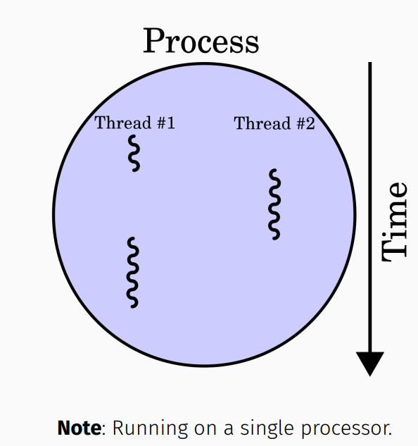
What are Processes and Threads
A process is an instance of a running program
Processes create threads (sub-processes) to handle sub-tasks
Threads live and operate inside a process

Slide 8
Application Example
When you open a text editor, you create a process
When you start typing, the process creates (spawns) threads:
One to read keystrokes
One to display text
One to autosave your file
One to highlight spelling mistakes
By creating multiple threads, the text editor takes advantage of idle CPU time (waiting for keystrokes or files to load) and makes you more productive
Diagram

Slide 9
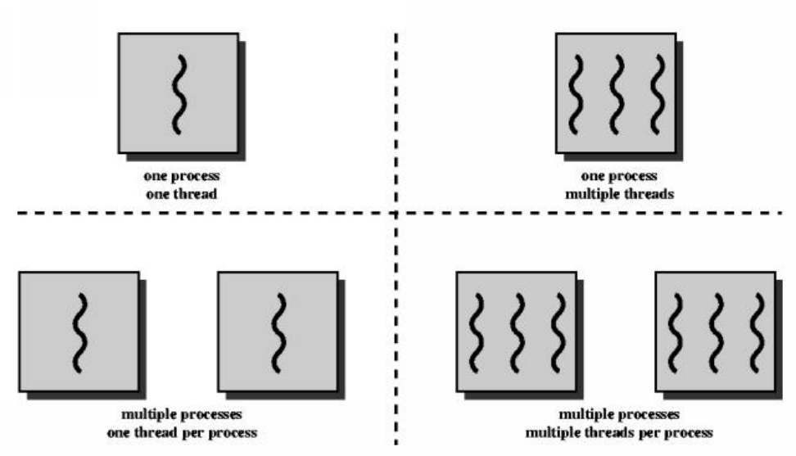
Multithreading vs Multiprocessing
Multithreading - Single processes, multiple threads
Multiprocessing - Multiple processes
Multithreading and Multiprocessing - Multiple processes and multiple threads
We will just focus on multiprocessing (multiple processes, one thread per process)

Slide 10
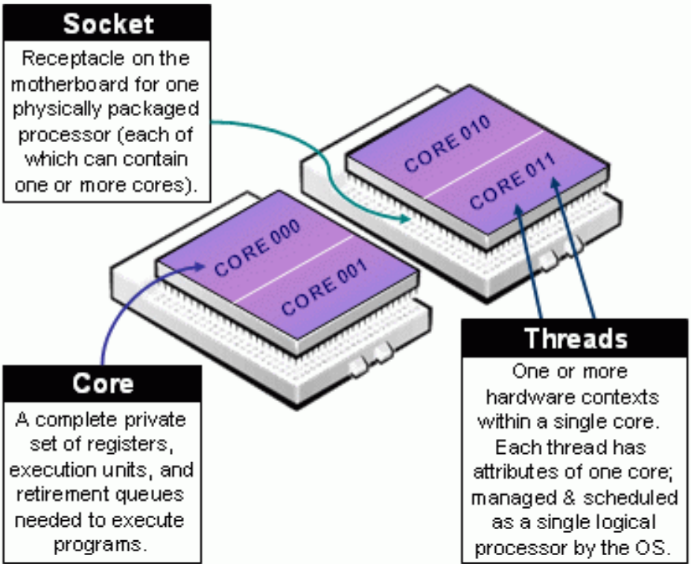
CPU vs Core
The CPU, or processor, manages the fundamental computation work of the computer (processes)
CPUs have one or more cores, allowing the CPU to execute code simultaneously
SCW 40 core node - 2 CPU with 20 cores each 64 core node - 2 CPU with 32 cores each

Slide 11
Python’s GIL Problem
Python has something called the GIL (Global Interpreter Lock)
It prevents two threads from executing simultaneously in the same process
Libraries like numpy bypass this limitation by running external code in C which can manually release the GIL to speed up computations.
The most popular solution is to use multiprocessing
Python provides a library to simplify multiprocessing
Python processes get their own Python interpreter and memory space so the GIL won’t be a problem.

Slide 12
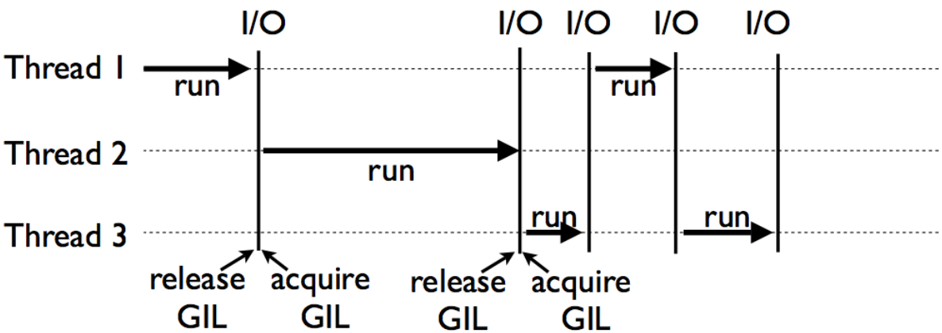
Python’s GIL Problem

Slide 13
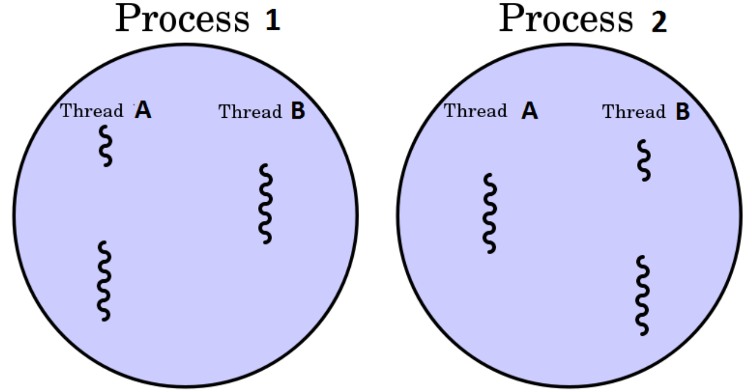
Multiple Processes

Slide 14
When to use Threads and Processes
Processes speed up Python operations that are CPU intensive because they benefit from multiple cores and avoid the GIL problem
Threads are best for I/O tasks or tasks involving external systems because threads can work more efficiently together (lower overhead)
Threads provide no benefit in Python for CPU intensive tasks because of the GIL problem

Slide 15
When to use Threads and Processes
If your code has a lot of I/O or Network usage
Multithreading is your best bet because of its low overhead
If you have a graphical user interface application
Multithreading so your UI thread doesn't get locked up
If your code is CPU heavy (bound)
You should use multiprocessing (if your machine has multiple cores)

Slide 16
What is Parallel Processing
Parallel processing is a mode of operation where a task (program) is executed simultaneously in multiple processes in the same computer
It is meant to reduce the overall processing time
Python provides a built in module to run independent parallel processes
It enables users to use multiple processors on a machine
The management of worker processes can be simplified with the Pool object

Slide 17
Process Example
from multiprocessing import Process
def func(name):
print(f'Hello {name}’)
def main():
p = Process(target=func, args=('Aaron', ))
p.start()
if __name__ == ‘__main__‘:
main()
print('Why is this line printing first?')

Slide 18
Process Example
from multiprocessing import Process
def func(name):
print(f'Hello {name}’)
def main():
p = Process(target=func, args=('Aaron', ))
p.start()
p.join()
if __name__ == ‘__main__‘:
main()
print('Why is this printing last?')

Slide 19
Process ID
from multiprocessing import Process
import os
def func():
print(f"\tfunc's process id {os.getpid()}")
print(f"\t\tfunc's parent process id = {os.getppid()}")
def main():
p1 = Process(target=func)
p1.start()
p1.join()
p2 = Process(target=func)
p2.start()
p2.join()
if __name__ == ‘__main__‘:
print(f"Main's process id is {os.getpid()}")
main()

Slide 20
Determine Available Resources
Firstly, we need to determine what resources are available to our program
The maximum number of processes you can run at a time is limited by the number of processors in your computer
We can use python to determine the number of processors
Enables us to avoid assumptions about the number of processors
import multiprocessing as mp
print(f'Number of processors: {mp.cpu_count()}’)
> Number of processes: 4
On the SCW cluster, we have access to a few more than 4 processors!

Slide 21
Multiprocessing
Let's treat the available cores as a pool of resources - workers (diagram)
Generate a list of items to be worked on
Each item in the list will be processed by worker core in the pool of resources
The multiprocessing pool can be used for parallel execution of a function across multiple input values
Distributing the input data across processes (data parallelism)
Example: Distributing work to each individual in the workshop

Slide 22
Multiprocessing Pool
Map func() to list items and print value:
import multiprocessing as mp
def func(x):
print(x * x)
def main():
num_cores = mp.cpu_count()
pool = mp.Pool(num_cores)
pool.map(func, [4, 2, 3])
if __name__ == ‘__main__‘:
main()
print('done')

Slide 23
Multiprocessing Pool
Map func(x): to list items and return values:
import multiprocessing as mp
def func(x):
return (x * x)
def main():
num_cores = mp.cpu_count()
pool = mp.Pool(num_cores)
result = pool.map(func, [4, 2, 3])
print(result)
if __name__ == ‘__main__‘:
main()
print('done')

Slide 24
Multiprocessing Pool
import multiprocessing as mp
work_items = ["Aaron", "Beth", "George", "Mia"]
def worker_func(work_item):
print(f'Process {work_item}’)
def main():
num_cores = mp.cpu_count()
work_pool = mp.Pool(num_cores)
work_pool.map(worker_func, work_items)
if __name__ == ‘__main__‘:
main()

Slide 25
Multiprocessing Pool with Process ID
Print process id:
import multiprocessing as mp
# This could be a list of any Python datatype (lists, functions, dicts)
work_items = ["Aaron", "Beth", "George", "Mia"]
def worker_func(work_item):
process_id = mp.current_process()
print(f'Process {work_item} on process {process_id}’)
def main():
num_cores = mp.cpu_count()
work_pool = mp.Pool(num_cores)
work_pool.map(worker_func, work_items)# map_async
if __name__ ==‘__main__‘:
main()
print('done')

Slide 26
Launch Multiple Python Programs
We can use Pool.map() to run multiple python scripts in parallel:
import os
import multiprocessing as mp
# List of scripts or args to program?
scripts = ['script_1.py', 'script_2.py', 'script_3.py’]
def run_python_script(script):
os.system(f'python {script}') # args?
def main():
num_cores = mp.cpu_count()
pool = mp.Pool(processes=num_cores)
pool.map(run_python_script, scripts)
if __name__ == ‘__main__‘:
main()
print('done')

Slide 27
Launch Multiple Python Programs
def run_script(script):
app = None
if script.endswith('.py’):
app = 'python3’
if script.endswith('.R’):
app = 'Rscript’
if app:
os.system(f'{app} {script}') # args?
else:
print('Unable to determine app’)
Challenge: Extend the code to pass through the command line args

Slide 28
Map vs imap
A more optimised method is imap
This method does not duplicate the memory space of the original Python process to different workers.
The outcome of using imap is identical to map , but reduces memory usage.
One thing to note is that imap and map can only pass one parameter to the function to be parallelised
We can pass more than one argument using starmap .

Slide 29
starmap
import multiprocessing as mp
def worker_func(a, b, c, d):
process_id = mp.current_process()
print(f'Process {a} {b} {c} {d} on process {process_id}’)
def main():
num_cores = mp.cpu_count()
work_pool = mp.Pool(num_cores)
work_pool.starmap( worker_func,
[
(1, 2, 3, 4), # process 1
(5, 6, 7, 8), # process 2
])
# starmap_async
if __name__ == ‘__main__‘:
main()
print('done’)

Slide 30
What is synchronous and asynchronous
In parallel processing, there are two types of execution:
Synchronous
Asynchronous.
Synchronous execution is where the processes are completed in the same order in which they were started.
Asynchronous execution is where the processes may not be completed in the same order in which they were started. However, it may process the items quicker.

Slide 31
Locks
If required, we can manually acquire and release a lock to control the order in which processes run
from multiprocessing import Process, Lock
def func(lock, num):
lock.acquire()
try:
print(f'The sentence is not mixed up.’)
finally:
lock.release()

Slide 32
Locks continued…
def main():
lock = Lock()
for num in range(10):
Process(target=func, args=(lock, num)).start()
if __name__ == ‘__main__’:
main()
Without using the lock output from the different processes is liable to be mixed up

Slide 33
Pool and Process
There are two main classes in the multiprocessing module to implement parallel execution:
The Pool Class
Process Class.
The general way to parallelise any operation is to take a particular function that should run multiple times and make it run in parallel on different processors
Feel free to ask Aaron for help when adding parallel features to code

Slide 34
Supercomputing Wales
Login
Modules
Python Shell Queue
Home / Scratch
Requesting resources
GNU parallel:
Store a file of commands - Automatic management of resource pool

Slide 35
Multiprocessing slurm script
#!/usr/bin/env bash
# Run main.py on 4 cores
# Usage: sbatch run.slurm
#SBATCH -job-name=map
#SBATCH -output=logs/map.%J.out
#SBATCH -error=logs/map.%J.err
#SBATCH -partition=htc
#SBATCH -nodes=1
#SBATCH -ntasks=1
#SBATCH -cpus-per-task=4
#SBATCH -account=scw1124
#SBATCH -time=00-00:05
module purge
module load python/3.7.0
python3 main.py

Slide 36
Multiprocessing Python script
import os
import multiprocessing as mp
def worker_func(data):
process_id = mp.current_process()
print(f'worker_func is running on process {process_id}, data={data}’)
def main():
# How many cores were assigned to the slurm job allocation?
num_cores = int(os.getenv('SLURM_CPUS_PER_TASK’))
print(f'Found {num_cores} cores’)
pool = mp.Pool(num_cores)
worker_data = range(10)
pool.map(worker_func, worker_data)
if __name__ == “__main__":
main()

Slide 37
GNU Parallel slurm Script
#!/usr/bin/env bash
#SBATCH -job-name=parallel
#SBATCH -output=%J.out
#SBATCH -error=%J.err
#SBATCH -nodes=1
#SBATCH -ntasks=1
#SBATCH -cpus-per-task=4
#SBATCH -account=scw1124
#SBATCH -time=00-03:00
module purge
module load python/3.9.2
module load parallel
echo "Start!"
time parallel < commands.txt
echo "Finished!"

Slide 38
commands.txt
python3 -c "print('Hello from line 1’)”
python3 -c "print('Hello from line 2’)”
python3 -c "print('Hello from line 3’)”
python3 -c "print('Hello from line 4')"

