Slide 1

Parallel Processing in Python

Slide 2


eResearch
Supercomputing Wales
Available to researchers at Bangor
Research Software Engineers
Collate expert knowledge into an open and shared centralised repository
Yammer
Github Workshops
Projects
Acknowledgements

Slide 3






Training Workshops
Introduction to the Linux Shell
Version Control using Git
Programming Principles and Practice using Python
Advanced Python
Parallel Processing in Python
Machine learning with Python
Introduction to MATLAB
Introduction to R
See and discuss on the Yammer group and suggestions for new training courses welcome!

Slide 4
Accessing the Bangor University Python Environment
To follow along with the examples in this presentation, you will need to access the Bangor University Python environment. To do this, please follow these steps:
Visit https://jupyter.bangor.ac.uk/jupyter/hub/login in your web browser.
Login using your Bangor University credentials.
Click the "Python 3.8" notebook to launch the Python environment.
Note: If you have any trouble accessing the environment, please let us know and we will do our best to assist you.

Slide 5
Workshop Overview
What are processes and threads
A brief introduction to the concepts of processes and threads, and how they relate to parallel processing.
What is parallel processing
An explanation of what parallel processing is, and how it can improve the performance of your code.
Multiprocessing vs Multithreading
A comparison of the two main approaches to parallel processing, and the pros and cons of each approach.
CPU vs Core
An overview of the differences between CPUs and cores, and how this relates to parallel processing.

Slide 6
Workshop Overview
Determining available resources
How to determine the available resources on your machine.
Python's GIL problem
An explanation of Python's Global Interpreter Lock (GIL), and how it can impact the performance of your Python code.
Multiprocessing examples
Examples of how to use the multiprocessing module in Python to implement parallel processing.
Using Supercomputing Wales
An introduction to using Supercomputing Wales for parallel processing.

Slide 7
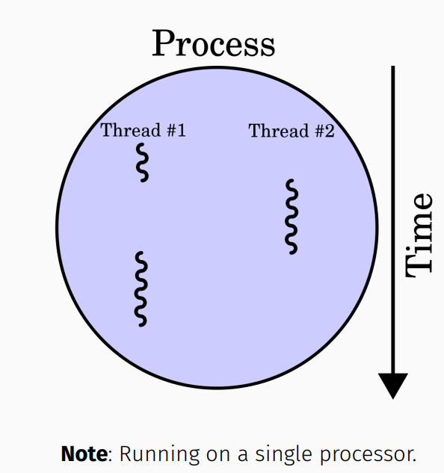
What are processes and threads
A process is an instance of a running program that has its own memory space and system resources.
Threads are sub-processes that can handle sub-tasks within a process and share the same memory space and system resources as the parent process.
In Python you can use both the threading and the multiprocessing modules for implementing parallel processing.

Slide 8
Application example
Example: Text Editor
Opening a text editor creates a process in the background.
The process spawns multiple threads to handle sub-tasks.
Threads include:
One to read keystroke
One to display text
One to autosave your file
One to highlight spelling mistakes
- Multiple threads take advantage of idle CPU time.
- Improves application performance and provides a seamless user experience.

Slide 9
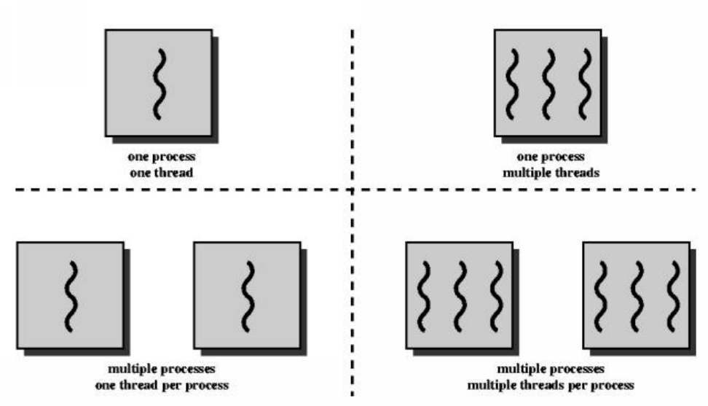
Multithreading vs Multiprocessing
Multithreading: multiple threads within a single process.
Multiprocessing: multiple processes running simultaneously.
Both approaches can improve performance, but have different benefits.
This workshop focuses on multiprocessing with one thread per process.
Using multiple processes allows for efficient distribution of workload.
Particularly useful for CPU-bound tasks for faster and efficient computation.

Slide 10
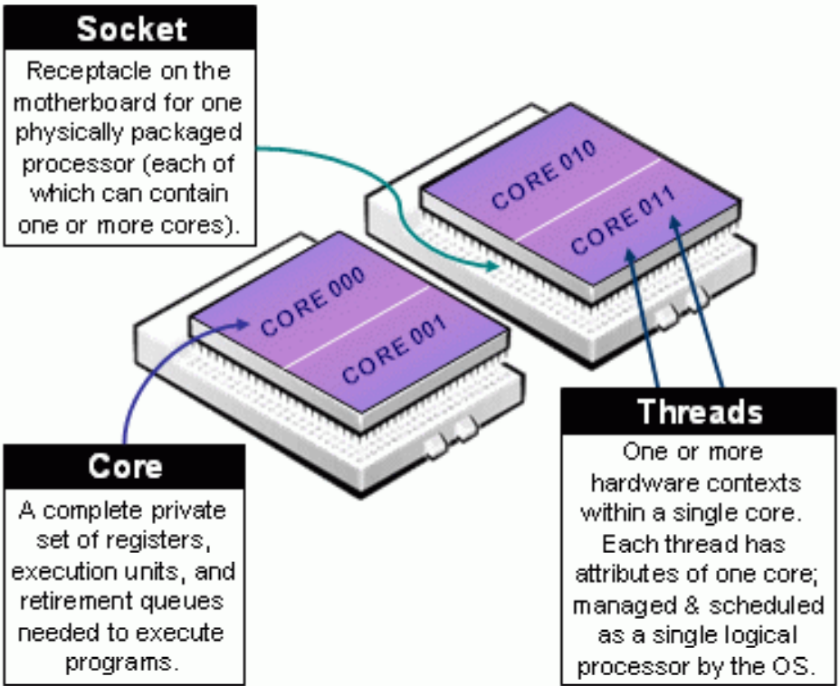
CPU vs Core
The CPU manages computation work (processes).
CPUs have one or more cores for simultaneous code execution.
Cores can execute code independently, allowing for parallel processing.
Multiple cores can improve performance for CPU-bound tasks.
SCW: 40 core node has 2 CPUs with 20 cores each.
SCW: 64 core node has 2 CPUs with 32 cores each.

Slide 11
Global Interpreter Lock
- Python has a Global Interpreter Lock (GIL) that prevents multiple threads from executing simultaneously in the same process.
The GIL can limit the performance gains that can be achieved through parallelisation.
Libraries like NumPy bypass this limitation by running external code in C that can manually release the GIL to speed up computations.
The most popular solution to overcome the GIL is to use multiprocessing.
Python provides a multiprocessing library that simplifies the use of multiple processes.
Multiprocessing allows each process to have its own Python interpreter and memory space, so the GIL won't be a problem.

Slide 12
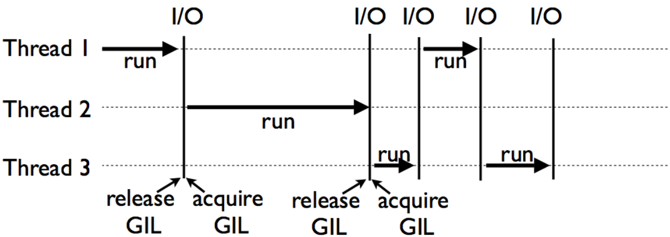
Global Interpreter Lock

Slide 13
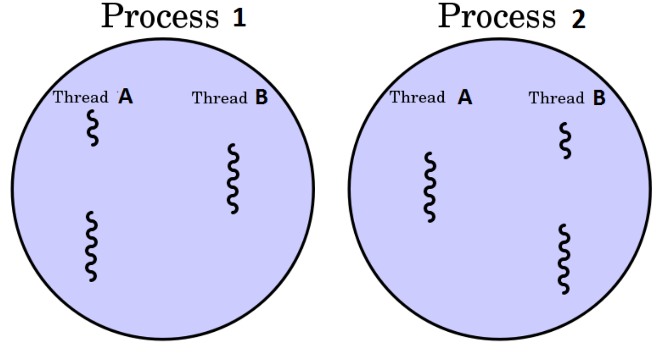
Multiple Processes

Slide 14
When to use threads and processes
Processes are best for CPU-intensive tasks because they can benefit from multiple cores and avoid the GIL problem.
Threads, on the other hand, are best for I/O-bound tasks or tasks involving external systems because threads can work more efficiently together and have lower overhead.
Threads do not provide any benefit for CPU-intensive tasks in Python because of the GIL problem. Since only one thread can execute Python code at a time due to the GIL, using multiple threads for CPU-bound tasks can actually slow down the program rather than speeding it up.

Slide 15
When to use threads and processes
If your code has a lot of I/O or network usage, multithreading is a good choice because of its low overhead. Threads can efficiently perform I/O operations without blocking the main thread.
If you have a graphical user interface application, multithreading is a good choice because it allows you to keep your UI thread responsive while other tasks are running in the background.
If your code is CPU-heavy, i.e., involves a lot of computations, multiprocessing is a good choice, especially if your machine has multiple cores. Each process can run on a separate core, avoiding the GIL problem, and potentially improving the performance.

Slide 16
What is parallel processing
Parallel processing is a mode of operation where a task or program is executed simultaneously in multiple processes on the same computer to reduce the overall processing time.
Python provides a built-in multiprocessing module to run independent parallel processes, enabling users to use multiple processors on a machine.
The Pool object in multiprocessing simplifies the management of worker processes by creating a pool of worker processes and distributing tasks among them.

Slide 17
Process example
from multiprocessing import Process
def func(name):
print(f'Hello {name}')
def main():
p = Process(target=func, args=('Aaron', ))
p.start()
if __name__ == '__main__':
main()
print('Why is this line printing first?')

Slide 18
Process example
from multiprocessing import Process
def func(name):
print(f'Hello {name}')
def main():
p = Process(target=func, args=('Aaron', ))
p.start()
p.join()
if __name__ == '__main__':
main()
print('Why is this printing last?')

Slide 19
Process ID
from multiprocessing import Process
import os
def func():
print(f"\tfunc's process id {os.getpid()}")
print(f"\t\tfunc's parent process id = {os.getppid()}")
def main():
p1 = Process(target=func)
p1.start()
p1.join()
p2 = Process(target=func)
p2.start()
p2.join()
if __name__ == '__main__':
print(f"Main's process id is {os.getpid()}")
main()

Slide 20
Determine available resources
To optimise the use of parallel processing, it's important to determine the resources available to our program.
The maximum number of processes you can run at a time is limited by the number of processors in your computer.
Python's multiprocessing module provides a cpu_count() function that returns the number of available CPUs in the system.
Using cpu_count() enables us to avoid assumptions about the number of processors available on different systems.

Slide 21
Determine available resources
import multiprocessing as mp
print(f'Number of processors: {mp.cpu_count()}')

Slide 22
Multiprocessing
In multiprocessing, we treat the available cores as a pool of resources (workers) that can process tasks simultaneously.
To use multiprocessing, we generate a list of items to be worked on, and each item in the list is processed by a worker core in the pool of resources.
The multiprocessing Pool object can be used for parallel execution of a function across multiple input values, enabling us to distribute the input data across processes (data parallelism).
Example: Distributing work to each individual in the workshop.

Slide 23
Multiprocessing pool
import multiprocessing as mp
def square(x):
"""Calculates the square of a number."""
return x ** 2
def main():
# Determine the number of cores
num_cores = mp.cpu_count()
# Create a pool of worker processes
with mp.Pool(num_cores) as pool:
# Map the square function to a list of numbers
results = pool.map(square, [4, 2, 3])
# Print the results
print(results)
print('done’)
if __name__ == '__main__':
main()

Slide 24
Multiprocessing pool
import multiprocessing as mp
def worker_func(work_item):
print(f'Process {work_item}\n')
if __name__ == '__main__':
work_items = ["Aaron", "Beth", "George", "Mia"]
num_cores = mp.cpu_count()
work_pool = mp.Pool(num_cores)
work_pool.map(worker_func, work_items)

Slide 25
Multiprocessing pool with process ID
import multiprocessing as mp
# This could be a list of any Python datatype
work_items = ["Aaron", "Beth", "George", "Mia"]
def worker_func(work_item):
process_id = mp.current_process()
print(f'Process {work_item} on process {process_id}')
if __name__ == '__main__':
num_cores = mp.cpu_count()
work_pool = mp.Pool(num_cores)
work_pool.map(worker_func, work_items) # map_async
print('done')

Slide 26
Launch multiple python programs
import multiprocessing as mp
import subprocess
# List of scripts or args to program?
scripts = ['script_1.py', 'script_2.py', 'script_3.py']
args = [['arg1', 'arg2'], [], ['arg3']]
def run_python_script(script, args):
subprocess.run(['python', script, *args])
def main():
num_cores = mp.cpu_count()
pool = mp.Pool(processes=num_cores)
pool.starmap(run_python_script, zip(scripts, args))
if __name__ == '__main__':
main()
print('done')

Slide 27
Launch multiple python programs
import os
import multiprocessing as mp
scripts = [
'script_1.py’,
'script_2.R’,
'script_3.py’
]
def run_script(script):
app = None
if script.endswith('.py’):
app = 'python3'
elif script.endswith('.R’):
app = 'Rscript'
if app:
# Add command line arguments here
os.system(f'{app} {script} arg1 arg2 arg3')
else:
print('Unable to determine app’)
def main():
num_cores = mp.cpu_count()
pool = mp.Pool(processes=num_cores)
pool.map(run_script, scripts)
if __name__ == '__main__':
main()
print('done')

Slide 28
map vs imap
A more optimised method is imap
imap does not duplicate the memory space of the original Python process to different workers
The outcome of using imap is identical to map, but it reduces memory usage
imap and map can only pass one parameter to the function to be parallelised
We can pass more than one argument using starmap

Slide 29
starmap
import multiprocessing as mp
def worker_func(a, b, c, d):
process_id = mp.current_process()
print(f'Process {a} {b} {c} {d} on process {process_id}')
def main():
num_cores = mp.cpu_count()
work_pool = mp.Pool(num_cores)
work_pool.starmap(worker_func, [(1, 2, 3, 4), (5, 6, 7, 8)])
if __name__ == '__main__':
main()
print('done')

Slide 30
What is synchronous and asynchronous
In parallel processing, there are two types of execution:
Synchronous
Asynchronous
Synchronous execution:
Processes are completed in the same order in which they were started.
Asynchronous execution:
Processes may not be completed in the same order in which they were started.
May process the items quicker.

Slide 31
Locks
In a parallel processing environment, it's possible for multiple processes to access and modify the same data simultaneously. This can cause problems if one process modifies the data while another process is still using it, leading to unexpected results and errors.
To avoid these issues, we can use locks to ensure that only one process at a time can access and modify the data. A lock is a synchronisation primitive that allows multiple processes to coordinate their access to shared resources.

Slide 32
Locks
from multiprocessing import Process, Lock
def func(lock, num):
lock.acquire()
try:
print(f'The sentence is not mixed up. {num}')
finally:
lock.release()
def main():
lock = Lock()
for num in range(10):
Process(target=func, args=(lock, num)).start()
if __name__ == '__main__’:
main()
# See lock_example.py

Slide 33
Locks
The main() function creates a Lock object and passes it to each child process.
The func() function acquires the lock before printing its message, and releases it afterwards. This ensures that only one process can print its message at a time, and prevents the messages from getting mixed up.

Slide 34
Pool and Process
multiprocessing has two main classes for parallel execution: Pool and Process
- Pool is useful for running the same function multiple times in parallel
- Process allows for more control over individual processes and their communication
If you need help adding parallel features to your code, don't hesitate to ask for assistance.

Slide 35
Supercomputing Wales
Login
Modules
Python Shell
Queue
Home / Scratch
Requesting resources
GNU parallel:
Store a file of commands - Automatic management of resource pool

Slide 36
Multiprocessing slurm script
#!/usr/bin/env bash
# Usage: sbatch run.slurm
#SBATCH -job-name=map
#SBATCH -output=logs/map.%J.out
#SBATCH -error=logs/map.%J.err
#SBATCH -nodes=1
#SBATCH -ntasks=1
#SBATCH -cpus-per-task=4
module purge
module load python/3.7.0
python3 main.py

Slide 37
Multiprocessing Python script
import os
import multiprocessing as mp
def worker_func(data):
process_id = mp.current_process()
print(f'worker_func is running on process {process_id}, data={data}')
def main():
# How many cores were assigned to the slurm job allocation?
num_cores = int(os.getenv('SLURM_CPUS_PER_TASK'))
print(f'Found {num_cores} cores')
pool = mp.Pool(num_cores)
worker_data = range(10)
pool.map(worker_func, worker_data)
if __name__ == '__main__':
main()

Slide 38
GNU Parallel slurm Script
#!/usr/bin/env bash
#SBATCH -job-name=parallel
#SBATCH -output=%J.out
#SBATCH -error=%J.err
#SBATCH -nodes=1
#SBATCH -ntasks=1
#SBATCH -cpus-per-task=4
module purge
module load python/3.9.2
module load parallel
echo "Start!"
time parallel < commands.txt
echo "Finished!"

Slide 39
commands.txt
python3 -c "print('Hello from line 1')"
python3 -c "print('Hello from line 2')"
python3 -c "print('Hello from line 3')"
python3 -c "print('Hello from line 4')"

