Slide 1
UNG DUNG CHAM TRAC NGHIEM
Miss Ngoc Center
Demo Flow Trai Nghiem Nguoi Dung
Chup anh bai trac nghiem - AI cham tu dong - Xuat bang diem Excel
Thang 10/2026

Slide 2
TONG QUAN FLOW
Quy trinh tu chuan bi den co bang diem hoan chinh
1
2
3
4
5
6
Tao lop
Import hoc sinh
Tao bai KT
Chup bai
Generate
Bang diem
Admin tao lop
va gan giao vien
Import danh sach
tu file Excel
Tao bai kiem tra
va nhap dap an
NV dung dien thoai
chup bai tung HS
AI doc anh va
tinh diem tu dong
Xem bang diem
va xuat Excel
FLOW CHINH - Chi tiet o cac slide sau
Buoc 1-3: Chuan bi du lieu (Admin/NV lam tren may tinh)
Buoc 4-6: Chup va cham bai (NV dung dien thoai + may tinh)

Slide 3
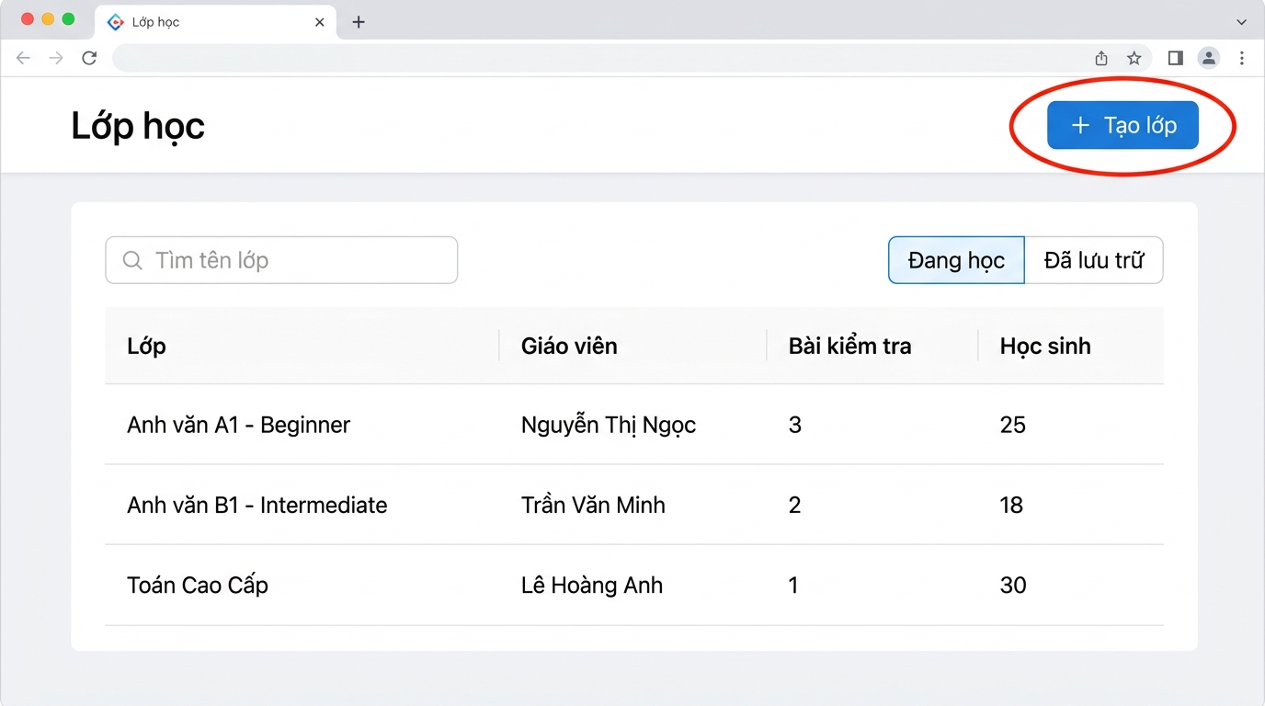
Buoc 1 - Tao lop
Admin hoac nhan vien tao lop moi
Bam "+ Tao lop"
- Nhap ten lop
- Chon trinh do
- Gan giao vien
- Dat thoi gian khoa hoc
Lop tao xong -> vao trang chi tiet
Khoanh do: nut can bam
Phan nay nhanh, chi can vai thao tac

Slide 4
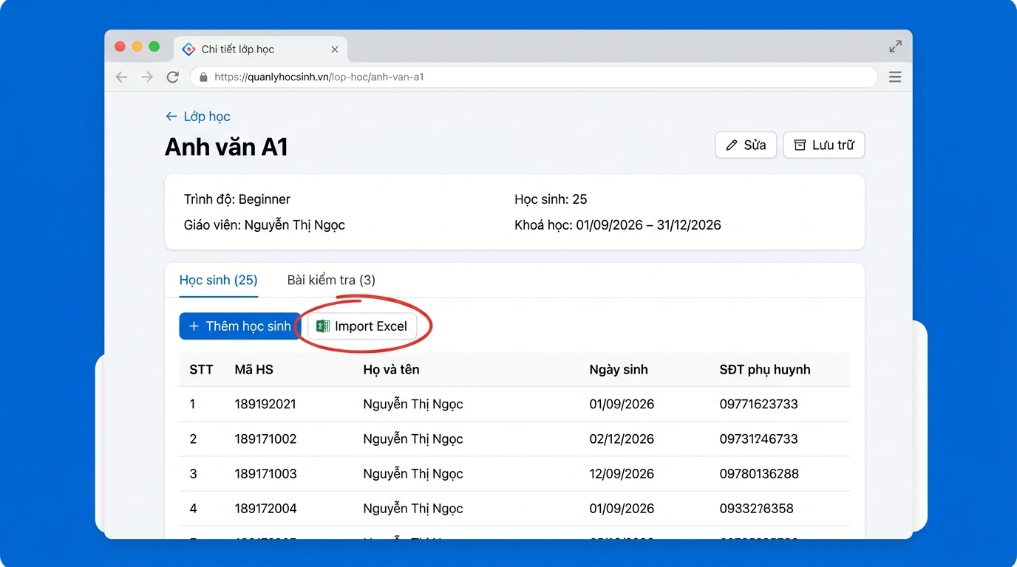
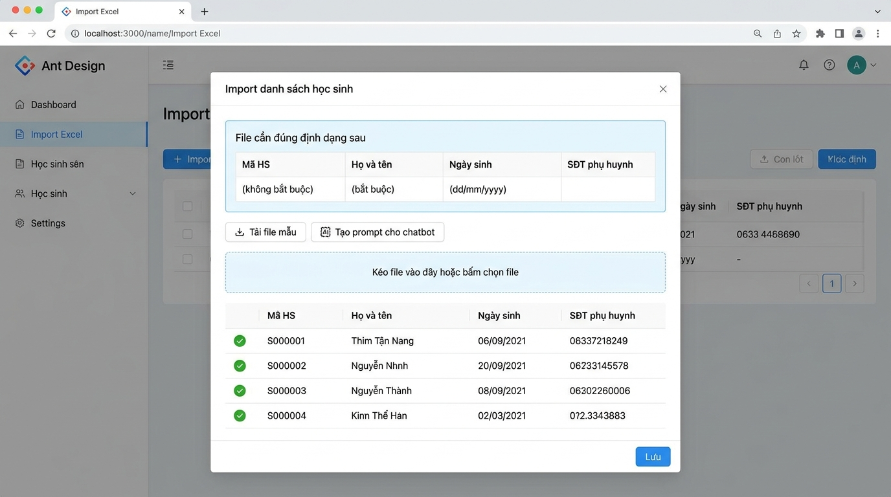
Buoc 2 - Import danh sach hoc sinh tu Excel
Trang chi tiet lop -> Tab Hoc sinh -> Bam Import Excel
Bam Import Excel -> Tai file mau (.xlsx) -> Dien danh sach hoc sinh -> Chon file -> Xem truoc va Luu
Co the dung nut Tao prompt cho chatbot de nho AI chuyen danh sach lon xon thanh dung dinh dang

Slide 5
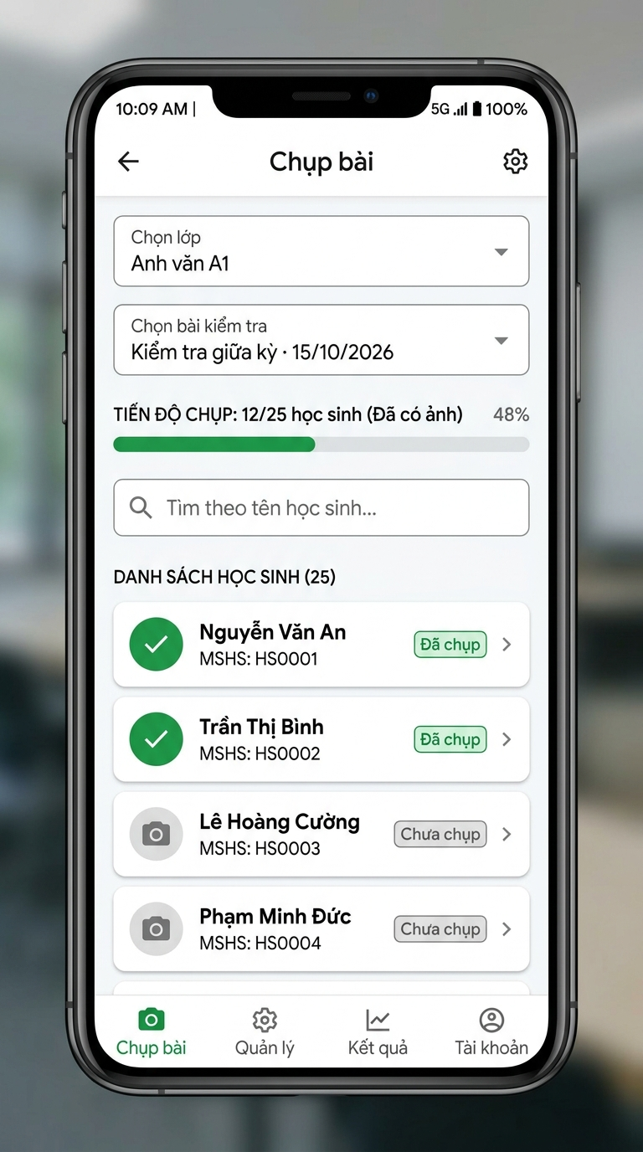
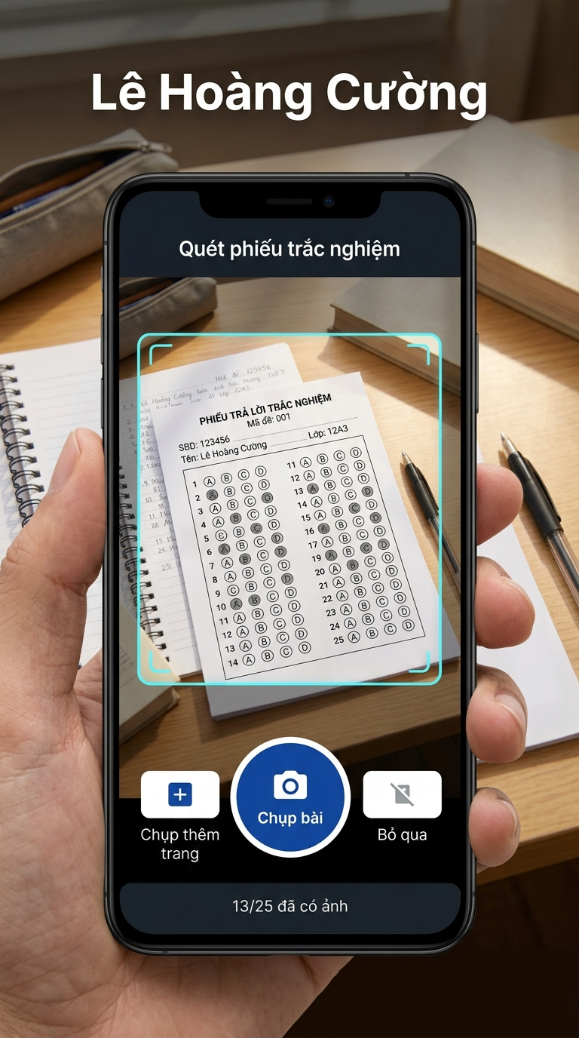
Buoc 4 - Nhan vien chup bai bang dien thoai
NV van phong mo trinh duyet dien thoai -> Dang nhap -> Chon lop va bai -> Chup tung hoc sinh
Flow chup bai
1. Chon lop va bai kiem tra
2. Cham vao ten hoc sinh
3. Bam Chup bai -> mo camera
4. Chup phieu tra loi
5. Anh tu tai len, chuyen sang HS ke tiep
6. Lap lai den het lop
Ten HS hien to tren man hinh - tranh gan nham
Tien do chup hien theo thoi gian thuc
Mang chap chon -> anh tu tai lai

Slide 6
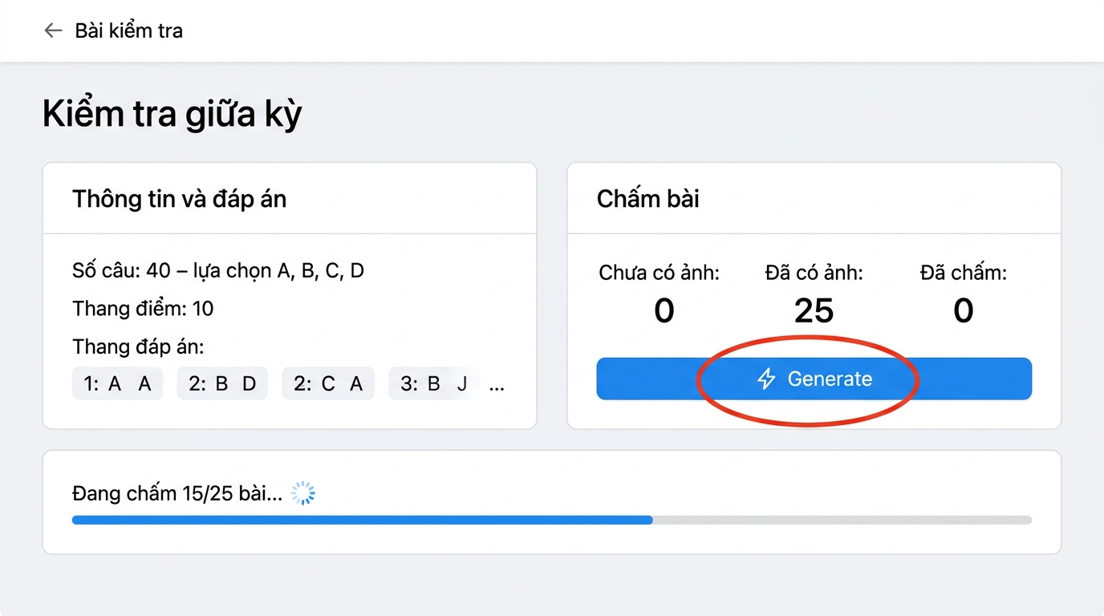
Buoc 5 - Bam Generate de AI cham bai
Trang chi tiet bai kiem tra -> Bam nut Generate -> AI doc anh va tinh diem
Cach Generate hoat dong
1. Bam nut Generate (khoanh do)
2. AI doc anh tung bai (5 bai/lan)
3. Tien do hien real-time
4. So sanh voi dap an -> tinh diem
5. Cau AI khong chac -> to vang
6. Xong -> hien bang diem
Tiet kiem thoi gian
Thu cong: ~3 phut/bai
Dung app: ~30 giay/bai
1.200 bai/thang:
60 gio -> 10 gio (giam 80%)

Slide 7
Buoc 6 - Bang diem va Xuat Excel
Xem bang diem tren web (giong het file Excel) -> Bam Xuat Excel de tai file .xlsx
Bang diem tren Web
File Excel xuat ra
STT Ho va ten 1 2 3 4 ... Diem Hang
BANG DIEM - KIEM TRA GIUA KY
Anh van A1 - 15/10/2026
1 Nguyen Van An A B A C ... 8.5 1
STT Ho va ten 1 2 3 4 ... Dung Diem
2 Tran Thi Binh B B C A ... 7.0 5
1 Nguyen Van An A B A C ... 34 8.5
3 Le Hoang Cuong A A A D ... 9.0 2
2 Tran Thi Binh B B C A ... 28 7.0
3 Le Hoang Cuong A A A D ... 36 9.0
4 Pham Minh Duc C B A B ... 6.5 8
5 Vu Thi Mai A C B C ... 7.5 3
Xuat Excel
Da cham: 25/25 TB: 7.2 Cao nhat: 9.5 Thap nhat: 3.0
Bang diem
Thong ke cau sai
Dung dinh dang, co mau sac, dung duoc ngay

Slide 8
TONG KET FLOW
1
2
3
4
5
6
Tao lop
Import HS
Tao bai KT
Chup bai
Generate
Bang diem
May tinh
May tinh
May tinh
Dien thoai
May tinh
May tinh
30 giay
1 phut
2 phut
10 phut / lop 30 HS
2-3 phut
Bam 1 nut
LOI ICH CHINH
Tiet kiem 80% thoi gian
Chinh xac 100%
De su dung
Excel ngay lap tuc
60 gio -> 10 gio / thang
AI + duyet tay = khong sai
Chi can dien thoai + trinh duyet
Co mau, dung mau, khong can chinh
Miss Ngoc Center - Ung dung cham trac nghiem

