Slide 1
Spark Streaming

Slide 2
Table of Content
What is Streaming Data?
Intro to Spark Streaming
How Spark Streaming Works?
Spark Streaming + Kafka Example
Intro to Structured Streaming

Slide 3
What is Streaming Data

Slide 4
What is Streaming Data
Streaming means continuous flow events
Streaming data is data that is generated continuously by thousands of data sources
Batch processing framework fail to process data of this nature
Streaming data processing is beneficial in most scenarios where new, dynamic data is generated on a continual basis

Slide 5
Intro to Spark Streaming

Slide 6
Intro to Spark Streaming
Spark Streaming API is used for processing the data in real-time
Other Spark abstractions available: Spark SQL, Spark Core components are not capable of handling the data that you receive in real-time

Slide 7
Intro to Spark Streaming
Spark Streaming is a processing engine to process data in real-time from sources and output data to external storage systems
It has three main components:
Input Source
Streaming Engine
Sink

Slide 8
Intro to Spark Streaming
Input sources: Kafka, Flume, HDFS/S3, etc.
Spark Streaming engine processes incoming data from various input sources
Sinks store processed data from Spark Streaming engine like HDFS, relational databases, or NoSQL datastores

Slide 9
Intro to Spark Streaming
Spark uses various output modes to store the streaming data:
Append Mode
Update Mode
Complete Mode

Slide 10
Intro to Spark Streaming
In append mode, Spark will output only newly processed rows since the last trigger
In update mode, Spark will output only updated rows since the last trigger
In complete mode, Spark will output all the rows it has processed so far

Slide 11
How Spark Streaming Works?

Slide 12
How Spark Streaming Works?
A spark streaming job gets data from multiple sources
You need to implement two components in this scenario:
Receiver (for connecting to a streaming source)
DStream (to receive the data)

Slide 13
How Spark Streaming Works?
The receiver gets connected to multiple sources that consistently generate events in real-time
The source streams the data and receiver is the interface in a spark streaming job to consume the data
We create the receiver using SparkStreamingContext interface

Slide 14
How Spark Streaming Works?
The second interface we implement to receive the data is Dstream (also known as Discretized Streams)
When talking about continuous streams, the term “continuous” means that we never start or stop receiving data as part of the stream
Dstream represents a continuous stream of data over time

Slide 15
How Spark Streaming Works?
RDD at time 1
RDD at time 2
RDD at time 3
RDD at time 4
DStream
Data from time 0 to 1
Data from time 1 to 2
Data from time 2 to 3
Data from time 3 to 4

Slide 16
How Spark Streaming Works?
Spark Streaming accumulates the data in the form of batches
The amount of data accumulated will depend on the batch interval defined in terms of time
By defining the batch interval of 5 seconds, spark job will accumulate the data for 5 seconds and it will create 1 batch
These batches gets generated continuously and the spark job runs on top of data accumulated in the batch interval of 5 seconds

Slide 17
How Spark Streaming Works?
You can apply transformations and actions (groupby, reduceby, map , flatmap, etc.) on top of these Dstreams
Once Dstream gets generated, after that you job becomes the same as normal spark Job

Slide 18
How Spark Streaming Works?
DStream transformations can be categorized into two types:
Stateless Transformations
Stateful Transformations

Slide 19
How Spark Streaming Works?
Stateless Transformations:
Stateless transformations are transformations that applies on every batch in a DStream
For any batch of data being processed, there is no dependency on the data from previous batches
Ex. map(), filter(), reduceByKey(), etc.

Slide 20
How Spark Streaming Works?
Stateful Transformations:
Stateful transformations are transformations that tracks data across multiple batches
For any batch of data being processed, there is either a partial or whole dependency on the data from previous batches
It makes use of some data/results from previous batches and computes the result of the current batch of data
Ex. map(), filter(), reduceByKey(), etc.

Slide 21

Stateful Transformation are advanced topics that requires good understanding of sliding window and checkpointing. For more information please refer:
https://spark.apache.org/docs/latest/streaming-programming-guide.html

Slide 22
Streaming Sources
The sources should be capable to stream the data to your spark job
The sources can be (not just limited to):
Kafka
Flume
Socket Streaming
File

Slide 23
Spark Streaming + Kafka Example

Slide 24
Spark Streaming + Kafka Example
We will count the number of words on the data you receive in real time
Here we create a Kafka Producer program that writes messages to a Kafka Topic as bytes
The objective is to create a Spark Streaming program as consumer that reads the data in real time and process it

Slide 25
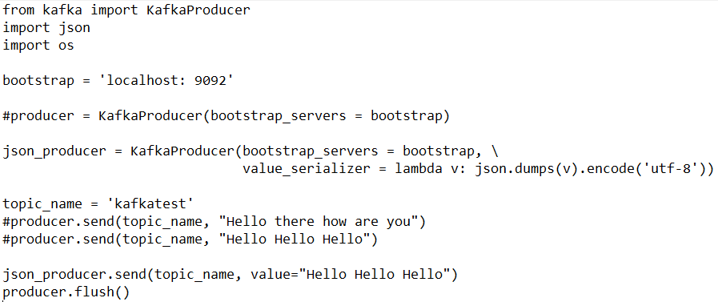
Spark Streaming + Kafka Example
Producer: Python program to publish data to a topic using KafkaProducer
Bootstrap server address

Slide 26
Spark Streaming + Kafka Example
We use json_producer, if you want to write messages in the form of Json
json_producer writes the data to a topic in the form of (key,value) pair
We will have to create value_serializer since we are interested in values and not keys
We also create another kafka producer with the same list of bootstrap server address for value we say
for every value convert it into json and use utf-8 as the encoder

Slide 27
keys in kafka is actually meant for accumulating all messages pertaining to a specific user or specific key by which you want to combine messages over single partition. In this case we don’t have such requirement

Slide 28
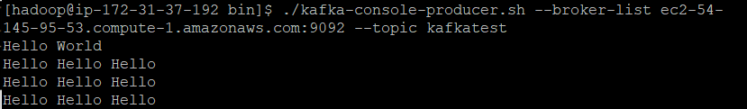
Producer: To write to a Topic, you can also try this command as well

Slide 29
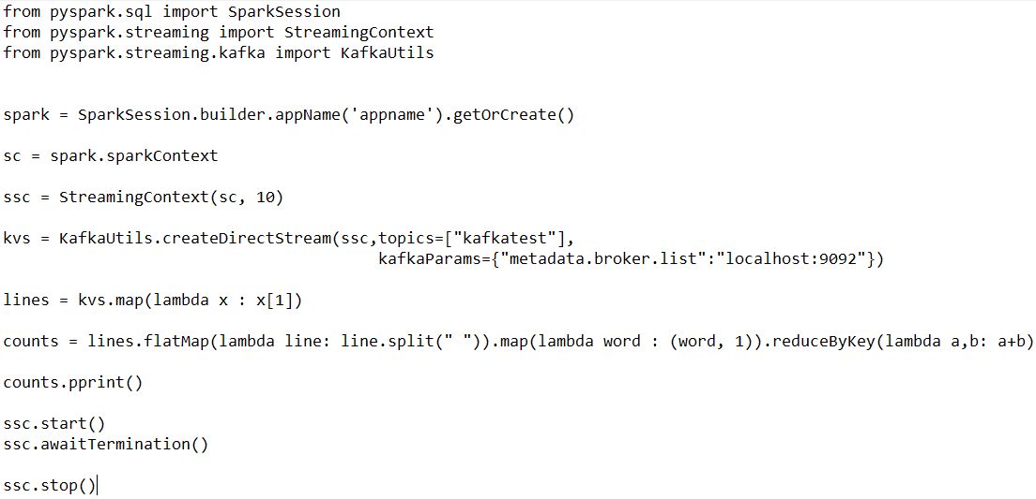
Spark Streaming + Kafka Example
Consumer: Program

Slide 30
Spark Streaming + Kafka Example
A spark streaming context is created by providing two parameters
spark configuration
batch interval (in seconds)
Once the spark streaming context is created, we need to create Dstream
Dstream is the actual object that connects you to the source

Slide 31
Spark Streaming + Kafka Example
In the Dstream you will provide source
Source would either be kafka, socket connection, file, flume, etc.
The syntax would be different for different types of sources

Slide 32

Spark Streaming + Kafka Example
Consumer: Result

Slide 33
Intro to Structured Streaming

Slide 34
Structured Streaming
Structured Streaming is a stream API built on top of Spark SQL
It lets you express computation on streaming data in the same way you express a batch computation on static data
The Spark SQL engine performs the computation incrementally and continuously updates the result as streaming data arrives

Slide 35
This model of streaming is based on Dataframe and Dataset APIs. Hence, with this library, we can easily apply any SQL query (using the DataFrame API) or Scala operations (using DataSet API) on streaming data.

Slide 36
Structured Streaming
The structured streaming construct using DataFrames is an improvement on the use of DStreams as found in the original Apache Spark streaming model
Dtreams are fault-tolerant, but the division of streamed data into RDD blocks is slower than the DataFrames
Hence, the processing and analysis of the data streams are slower, increasing the latency and reducing the message delivering reliability

Slide 37
Structured Streaming vs. Spark Streaming
Spark Streaming | Structured Streaming
Dstream based | Dataframe/Dataset based
Apache Spark streaming is a separate library in the Spark engine | Spark Structured streaming is part of the Spark 2.0 release built on top of Spark SQL
Slower | Faster
Spark Streaming works on something we call a micro batch | In Structured Streaming, there is no batch concept

Slide 38
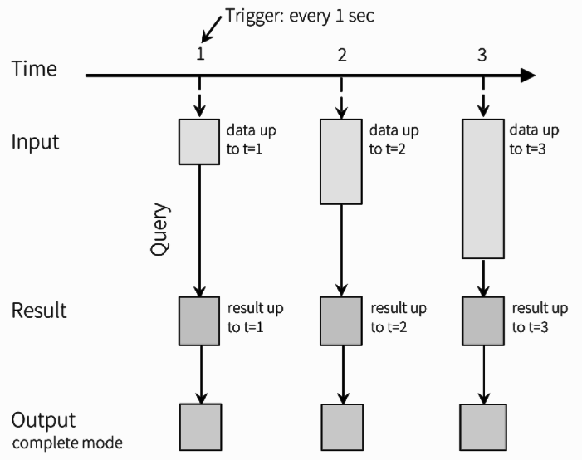
Structured Streaming Programming Model

Slide 39
Structured Streaming Programming Model
Every data item that is arriving on the stream is like a new row being appended to the Input Table
A query on the input will generate the “Result Table”
Every trigger interval new rows get appended to the Input Table
This Input Table updates the Result Table
Whenever the result table gets updated, the changed result rows is written to an external sink in different Output modes

Slide 40
Structured Streaming DOES NOT materialize the entire table. It reads the latest available data from the streaming data source, processes it incrementally to update the result, and then discards the source data. It only keeps around the minimal intermediate state data as required to update the result

Slide 41
Example
Write a structured streaming query that processes the incoming csv file(in a folder) in real time a display the result on the console
The data has following information about an employee:
emp_id
emp_name
job_name
manager_id
salary
dept_name
The result should display the count of each job_name and should update the result as and when a file arrives in the folder

Slide 42
Example
Structured Streaming Program
from pyspark.sql import SparkSession
from pyspark.sql.functions import *
from pyspark.sql.types import *
#create sparksession
spark = SparkSession.builder.appName("StructStream").getOrCreate()
#creating Schema
#Note:structured Streaming processing always requires the specification of a schema for #the data in the stream
schema = StructType([StructField('emp_id', IntegerType(), True),
StructField('emp_name', StringType(), True),
StructField('job_name', StringType(), True),
StructField('manager_id', IntegerType(), True),
StructField('salary', DoubleType(), True),
StructField('dept_name', StringType(), True)])

Slide 43
Example
#creating Streaming Dataframe that would read the data from a given folder
#Note: Please change the folder path accordingly
customer = spark.readStream.schema(schema)\
.option("header", True)\
.option("sep", ",")\
.csv("hdfs:///users/hadoop")
#query to find the total count of employees in a particular profession
customer.groupBy("job_name").count().writeStream.format('console').outputMode('complete').start().awaitTermination()

Slide 44
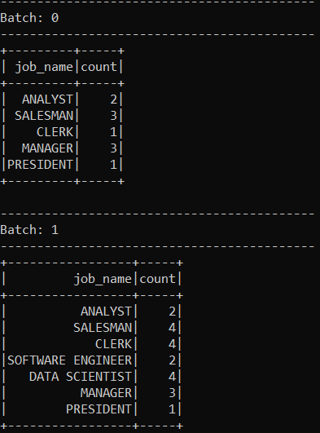
Example
Pass the csv files (data1.csv and data2.csv) in the streamingdata folder one at a time
Result (after passing the first file)

Slide 45
Example
Result (after passing the second file)

Slide 46
Summary
Streaming data is data that is generated continuously by thousands of data sources
Spark Streaming API is used for processing the data in real-time
Spark Streaming engine processes incoming data from various input sources
You need to implement two components in Spark Streaming:
Receiver - for connecting to a streaming source
DStream - to receive the data
Dstream represents a continuous stream of data over time (batch interval)

Slide 47
Thank You

