Slide 1
Variables ,methods ,classes and objects
Day-4

Slide 2
Learning Objectives
Learning about Scala insights
Higher Order functions in Scala
Scala collections of SBT

Slide 3
Package and Package Objects
Package and package objects
You can develop and release your own providers. Your custom operators, hooks, sensors, transfer operators can be packaged together in a standard airflow package and installed using the same mechanisms. Moreover they can also use the same mechanisms to extend the Airflow Core with auth backends, custom connections, logging, secret backends and extra operator links

Slide 4
Higher Order functions in scala
Higher order functions take other functions as parameters or return a function as a result. This is possible because functions are first-class values in Scala. The terminology can get a bit confusing at this point, and we use the phrase “higher order function” for both methods and functions that take functions as parameters or that return a function.
In a pure Object Oriented world a good practice is to avoid exposing methods parameterized with functions that might leak object’s internal state. Leaking internal state might break the invariants of the object itself thus violating encapsulation.

Slide 5
One of the most common examples is the higher-order function map which is available for collections in Scala.
Scala 2 and 3
val salaries = Seq(20_000, 70_000, 40_000) val doubleSalary = (x: Int) => x * 2 val newSalaries = salaries.map(doubleSalary) // List(40000, 140000, 80000)

Slide 6
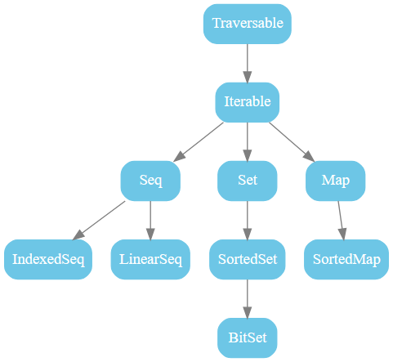
Scala Collections of SBT
The following figure shows all collections in package scala.collection. These are all high-level abstract classes or traits, which generally have mutable as well as immutable
implementations.
scala.collection.immutable.List // that's where it is defined scala.List // via the alias in the scala package List // because scala._ // is always automatically imported

Slide 7
Summary
Learning about scala and implementing scala

Slide 8
Learning Outcomes
To be included on module/unit level by the content team.

