Slide 1
Overview of Data management
Day-5

Slide 2
Learning Objectives
Data Management , objectives are
1.Data management
2.Why is Data management is important
3.Types of Data management
4.Data Management Best practices and Techniques

Slide 3
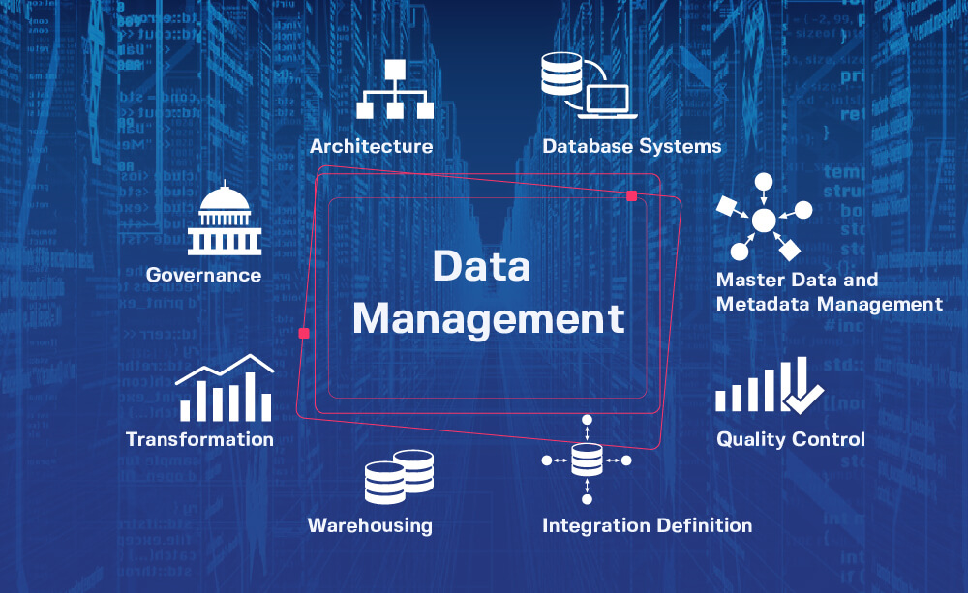

Slide 4
Data management
What is Data management
Data management is used to Describe the process of collecting and using data in an organized manner .
Data management allows you efficiently collect , organize.
Data management is important for the following
1.visibiity- Data management can improve the transparency of the business data assets, making it easier find the appropriate data to conduct their research
2.Data stewardship: Data steward is not a person who develops policies on information management but implements and enforces them throughout the enterprise
Quality management of data: Quality management is accountable for scouring the collected information to find the root cause of issues like duplicates records, incompatible versions and much more
Security of Data: Managing Data requires high level security , security experts
Are responsible for security management of encryption

Slide 5
Contd:
Data Governance: Data governance is the basis of determining an organizational information security
Data governance is a framework to a constitution that clarifies the policies that govern the ingestion
Flow and security of institution data
Data warehouse : Data warehouse management Is responsible and manages the physical or cloud infrastructure used to gather the data in its raw form and analyze it thoroughly to provide business insights.

Slide 6
Higher Order functions in scala
Higher order functions take other functions as parameters or return a function as a result. This is possible because functions are first-class values in Scala. The terminology can get a bit confusing at this point, and we use the phrase “higher order function” for both methods and functions that take functions as parameters or that return a function.
In a pure Object Oriented world a good practice is to avoid exposing methods parameterized with functions that might leak object’s internal state. Leaking internal state might break the invariants of the object itself thus violating encapsulation.

Slide 7
One of the most common examples is the higher-order function map which is available for collections in Scala.
Scala 2 and 3
val salaries = Seq(20_000, 70_000, 40_000) val doubleSalary = (x: Int) => x * 2 val newSalaries = salaries.map(doubleSalary) // List(40000, 140000, 80000)

Slide 8
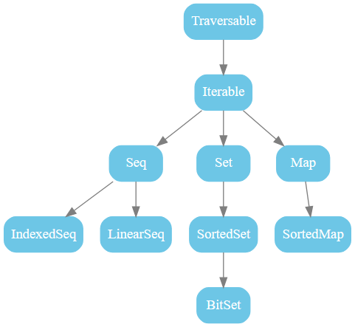
Scala Collections of SBT
The following figure shows all collections in package scala.collection. These are all high-level abstract classes or traits, which generally have mutable as well as immutable
implementations.
scala.collection.immutable.List // that's where it is defined scala.List // via the alias in the scala package List // because scala._ // is always automatically imported

Slide 12
Summary

Slide 13
Learning Outcomes
To be included on module/unit level by the content team.

