Slide 1
AVALANCHE
EARLY WARNING
SYSTEM
(AEWS)
By:-
Sowmaya ranjan jena
Banita Jaipuria
Team TechBoosters

Slide 2
Contents :
Avalanche And it’s Types
Problem Arises From Avalanches
Solution To The Problem
Working Mechanism
Future Development
Deployment Of AEWS
Community It Will Serve
Conclusion

Slide 3
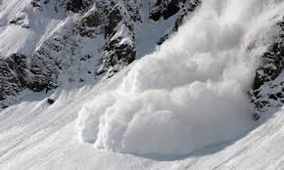
Avalanche And it’s Types:
An avalanche is a cohesive slab of snow laying upon a weaker layer of snow in the snow pack that fractures and slides down a step when triggered.
These avalanche occurs due to many reasons some are natural and some are man-made.
Types of avalanche: Slab Avalanche
Powder Snow Avalanche
Wet Snow Avalanche
Avalanche Pathway
Ice Avalanche

Slide 4
Problem Arises From Avalanches:
These Avalanche are causing great loss to both life and property in hilly areas.
To protect the people from this Natural Disaster proper information about the disaster is needed and a accurate prediction also.
No one can know the exact temperture and acceleration that triggers an Avalanche.

Slide 5
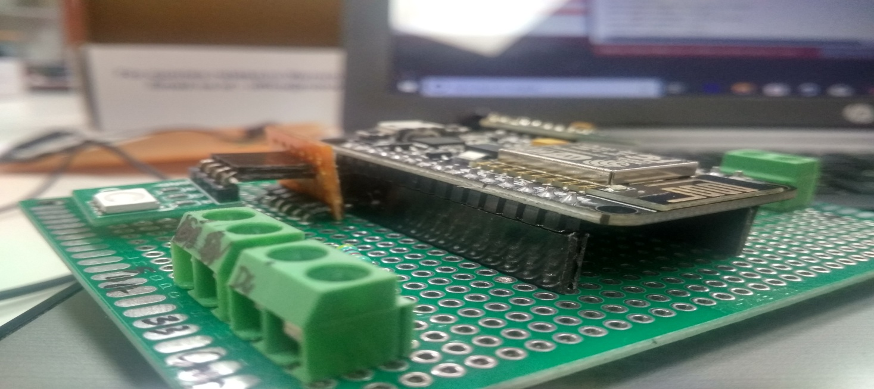
Solution To The Problem:
As told earlier it is causing death and destruction to human life and property to prevent it to some extent Avalanche Early Warning Can Prove it’s iron.
By providing accurate data of snow temperture and acceleration that can trigger an avalanche we can aware the people nearby.
As Earthquake also trigger a bigger avalanche so to detect it we have made a earthquake detector.

Slide 6
Working Mechanism:
The temperture sensor will measure the temperture of snow,accelerometer will measure the vibration in 3 axis of that particular place and will detect the earthquake when there will be a vibration and rgb will glow and buzzer will beep accordingly to inform people.
All the data will be sent directly to microcontroller where the data will be analyzed and the instruction will be given for rgb module for particular colour to glow and if the vibration will be at high scale .
Then the microcontroller will send the data to firebase and the user will interfaced with it.
Then the movement will be made according to that data.
If there will be any danger then the people at that place can shift to other place and anticipate their path.

Slide 7
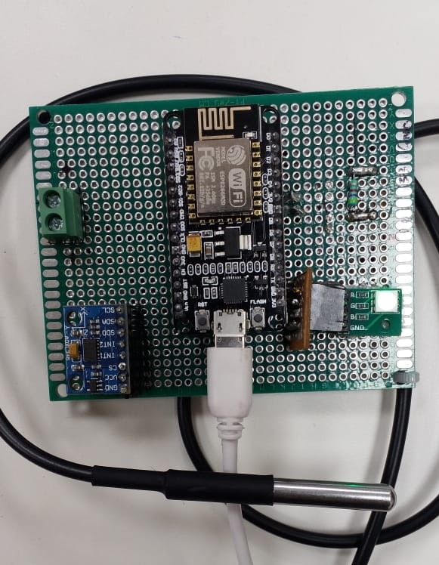

Slide 8
Future Development:
Proper insertion of lora and gsm in AEWS.
PCB design of AEWS.
More compact device.
Combination of Avalanche Early warning System and Earthquake detector.

Slide 9
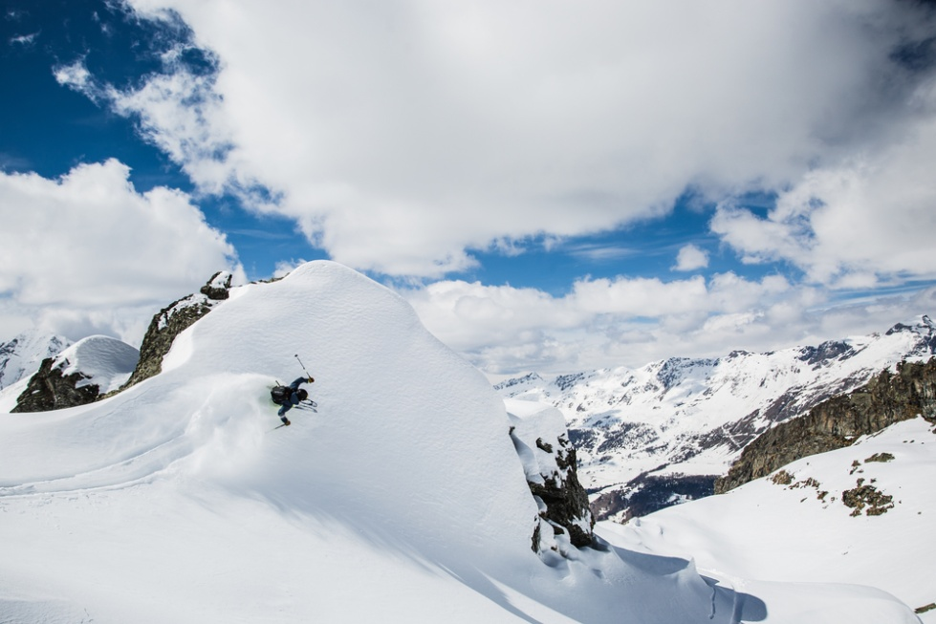
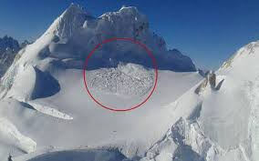
Deployment Of AEWS:
The AEWS will be deployed in the following places:
Siachen Glacier
Steep himalayan range.
Hills of Sikkim,Himachal Pradesh
Other sensitive Mountain of World

Slide 10

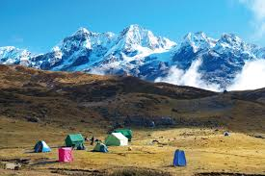
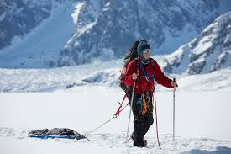
Community It Will Serve:
Indian Army
Mountaineers
Inhabitants of Sikkim,Himachal pradesh
Weather Forecaster

Slide 11
Conclusion:
So from this it can be concluded we can not control the nature but we can predict it.
And this AEWS will be the best option to predict the dangerous avalanches.
We can not protect everyone from the curse of nature but we can save some life and property by anticipating from its path.

Slide 12
Thank you !

