Slide 1
Safety Third Presents: Kink 101
An introduction to alternative forms of adult play.

Slide 2
AGENDA(ish)
Disclaimer
Introductions
Terminology Review
What is Kink?
Break (5-15 minutes)
Types of Play
Play Party Expectations
Play Party Etiquette
Best Practices
Q & A

Slide 3
DISCLAIMER
This presentation discusses kink as a form of consensual adult play. All content is intended for adults (age 18+) only.
All activities discussed emphasize informed consent, communication, and personal boundaries. Participation in or interest in kink is a personal choice; no experience or endorsement is assumed.
All information is presented is general in nature and intended for educational discussion. It is not a substitute for legal, medical, or professional guidance. Participants are responsible for understanding and complying with applicable laws, safety practices, and personal boundaries. The presenter assumes no responsibility for individual actions or outcomes

Slide 4
LICENSING – CC BY-NC 4.0
All Safety Third publications are covered under Creative Commons Attribution NonCommercial License You are free to:
SHARE - copy and redistribute the material in any medium or format
ADAPT - remix, transform, and build upon the material
Under the following terms:
ATTRIBUTION - You must give appropriate credit, provide a link to the license, and indicate if changes were made. You may do so in any reasonable manner, but not in any way that suggests the licensor endorses you or your use.
NONCOMMERCIAL - You may not use the material for commercial purposes.
Attribution-NonCommercial 4.0 International Deed: https://creativecommons.org/licenses/by-nc/4.0/

Slide 5
INTRODUCTIONS

Slide 6
WHO THE FUCK IS BANJO FOX!?
FetLife Member since 2008
Dungeon Monitor since 2022
Service-Type Kinkster
Educator Always
Toy Maker
Founder of the Safety Third Organization
Outside of Kink?
IT Security Professional
Open-Source, and Privacy Enthusiast
DIY Guy

Slide 7
WHAT IN THE CORNBREAD HELL IS SAFETY THIRD?!?!
As a philosophy*
“Safety Third is a philosophy that makes allowances for risky behavior and also encourages individuals to be responsible for their own safety.” - Banjo Fox
As an organization
Safety Third (the organization) aims to be a resource to provide free, and open-source educational materials for the kink community.
*Based on the original concept by Mike Rowe (as from Dirty Jobs)

Slide 8
WHY SAFETY THIRD?
From the man himself: “...Safety is not a thing to be “ranked,” but rather, a state of mind, to be applied as needed to a myriad of situations in varying amounts. But if we were to rank it, it would rarely be “first.” Were safety truly “first,” no level of risk would ever be encouraged or permitted, and no work would ever get done. Or play for that matter.” - Mike Rowe
Mike Rowe (2020) - Walk me through this “Safety Third” thing https://mikerowe.com/2020/03/walk-me-through-this-safety-third-thing/

Slide 9
Terminology Review

Slide 10
KINK: DEFINED BROADLY
Definitions so that we can talk in the same language.
(Modern) Kink - A broad range of activities in which one or more participants engage in activities that are typically considered “non-normative”.
Munch - A gathering at a public space, often a bar/restaurant, that allows individuals to participate in casual conversation, and meet others.
Dungeon/Playspace - Synonymous terms for a physical space where individuals are able to partake in kinky activities.
Play - The act of partaking in a kinky activity.

Slide 11
KINK: DEFINED IN MORE DETAILS
… and in slightly more detail.
Roles - A loosely-defined part taken on by individuals in particular social-settings.
Negotiation - Mutual discussion about the terms of a particular scene in which the participants establish rules, boundaries, and share expectations.
Consent - Agreement between parties regarding a negotiated set of boundaries.
Scene - A period of time in which one or more participants engage in a kinky activity.
Aftercare - The time after a scene which participants in the scene use to recover from the activity.

Slide 12
What is Kink?
( But first… )

Slide 13
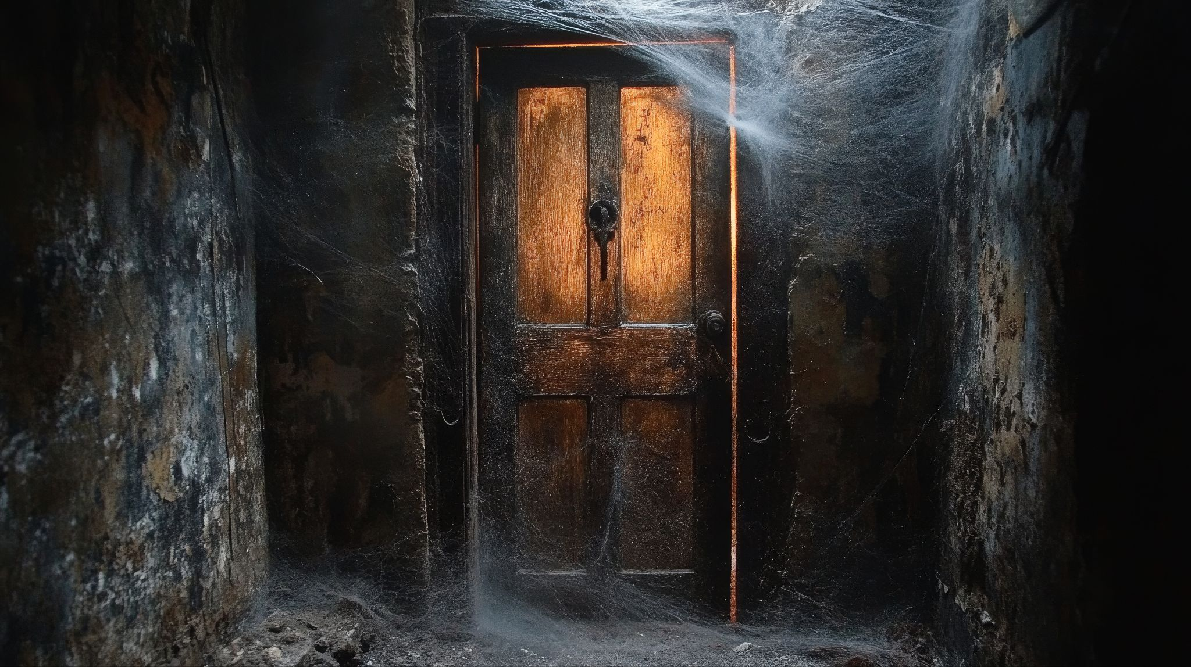
THE SCARY DOOR
Image by Oleg Gapeenko (Vecteezy)

Slide 14
BEHIND THE SCARY DOOR
THE ONE TWU WAY
Image by Oleg Gapeenko (Vecteezy)

Slide 15
HERE BE DRAGONS (Explaining the Scary Door)
Two takes on “The one true way”
RED FLAG (probably)
Folks that are “old guard”
Stuck in their ways
Not inherently unsafe, but probably not what you are looking for
Adopt, adapt, and improve
Change the definition to: “The one true way to do kink is to make it my own.”
Individualized, personal, flexible
Leaves room for improvement

Slide 16
WHAT IS KINK…REALLY?
Community - Socializing with like-minded folk - Education/skill-sharing
Lifestyle - Some people just want to live it 24/7 - Form of structure
Personal Expression - Fetish wear - Gender affirming outfits
Hobby or Profession - Toy making - Professional services
Mental Health - A means of “escape” (eg. “subspace”) - Resolving Trauma Physical Therapy - Fire Cupping - Electro-stim

Slide 17
WHAT IS KINK (cont.)
In practice:
Kink is what you, as a participant, make of it.
( With a couple of strict rules )

Slide 18
THE UNIVERSAL* RULES OF KINK
CONSENT IS MANDATORY
No exceptions
Violating consent will get you blacklisted fast
Kink is NOT always sexual
It is also not always romantic, or pretty
Kink is more than just BDSM
Bondage, Domination, and Sado-Masochism are merely four possibilities out of countless others.
*At least within the United States

Slide 19
BREAK TIME
( …finally )

Slide 20
Types of Play

Slide 21
TYPES OF PLAY (Non-Exhaustive)
COMMON | POPULAR
IMPACT
Floggers, whips
Paddles, Spanking
BONDAGE
General Restraints
Rope | Shibari (Rope as art )
ROLEPLAY (various)
Age
Animal
POWER EXCHANGE
Dominant/submissive
Caregiver/Little
ADVANCED | HIGH-RISK
CBT (Cock-and-Ball Torture)
ELECTRO
EMOTIONAL POWER EXCHANGE
Degradation / Humiliation
FIRE
Cell Popping | Branding
MEDICAL
Needles | Piercing
Blood
SUSPENSION
Rope

Slide 22
TABOO KINKS
BREATH PLAY
General restriction of breath, or airways
Considered Very-High Risk
CNC - Consensual Non-Consent
Requires a lot of specific negotiation
May cause panic amongst witnesses
BODILY FLUIDS (Not-Blood)
Scat | Watersports
Generally unsanitary, and spaces are not equipped for this.
INTOXICATION
Alcohol, marijuana, all other drugs
Broadly banned in play spaces. Intoxicated individuals cannot consent.

Slide 23
Play Party Expectations

Slide 24
WHAT TO EXPECT AT A PLAY SPACE
Paperwork (First Time)
Waiver forms
Rules of the space, often common sense
Tour of the space (First time)
As it says on the tin
Storage area for personal items
Sometimes doubles as changing space
Dedicated Social and Play Areas
Distinct spaces for talking, and kink activities
Hygiene Stations
“Chucks”, Cleaning wipes, etc.
Some spaces also provide bottled water
GOOD spaces have a safety crew
Dungeon Monitor(s)
Medical Staff
Shared “House” equipment
Benches, crosses, maybe some toys, or restraints
Naked individuals (often)
Some play spaces require underwear at all times
Loud Music
At least in the play areas

Slide 25
WHAT TO EXPECT IN THE DUNGEON
Scenes, and the things you will see, and hear.
Pain, and Pain Accessories
All manner of toys, and implements of kink
More emotions than you can shake a stick at
Blood, Bruises, Laughter
Most impact scenes leave marks or break the skin
Laughter is more common than you might think
People watching (quietly)
Public (in the open) scenes are look but don’t touch

Slide 26
Play Party Etiquette

Slide 27
PARTY ETIQUETTE - GENERALIZED
FOLLOW THE HOUSE RULES
All rules set by the space override anything written here
No Devices Allowed!
No cellphones, no cameras, no recording devices are allowed
A lot of spaces have designated photographers.
Zero tolerance policies (No Alcohol, Drugs)
Places that are generally considered safe for play have zero tolerance policies for drugs, and alcohol.
Keep food, and drink to the designated areas
Drinks with sealed containers may be
The “Grandma Rule”
While outside of the space, dress like you would if you were visiting Grandma
Looking is okay, but touching is not
Folks in all manner of undress are expecting others to look. This does not constitute an invitation for anything else.
Respectful Commentary
Not everyone wants to be called “hot”
If you see something, say something
If something feels “off”, please inform a member of the party staff.

Slide 28
PARTY ETIQUETTE - IN THE PLAY AREAS
Keep chit-chat to a minimum
A lot of scenes require the participants to focus. Talking is disruptive.
Pay attention to our surroundings!
Gear on the floor
Swinging implements
Individuals trying to watch a scene
Keep pathways clear!
You, and your stuff should be out of the way
Voyeurism is Expected
Scenes in open spaces are open to folks watching quietly
Keep a respectful distance as the space allows
Borrowing | Using House Equipment
Follow rules as provided
Use “chucks”, towels, blankets where bare skin might touch
Clean up, and wipe down the equipment afterwards
Be mindful of the time
Other people will want to use a given space or piece of equipment. Do your scene, and move on.
The Aftercare Space
Aftercare rooms are places for folks to cool down after a scene
Not a place to have sex
Semi-private, leave them be

Slide 29
Best Practices

Slide 30
BEST PRACTICES (Generalized)
Go to Munches
Arguably the best way to meet folks
More room for real conversation, and connections
Don’t rush into anything
You absolutely do not need to be in a dynamic to enjoy kink!
Keep Educating Yourself
Classes and other learning activities are usually easy to find
May discover new things
Adapt, Adopt, Improve
Play is different for everyone.
Don’t let someone’s style define you.
Understand the risks
All kink has associated risks
Knowing what could happen will help lessen the chance that it does
Know yourself, Know your limits
You are the expert of your needs and limits

Slide 31
THE ULTIMATE BEST PRACTICE

Slide 32

SAY IT WITH ME
COMMUNICATE!
COMMUNICATE!
COMMUNICATE!
Image Credit: Leonardo Creative Digital Art

Slide 33
Q & A

