Slide 1
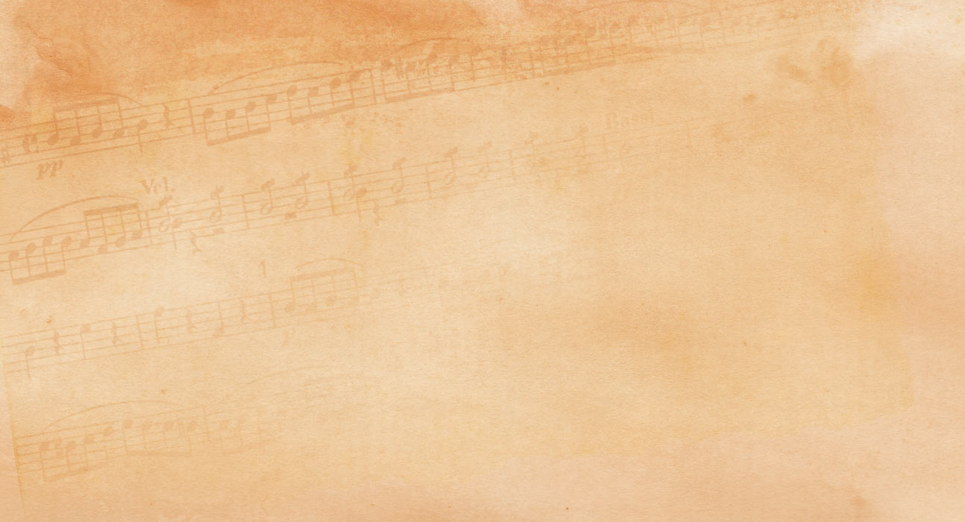
blessed Redeemer
12

