Slide 1
Deep Learning-Based UX Quality Prediction
from Mobile Screenshots Using Visual and Structural Cues
IEEE Access Manuscript Presentation
King Mongkut's University of Technology Thonburi (KMUTT)
Dataset: UICrit (983 mobile UIs) | Metric: Kendall's tau | Best: tau = 0.215

Slide 2
Problem & Motivation
Why automate UX quality assessment?
• UX quality assessment is expensive and slow
Research Questions
– Requires 7+ expert designers per UI (UICrit protocol)
– Time-consuming, difficult to scale to millions of apps
RQ1
•
Can ImageNet visual features predict UX quality significantly?
• Manual heuristics are too rigid
– Rule-based checks miss holistic design quality
– Cannot capture semantic visual aesthetics
RQ2
•
Does CLIP pretraining on RICO improve performance?
• Research gap
– No systematic study on visual vs structural features
– CLIP pretraining effect on UX quality unknown
RQ3
Do structural pixel features help via multi-modal fusion?
Deep Learning-Based UX Quality Prediction | KMUTT | IEEE Access
2

Slide 3
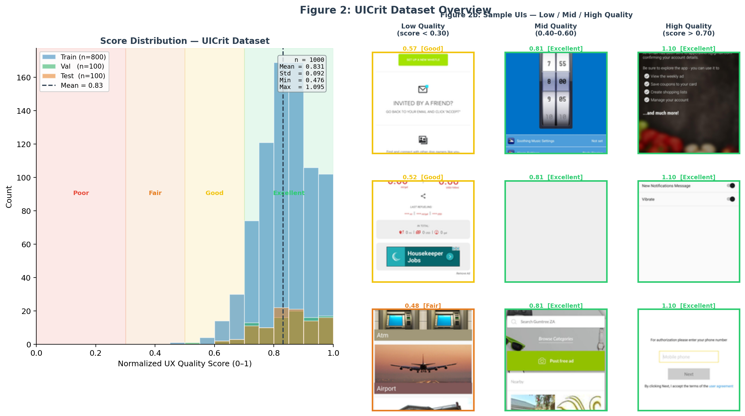
Dataset: UICrit + RICO
983 expert-annotated mobile UIs + 66,261 unlabeled RICO screens
UICrit (Duan et al., UIST 2024)
• 983 mobile UI screenshots from RICO
• 7 experienced UX designers per UI
• Ratings: aesthetics, usability, overall (1-7 scale)
• Split: 686 train / 98 val / 100 test
• Score distribution: approx. normal, mean ~0.45
RICO (Deka et al., UIST 2017)
• 72,219 unique Android UI screens
• 9,772 applications across 27 categories
• Used for CLIP pseudo-label pretraining only
• No quality annotations — labels generated by CLIP
Deep Learning-Based UX Quality Prediction | KMUTT | IEEE Access
3

Slide 4
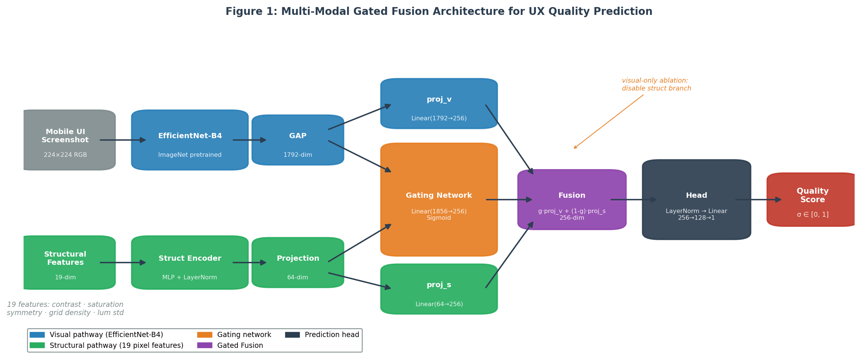
Methodology
Three complementary approaches investigated
Approach 1 — Visual Backbone (ImageNet pretrained)
• EfficientNet-B4: 1792-dim GAP embedding → MLP head → sigmoid score
• Two regimes: linear probe (frozen) vs fine-tuning (last 3 stages)
• Also tested: EfficientNet-B0, ResNet-50, Swin-T
Approach 2 — CLIP Pseudo-Label Pretraining
• CLIP (ViT-B/32): compute similarity with 6 positive + 4 negative quality prompts
• Generate pseudo-labels for 66,261 RICO screenshots
• Pretrain EfficientNet-B4 on RICO, then fine-tune on UICrit
Approach 3 — Multi-Modal Gated Fusion
• 19 pixel-derived structural features: contrast, symmetry, 3x3 grid density, color stats, lum variance
• Structural encoder (MLP + LayerNorm) -> 64-dim projection
• Gating: g = sigmoid(Linear([fv; fs])) -> fused = g*proj_v + (1-g)*proj_s
• Ablation: visual-only / struct-only / full fusion
Deep Learning-Based UX Quality Prediction | KMUTT | IEEE Access
4

Slide 5
Experimental Results
Kendall tau with 95% bootstrap CI on UICrit test set (n=100)
Model
tau
95% CI
rho
MSE
MAE
Sig.
EfficientNet-B4 visual-only (probe) *BEST*
0.215
[0.088, 0.344]
0.303
0.022
0.129
YES
Gated Fusion full (finetune)
0.183
[0.046, 0.306]
0.255
0.096
0.298
YES
EfficientNet-B4 probe
0.165
[0.038, 0.284]
0.247
0.052
0.201
YES
Swin-T probe
0.120
[-0.014, 0.258]
0.164
0.028
0.125
No
ResNet-50 probe
0.088
[-0.041, 0.211]
0.126
0.028
0.146
No
CLIP->EfficientNet probe
0.063
[-0.070, 0.196]
0.085
0.076
0.251
No
CLIP->EfficientNet finetune
0.007
[-0.140, 0.149]
0.017
0.083
0.259
No
Gated Fusion full (probe)
0.024
[-0.112, 0.155]
0.037
0.016
0.100
No
Structural-only (probe)
0.002
[-0.142, 0.147]
0.003
0.019
0.114
No
* Significant = bootstrap 95% CI excludes zero | Green = best | Red = collapse
Deep Learning-Based UX Quality Prediction | KMUTT | IEEE Access
5

Slide 6
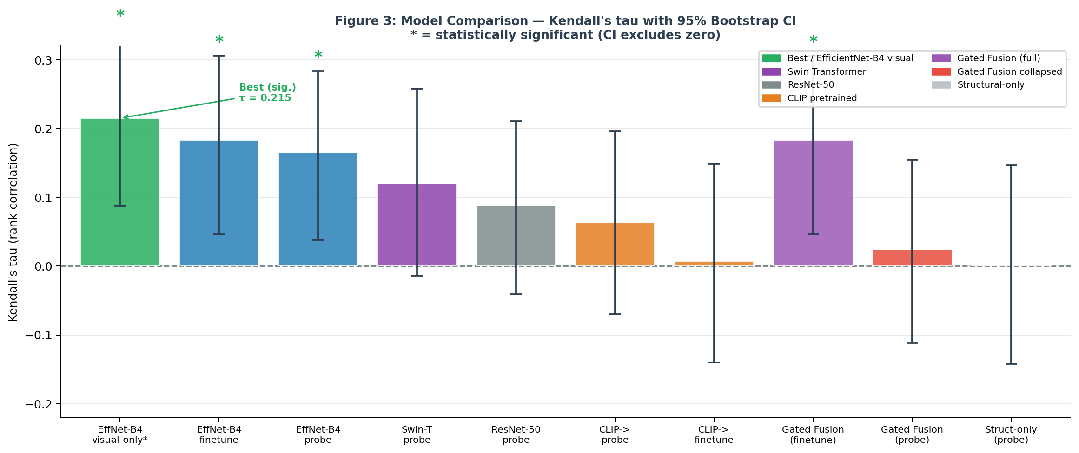
Results Visualisation
Model comparison with 95% confidence intervals
Deep Learning-Based UX Quality Prediction | KMUTT | IEEE Access
6

Slide 7
Analysis & Discussion
Answers to our three research questions
RQ1 — ImageNet Visual Features
RQ2 — CLIP Pretraining
RQ3 — Structural Fusion
SUPPORTED
REFUTED
REFUTED
• EfficientNet-B4 visual-only achieves tau = 0.215 (sig.)
• CLIP pseudo-labels: tau = 0.089 vs UICrit (too weak)
• Struct-only: tau = 0.002 (random)
• ImageNet features capture semantic UX quality
• Pretraining tau: 0.007 to 0.063 (all not significant)
• Gated Fusion (probe) COLLAPSES to tau = 0.024
• Frozen probe >= fine-tuned on 686 samples
• RICO distribution too different from UICrit
• Gating overfits on 686 samples (990K params)
Deep Learning-Based UX Quality Prediction | KMUTT | IEEE Access
7

Slide 8
System Demo
Gradio web application for UX quality assessment
Gradio Demo — http://127.0.0.1:7860
Best Checkpoint
python scripts/app.py
checkpoints/baselines/ efficientnet_b4/best.pt
Upload any mobile screenshot
tau = 0.165 (standalone) tau = 0.215 (visual-only ablation)
Quality Score: 0-100% with tier (Poor/Fair/Good/Excellent)
Attention Map Method
Multi-scale Attention Map (head weights + activation energy)
Multi-scale CAM (3 layers):
19 Structural Feature breakdown bar chart
50% head-weight CAM (semantic)
30% activation energy features[-2]
Real-time inference on GPU (< 1 second)
20% activation energy features[5]
(14x14, finer spatial detail)
Deep Learning-Based UX Quality Prediction | KMUTT | IEEE Access
8

Slide 9
Conclusion & Future Work
Key Findings
Future Work
ImageNet EfficientNet-B4 achieves tau = 0.215 (sig.)
Larger annotated datasets (active learning / crowdsourcing)
Best model — rich visual semantics sufficient
CLIP pretraining consistently HURTS (tau 0.007-0.063)
LLM-based quality prediction (GPT-4V, Gemini Vision)
Pseudo-label quality too low (tau = 0.089 vs UICrit)
View hierarchy structural features (element-level, not pixel-level)
Gated Fusion COLLAPSES (tau = 0.024, probe)
990K params overfit on 686 samples
Pairwise ranking loss aligned with Kendall tau objective
Structural features alone: tau = 0.002
UX quality is semantic, not measurable by pixels
Cross-app generalization study
Deep Learning-Based UX Quality Prediction | KMUTT | IEEE Access
9

Slide 10
Thank You
Questions & Discussion
Deep Learning-Based UX Quality Prediction from Mobile Screenshots Using Visual and Structural Cues
IEEE Access | KMUTT | 2025
• Best model: EfficientNet-B4 visual-only tau = 0.215
• Dataset: UICrit 983 UIs + RICO 66K screens
• Code & models: github.com/BankDesu/...

