Slide 1
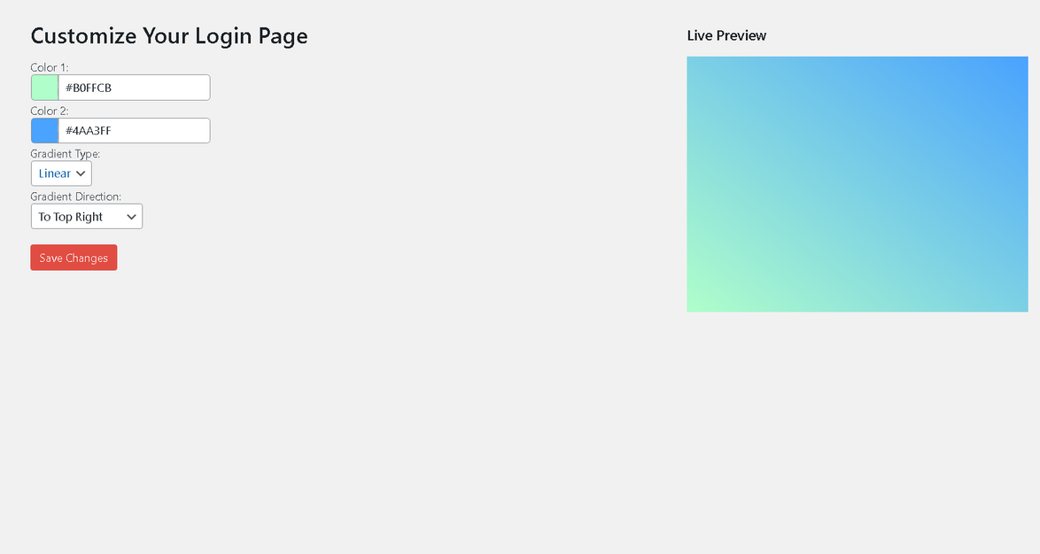
Scorching Mustang
2024
Introducing the
Login Page Background Optimizer

Slide 2
Scorching Mustang
2024
Project Title: Login Page Customizer
Table Of Contents
Hackathon: Word Sprint 3.0
Team: Scorching Mustangs
[01]
Introduction
[02]
Market Analysis
Elaborate on what you want to discuss.
Elaborate on what you want to discuss.
Contribution
Members
[03]
Muneeb Ahmad (Team Lead)
Muhammad Hassan Raza
Muhammad Minhal Manjee
Muhammad Umer Shaheen
Developed: Plugin, Slides, Repository, Video
No contributions made
No contributions made
No contributions made
Challenges
[04]
Solution Overview
Elaborate on what you want to discuss.
Elaborate on what you want to discuss.

Slide 3
Scorching Mustang
2024
Table Of Contents
Problem Statement
4# CUSTOM LOGIN PAGE CUSTOMIZER.
1# Add Gradients Background
2# Add Tooltips/ Help to Form Fields
Problem link: https://docs.google.com/document/d/1deYz6BhW-e01nVrmGfbHw9EstWH7x9-Rsi79XtRGAec/edit
[01]
Introduction
[02]
Market Analysis
Elaborate on what you want to discuss.
Elaborate on what you want to discuss.
[03]
Challenges
[04]
Solution Overview
Elaborate on what you want to discuss.
Elaborate on what you want to discuss.

Slide 4
Scorching Mustang
2024
Table Of Contents
Introduction to the Plugin:
Functionalities Provided:
Changing the background of the login page
Gradient option provided
Live Preview provided to save users time to go and look for changes
[01]
Introduction
[02]
Market Analysis
Elaborate on what you want to discuss.
Elaborate on what you want to discuss.
[03]
Challenges
[04]
Solution Overview
Elaborate on what you want to discuss.
Elaborate on what you want to discuss.
Project Repository: https://github.com/Muneeb-Ahmad-404/Login-page-gradient-changer

Slide 5
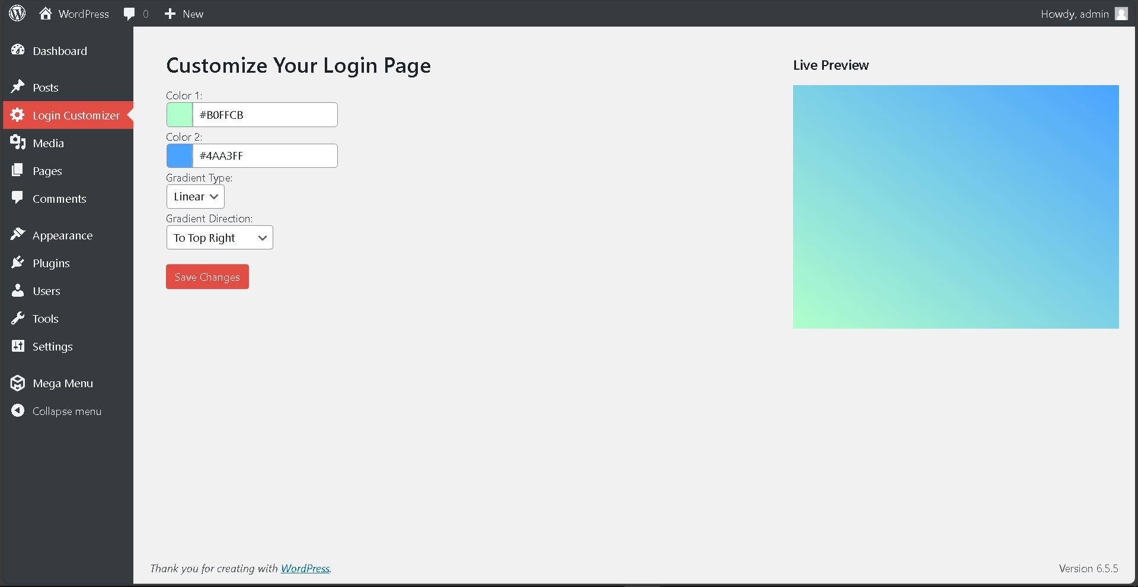
Highlights of the Plugin
Table Of Contents
Introduction
[01]
[02]
Market Analysis
Press the button to see changes in the live preview and the login page
Open the Plugin menu (after installation)

Slide 6
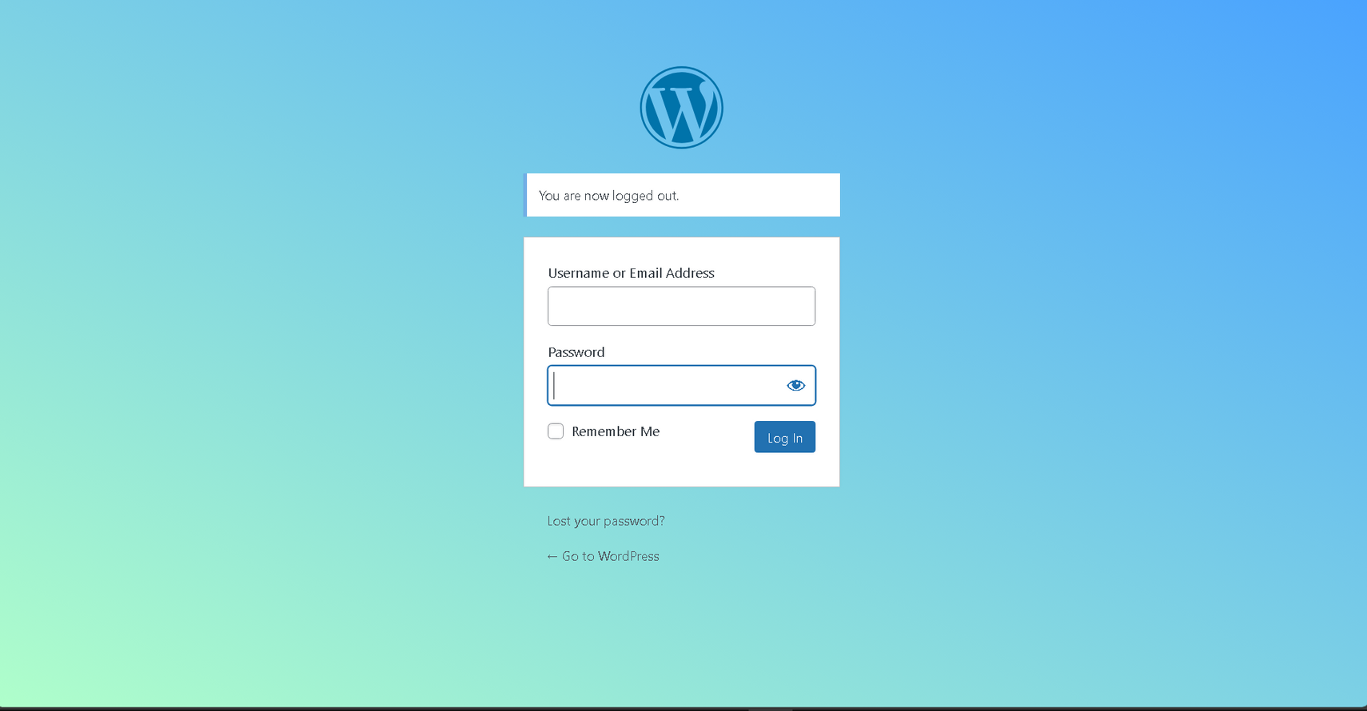
Scorching Mustang
2024
Table Of Contents
Result
[01]
Introduction
[02]
Market Analysis
Elaborate on what you want to discuss.
Elaborate on what you want to discuss.
[03]
Challenges
[04]
Solution Overview
Elaborate on what you want to discuss.
Elaborate on what you want to discuss.

Slide 7
Scorching Mustang
2024
Table Of Contents
Learning Outcomes
Word Press
PHP
CSS basics
JavaScript basics
Github
Prompt Engineering
Managment
[01]
Introduction
[02]
Market Analysis
Elaborate on what you want to discuss.
Elaborate on what you want to discuss.
[03]
Challenges
[04]
Solution Overview
Elaborate on what you want to discuss.
Elaborate on what you want to discuss.

Slide 8
Scorching Mustang
2024
Table Of Contents
Future Insights
Following areas would be worked on in future:
Tooltips section
Providing more gradient options
Making preview better
Providing a default button to go to default settings
Allowing multiple setting choices to be choosed from
The other features would be worked on near future.
[01]
Introduction
[02]
Market Analysis
Elaborate on what you want to discuss.
Elaborate on what you want to discuss.
[03]
Challenges
[04]
Solution Overview
Elaborate on what you want to discuss.
Elaborate on what you want to discuss.

Slide 9
Scorching Mustang
2024
Table Of Contents
Future Insights
Following areas would be worked on in future:
Tooltips section
Providing more gradient options
Making preview better
Providing a default button to go to default settings
Allowing multiple setting choices to be choosed from
The other features would be worked on near future.
[01]
Introduction
[02]
Market Analysis
Elaborate on what you want to discuss.
Elaborate on what you want to discuss.
[03]
Challenges
[04]
Solution Overview
Elaborate on what you want to discuss.
Elaborate on what you want to discuss.

Slide 10
Scorching Mustang
2024
Table Of Contents
Contact Information (Team Lead)
Email: muneebahmad2005p@gmail.com
Github: https://github.com/Muneeb-Ahmad-404
Linkedin: https://www.linkedin.com/in/muneeb-ahmad-6b36712b9/
[01]
Introduction
[02]
Market Analysis
Elaborate on what you want to discuss.
Elaborate on what you want to discuss.
[03]
Challenges
[04]
Solution Overview
Elaborate on what you want to discuss.
Elaborate on what you want to discuss.

Slide 11
Scorching Mustang
2024
Table Of Contents
[01]
Introduction
[02]
Market Analysis
THE END (For Now)
Elaborate on what you want to discuss.
Elaborate on what you want to discuss.
[03]
Challenges
[04]
Solution Overview
Elaborate on what you want to discuss.
Elaborate on what you want to discuss.

