Slide 1

Presented by : Bankim Das

Slide 2
BUSINESS REQUIREMENT
To conduct a comprehensive analysis of Blinkit's sales performance, customer satisfaction, and inventory distribution to identify key insights and opportunities for optimization using various KPIs using SQL.
KPI’s REQUIREMENTS :
Total Sales: The overall revenue generated from all items sold.
Average Sales: The average revenue per sale.
Number of Items: The total count of different items sold.
Average Rating: The average customer rating for items sold.
Presented by : Bankim Das

Slide 3
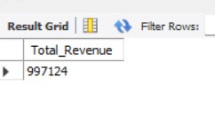

SOLUTION OF KPI’s REQUIREMENTS
1. Total Sales: The overall revenue generated from all items sold.
SELECT SUM(Total_Sales) AS Total_Revenue
FROM blinkit_grocery_data ;
2. Average Sales: The average revenue per sale.
SELECT ROUND( AVG(Total_Sales) , 2 ) AS Avg_Revenue FROM blinkit_grocery_data ;
Presented by : Bankim Das

Slide 4


SOLUTION OF KPI’s REQUIREMENTS
3. Number of Items: The total count of different items sold.
SELECT COUNT(*) AS Count_Of_Items
FROM blinkit_grocery_data ;
4. Average Rating: The average customer rating for items sold.
SELECT ROUND( AVG(Rating) , 2 ) AS Avg_Rating FROM blinkit_grocery_data ;
Presented by : Bankim Das

Slide 5
BUSINESS REQUIREMENT
Granular Requirements :
1. Total Sales by Fat Content:
Objective: Analyze the impact of fat content on total sales.
2. Total Sales by Item Type:
Objective: Identify the performance of different item types in terms of total sales.
3. Fat Content by Outlet for Total Sales:
Objective: Compare total sales across different outlets segmented by fat content.
4. Total Sales by Outlet Establishment:
Objective: Evaluate how the age or type of outlet establishment influences total sales.
5. Percentage of Sales by Outlet Size:
Objective: Analyze the correlation between outlet size and total sales.
6. Sales by Outlet Location:
Objective: Assess the geographic distribution of sales across different locations.
7. All Metrics by Outlet Type:
Objective: Provide a comprehensive view of all key metrics (Total Sales, Average Sales, Number of Items, Average Rating) broken down by different outlet types.
Presented by : Bankim Das

Slide 6
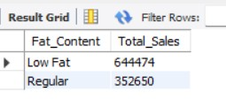
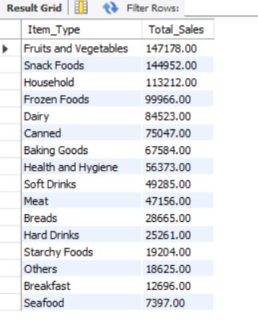
Solution of Granular Requirements
Total Sales by Fat Content
SELECT Fat_Content ,
SUM(Total_Sales) AS Total_Sales
FROM blinkit_grocery_data
GROUP BY Fat_Content
ORDER BY Total_Sales DESC ;
2. Total Sales by Item Type:
SELECT Item_Type ,
CAST(SUM(Total_Sales) AS DECIMAL(10 , 2) ) AS Total_Sales
FROM blinkit_grocery_data
GROUP BY Item_Type
ORDER BY Total_Sales DESC ;
Presented by : Bankim Das

Slide 7
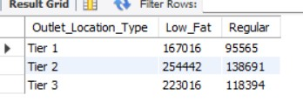
Solution of Granular Requirements
3. Fat Content by Outlet for Total Sales:
SELECT Outlet_Location_Type,
SUM( CASE WHEN Fat_Content = 'Low Fat' THEN Total_Sales END ) AS Low_Fat , SUM( CASE WHEN Fat_Content = 'Regular' THEN Total_Sales END ) AS Regular
FROM blinkit_grocery_data
GROUP BY Outlet_Location_Type
ORDER BY Outlet_Location_Type ;
Presented by : Bankim Das

Slide 8
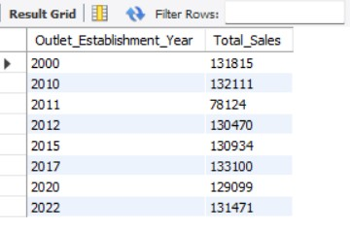
Solution of Granular Requirements
4. Total Sales by Outlet Establishment:
SELECT Outlet_Establishment_Year ,
SUM(Total_Sales) AS Total_Sales
FROM blinkit_grocery_data
GROUP BY Outlet_Establishment_Year
ORDER BY Outlet_Establishment_Year ;
Presented by : Bankim Das

Slide 9
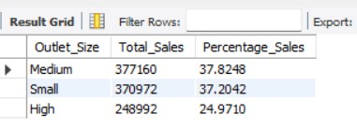
Solution of Granular Requirements
5. Percentage of Sales by Outlet Size:
WITH cte AS (
SELECT Outlet_Size ,
SUM( Total_Sales ) AS Total_Sales
FROM blinkit_grocery_data
GROUP BY Outlet_Size )
SELECT Outlet_Size ,
Total_Sales ,
(100*Total_Sales / SUM( Total_Sales ) OVER() ) AS Percentage_Sales
FROM cte ;
Presented by : Bankim Das

Slide 10
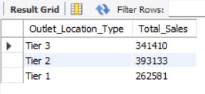
Solution of Granular Requirements
6. Sales by Outlet Location :
SELECT Outlet_Location_Type ,
SUM(Total_Sales) AS Total_Sales
FROM blinkit_grocery_data
GROUP BY Outlet_Location_Type
ORDER BY Outlet_Location_Type DESC;
Presented by : Bankim Das

Slide 11
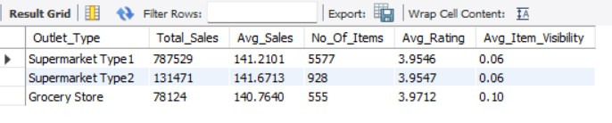
Solution of Granular Requirements
7. All Metrics by Outlet Type:
SELECT Outlet_Type ,
SUM(Total_Sales) AS Total_Sales,
AVG(Total_Sales) AS Avg_Sales,
COUNT(*) AS No_Of_Items,
AVG(Rating) AS Avg_Rating, CAST(AVG(Item_Visibility) AS DECIMAL(10,2)) AS Avg_Item_Visibility
FROM blinkit_grocery_data
GROUP BY Outlet_Type ;
Presented by : Bankim Das

