Slide 1
FINAL PROJECT – DATA 1200
AROWOLO BANKOLE
STUDENT NO: 100833830

Slide 2
a) Description of the problem
Diabetes is a chronic illness affecting many people and is characterized by the presence of high blood sugar levels. Early detection is important since diabetes detected in early stages can be controlled by lifestyle changes and/or minimal medication. Diabetes prediction serves as a useful reference for doctors because they can order further tests to detect diabetes early.
To achieve this goal Mr. John Hughes has given the instruction to perform early prediction of Diabetes in a human or a patient for a higher accuracy through applying various algorithms. The algorithms will provide better result for prediction by constructing models from datasets collected from patients. In this project various algorithm will be used on a dataset to predict diabetes.

Slide 3
b) methodology used in tackling the problem
In this project we will use 3 different algorithms on the diabetes dataset to predict diabetes.
Logistic Regression (LR) -Logistic regression is also a supervised learning classification algorithm. It is used to estimate the probability of a binary response based on one or more predictors. They can be continuous or discrete. It classify the data in binary form means only in 0 and 1 which refer case to classify patient that is positive or negative for diabetes.
Decision Tree (DT) - Decision tree is a basic classification method. It is supervised learning method. Decision tree used when response variable is categorical. Decision tree has tree like structure based model which describes classification process based on input feature. Input variables are any types like graph, text, discrete, continuous etc.
Support Vector Machine (SVM) - Support Vector Machine also known as svm is a supervised machine learning algorithm. Svm is most popular classification technique. Svm creates a hyperplane that separate two classes.

Slide 4
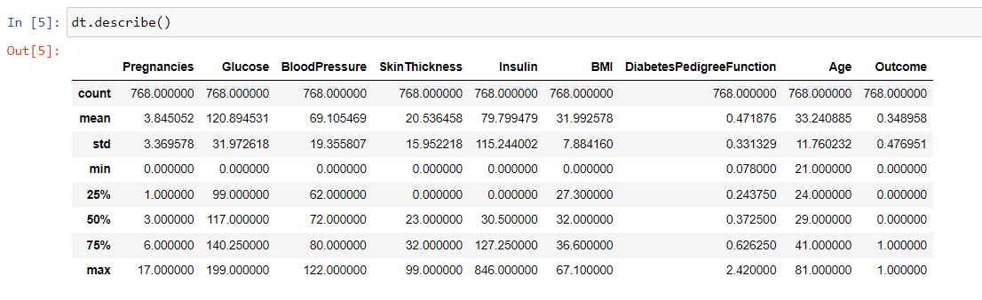
c) basic statistics of the dataset
dt.describe() method generates descriptive statistics that summarize the central tendency, dispersion and shape of the diabetes dataset’s distribution, excluding NaN values. This method tells us a lot of things about a dataset and only deals with numeric values. It doesn't work with any categorical values.
COUNT shows the number of non-empty rows in a feature.
MEAN shows the mean value of that feature.
STD shows the Standard Deviation Value of that feature.
MIN shows the minimum value of that feature.
25%, 50%, and 75% are the percentile/quartile of each features. This quartile information helps us to detect Outliers.
MAX shows the maximum value of that feature.

Slide 5
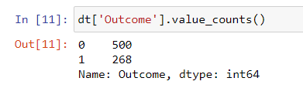
c) key insights gained from the basic statistics
The dataset has about 34.8% i.e. 35% entries with a likelihood of getting diabetes.
MISSING VALUES: From the describe function output above, we can see that the diabetes dataset contains some missing values which appear to be 0 i.e., values that can clearly not be zero like the glucose, insulin, BMI, or blood pressure.

Slide 6
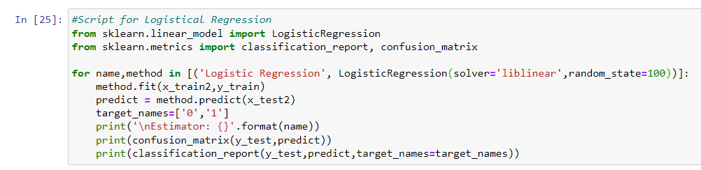
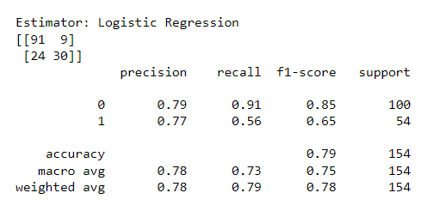
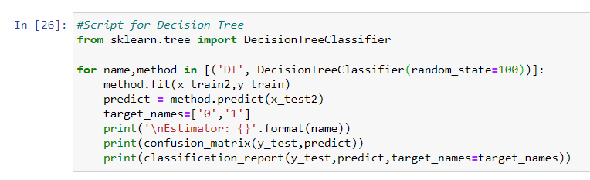
d) Confusion Matrix and Classification Report
LOGISTICAL REGRESSION
DECISION TREE

Slide 7
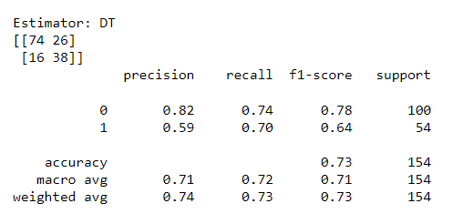
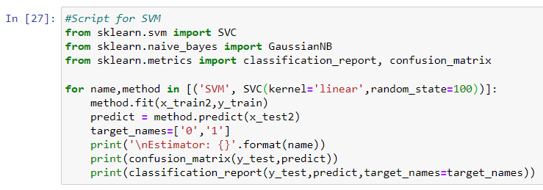
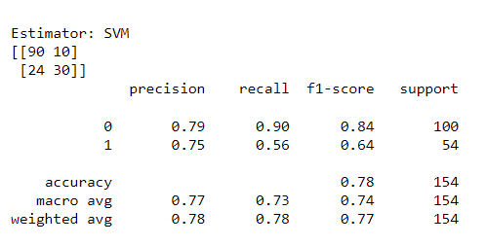
d) Confusion Matrix and Classification Report
DECISION TREE
SVM

Slide 8
d) Confusion Matrix and Classification Report
The confusion matrix is a technique used for summarizing the performance of a classification algorithm i.e. it has binary outputs.
The classification Report which includes Precision, Recall and F1-Score.
Precision Score
TP – True Positives FP – False Positives Precision – Accuracy of positive predictions. Precision = TP/(TP + FP)
Recall Score
FN – False Negatives Recall(sensitivity or true positive rate): Fraction of positives that were correctly identified. Recall = TP/(TP+FN)
F1 Score
A helpful metric for comparing two classifiers. F1 Score takes into account precision and the recall. It is created by finding the harmonic mean of precision and recall.
F1 = 2 x (precision x recall)/(precision + recall)

Slide 9
d) Key Insight Confusion Matrix and Classification Report
LOGISTICAL REGRESSION
Precision tells us what fraction has diabetes from all the patients our model predicted to have diabetes. The Logistical Regression predicts non-diabetes to be 79% and diabetes to be 77%.
Recall gives us the fraction our model correctly detected as having diabetes out of all the diabetic patients. Here, it predicts non-diabetes to be 91% and diabetes to be 56%.
The f1-score finds a good balance between precision and recall. For the non-diabetic patient, the F1 Score is 85% while for the diabetic patient, the F1 Score is 65%.
DECISION TREE
Precision tells us what fraction has diabetes from all the patients our model predicted to have diabetes. The Logistical Regression predicts non-diabetes to be 82% and diabetes to be 59%.
Recall gives us the fraction our model correctly detected as having diabetes out of all the diabetic patients. Here, it predicts non-diabetes to be 74% and diabetes to be 70%.

Slide 10
d) Key Insight Confusion Matrix and Classification Report
DECISION TREE CONT’D
The f1-score finds a good balance between precision and recall. For the non-diabetic patient, the F1 Score is 78% while for the diabetic patient, the F1 Score is 64%.
Support Vector Machine (SVM)
Precision tells us what fraction has diabetes from all the patients our model predicted to have diabetes. The Logistical Regression predicts non-diabetes to be 79% and diabetes to be 75%.
Recall gives us the fraction our model correctly detected as having diabetes out of all the diabetic patients. Here, it predicts non-diabetes to be 90% and diabetes to be 56%.
The f1-score finds a good balance between precision and recall. For the non-diabetic patient, the F1 Score is 84% while for the diabetic patient, the F1 Score is 64%.

Slide 11
e) Recommend one (1) model that should be utilized
The performance of the proposed algorithm shows us the prediction result where we used the following algorithm: Logistic Regression, Decision Tree, SVM .
Here we see that logistic regression algorithm shows the better results than other algorithms to predict diabetes. According to the figure logistic regression shows 78% accuracy on this dataset, which is greater than all other algorithms. This it shows that logistic regression performs well on this medical dataset for predicting diabetes.

Slide 12
e) Possible improvements that can be made to increase the effectiveness of the model
Creating new variables for blood pressure in a particular range, glucose levels in a particular range, and other missing value.
The effectiveness can be improved through the data cleaning, by replacing 0 values with either the mean or median value.
The model performance can be improved by collecting more data.

