Slide 1


Google Play Store App Analysis
Develapp.
Tap Into Apps
Arowolo Bankole
100833830

Slide 2
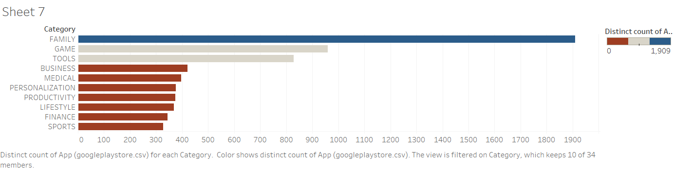
EXECUTIVE SUMMARY
OVERVIEW
Analysis on Google Play Store App. The dataset contains various data on a set of apps in the Google play store.
9660 Unique apps & 13 Unique Variables.
FACTS
KEY HIGHLIGHTS
92%
of Apps are
FREE TO DOWNLOAD
The FAMILY category has the most apps on the Google play store.
I’M RICH – Trump Edition App is the most expensive App (400$) on Google play store.
The GAME category has the most installed Apps on Google play store.

Slide 3
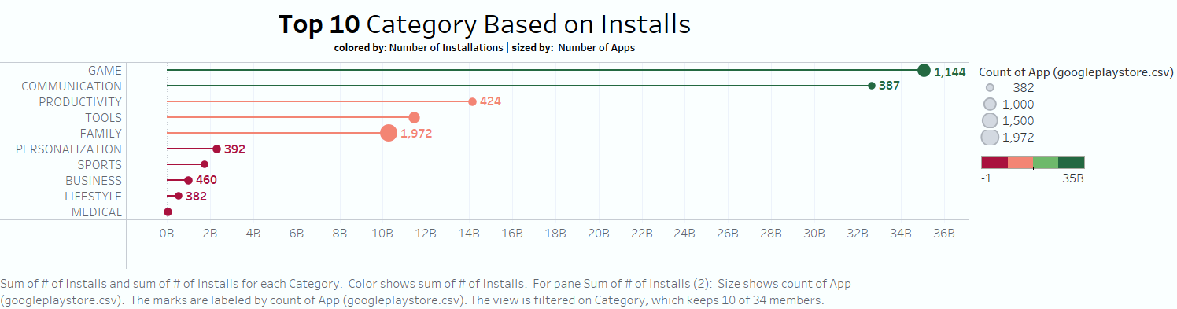
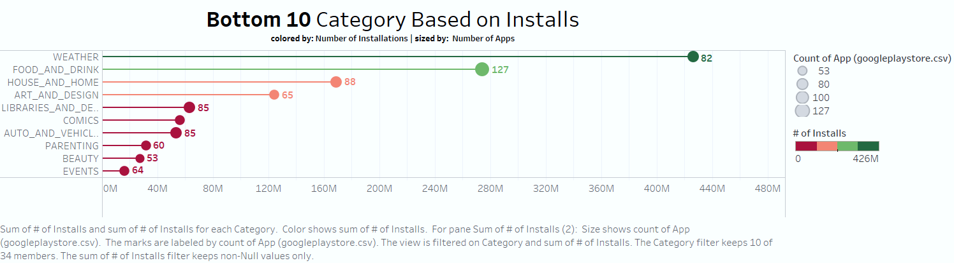
Number of Apps
Most Apps in the Top 10 & Google play store.
Colored by Number of Installs and Sized by the actual Number of Apps in each category.

Slide 4
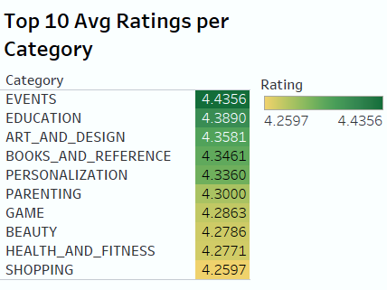
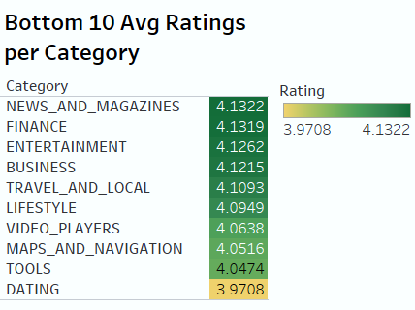
Highest overall Rating – Events at 4.44
Lowest overall Rating – Dating at 3.97
The overall ratings on the play store are positive.

Slide 5
INSIGHT
4.3 Avg Rating
53 Apps
The global beauty industry is worth $511 billion.
It is the category with the fewest App on the Google play store.
There is a huge success rate in developing a beauty App.

Slide 6
THANK YOU!

