Slide 1

TechMe Corp.
TECHNOLOGIES
Arowolo Bankole
100833830

Slide 2
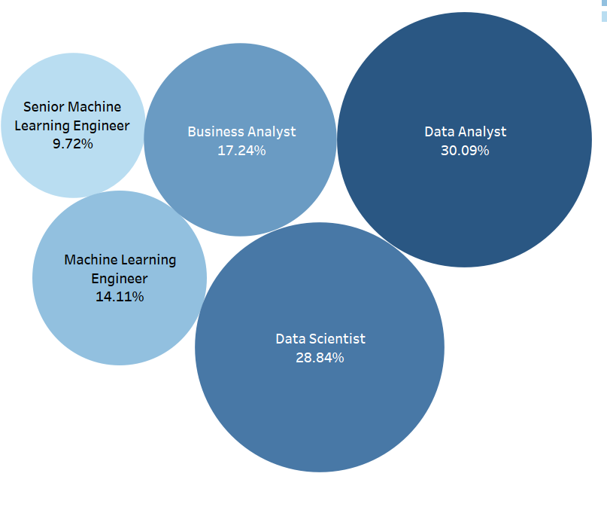


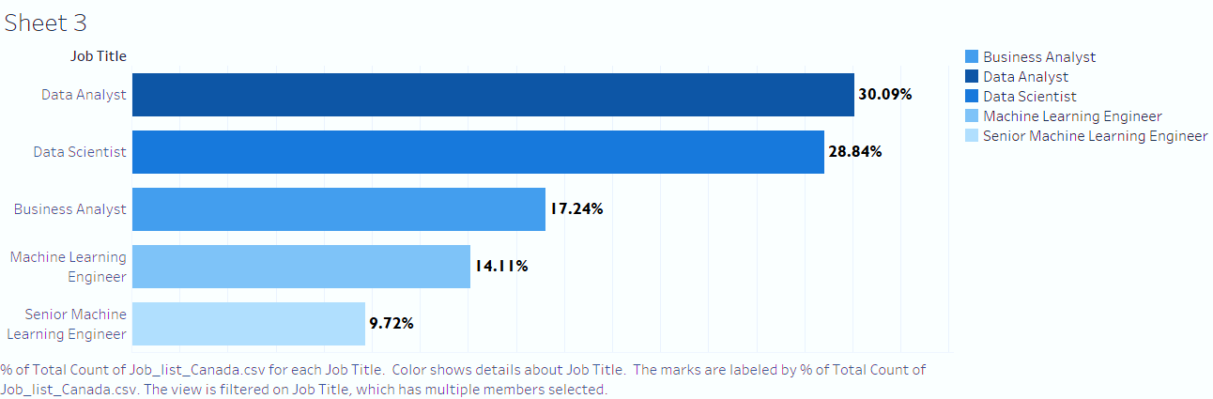
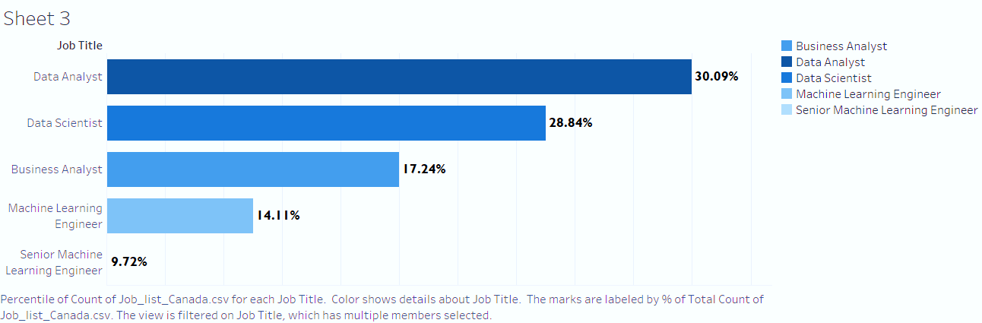
Executive Summary
Overview
Multiple companies in the Tech world are fighting to hire the best and qualified candidates.
Here are the top 5 Job titles in demand in the Tech Industry:
Standing Out From Competitors When Recruiting Tech Talent, flexible hours can be a great option
Data Analyst
Data Scientist
Business Analyst
Machine Learning Engineer
Senior Machine Learning Engineer
# | Finding skilled & qualified candidates
1 | Remote work benefit & flexible schedule.
2 | Regular employee benefits (Insurance, vacation, healthcare)
3 | Broaden Recruitment method – Remote recruitment is a great way to attract top professionals.
Recommendations
Improve/Maintain a positive company brand and job flexibility
Continue to seek employee referrals
Host meetups, workshops, and invite outside techies
CMO
FMO

