Slide 1
FINAL PROJECT
AROWOLO BANKOLE
STUDENT NO: 100833830

Slide 2
Description of the research requirements
Mr. John Hughes has been collecting data on the effect of personal attributes on household expenses. He would like to know the effect of Smoking, Age, BMI, Region etc. on expenses. To achieve this goal, he put together a dataset with contains 1338 observations and 7 features and has given the instruction to perform prediction by creating a linear regression model and multivariate regression model.

Slide 3
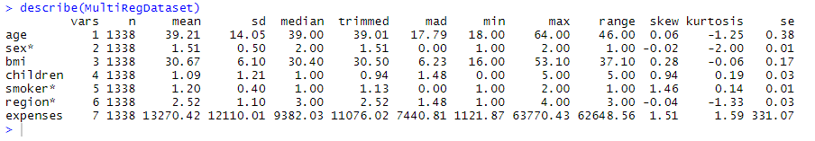
Compute and state the basic statistics
describe() method generates descriptive statistics that summarize the central tendency, dispersion and shape of the MultiReg dataset’s distribution. This method tells us a lot of things about a dataset and only deals with numeric values. It doesn't work with any categorical values.
N – shows the number of non-empty rows in a feature (1338).
Mean - shows the mean value of that feature.
Sd - shows the Standard Deviation Value of that feature.
Median – The middle value in a set of observations is the median.

Slide 4
Compute and state the basic statistics cont’d
Trimmed Mean – This is computed. The lower and upper a% of the data are removed and the mean is calculated using the rest of the data.
Mad – It is the median absolute deviation from the median.
Min – shows the minimum value of that feature.
Max – shows the maximum value of that feature.
Range - The range of a variable is the largest value minus the smallest value.

Slide 5
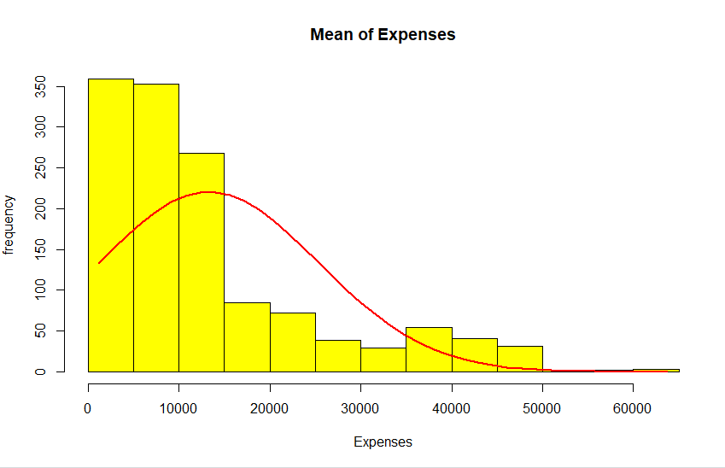
Create and show a fully labeled Histogram of the dependent variable(expenses).
From the plot above, we can see that the value of expenses vary from 0 to 60,000+, but looking at it, the most of the values are in a range from 0 to 15,000.

Slide 6
Conduct a T-test that the mean for expenses is equal to 10,000
Null Hypothesis (H0): β = 10,000, is that the coefficients associated with the variables is equal to 10,000. In other words, there is no statistically significant relationship between the predictor variable, x, and the response variable, y. i.e. mean of the expenses column is 10,000.
Alternative Hypothesis (Ha): β ≠ 0, hypothesis is that the coefficients are not equal to 10,000 (i.e. there exists a relationship between the predictor variable and the response variable). True mean is not equal to 10,000.

Slide 7
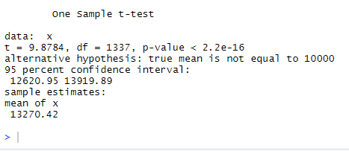
Conduct a T-test that the mean for expenses is equal to 10,000
P-Value is less than 0.05 so we reject the null hypothesis that “The coefficient of the prediction is zero and not statistically significant”. Mean is 13,270.

Slide 8
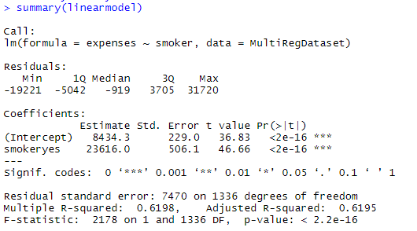
linear regression using smoker as your independent variable and expenses as your dependent variable
Null hypothesis: A relationship between these values doesn’t exist.
Alternate hypothesis: A relationship exists between the values.
In the first row, it shows the results for the Y intercept (expenses). This is the point where the regression line crosses the Y axis when the value of X = 0. So, In this analysis, this occurs when Y = 8434.3.
In the second row, you will find the slope coefficient value for the independent variable. In this analysis, this is smokers, which had a slope of 23.616.

Slide 9
linear regression using smoker as your independent variable and expenses as your dependent variable
The multiple R-squared value tells you how much variance the dependent variable can be accounted for by the values of the independent variable.
In this analysis, we can say that 62%of the variability of the data can be accounted for by the smokers.
P-Value is less than 0.05 level so we reject the null hypothesis and accept the hypothesis that there is a relationship between smokers and expenses.
Smokers are more likely to spend more money than a non-smoking person.

Slide 10
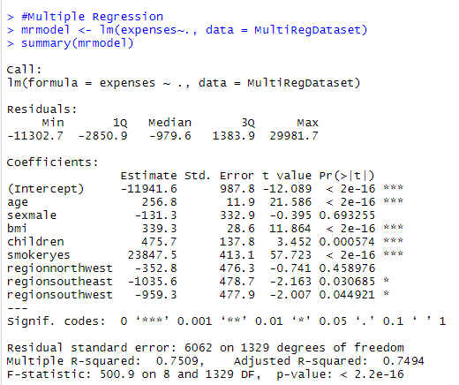
multiple linear regression on all variables and report the results
Null hypothesis: A relationship between expenses and the other variables doesn’t exist.
Alternative hypothesis: that relationship does exist.

Slide 11
multiple linear regression on all variables and report the results
The Adjusted R-squared takes into account the number of independent variables used for predicting the target variable.
The highlighted independent variables are not of significance in predicting the outcome because the p value is not less than 0.05.

Slide 12
CONCLUSION
The performance of the proposed model shows us the prediction result where we used the following algorithm: Simple linear regression and Multiple regression model.
We can tell that Smoking have an effect on the amount of expenses of a person and using the regression model, it has shown that a smoker spends more money than a non-smoker.
Furthermore, other variable like, Age, BMI, Children and a particular location also have an effect on the expenses. The mentioned variables all have a part in a persons expenses.

Slide 13
R-CODE
#Load Libraries
library(lattice)
library(psych)
library(gmodels)
#View Dataset
summary(MultiRegDataset)
describe(MultiRegDataset)
#histogram
x=MultiRegDataset$expenses
hist(x, col='yellow',main="Mean of Expenses",
xlab='Expenses',ylab='frequency')
lines(xfit, yfit, col="red", lwd=2)

Slide 14
R-CODE
#ttest
t.test(x, mu=10000)
#Linear Regression Model
linearmodel <- lm(expenses ~ smoker, data=MultiRegDataset)
#Summary of Key Statistics of the Model
summary(linearmodel)
#Multiple Regression
mrmodel <- lm(expenses~., data = MultiRegDataset)
summary(mrmodel)

