Slide 1

_{PID Control}
Dheeraj Upadhyay M.Tech . Faculty of Engineering D.E.I, Agra

Slide 2
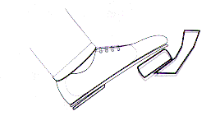
To understand PID we need a model. Suppose You are driving a car.
Velocity
.
Gas paddle
×
ɸ
Plant
Here , Car is considered as Plant Gas pedal angle is Input variable Velocity is output variable

Slide 3
T.F of car is depended on car model.
We can simplify the model by assuming this to be
L.P.F. So T.F of Car =
1
s
+
1
ᵚo
ɸ
1
.
×
s
+
1
ᵚo

Slide 4
Now ...if you want the speed of car to be 50 kmh. How would you recognize the specific pedal angle to get this speed…????????
At What angle I am ?????
Velocity
.
Gas paddle
×
ɸ
Plant

Slide 5
In real life no one drives by knowingly putting the gas pedal at specific angle. Instead of it people drive the car by applying a change in the pedal angle.
Going slow..want to be fast
30 kmh
Change the Gas pedal angle by Putting weight on it
Going fast now…
50 kmh

Slide 6
Now command = change in angle over time
.
1
.
ɸ
ɸ
×
1
s
s
+
1
ᵚo
.
.
1
.
ɸ
×
s
2
+
s
ᵚo

Slide 7
Close Loop control system for car with P controller-
.
.
Error
ɸ
×
+
P controller
-
CAR
Reference
Speed limit 40 Kmh
When Light turns Green ,you press the pedal to accelerate the car up to speed limit. In real life as you drive car to respond the step command ,you are actually unknowingly performing Proportional Control Action.

Slide 8
Speed limit 40 Kmh
Velocity
40 kmh
At rest you are commanding 0 kmh.
When light turn green , the ref signal step up to 40 kmh error becomes 40kmh which is very large error.
Proportionally the control signal applied and velocity increased towards 40kmh.
Error gradually becomes smaller and smaller.
When error becomes zero you atop adjusting the pedal and hold it constant.
At this point we can say that here no steady state error.
Time
Error
Time
.
ɸ
Time

Slide 9
Let’s Increase the Gain…
Velocity
40 kmh
Initially error = 40kmh as before when light turns green , due to high gain to proportional control action is large. Your car will go above ref speed .. At this point error becomes negative
Again you realize to slow down the car and again error becomes positive due to high gain. Due to high gain …system becomes Unstable
STOP DRIVING WITH HIGH GAIN..
Time
Error
Time
.
ɸ
Time

Slide 10
Proportional-only control
Set value
Deviation
Offset
Low Gain
Process variable
time
Set value
Offset
Deviation
High gain
time
The above plots shows that the proportional controller reduced both the rise time and the steady-state error, increased the overshoot, and decreased the settling time by small amount.

Slide 11
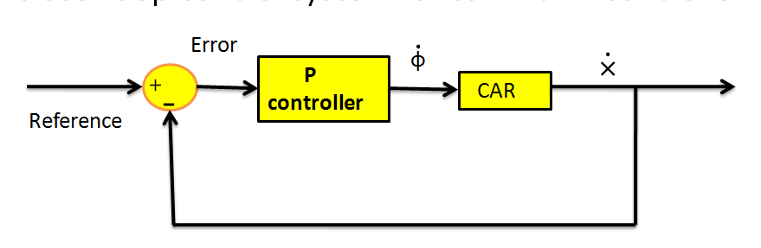


Proportional + Derivative
×
Reference Position
In this example we want to control the position instead of speed.
.
.
1
.
ɸ
×
×
1
s
2
+
s
s
ᵚo
New T.F

Slide 12
Proportional + Derivative
×
Reference Position
position
2nd Stoplight
As car move towards 2nd stop . The error gets smaller and when you reach error becomes zero. You stop changing pedal position but you hold that pedal on that position. Car will cross the stoplight. When you realize it..you start releasing pedal.
Time
Error
Zero Error
Time
Start releasing pedal

Slide 13
×
Reference Position
position
2nd Stoplight
When you realize it..you start releasing pedal. And get back to safe position… To avoid this the DERIVATIVE ACTION is used. It gives output according to rate of change of error… as error change slowly….smaller output it gives.
Time
Error
Zero Error
Time
Start releasing pedal

Slide 14
Error
.
ɸ
×
+
PD
controller
-
CAR
Reference
×
Reference Position

Slide 15
×
Reference Position
position
P
Time
Time
+
Negative Slope
Error
D
Time
Time

Slide 16
Proportional – gets you to the destination as fast as possible Derivative – Try to restrain you from moving too quickly. Here the balance of two is required to properly stop the at light.

Slide 17
Deviation
time
Controller output
Derivative action only
time
Controller output
Proportional + Derivative action
Proportional action only
change due to the Proportional action
time
CP0610

Slide 18
Proportional + Integral+ Derivative
Error
ɸ
×
+
PID
controller
-
CAR
.
1
.
ɸ
ɸ
×
×
1
1
+
-
s
s
+
1
s
Reference
ᵚo

Slide 19
No one drives the car by commanding gas pedal angle, rather they drive by change in the command angle. In this example I will command the gas pedal angle and try to show you….why this is not a good idea..??

Slide 20
Error
1
.
ɸ
×
×1
PD
controller
1
+
-
s
+
1
s
Position of friend
ᵚo
Reference Position
×1
Error
×1
If the output of controller is pedal angle …its easy to say that there will be always a steady state error. Means you will be always trailing your friend & never beside him.

Slide 21
Reference Position
×1
Error
×1
Less Error with higher gain
Imagine you at some distance behind your friend and both are going with same speed. Then there will be a const. error hence derivative
Term is zero. Since the velocity is matched so you are not going to put weight on gas paddle. One might think that higher gain can help to catch up that friend. By doing you may get closer…results in error reduction and causing to release the pedal and again car will slow down… so there will be steady state error always…
Error
Time
ɸ
Time
Derivative
Proportional

Slide 22
Reference Position
×1
Error
×1
Less Error with higher gain
Error
Time
If somehow you catch that friend.. Then Error =0, same speed so P=0,D=0 So you release the pedal..and car again start slowing down.
ɸ
×
Time
You let go the pedal
Derivative
Proportional

Slide 23
So by Controlling pedal position and using PD controller you are not going to achieve steady state error to be zero. Now the Integral Part is going to solve this problem..

Slide 24
Error
1
.
ɸ
×
×1
PID
controller
1
+
-
s
+
1
s
Position of friend
ᵚo
Reference Position
×1
Error
×1

Slide 25
Reference Position
×1
Error
×1
P
Time
Error
D
Time
Time
ɸ
I
Time
Time
Error is non zero so integral path summing up the error over time
And gradually increase the pedal position.

Slide 26
Integral action
Deviation
Time
Controller Output
Integral Action Only
Time
Controller Output
Proportional + Integral Action
Proportional Action Only
Change due to the Proportional Action
Time

Slide 27
PID Controller Functions
Output feedback
→ from Proportional action
compare output with set-point
Eliminate steady-state offset (=error)
→ from Integral action
apply constant control even when error is zero
Anticipation
→ From Derivative action
react to rapid rate of change before errors grows too big

Slide 28
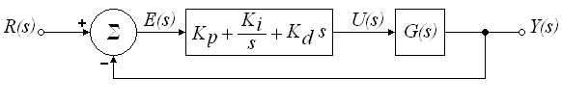
In the time domain:
The signal u(t) will be sent to the plant, and a new output will be obtained. This new output will be sent back to the sensor again to find the new error signal. The controllers takes this new error signal and computes its derivative and its integral gain. This process goes on and on…

Slide 29
integral time constant
derivative time constant
derivative gain
integral gain

Slide 30
Controller Effects
A proportional controller (P) reduces error responses to disturbances, but still allows a steady-state error.
When the controller includes a term proportional to the integral of the error (I), then the steady state error to a constant input is eliminated,
A derivative control typically makes the system better damped and more stable.

Slide 31
Closed-loop Response
 | Rise time | Maximum overshoot | Settling time | Steady-state error
P | Decrease | Increase | Small change | Decrease
I | Decrease | Increase | Increase | Eliminate
D | Small change | Decrease | Decrease | Small change
Note that these correlations may not be exactly accurate, because P, I and D gains are dependent of each other.

Slide 32
Proportional + Integral + Derivative control
P + I action (without Derivative action)
Set value
Deviation
Process Variable
time
P + I + D action
Set value
Deviation
Process Variable
time
CP0620

Slide 33
Conclusions
Proportional action gives an output signal proportional to the size of the error .Increasing the proportional feedback gain reduces steady-state errors, but high gains almost always destabilize the system.
Integral action gives a signal which magnitude depends on the time the error has been there. Integral control provides robust reduction in steady-state errors, but often makes the system less stable.
Derivative action gives a signal proportional to the change in the Error. It gives sort of “anticipatory” control .Derivative control usually increases damping and improves stability, but has almost no effect on the steady state error
These 3 kinds of control combined from the classical PID controller

