Slide 1
TASK2 BUG REPORT
Bug Name: Out-Of-Date Version (Tomcat)
Domain: webappsecurity.com
Sub Domain: zero.webappsecurity.comSeverity: HIGH
Reported By: Bannela Rohith
Reported On: 09/07/2021
Environment: Linux Debian 64-bit
Description: By using automatic Vulnarability scanner i.e Netsparker I have identified the target web site is using jQuery and detected that it is out of date.
Steps To Reproduce:
Step 1: Add Website http://zero.webappsecurity.com/ to the dialogue box.
Step 2: I have define the customization option to scan vulnarabilities.
Step 3: It will start scanning it automatically

Slide 2
Step 4: I have found 3 Critical Vulnerabilities.
Step 5: In which I have choosen only one. Which is Out-Of-Date Version (Tomcat) .A java query Bug.
Impact : Since this is an old version of the software, it may be vulnerable to attacks.
Mitigation : Please upgrade your installation of jQuery to the latest stable version.
POC including screenshot/sreen recoding is attached .

Slide 3
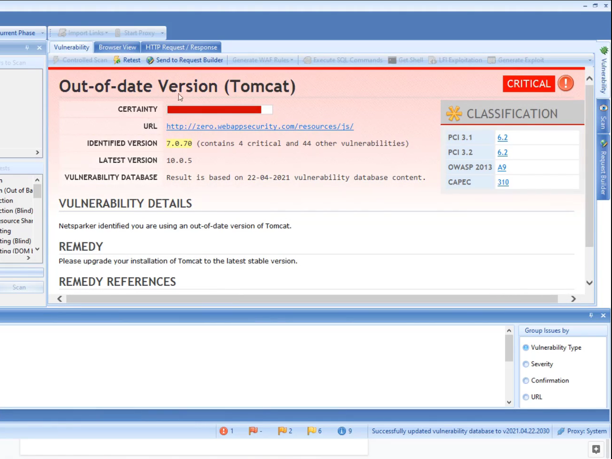
POC:-

