Slide 1
TASK3 BUG REPORT
Bug Name: Cross Site Scripting Vulnerability
Domain: Vulnweb.com
Sub Domain: testasp.vulnweb.com
Area Path: Search > Search box
Severity: HIGH
Reported By: Bannela Rohith
Reported On: 09/07/2021
Environment: Linux Debian 64-bit
Description:Cross-Site Scripting (XSS) attacks occur when: Data enters a Web application through an untrusted source, most frequently a web request. The data is included in dynamic content that is sent to a web user without being validated for malicious content.
Steps To Reproduce:
Step 1: Visit http://testasp.vulnweb.com/
Step 2: On the top you can find different options there you can find search option.
Step 3: Click on that search option and you will be prompted with the Search box.

Slide 2
Step 4: I have intercepted the request in Burp Suite.
Step 5: I have found different payloads for XSS.
Step 6: I have sent the request to the intruder and pasted all the payloads and performed a bruite force attack.
Step 7: The payload <script>alert("PayLoad")</script> seems to be the successful payload for XXS.
Impact : XSS can have huge implications for a web application and its users. User accounts can be hijacked, credentials could be stolen, sensitive data could be exfiltrated, and lastly, access to your client computers can be obtained.
Mitigation : Content security policy (CSP) is a browser mechanism that aims to mitigate the impact of cross-site scripting and some other vulnerabilities. If an application that employs CSP contains XSS-like behavior, then the CSP might hinder or prevent exploitation of the vulnerability.
POC including screenshot/sreen recoding is attached .

Slide 3
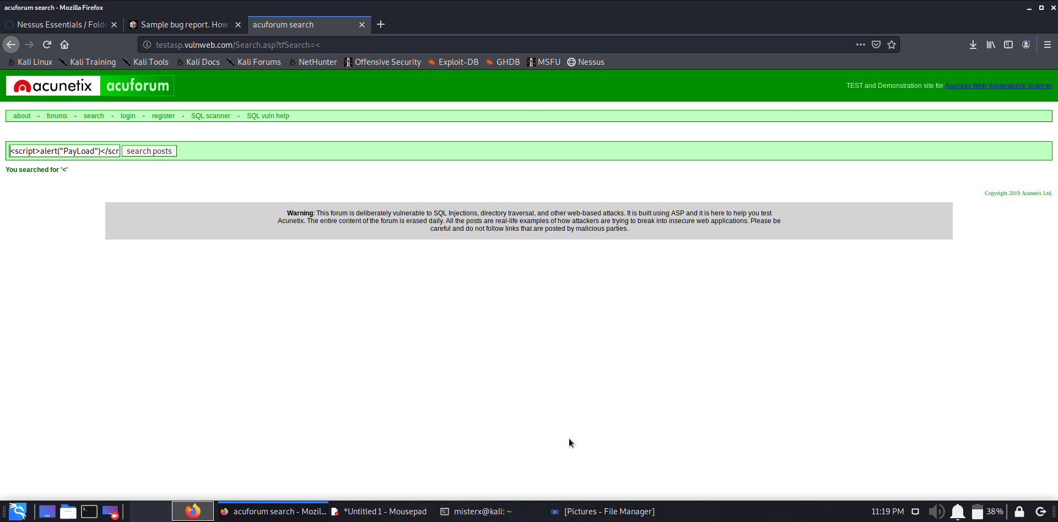
POC:-

Slide 4
