Slide 1
Secure Data Hiding in Image Using Steganography
CAPSTONE PROJECT
Presented By: Patnam Banni
College Name & Department : Indian Institute of Information Technology Tiruchirappalli & . Electronics and Communication Engineering

Slide 2
OUTLINE
Problem Statement
Technology used
Wow factor
End users
Result
Conclusion
Git-hub Link
Future scope

Slide 3
Problem Statement
In the digital age today, the security of private data is paramount. Encryption techniques are effective, but they could generate unwanted attention. Image steganography offers a
technique of concealing messages in images such that secret communication is possible without
arousing suspicion. The goal of this project is to create an online application where users
can encrypt and decrypt confidential messages within images using Python and OpenCV.

Slide 4
Technology used
Frontend: HTML, CSS, Bootstrap (used for making the UI responsive)
Backend: Flask (Python web framework)
Image Processing: OpenCV (used for changing pixel values)
Deployment: Render (used for hosting the website)
Version Control: GitHub

Slide 5
Wow factor
✅ User-Friendly Interface – Easy and user-friendly web UI for non-technical users ✅ Dual Functionality – Encrypt and decrypt messages both seamlessly ✅ Password Protection – Only people who have the password can decrypt messages ✅ Cross-Platform – Usable from any web browser-accessible device ✅ Online Deployment – Global accessibility through deployed link

Slide 6
End users
This application is beneficial to:
Cybersecurity enthusiasts – Familiarization with steganography and encryption
Businesses & Journalists – Securing confidential emails
Government & Military – Confidentially sharing secret data
General Public – Securing sensitive personal data

Slide 7
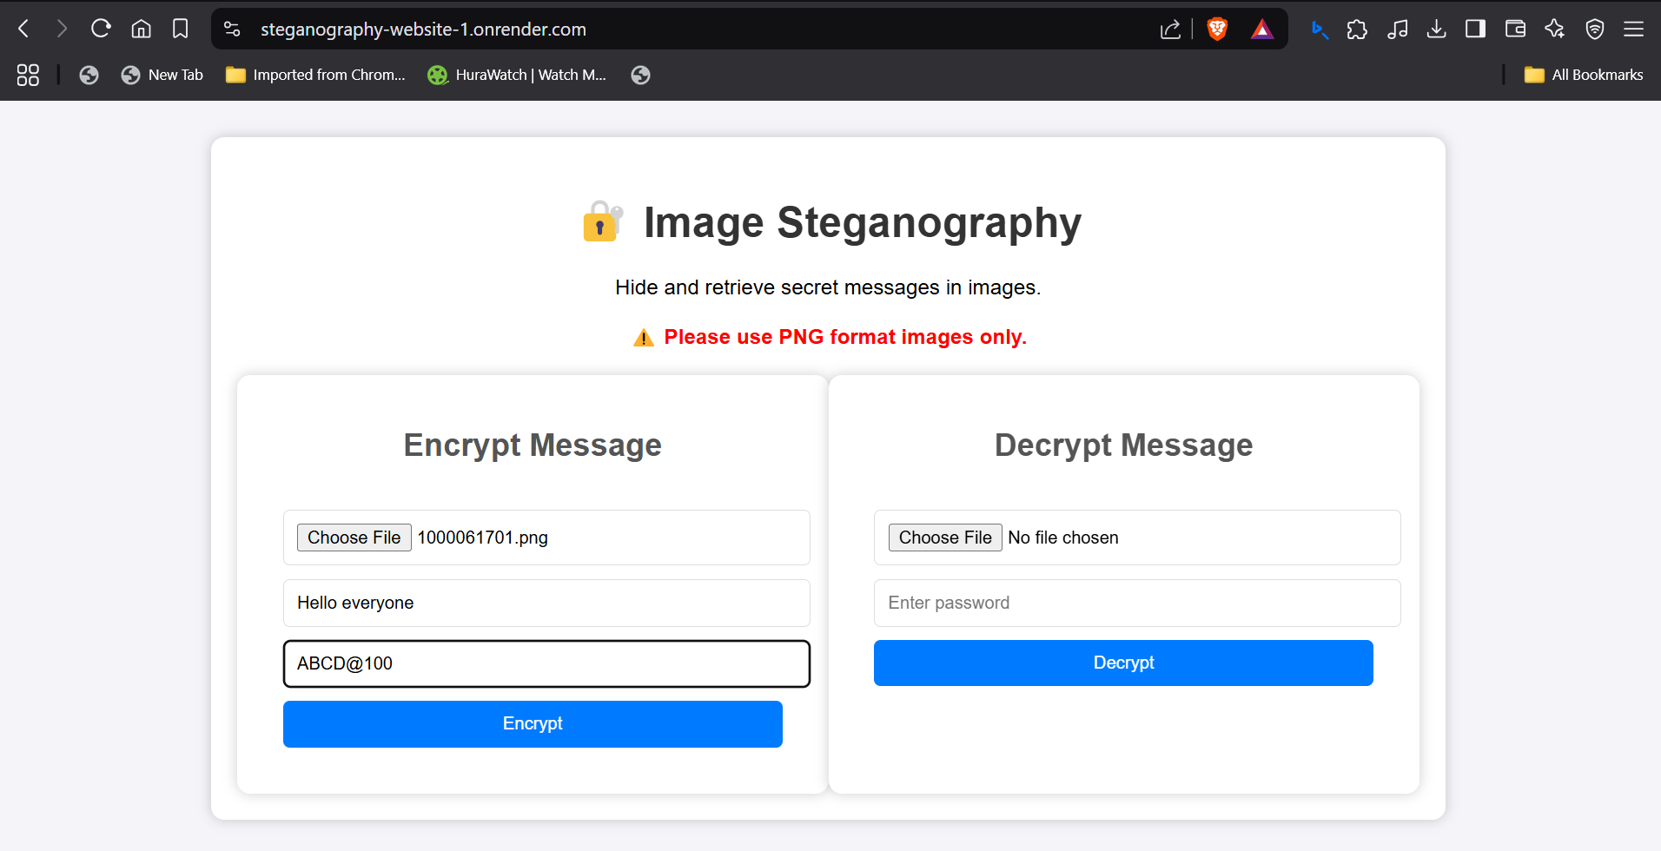
Results

Slide 8
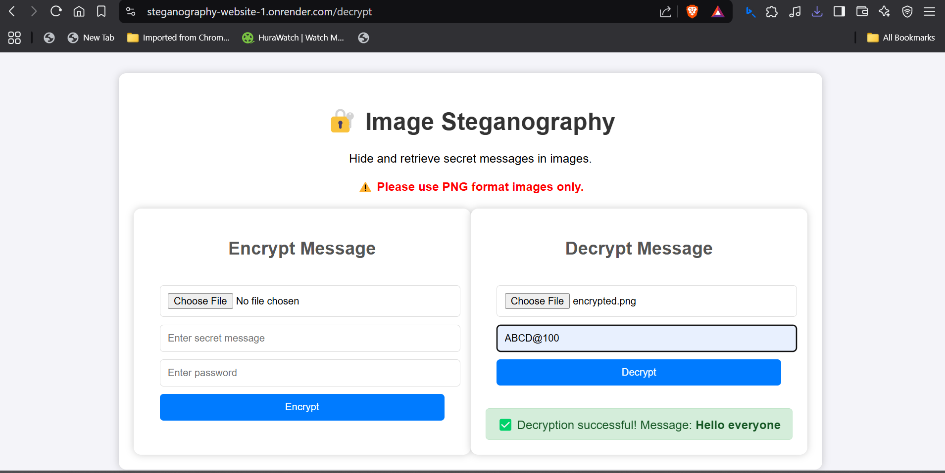
Results

Slide 9
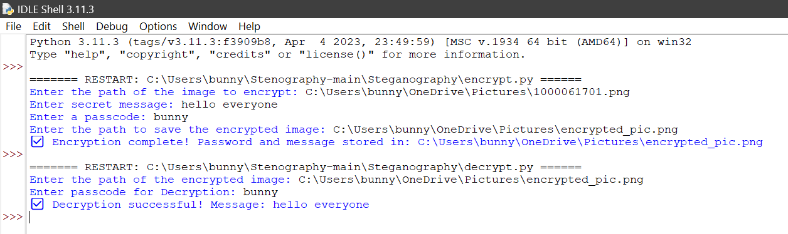
Results

Slide 10
Conclusion
This project effectively applies image steganography in web-based format, so anyone can easily use it.
It maintains privacy of data without making the encrypted message detectable.
The application of Flask and OpenCV is a light-weight and effective approach.

Slide 11
GitHub Link
https://github.com/Banni7/Stego_project.git
https://github.com/Banni7/steganography_website.git
Website- https://steganography-website-1.onrender.com

Slide 12
Future scope
Multiplying Image Support – Extend functionality beyond .png and .jpg.
Mobile App Development – Port the project as an Android/iOS app.
Enhanced Encryption – Employ high-level cryptographic algorithms for enhanced protection.

Slide 13
THANK YOU

