Slide 1

IDEAL SPOTS FOR FITNESS ACTIVITIES
By Bano aqeel

Slide 2
INTRODUCTION
Companies such as Camp Gladiator setup outdoor meetup locations across the city in areas that would be convenient for people looking to workout. They focus on areas with higher density populations of people that are more likely to be active, around office parks, schools, suburban areas, and more.
My program will help companies like Camp Gladiator identify the best locations to setup a new outdoor location. It will recommend “Ideal spots" by identifying areas that have trending venues related to health (healthy restaurants, active wear shopping, etc) and no gyms within close proximity.

Slide 3
DATA
To develop the program, I will use location and venue data from the Foursquare API for Toronto, Canada. These are the specific endpoints that will be used:
Trending: get trending venues
Categories: get venue categories
Explore: get venue recommendations
will also use two other data sources to identify neighborhoods in Toronto:
Neighborhood names : https://en.wikipedia.org/wiki/List_of_postal_codes_of_Canada:_M
Neighborhood locations: https://cocl.us/Geospatial_data

Slide 4
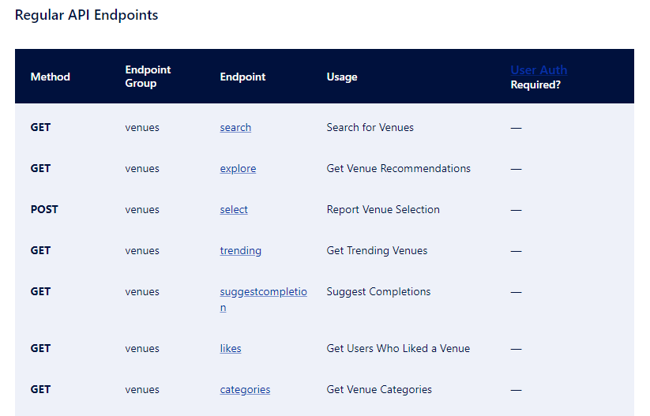
API ENDPOINTS

Slide 5
METHODOLOGY
The process to analyze this data will be as follows:
(https://en.wikipedia.org/wiki/List_of_postal_codes_of_Canada:_M)
• Identify latitude and longitude of each neighborhood (https://cocl.us/Geospatial_data)
• Lookup top 5 trending venues for each neighborhood (Foursquare API - Trending)
• Filter neighborhoods that have a health venue in top 5 trending venues (Foursquare API - Categories)
• Verify if a gym is within 5 miles of the filtered list of neighborhoods (Foursquare API - Explore)
• Present final list of “Ideal spots"

Slide 6
RESULT
The results of the program identified four neighborhoods as recommended spots for a new outdoor fitness location in Toronto:
• Berczy Park
• The Beaches
• Central Bay Street
• Kensington Market/Chinatown/Grange Park

Slide 7
RESULT
See below for the list of locations and top venues.
Each neighborhood has a farmer’s market, health food store, salad place, or vegetarian/vegan restaurant in the top 5 venues. Berczy Park or Kensington

Slide 8
CONCLUSION
The fitness hot spot program is a useful tool for growing fitness companies to tap into trending locations of an active city. Using recommendations based on high traffic locations will help ensure that new workout spots have the best chance at success. This program can be easily adapted for other cities and company types to focus on a target demographic.

