Slide 1
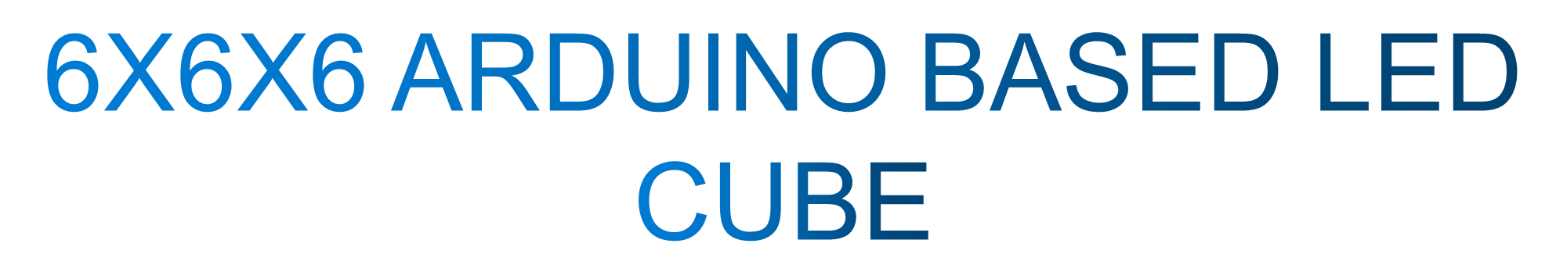
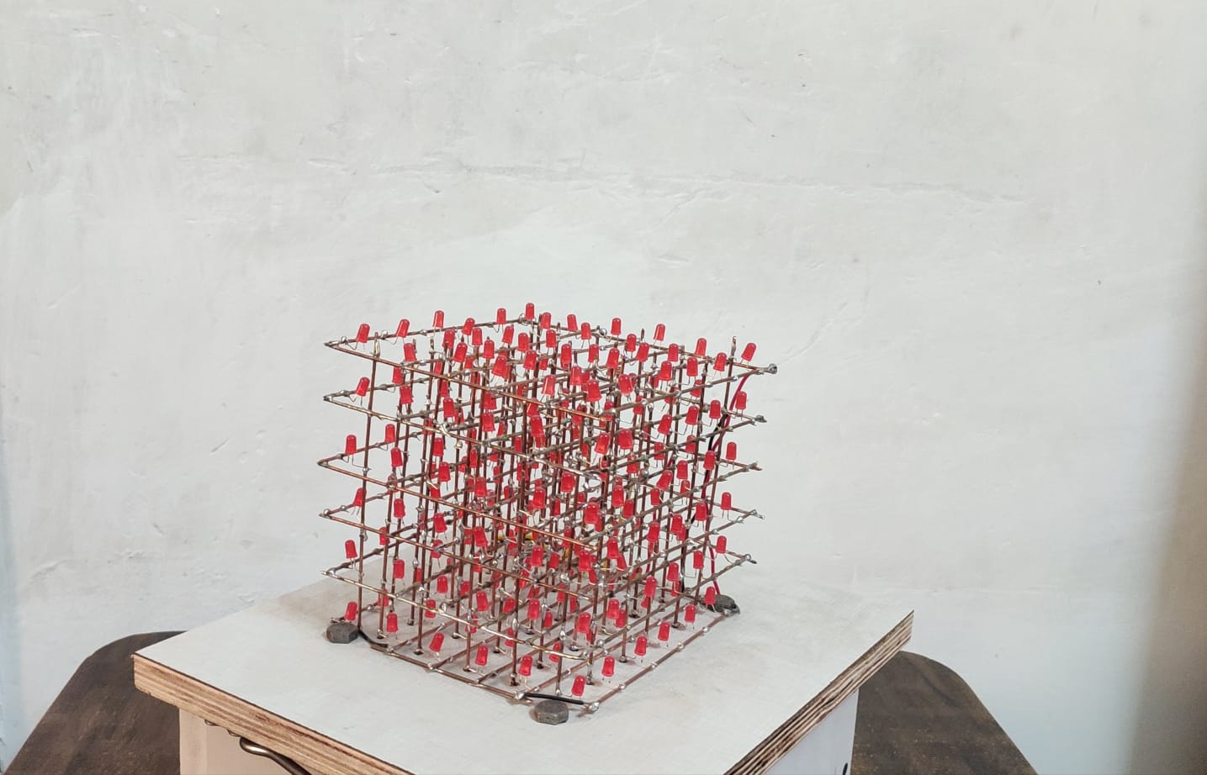
DIKSHANT
21116038
ECE

Slide 2
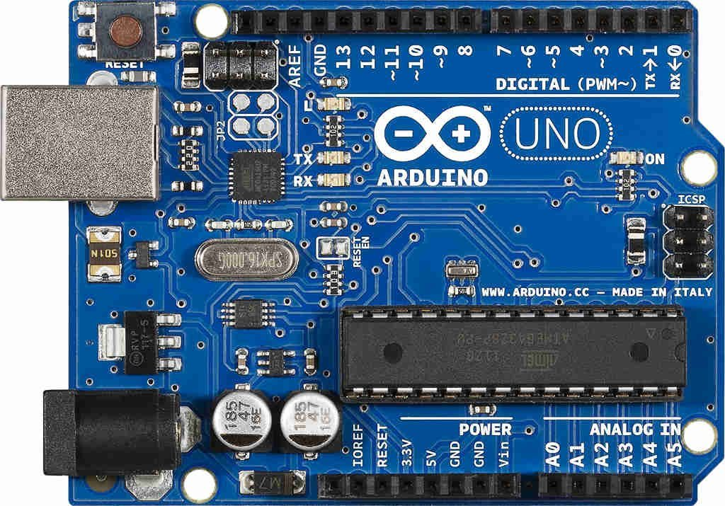
Arduino Uno is a microcontroller board which is based on the microcontroller ATmega328P. Basically this acts as an interface between the control circuit and the PC. It stores all the programs and generates the desired clock signals which is communicated with a shift register 74HC595, the heart of the system,using SPI protocol.

Slide 3

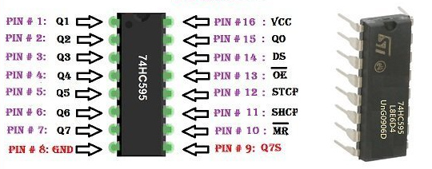
The 74HC595 is an 8-bit serial in parallel out shift register that contains a shift and a storage register. It contains a total of 8 outputs which can be easily expanded using the daisy chaining method.
The arduino generates the required clock, latch and data signal for this IC and the IC outputs the data according to these clock signals.This can be better understood in the following animation.

Slide 4

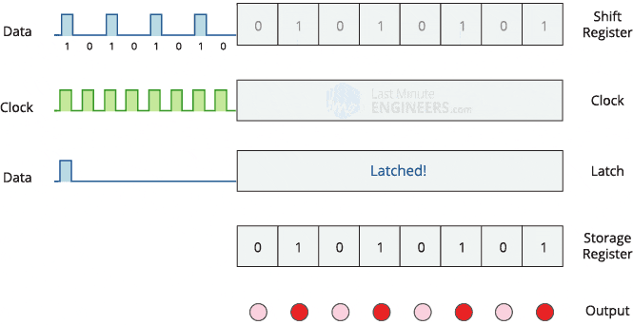

Slide 5
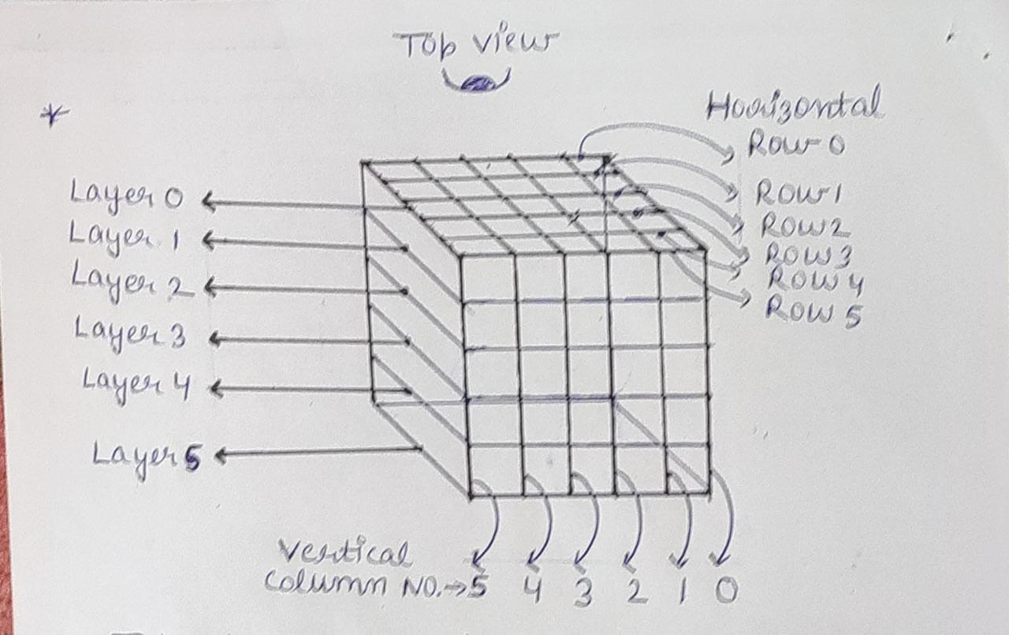

Slide 6
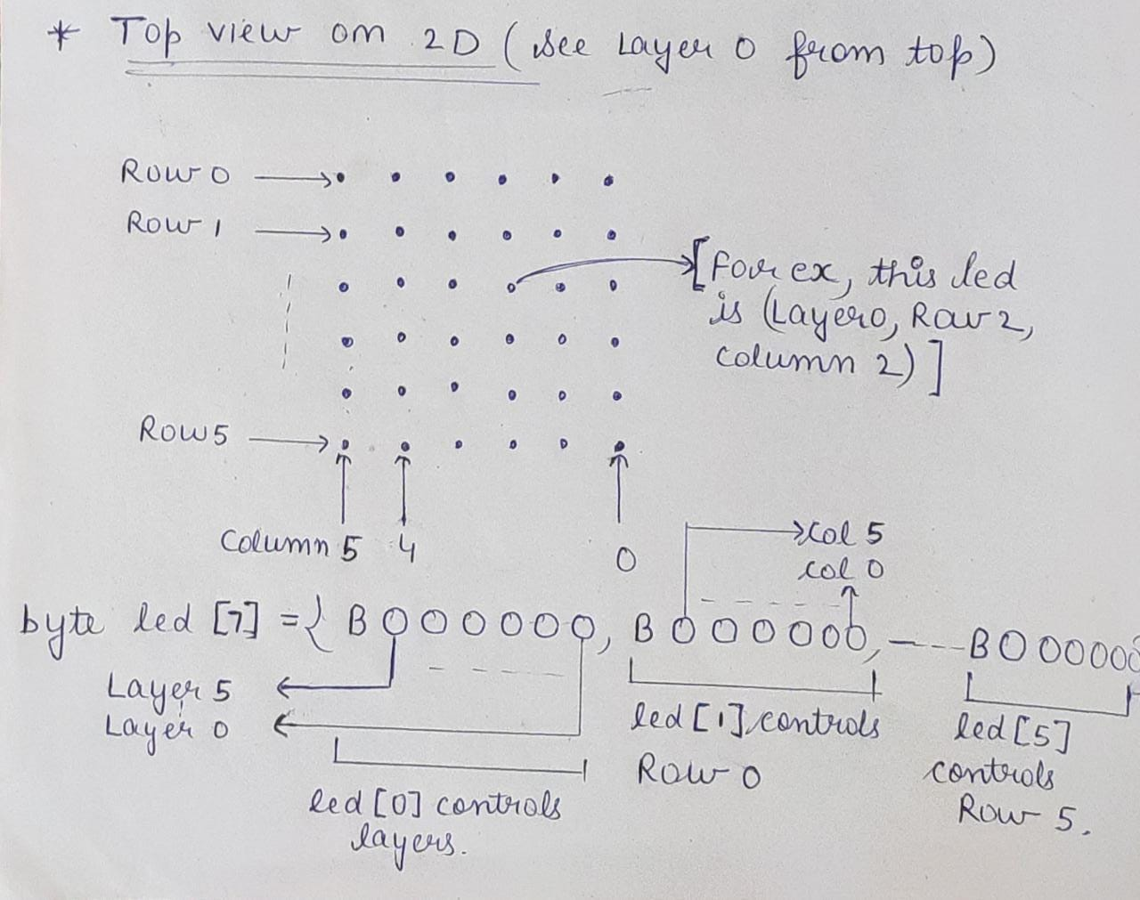
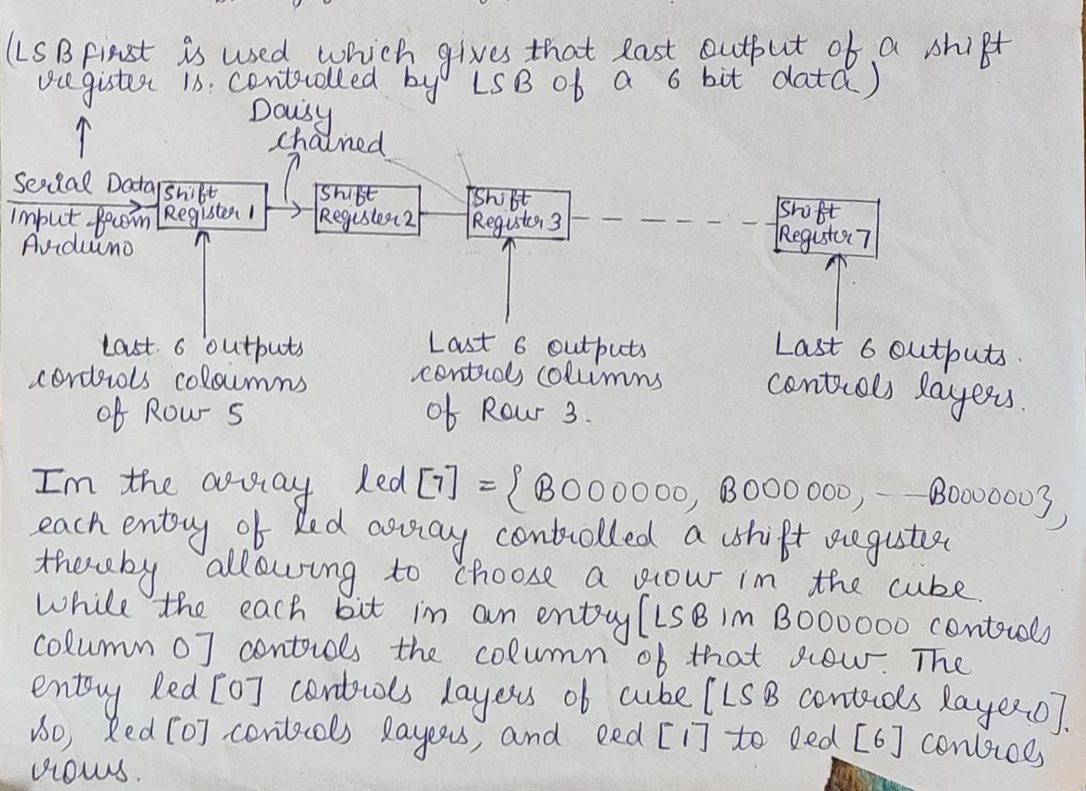
THE MULTIPLEXING TECHNIQUE USED HERE ALLOWS US TO CONTROL THE 216 LED’S USING
ONLY AN ARRAY LED[] OF JUST 7 ELEMENTS.

Slide 7
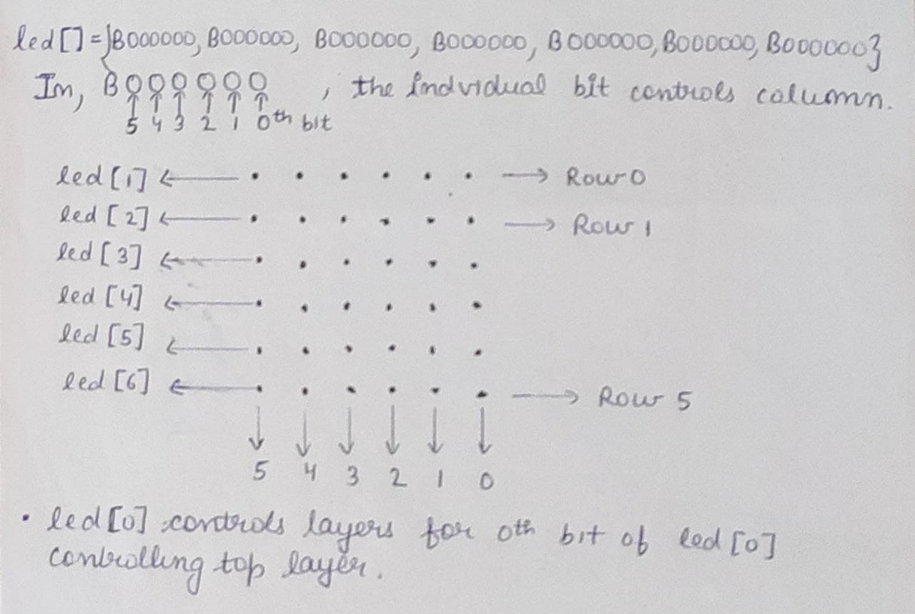
So for example, the LSB of the element led[1] controls the rightmost coloumn(Col 0) of the backmost layer(Row 0). To select the LED from the 6 LED, 1 in each floor/layer, bits of element led[0] are controlled where LSB controls topmost floor (Layer 0) and MSB controls bottommost floor(Layer 5). Thus we get control of each led in these 216 LED’s.

Slide 8
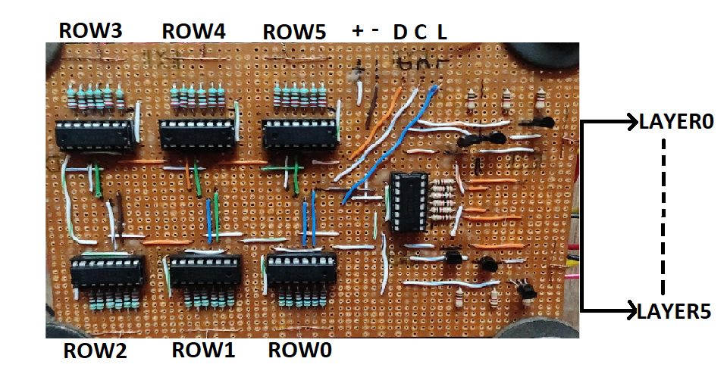
D = DATA, C = CLOCK, L = LATCH, + = VCC, - = GROUND

Slide 9
THANKS

