Slide 1

Project Overview
Developers
Guidance
Sangani Mitali & Katoch Rishita
Prof. Pritesh Vyas
Master of Computer Application, Sem-IV
Faculty of Computer Applications
Institution
Ahmedabad Institute of Technology
Approved by AICTE & AICTE

Slide 2
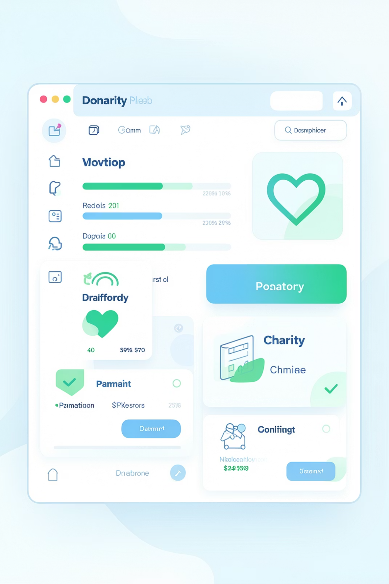
E-NGO Web Application
A multi-tenant platform connecting donors, volunteers, NGOs, and corporate partners through AI-driven recommendations and blockchain-secured transparency.

Slide 3
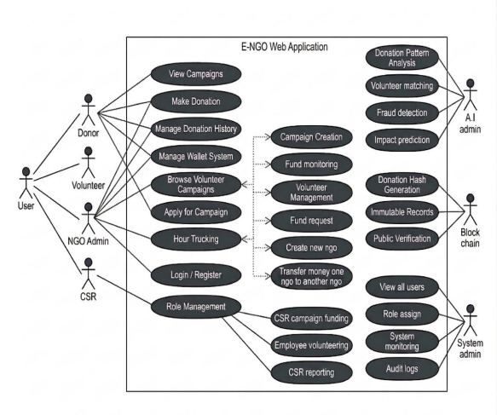
EcoNexus: A Future-Ready NGO Ecosystem
The ENGO Web Application (EcoNexus NGO) is a modern, integrated digital platform designed to streamline and improve the transparency of Non-Governmental Organizations (NGOs).
Built using the Django framework, the system provides a centralized hub to manage donations, volunteers, and social impact campaigns through a secure, multi-tenant architecture.
EcoNexus aims to create a smart and accountable ecosystem for social good. By replacing fragmented, manual systems with a unified digital solution, it enhances the reach and effectiveness of social initiatives while providing a foundation for future expansions like mobile applications and global multi-currency support.
vbb

Slide 4
Problem Statement
The current NGO sector faces significant operational hurdles due to fragmented, manual, and non-transparent management systems:
Fragmentation of Services: Most existing platforms operate independently, forcing donors and volunteers to manage separate accounts and records for different organizations.
Manual & Inefficient Operations: Many NGOs still rely on manual record-keeping or basic spreadsheets, leading to data inconsistency, record duplication, and increased human error.
Transparency & Trust Gap: Donors often lack real-time visibility into how their contributions are utilized, which reduces confidence and discourages long-term engagement.
Inefficient Resource Coordination: The absence of a structured volunteer management system results in the underutilization of human capital, as skills are not effectively matched with organizational needs.
Data Security Risks: Traditional systems frequently lack robust encryption and modern security measures, making sensitive user data and financial transactions vulnerable to breaches
Lack of Real-Time Engagement: Existing platforms often suffer from slow responsiveness, missing live updates for donation progress or instant campaign notifications.

Slide 5
T
The Proposed Solution: EcoNexus
To address the challenges of fragmentation and mistrust, EcoNexus provides an all-in-one digital ecosystem that streamlines NGO operations through modern technology.
Unified Centralized Platform: Integrates donation management, volunteer coordination, and corporate CSR activities into a single, cohesive system.
Multi-Tenant Architecture: Built using a scalable architecture that allows multiple NGOs to operate on a single platform while maintaining complete data isolation and security.
Blockchain-Driven Transparency: Implements a blockchain-simulated ledger to record donations with unique SHA-256 hashes, ensuring immutable and verifiable financial records.
AI-Powered Intelligence: Features AI modules for personalized donor recommendations, predictive analytics for campaign success, and automated volunteer skill-matching.
Real-Time Responsiveness: Utilizes WebSockets (Django Channels) to provide live updates for donation tracking and instant user notifications without page refreshes.
Role-Based Access Control (RBAC): Enables a seamless user experience where one account can securely switch between Donor, Volunteer, and Corporate roles.
Automated Reporting & Analytics: Provides customized dashboards for all stakeholders to monitor social impact through automated reports, certificates, and data visualizations.

Slide 6
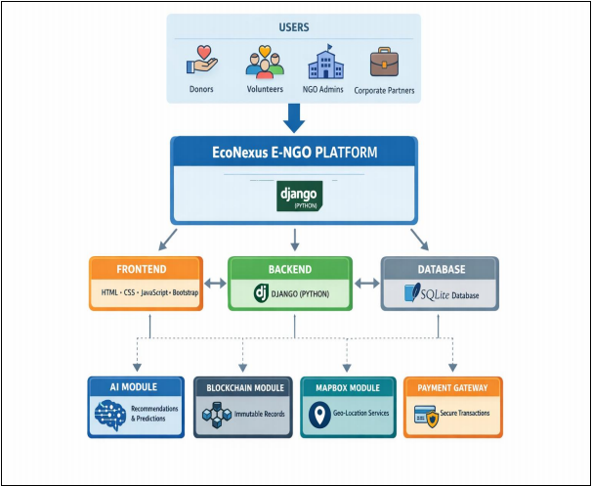
System Architecture
Technology Stack
Advanced Features
Python Django framework
Django REST APIs
SQLite3 database
WebSockets for real-time updates
Celery with Redis for background tasks
AI-based recommendations
Blockchain integration
Multi-tenant architecture
Role-based access control
Payment gateway integration

Slide 7

Key Features
Multi-Donation Models
Volunteer Management
One-time, recurring, pledge-based, and wallet-based donations with automated receipts.
Skill-based matching, hour tracking, and automated certificate generation.
AI Intelligence
Blockchain Security
Donor behavior analysis, campaign recommendations, and predictive analytics.
Immutable donation records with SHA-256 hash verification and transparent tracking.
CSR Dashboard
Real-Time Updates
Corporate funding, compliance tracking, and employee volunteering programs.
Live donation tracking, instant notifications, and WebSocket-enabled dashboards.

Slide 8





Donation & Volunteer Management
Browse Campaigns
Explore verified NGO campaigns across various sectors.
Choose Contribution
Select donation type or volunteer opportunity.
Secure Processing
Encrypted transactions with blockchain verification.
Track Impact
Monitor progress and view transparent fund usage.

Slide 9

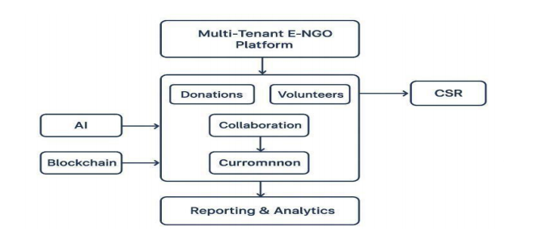
AI & Blockchain Integration
AI-Powered Intelligence
Blockchain Security
Campaign recommendation engine
Donor churn prediction
Volunteer skill matching
Sentiment analysis from feedback
Predictive donation analytics
Immutable transaction records
SHA-256 hash generation
Transparent fund tracking
Public verification capability
Smart contract support

Slide 10
System Benefits
For Donors
For Volunteers
Simple, secure donation process with complete transparency in fund utilization and donation history tracking.
Easy exploration of campaigns, skill-based matching, participation tracking, and automated certificates.
For NGOs
For Corporates
Efficient campaign management, real-time donation tracking, volunteer coordination, and analytics dashboards.
CSR fund allocation, compliance reporting, employee volunteering programs, and impact analysis.

Slide 11
Future Enhancements
Mobile Applications
Android and iOS apps with push notifications and offline functionality.
Global Expansion
Multi-language support and multi-currency transactions for international reach.
Gamification
Badges, leaderboards, and achievement systems to boost engagement.
Geo-Based Services
Location-aware campaign suggestions and map-based tracking.
Government Integration
Automated CSR compliance and tax document generation.

Slide 12

Conclusion
The E-NGO Web Application transforms traditional NGO platforms into a smart, transparent, and future-ready ecosystem, ensuring trust, accountability, and improved collaboration among all stakeholders.
100%
24/7
Transparency
Availability
Blockchain-secured donation tracking
Real-time updates and notifications
10+
Features
Integrated platform for all NGO needs

Slide 13

Thank You
Project Team
Guidance
Sangani Mitali & Katoch Rishita
Prof. Pritesh Vyas
MCA Semester IV
Faculty of Computer Applications
Institution
Ahmedabad Institute of Technology
Gujarat, India

