Slide 1
NPM PACKAGE
NPM means node package manager
The npm program is installed on our computer when we install node.js.
NPM install packages in two modes local and global.
PACKAGE.JSON will store all information regarding application and its name etc. In node.js

Slide 2
Comparing the scenario with android:
Androird -> Mobile->Application-> Whatsapp (click install)
->Facebook (click Update)
In this, we have to simply click button but same thing doesn’t happen in node.js
Update: LocalPackage.json compare with Live Application Number
Local vs live
NODE JS: Library 5000 files
a. js 800 mb
b.js 900 mb
IN order to save bandwidth or work fast, the concept of global & local must be clear
If some some error occurs in node.js, then also it can’t be solved by deleting & re-installing npm package.

Slide 3
WHAT IS THE USE OF NPM?
Npm makes it easy for JS developers to share and reuse code, and itbmakes it easy to update the code that you’re sharing.
Just like php has composer for downloading decencies which are just code in files.
Just like python has pip, ruby has gems etc.
To find various NPM packages visit www.npmjs.com
Example: Nodemon package -> npm i nodemon command is used to install this package
Others are node restart, chokidar, react, angular, react-native etc.

Slide 4
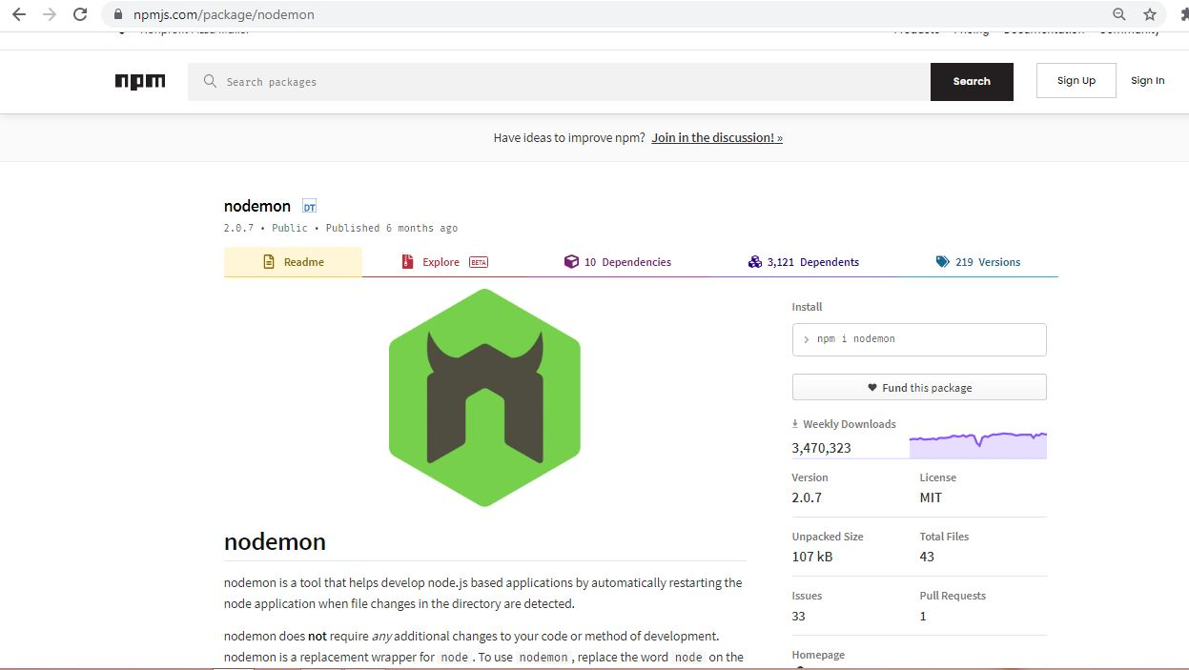

Slide 5
How TO INSTALL/UPGRADE NPM ?
NPM INSTALL –G NPM
NPM INSTALL –G NPM@7.5.0

Slide 6
GLOBAL VS LOCAL
LOCAL: FOLDER BASED MODULES:
In the local mode,NPM packages in the node_module directory of the current working directory which location is owned by the current user.
It always download package through internet.
EG : C:\Users\node_modules
GLOBAL- SYSTEM BASED MODULES:
Global packages installed in the directory where the node is installed and the location is owned by the root user.
EG: file:///C:/Users/node_modules/npm/docs/output/commands/npm-cache.html

Slide 7
How to check the version?
npm –v
npm -version

Slide 8
What is MODULE?
Each js file is a module.
Variables outside the file cannot visible except there are global or expected.
Use module.exports to write modules.
Use require (‘fs’) to import fs module.
WHAT IS PACKAGE?
Package is agroup of a module
Package metadata is a defined in a package.json
Package.json in the root of a package dir.

Slide 9
WHAT IS PACKAGE.JSON?
Package.json is a plain JSON text file which manages all the packages which you installed in your application.
Very node.js applications should have this file at the root directory to describe the application metadata.
A simple package.json file looks like below:-

Slide 10
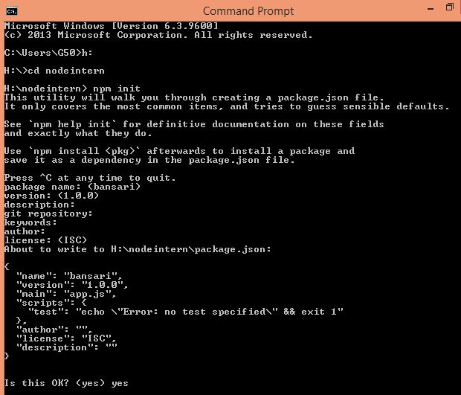

Slide 11
Code:-
{
"name": "bansari",
"version": "1.0.0",
"main": "app.js",
"scripts": {
"test": "echo \"Error: no test specified\" && exit 1"
},
"author": "",
"license": "ISC",
"description": ""
}
# Shortcut : npm init --y

Slide 12
HOW TO CREATE PACKAGE.JSON FILE ?
CREATE ONE FOLDER
NAVIGATE TO FOLDER
OPEN COMMAND PROMPT
TYPE BELOW COMMAND
“NPM INIT”
PROVIDE REQUIRED INFO.

Slide 13
Important term while creating package.json:-
Dependencies: Every node js project or module may dependent on other node js /3rd party modules or our own custom modules.We should provide all those dependencies by using this “dependencies” directive.

Slide 14
npm init nodemon –g (globally)
npm init nodemon –save (locally)

Slide 15
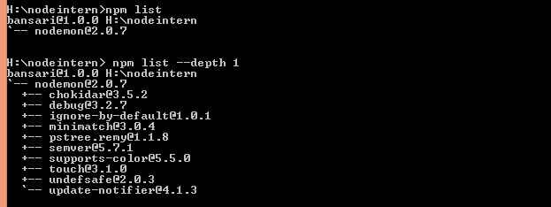
Npm commands

Slide 16
