Slide 1


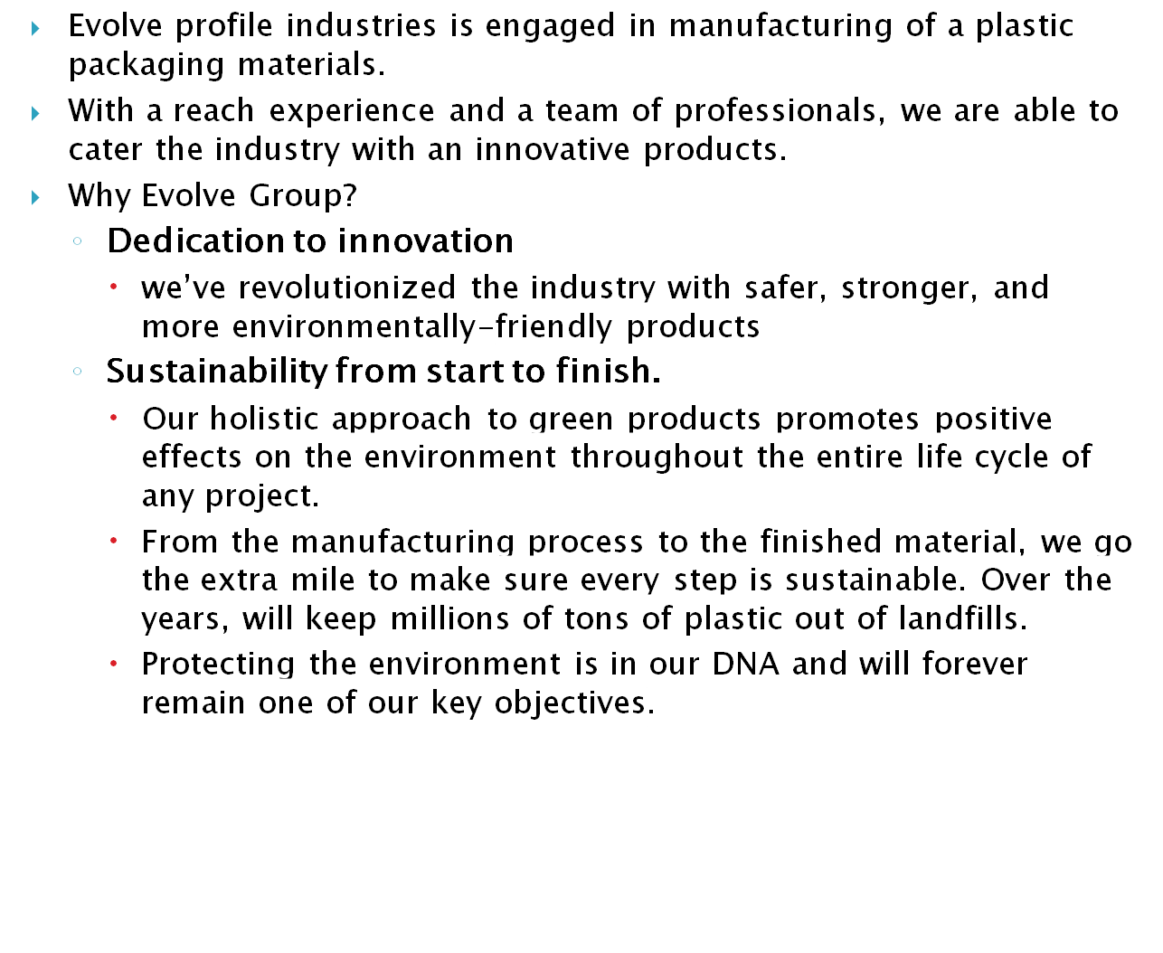

Slide 2

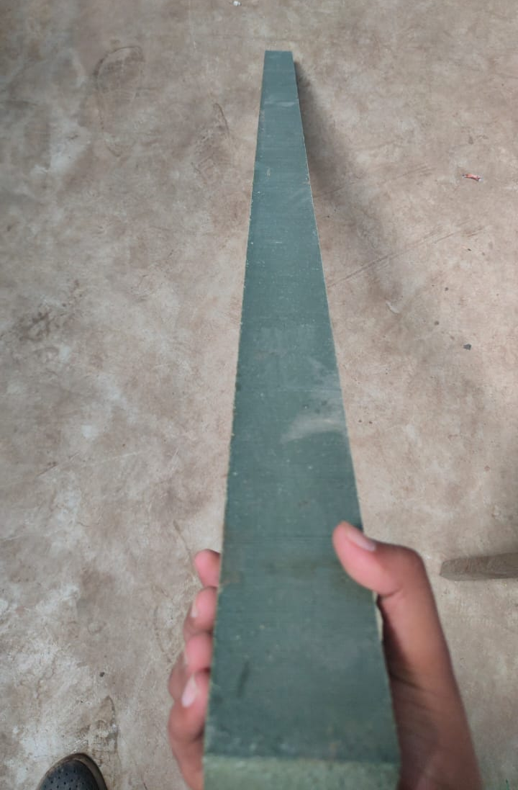
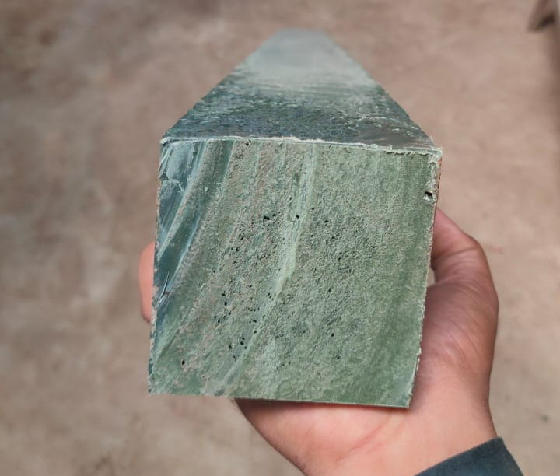
“EvolveWood” is an Innovative product by Evolve Profile Industries
“EvolveWood” is made out of recycled plastic and waste wood.ECO FRIENDLY PRODUCT.
EvolveWood can be produced in various sizes AS PER COUSTOMER REQUIRMENT.
EvolveWood comes in square / rectangle/ROUND shape
EvolveWood gives high load bearing capacity
EvolveWood is user friendly product and it can be fabricated in various products as it is easy to use and convert.

Slide 3

India is generating about 3.5 million tones of plastic waste annually and per capita plastic waste generation has almost doubled over the last five years.
Around 60% of the generated plastic waste is reportedly recycled and remaining quantities were disposed in landfills or open dumps.
Today, annual tree harvest vs. production on a world-wide scale shows that humans cut down approximately 15 billion trees a year and re-plant about 5 billion. That's a net loss of 10 billion trees every year, and a rate that would mean the loss of all trees within the next 300 years.

Slide 4

As an initiative to reduce carbon foot print and plastic landfill, EVOLVE GROUP started making EvolveWood Composite, EvolveWood products will be environmental friendly and are best substitute to wooden and plastic products. Dunnage/ Pallet which is used for transporting, storing material in various climatic conditions.
EvolveWood is more environmental friendly and requires less maintenance than the alternatives of solid wood treated with preservatives or solid wood of rot-resistant species.
The environmental impact of EvolveWoods is directly affected by the ratio of renewable to non- renewable materials.
The commonly used petroleum-based polymers have a negative environmental impact because they rely on non-renewable raw materials and the non- biodegradability of plastics.

Slide 5
Made from 100% recycled materials, plastic lumber is the perfect alternative to wood.
Plastic lumber can be cut with a regular saw, routed, drilled, nailed and screwed. Our product is available in a variety of dimensional sizes similar to regular wood, such as: 2x2, 2x3, 2x4, 2x6, 2x8, 4x4 and 6x6. We offer it in both a Standard Grade, typically grey/black in colour and a Premium Grade in a variety of colours.
The fact that it’s made of plastic means that it’s Built to Last. Plastic lumber is environmentally friendly and made from 100% recycled materials. It doesn’t rot or splinter, and it’s very economically priced.
Available in a variety of colours eliminating the need for painting, staining or the use of other preservatives.Plastic Lumber can be used for many building projects including benches, decks, docks, fences, planter boxes, picnic tables, landscaping and boardwalks.
Copyright ©

Slide 6







Water Proof
Chemical resistant
Termite Proof
Fire Retardent
Easy installation
Eco Friendly

Slide 7




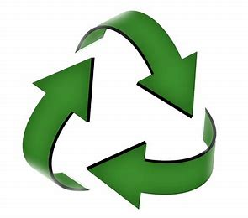

UV Protection
Tough and Durable
Thermal Resistant
Recyclable
No Odour

Slide 8





